Slide 1
1200V Gen7 Diode Bare Die
Feb, 2023

Slide 2
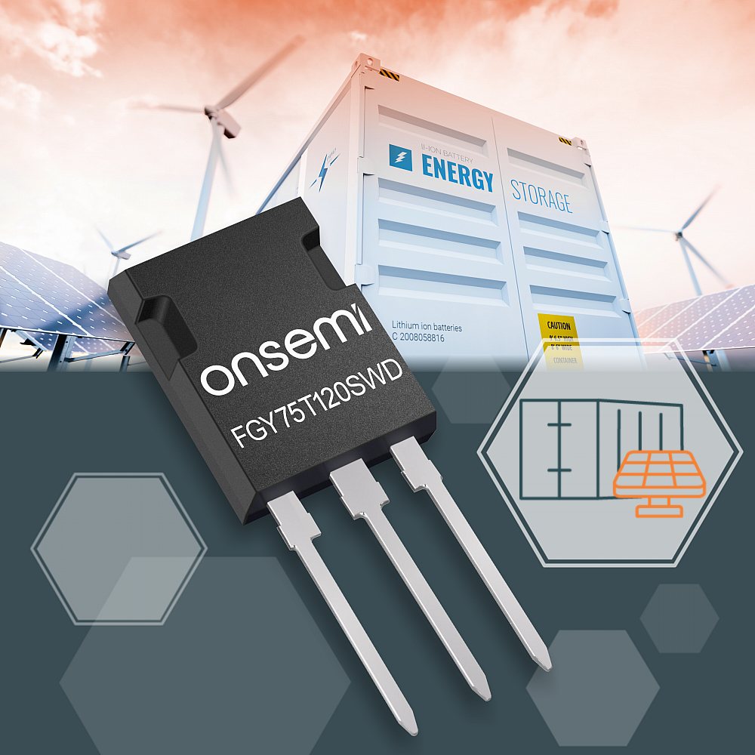
onsemi Announces New Gen7 IGBT and Diode With Great Efficiency

Slide 3
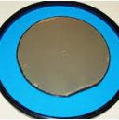
1200V 7th Gen Diode Bare Die
Features
Current Rating and Mechanical Details
Gen7 1200V Diode Technology
V_{F} = 1.9V (T_{C}=175 °C)
Soft Reverse Recovery
Low Err
100% Probe Tested
Sawn on Foil
Diode current rating | Die size
PCFF150H120SWF 1200V 150A | 10.0mm x 5.0mm
PCFF100H120SWF 1200V 100A | 8.4mm x 4.2mm
PCFF75H120SWF 1200V 75A | 7.0mm x 3.9mm
PCFF55H120SWF 1200V 55A | 6.4mm x 3.4mm
PCFF45H120SWF 1200V 45A | 5.4mm x 3.36mm
PCFF30H120SWF 1200V 30A | 4.5mm x 2.97mm
Parameter | Value
WAFER SIZE | 8”
PDPW | …
DIE TECHNOLOGY | 7th Gen 1200V Diode
DIE SIZE | …
DIE THICKNESS | 119 µm
BACKMETAL | TiNiVAg
BACKMETAL THICKNESS | 1.65 µm
TOP METAL | AlSiCu
TOP METAL THICKNESS | 6 µm
Released
Releasing in 2023

Slide 4
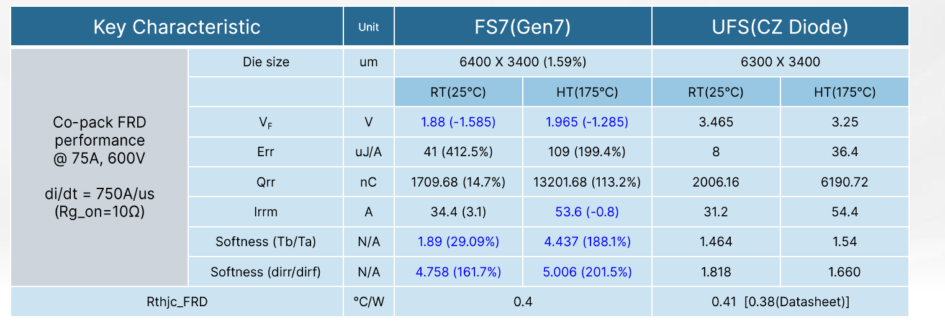
Comparison Data of 7th Gen Diode Bare Die

Slide 7
Backup

Slide 8
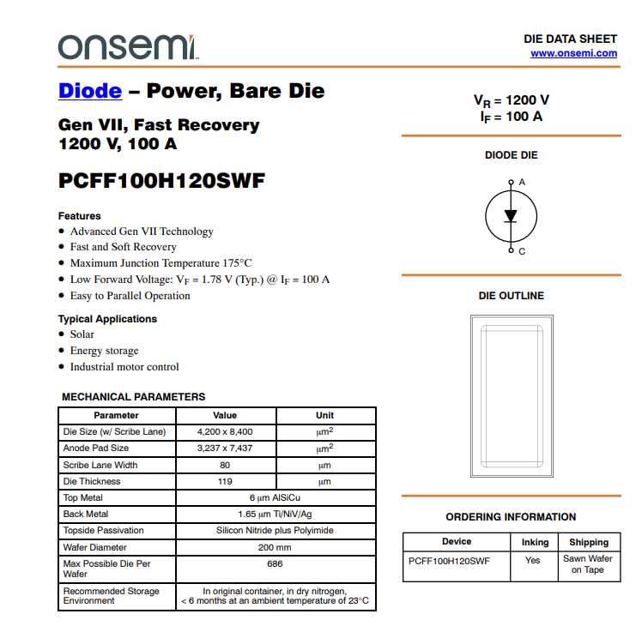
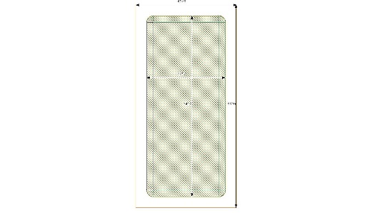
PCFF100H120SWF - 1200V 100A 7th Gen Diode Bare Die
Features
Mechanical and Rating Details
Gen7 1200V Diode Technology 35 mm²
V_{F} = 1.9V (@I_{F}=100A T_{C}=175 °C)
Soft Reverse Recovery
Low Err
100% Probe Tested
Sawn on Foil
8400 µm
4200 µm
Parameter | Value
WAFER SIZE | 8”
PDPW | 765
DIE TECHNOLOGY | 7th Gen 1200V Diode
DIE SIZE | 8400µm x 4200µm
DIE THICKNESS | 119µm
BACKMETAL | TiNiVAg
BACKMETAL THICKNESS | 1.65µm
TOP METAL | AlSiCu
TOP METAL THICKNESS | 6 µm
Released

Slide 9
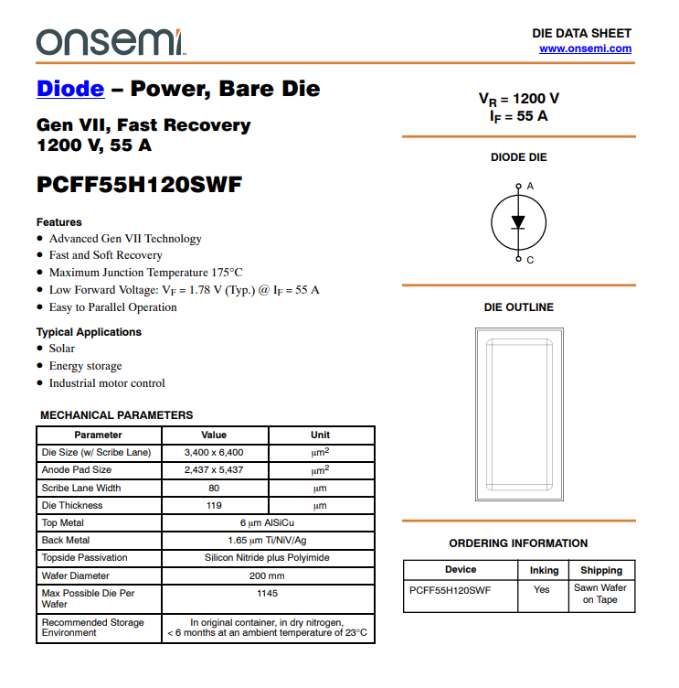
PCFF55H120SWF - 1200V 55A 7th Gen Diode Bare Die
Features
Mechanical and Rating Details
Gen7 1200V Diode Technology 22 mm²
V_{F} = 1.9V (@I_{F}=55A T_{C}=175 °C)
Soft Reverse Recovery
Low Err
100% Probe Tested
Sawn on Foil
6400 µm
3400 µm
Parameter | Value
WAFER SIZE | 8”
PDPW | 1145
DIE TECHNOLOGY | 7th Gen 1200V Diode
DIE SIZE | 3400 µm x 6400 µm
DIE THICKNESS | 119 µm
BACKMETAL | TiNiVAg
BACKMETAL THICKNESS | 1.65 µm
TOP METAL | AlSiCu
TOP METAL THICKNESS | 6 µm
Released

