Slide 1
FIELD GUIDANCE
THE FIRST SECTION CONSISTING OF 3 SLIDES IS AN ELEVATOR PITCH THAT REQUIRES NO NDA
PLEASE NOTE THE CONFIDENTIALITY LOGO IN THE NEXT SECTION WHICH IS A DETAILED PRODUCT PRESENTATION

Slide 2
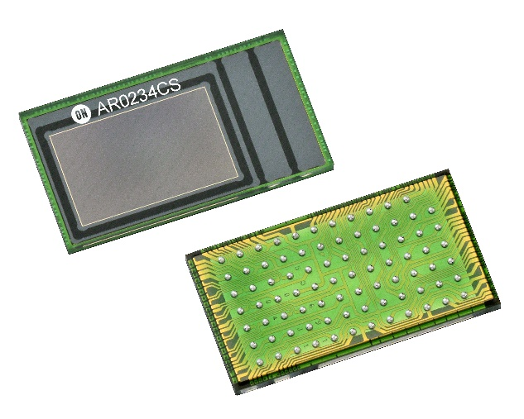
AR0234CS – Product Presentation
Feb 2021

Slide 3
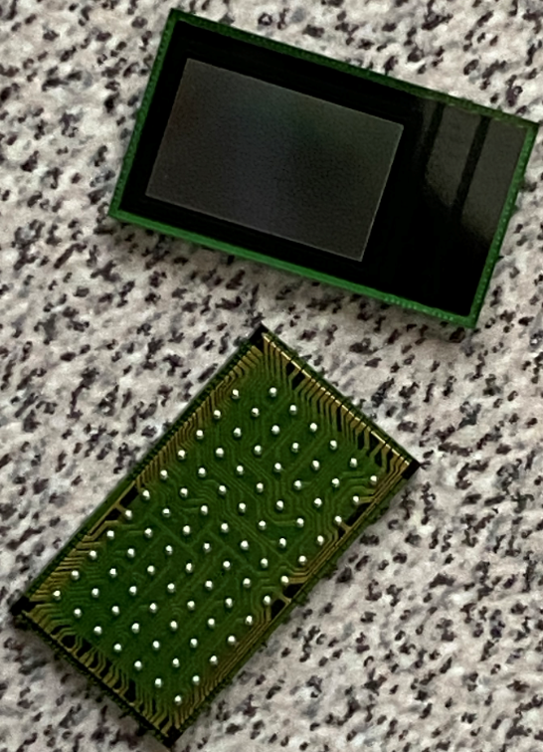
AR0234 – 2MP CMOS Global Shutter Imaging Sensor
Features
1/2.6” Optical Format
1920 (H) x 1200 (V)
3.0µm Global Shutter Pixel
RGB Bayer & Mono Options
Data Plane I/F - 4-Lane MIPI or 12b Parallel
Control Plane I/F – 2-wire Serial
Less than 395mW @ 120fps, full resolution
Onboard temperature sensor
Defect Pixel Correction – Static & Dynamic
-40ºC to 105ºC (Tj) operating temp
0 degree, 28 degree CRA options
Bare Die & CSP Packages (Y-height 5.6mm same as AR0144)
Key System Capabilities & Benefits
Leading Global Shutter Efficiency minimizes motion artifacts
Wide rows (1920 pixels) enables Fast Read in Wide FOV Applications
Programmable & Switchable ROIs, with Statistics Engines for each ROI
Auto Black Level, Auto Exposure & Control for Adaptation to Dynamic Lighting Conditions
Trigger Mode & Strobe Controls for Precision Lighting & ISP Synchronization
AP1302 ISP supports for Easy & Short TTM Imaging System Development
Extended Operating Temp Range enables Usage in Demanding Conditions
Orderable Part Numbers (example : Mono 28)
Key Applications
Scanning
Autonomous Mobility
Machine Vision
AR/VR/MR
Retail Analytics
Access Control

Slide 4
AR0234CS – ON Part Numbers (OPN)
Mono; CRA 0deg | Description | MOQ
AR0234CSSM00SUKA0-CP | CSP Chip Tray with Protective Film | 2100
AR0234CSSM00SUKA0-CR | CSP Chip Tray without Protective Film | 2100
AR0234CSSM00SUKA0-CP1 | CSP Chip Tray with Protective Film Low MOQ | 210
AR0234CSSM00SUD20 | Bare Die | NA
AR0234CSSM00SUKAH3-GEVB | Demo Headboard | NA
Color; CRA 0deg | Description | MOQ
AR0234CSSC00SUKA0-CP | CSP Chip Tray with Protective Film | 2100
AR0234CSSC00SUKA0-CR | CSP Chip Tray without Protective Film | 2100
AR0234CSSC00SUKA0-CP1 | CSP Chip Tray with Protective Film Low MOQ | 210
AR0234CSSC00SUD20 | Bare Die | NA
AR0234CSSC00SUKAH3-GEVB | Demo Headboard | NA
Mono; CRA 28deg | Description | MOQ
AR0234CSSM28SUKA0-CP | CSP Chip Tray with Protective Film | 2100
AR0234CSSM28SUKA0-CR | CSP Chip Tray without Protective Film | 2100
AR0234CSSM28SUKA0-CP1 | CSP Chip Tray with Protective Film Low MOQ | 210
AR0234CSSM28SUD20 | Bare Die | NA
AR0234CSSM28SUD20-RC1 | Bare Die, with Low MPQ | NA
AR0234CSSM28SUKAH3-GEVB | Demo Headboard | NA
Color; CRA 28deg | Description | MOQ
AR0234CSSC28SUKA0-CP | CSP Chip Tray with Protective Film | 2100
AR0234CSSC28SUKA0-CR | CSP Chip Tray without Protective Film | 2100
AR0234CSSC28SUKA0-CP1 | CSP Chip Tray with Protective Film Low MOQ | 210
AR0234CSSC28SUD20 | Bare Die | NA
AR0234CSSC28SUKAH3-GEVB | Demo Headboard | NA
Die Options – Check with Marketing for Specific Instructions
Samples
Use *-CP1 OPN; first 10 units can be free; need PO beyond 10 units
Always order in x10 units
All OPNs Fully Qualified & Shipping in Volume

Slide 5
AR0234CS – Product Presentation
Sep 2020

Slide 6
AR0234 – 2MP CMOS Global Shutter Imaging Sensor
Features
1/2.6” Optical Format
1920 (H) x 1200 (V)
3.0µm Global Shutter Pixel
RGB Bayer & Mono Options
Data Plane I/F - 4-Lane MIPI or 12b Parallel
Control Plane I/F – 2-wire Serial
Less than <395mW @ 120fps, full resolution
Onboard temperature sensor
Defect Pixel Correction – Static & Dynamic
-40ºC to 105ºC (Tj) operating temp
0 degree, 28 degree CRA options
Bare Die & CSP Packages (Y-height 5.6mm same as AR0144)
Key System Capabilities & Benefits
Leading Global Shutter Efficiency minimizes motion artifacts
Wide rows (1920 pixels) enables Fast Read in Wide FOV Applications
Programmable & Switchable ROIs, with Statistics Engines for each ROI
Auto Black Level, Auto Exposure & Control for Adaptation to Dynamic Lighting Conditions
Trigger Mode & Strobe Controls for Precision Lighting & ISP Synchronization
AP1302 ISP supports for Easy & Short TTM Imaging System Development
Extended Operating Temp Range enables Usage in Demanding Conditions
Orderable Part Numbers (example : Mono 28)
Key Applications
Scanning
Autonomous Mobility
Machine Vision
AR/VR/MR
Retail Analytics
Access Control

Slide 7
GS Sensor Family – Packing More in Smaller Size with Superior Performance
MT9V034
MT9V024
120
6.0
MT9V034
MT9V024
Pixel Size (μm)
AR0135
Performance (FPS)
AR0134
AR0135
AR0134
60
3.0
AR0144
AR0234
AR0144
AR0234
0.3
1.0
2.0
Resolution (MP)

Slide 8
ON Semiconductor Global Shutter Sensors
Specification | AR0134 | AR0135 | AR0144 | AR0234
Optical Format | 1/3” | 1/3” | 1/4” | 1/2.6”
Output Resolution | 1280(H) x 960(V) | 1280(H) x 960(V) | 1280(H) x 800(V) | 1920(H) x 1200(V)
Frame Rate | 54fps | 54fps | 60fps | 120fps
Pixel | 3.75um GS | 3.75um GS | 3um GS | 3um GS
Full-Well (ke-) | 7 | 11 | 7.9 | 8.55
Dark Current e-/sec @ 60C | >2000 | <150 | 75 | 63
Global Shutter Efficiency (350nm-650nm, Mono) | 1200 | 4700 | 4300 | 4300
Power @ max fps | <400 mW; 7.40 mW/fps | <400 mW; 7.40 mW/fps | <215 mW; 3.58 mW/fps | <395 mW; 3.29 mW/fps
Output Interface | Parallel / HiSpi | Parallel / HiSpi | Parallel/MIPI 2-lane | Parallel/MIPI 4-lane
Package | 9x9 iBGA | 9x9 iBGA (Pin Compatible with AR0134) | 5.6mm x 5.6mm CSP | 9.995mm x 5.595mm CSP
Notes:
Full Well Capacity: This represents the amount of charge a pixel can hold before saturating. It directly impacts the dynamic range of the sensor.
Dark Current: Is a representation of electrons being created independent of photon capture. Generally seen to be higher at higher temperature. A reduction in dark current reduces the total noise floor resulting in SNR improvement
Global Shutter Efficiency:
****************************************************************************************************************
Dynamic Range: This represents a cameras capabilities to display/reproduce the brightest & darkest portions of the image . Within one image there may be a portion that is in complete black & a portion that is complete saturated. The largest possible signal is directly proportional to the full well capacity of the pixel.
Full Well Capacity: This represents the maximum number of electrons per pixel.
Higher guarantee can have
Machine vision calculate thresholds
DR = ratio of Margin of error to the total sample size
How many distinct
Pixel gives
Dark Current: In VR, close to human skin, extremely high temp will make dark current degrades on image quality which in turn will impact machine vision algorithms in finding objects
Designer of a VR headset to keep the headset cool
Global Shutter Efficiency: Additive component that increases the margin of error

Slide 9
AR0234CS – Seamless Xfer from AR0144
Specification | AR0144
Optical Format | 1/4”
Output Resolution | 1280(H) x 800(V)
Frame Rate | 60fps
Pixel | 3um GS
Full-Well (ke-) | 7.9
Dark Current e-/sec @ 60C | 75
Global Shutter Efficiency (350nm-650nm) | 4300
Power | <215 mW; 3.58 mW/fps
Output Interface | Parallel/MIPI 2-lane
Package | 5.6mm x 5.6mm CSP
Same Pixels
AR0234
1/2.6”
1920(H) x 1200(V)
120fps
3um GS
8.55
63
4300
<395 mW; 3.29 mW/fps
Parallel/MIPI 4-lane
9.995mm x 5.595mm CSP
Carry Forward Pixel Perf, Tuning
Same Architecture
Carry Forward Tuning
Optimized for Higher Performance, Lower Power
Same Height
Common Height across Generations
Notes:
Full Well Capacity: This represents the amount of charge a pixel can hold before saturating. It directly impacts the dynamic range of the sensor.
Dark Current: Is a representation of electrons being created independent of photon capture. Generally seen to be higher at higher temperature. A reduction in dark current reduces the total noise floor resulting in SNR improvement
Global Shutter Efficiency:
****************************************************************************************************************
Dynamic Range: This represents a cameras capabilities to display/reproduce the brightest & darkest portions of the image . Within one image there may be a portion that is in complete black & a portion that is complete saturated. The largest possible signal is directly proportional to the full well capacity of the pixel.
Full Well Capacity: This represents the maximum number of electrons per pixel.
Higher guarantee can have
Machine vision calculate thresholds
DR = ratio of Margin of error to the total sample size
How many distinct
Pixel gives
Dark Current: In VR, close to human skin, extremely high temp will make dark current degrades on image quality which in turn will impact machine vision algorithms in finding objects
Designer of a VR headset to keep the headset cool
Global Shutter Efficiency: Additive component that increases the margin of error

Slide 10
Operation Modes
Master Mode
Frame Readout Overlaps with Photodiode Exposure Time
Enables Highest Frame Rates
Upto 120fps MIPI
Upto 30fps Parallel
Upto 237fps 2x2 bin
Pulse Trigger Mode
Frame Readout Sequential to Photodiode Exposure Time
Single Frame when Triggered; Precise Control, especially with Light Controlled Applications
Synchronization of Multiple Sensors
Upto 60fps MIPI
Upto 30fps Parallel
Upto 120fps 2x2 bin
Automatic Trigger Mode
Frame Readout Sequential to Photodiode Exposure Time
Series of Frames when Triggered; Good Control
Upto 120fps MIPI
Upto 30fps Parallel
Upto 237fps 2x2 bin
All metrics – 1920x1200
2x2 bin – 960x600

Slide 11
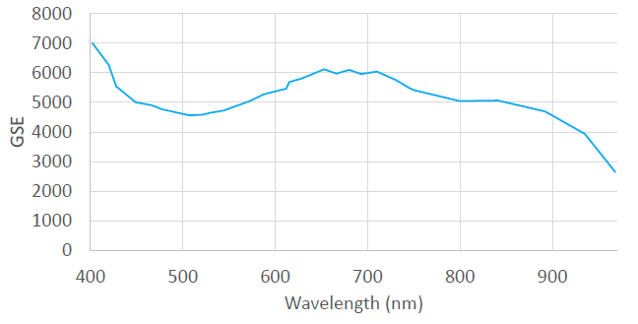
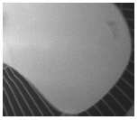
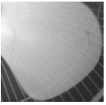
AR0234CS – Superior Image Quality due to High GSE
GSE – Quantifies the Pixel’s Sensitivity to Parasitic Light (PLS) Contamination
PLS ↑ ➔ GSE ↓ ➔ Poor Image Quality (Smears, Shading Artifacts, Leaky Images, etc.)
High GSE
Low GSE
Measured Results of AR0234CS Pixel
AR0234CS
Competition
Stripes behind the fan are covered well
Stripes behind the fan are clearly visible

Slide 12
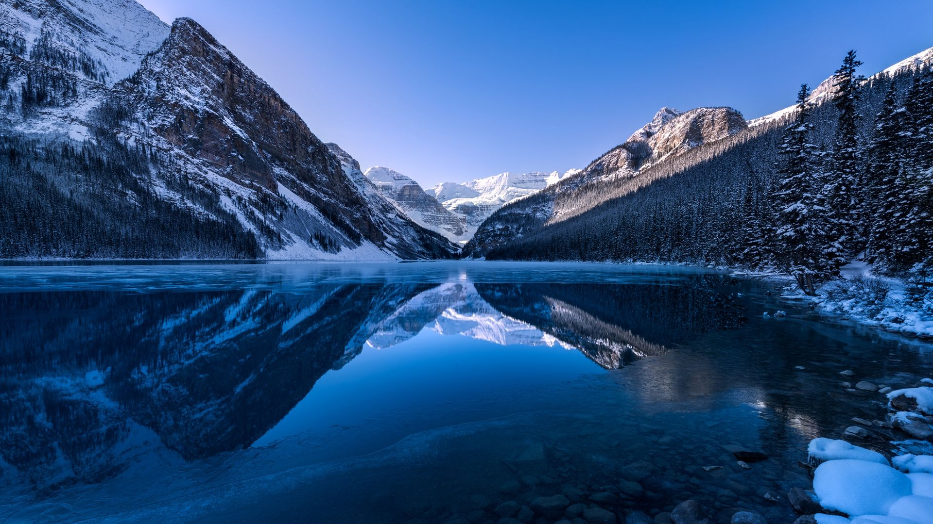
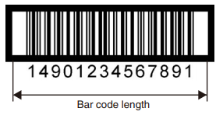
AR0234CS – Wide Horizontal Pixel Count Enables Significant Benefits
1600x1300
AR0234CS
Barcodes reaching > 6” (GSI-128)
SingleShot Fast Reads with Wide Hor. Pixel Count
1920 x 1200 Pixels – Delivers a True 1080p Resolution

Slide 13
AR0234CS – Power Profiles
Power Efficiency
AR0234CS ↑ – FPS ↑ ➔ Power/FPS ↓
mW
mW/FPS
Full Resolution
FPS
2x2 Bin (960x600)
FPS ↑ ➔ Power ↑
Trigger Mode Power < Master Mode Power
FPS
Full Resolution
2x2 Bin (960x600)
Requires Smaller Power Budgets, Enables Superior Camera System Performance
NOTE – FPS to mW is non-Linear due to Analog Content

Slide 14
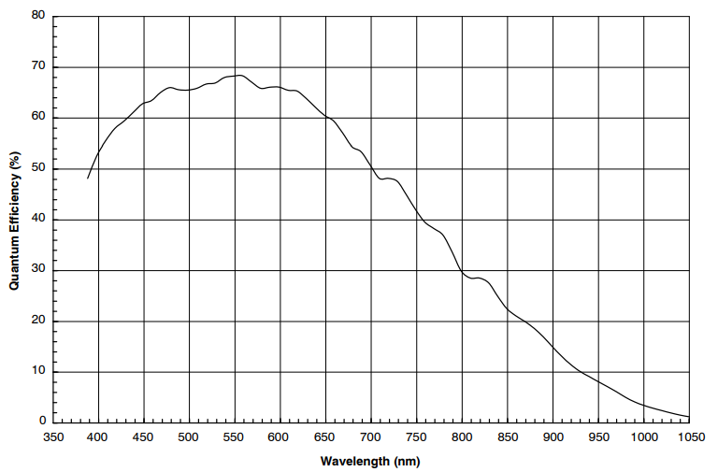
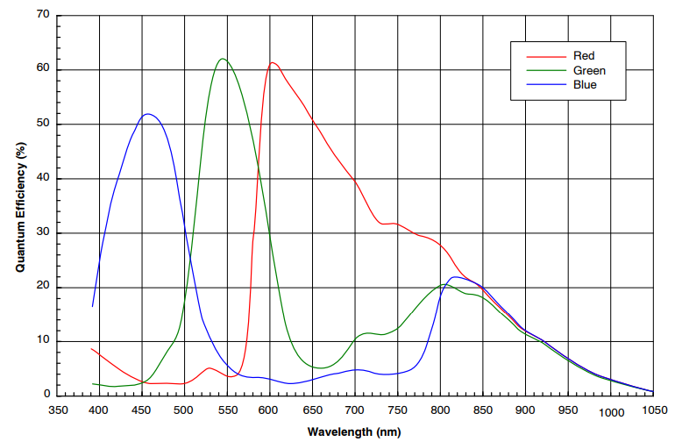
Spectral Characteristics

Slide 15
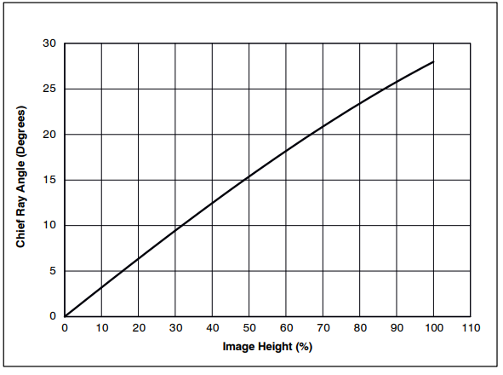
CRA Curve for Lens Selection
28deg Curve

Slide 16
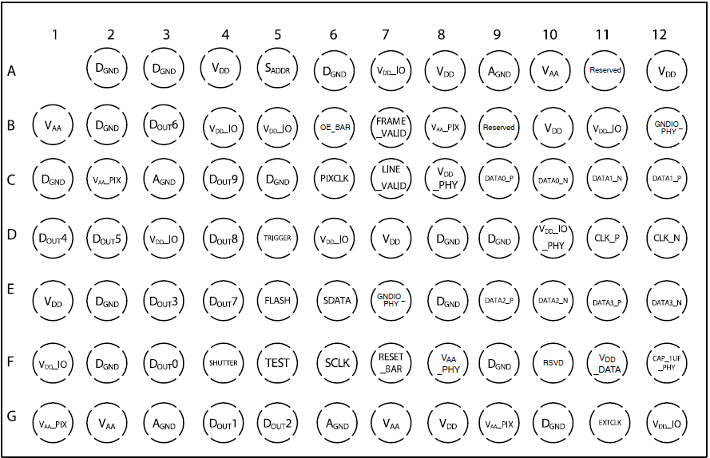
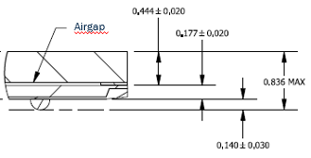
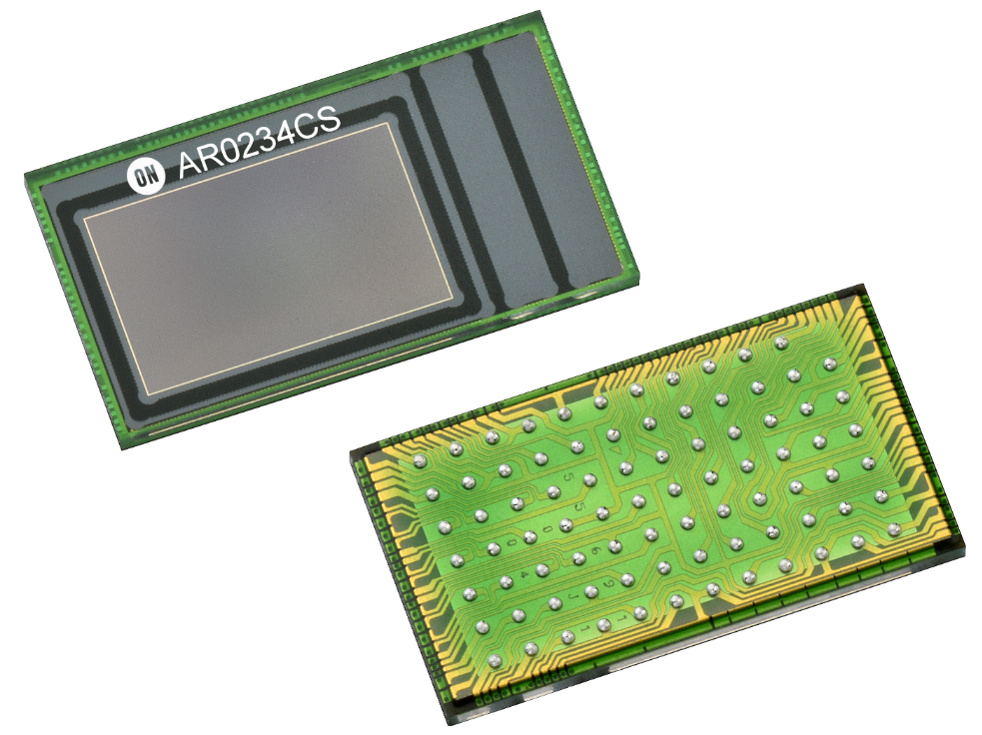
Package – Small Footprint Enables Tiny Modules
5.595mm
9.995mm
Contact Your Sales/FAE if Only Dies are Needed

Slide 17
AP1302 Companion ISP
AP1302
Parameter | Value
Maximum processing speed | 450 MPix/second (13MPix@30FPS)
Maximum output resolution | 4224x3156 (13 MPix)
Input | MIPI 4x1.2Gbps
Output | MIPI 4x1.2Gbps
Package | 6.5x 6.5 x 0.8(mm) VFBGA
I2C Master
Sensor1
Sensor I/F0
MIPI 4x1.2G
Host Processor
Host I/F
MIPI 4x1.2G
MIPI 2x1.2G
Sensor I/F1
I2C Slave
and/or SPI Slave
(muxed with GPIOs)
Sensor2
I2C Master
SPI Master
(muxed with GPIOs)
Deployed in Millions of Imaging Systems
And Many More……
SPI Serial Flash Memory
AR0330, AR0821, AR1335, AR1820
AP1302 Shipping in Volume Since 2015
AR0144, AR0261

Slide 18
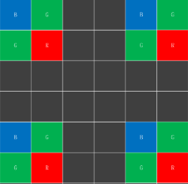
AR0234CS + AP1302 – A Powerful Combination for Camera System
System Development Time
Sensor Tuning
Other ISPs
Calibration
With AP1302
Performance Optimizations
Months Saved !!
Seamless Switch between Product Generations
Same 1302, Same Host
AP1302
Host
AR0144
AP1302
Host
AR0144
AR0234
AR1335
Native
Same 1302, Same Host
Transparent Switching between Sensor Modes
Binning
Skipping
AP1302
Host

Slide 19
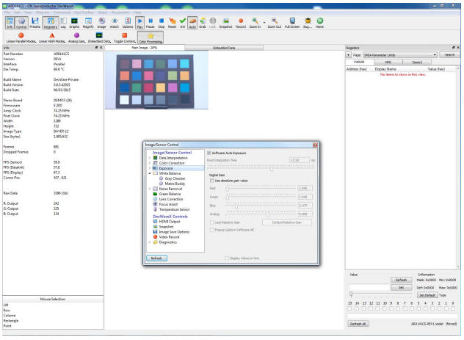
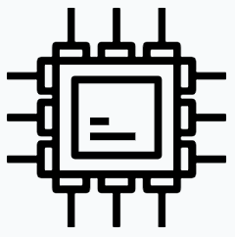
DevSuite – Comprehensive SW Eases System Level Design
Libraries
Tools
Hardware Interface
DevWare GUI

Slide 20
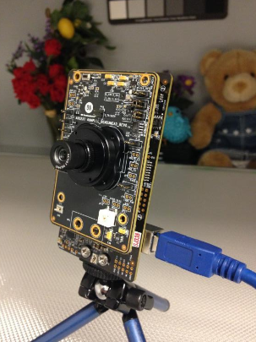
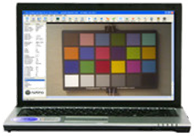
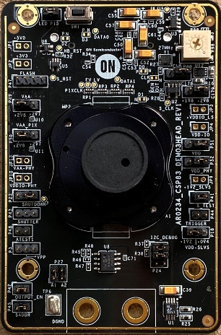
AR0234CS – Full Development System Available
Provides Full Testing Capabilities
Hardware Capabilities
Output Size
Frame Rate
Gain & Exposure
Software Capabilities
Graphing
Color Pipe
Noise Reduction
Image Statistics
Enables Product Evaluation before Starting Product Design
Provides Reference during Design Stage
Available for Order
DevWare SW
AGB1N0CS-GEVK (Demo3 Board)
AR0234CSS***SUKH3-GEVB (AR0234CS Board)
AR0234CS Sensor Headboard
(comes with a default lens)

Slide 21
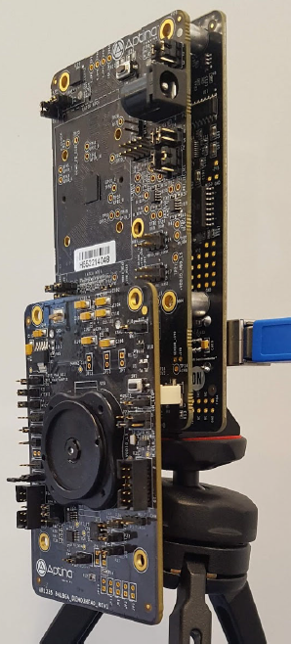
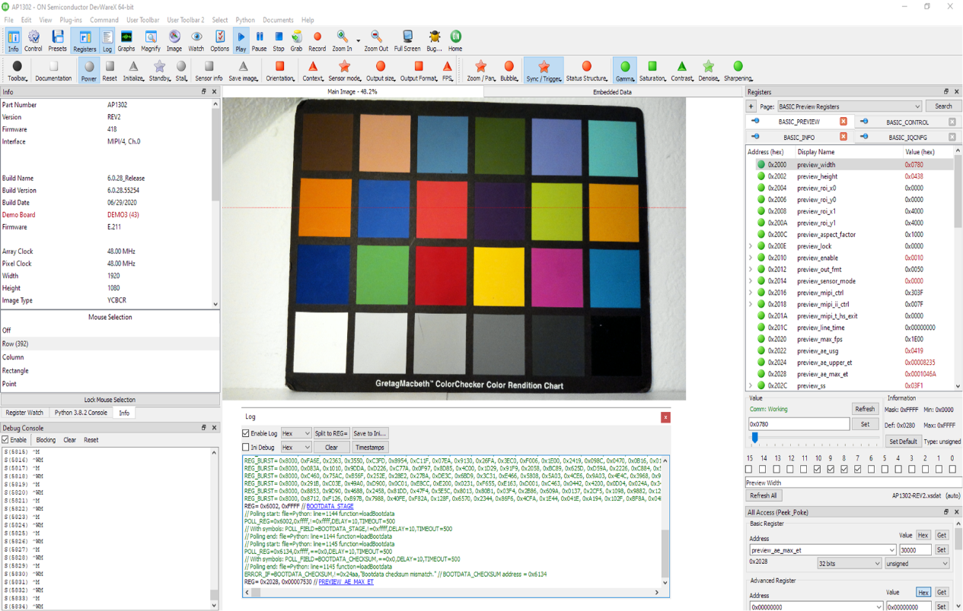
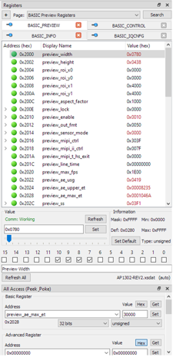
AR0234CS + AP1302 + DevSuite – Rapid Camera System Design
Configured
Calibrated
Tuned
Development Hardware Kit
AGB1N0CS-GEVK (Demo3 Board)
AP1302CSSL00SMGAH3-GEVB (AP1302 Board)
AR0234CSSC00SUKH3-GEVB (AR0234CS Board)
Development Software
DevWare Base Package (SW Platform)
AP1302 SW Package (AR0234 Specific Support)
Output
AP1302 Init File (XML)
Usable in System Design
Parametrized, Modifiable Default Inputs, Customized Outputs
Saves Several Months of Camera System Development
Pls contact your FAE for details on setup & use

Slide 22
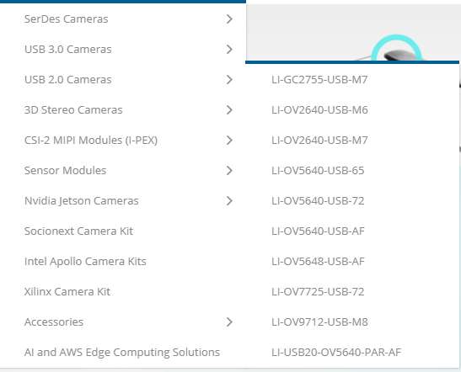
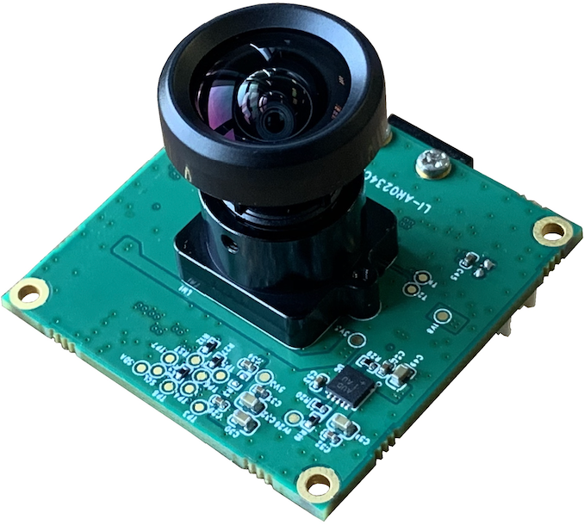
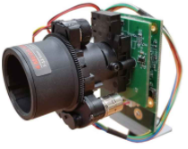
Module Support – Some Examples
Multiple AR0234 Modules
Driver Support
Nano | TX2 | USB3.0
Nvidia Jetson Camera Kit
Coming Soon !
Multiple AR0234 Modules
Complete System
Available NOW!
Socionext ISP MBG967 Tuned
Nano | TX2 | Xavier
Nvidia Jetson Camera Enabled
AR0234 Module
Drivers – In Works
Nvidia Jetson Camera Kit CY21

Slide 23
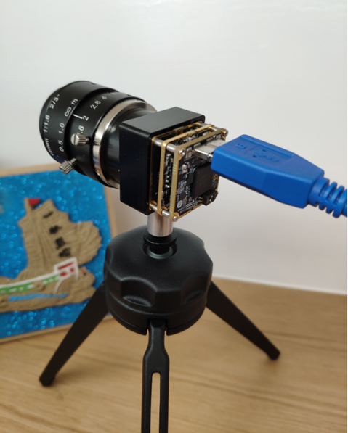
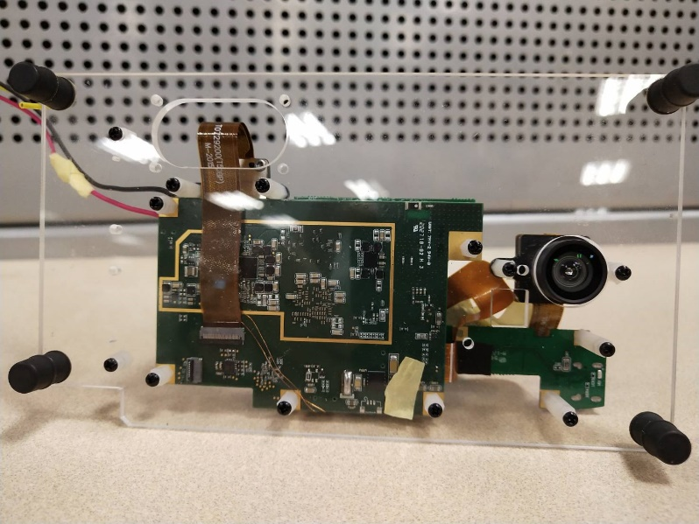
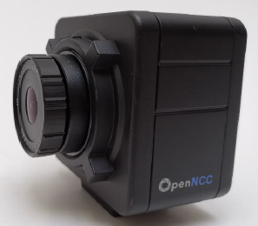
AR0234CS – Reference Designs
AR0234CS
AP1302
Machine Vision Reference Module (MVRM)
AR0234CS + AP1302 + USB3.0 Stack
Compact, MV Camera Form Factor 26x26x13mm
Readily Deployable HW Module with USB3 Driver
More Support Coming Soon !
USB3 Bridge
Driver Monitor Reference Design (Primax)
AR0234CS + QCOM QCS603
Ready to Deploy – HW + Drivers
Contact ON Sales &/or Primax !
OpenNCC Camera Reference Platform (Eyecloud)
AR0234CS + Intel VPU + OpenVINO
Rapid AI Camera based Solutions
Sensor Fusion, Object Det/Class/Rec
Intel’s AIoT PaaS Platform
Available Now !
Check with Marketing for Additional Information

Slide 24
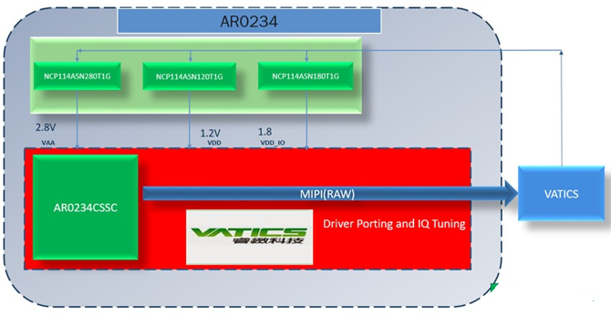
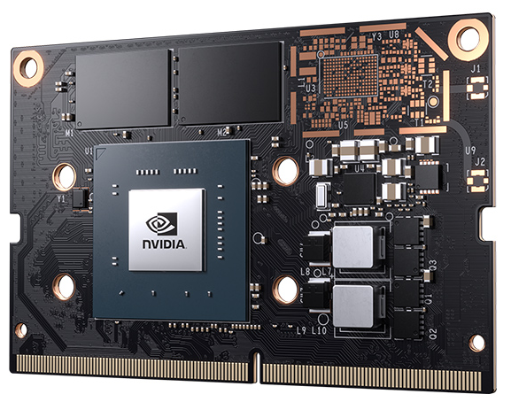
Multiple ISPs Support AR0234CS
Socionext – MBG967
Appro.Pho Camera Module - AR0234(Global shutter)+ISP(YUV)+AF Zoom lens(4.4X)
VATICS – M5S
Qualcomm – QCS603
Nvidia – Jetson Platforms
VATICS
M5S
Others in Works!

Slide 25
AR0234CS – Ordering
AR0234 CS S M 00 S U K A 0 - C P
Web Part Number
WPN
CMOS Sensor
CS = Default
CRA Angle
Package
K = CSP
Ship Package
C = Chip Tray
Revision
S = Default
Operating Temp
S = Commercial
Package Options
A = Lead Free
P = Protective Film
R = No PF
# Extns for Lower MOQs
Chromaticity
Interface
U = Multiple
Special
0 = Default

Slide 26
AR0234CS – ON Part Numbers (OPN)
Mono; CRA 0deg | Description | MOQ
AR0234CSSM00SUKA0-CP | CSP Chip Tray with Protective Film | 2100
AR0234CSSM00SUKA0-CR | CSP Chip Tray without Protective Film | 2100
AR0234CSSM00SUKA0-CP1 | CSP Chip Tray with Protective Film Low MOQ | 210
AR0234CSSM00SUD20 | Bare Die | NA
AR0234CSSM00SUKAH3-GEVB | Demo Headboard | NA
Color; CRA 0deg | Description | MOQ
AR0234CSSC00SUKA0-CP | CSP Chip Tray with Protective Film | 2100
AR0234CSSC00SUKA0-CR | CSP Chip Tray without Protective Film | 2100
AR0234CSSC00SUKA0-CP1 | CSP Chip Tray with Protective Film Low MOQ | 210
AR0234CSSC00SUD20 | Bare Die | NA
AR0234CSSC00SUKAH3-GEVB | Demo Headboard | NA
Mono; CRA 28deg | Description | MOQ
AR0234CSSM28SUKA0-CP | CSP Chip Tray with Protective Film | 2100
AR0234CSSM28SUKA0-CR | CSP Chip Tray without Protective Film | 2100
AR0234CSSM28SUKA0-CP1 | CSP Chip Tray with Protective Film Low MOQ | 210
AR0234CSSM28SUD20 | Bare Die | NA
AR0234CSSM28SUD20-RC1 | Bare Die, with Low MPQ | NA
AR0234CSSM28SUKAH3-GEVB | Demo Headboard | NA
Color; CRA 28deg | Description | MOQ
AR0234CSSC28SUKA0-CP | CSP Chip Tray with Protective Film | 2100
AR0234CSSC28SUKA0-CR | CSP Chip Tray without Protective Film | 2100
AR0234CSSC28SUKA0-CP1 | CSP Chip Tray with Protective Film Low MOQ | 210
AR0234CSSC28SUD20 | Bare Die | NA
AR0234CSSC28SUKAH3-GEVB | Demo Headboard | NA
Die Options – Check with Marketing for Specific Instructions
Samples
Use *-CP1 OPN; first 10 units can be free; need PO beyond 10 units
Always order in x10 units
All OPNs Fully Qualified & Shipping in Volume

Slide 27
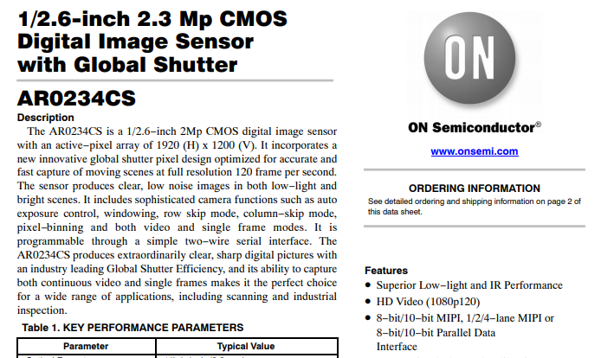
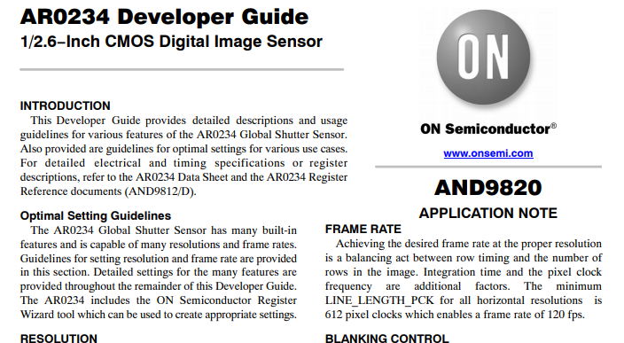
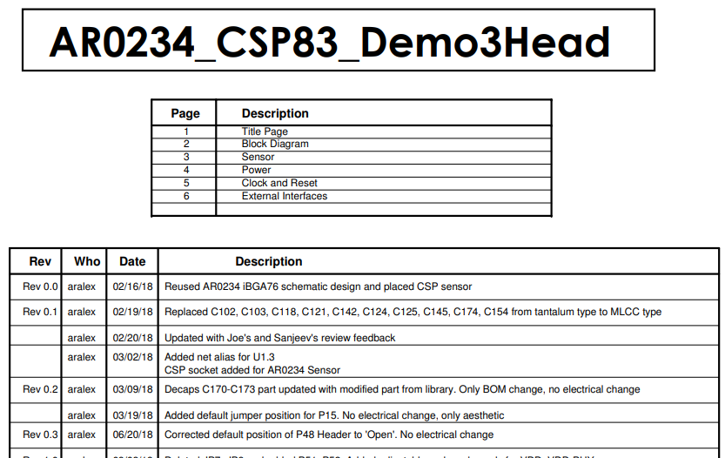
AR0234CS – Technical Documentation
Comprehensive Set Available on Doc Management

Slide 28
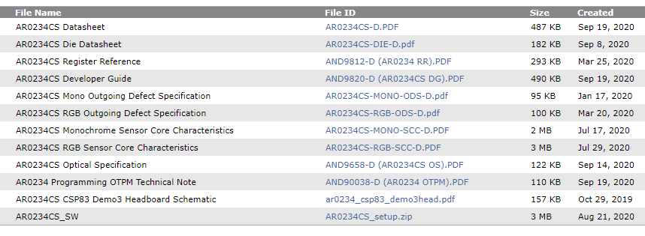
AR0234CS – Technical Documentation
AR0234CS ISG Extranet Documents Folder - https://cma.onsemi.com/PowerSolutions/cma/erFileEdit.do?folderId=1503046

Slide 29
Thank You!

