Slide 1
PCS xEV AEC Portfolio Overview
ASG/MCC/PCS – Q4 2022

Slide 2
PCS Products focus in HEV/EV Power systems

Slide 3
AEC PWM Controllers

Slide 4
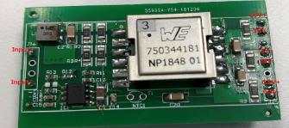
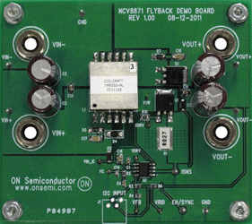
ASG Auxiliary PSU for xEV
Any Low Power SMPS that is connected to the Battery or the Ac mains (OBC) to deliver regulated bias voltages to key components of the system (MCU, Drivers, Controllers, …)
10W 3 outputs PSR Flyback
Using NCV1362
20 W 3 Flyback
Using NCV8871
Go to SalesConnect
Aux PSU Overview

Slide 5
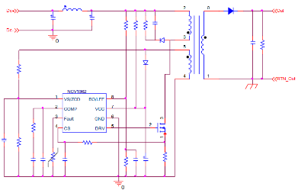

NCV1362 Automotive Wide Vin PSR Controller
The NCV1362 is a Quasi-Resonant primary side PWM controller which provides Constant-Voltage (CV) and Constant-Current (CC) output regulation without the need of an optical coupler. The controller achieves excellent line and load regulation of 5% and features protections such as Brown-Out, UVP/OVP, OTP, SCP, as well as improved light load efficiency and stand-by performance.
Primary Side Regulation
Valley Lockout
Line Feed Forward
Frequency Jitter
Dual Frozen Peak Current
Eliminates optocoupler & feedback circuitry
Eliminates valley jumping
Improved CC regulation
Improved EMI signature
Optimized light load & stand-by
Constant Voltage Primary−Side Regulation < ±5
Constant Current Primary−Side Regulation < ±5
LFF and BO Feature on Dedicated Pin
Max Frequency Clamp Options
No Clamp, 80, 110 and 140 kHz
Wide Operation VCC Range up to 28 V
Multiple protections
Low power AC/DC adapters for chargers
Automotive and Industrial Auxiliary Power
SOIC-8
NCV1362AADR2G, NCV1362ABCDR2G, NCV1362ACDR2G

Slide 6
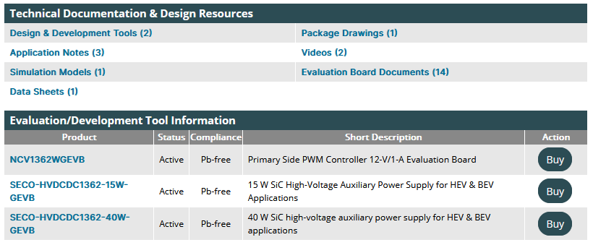
NCV1362 Collaterals
MathCad Design for AC Ac & Dc Input
App Notes and Design guide with PSR
Simplis Model
For more info: NCV1362 Technical presentation

Slide 7
PSR Product Family Comparison
 | NCP1360 (1st gen) | NCP1361 (1st gen) | NCV/NCP1362 (2nd gen) | FAN105 | TI UCC2870x | Benefit
Current Regulation | CC on primary | CC on primary | CC on primary | CC on primary | CC on primary
Voltage Regulation | CV on primary | CV on secondary (opto) | CV on primary | CV on primary | CV on primary | Auto desire no opto due to reliability
Package | TSOP6 | TSOP6 | SO8 | TSOP6 | TSOP6 | Dedicated BO & Fault pin
HV Startup Current Source | No | No | No | No | No
Valley Lockout | First 4 Valleys | First 4 Valleys | First 4 Valleys | No | No | Eliminates valley jumping
VCO mode - Min frequency | 200 Hz 600 Hz 1.2 kHz | 200 Hz 600 Hz 1.2 kHz | 200 Hz 400 Hz 1 kHz 2 kHz 3 kHz 4 kHz | 1.25 kHz | 1 kHz | Options when controller enters standby
Double frozen peak current | No | No | Yes | No | No | Optimizes for light load & standby
Frozen Peak Current in VCO mode | 15% 20% 25% | 15% 20% 25% | 25% 30% 35% 40% |  | 15%
Frozen Peak Current in STB mode | NA | NA | 5.6% 8.1% 11.3% 13.8% | NA | NA | Optimize Standby
Maximum frequency clamp | No clamp 80 kHz 110 kHz | No clamp 80 kHz 110 kHz | No clamp 80 kHz 110 kHz 140 kHz | 76 kHz | 130 kHz | Higher frequency clamp
Dynamic frequency clamp (Hi/Lo Mains) | No | No | Yes (optional) | No | No | Detects low or high lines and adjusts clamp
Cable compensation (5 V) | 0 150 mV 300 mV 450 mV | 0 150 mV 300 mV 450 mV | 0 150 mV 300 mV 450 mV | Resistor Programmable | Programmable (UCC28700) 0 (UCC28701) 150 mV(UCC28702) 300 mV (UCC28703 | Optional
Cable compensation (12 V) | 0 360 mV | 0 360 mV | 0 200 mV 250 mV 300 mV 410 mV | Resistor Programmable | 0 | Optional
Brown Out | No | No | Yes | Yes | 70V fixed | Dedicated pin
Protections | UVP/OVP, OCP, SCP | UVP/OVP, OCP, SCP | UVP/OVP, OCP, SCP, OTP, BO | OVP, Internal OTP | OVP, OCP, BO | Fault protections
NTC Compatible OTP | No | No | Yes, Fault Pin | No | Yes | High accuracy OTP
LineFeed Forward | No | No | Yes | No | Yes | Improved CC regulation
CV/CC Regulation | ±5%/±10% | ±5%/±10% | <±5%/±5% | ?? | ±5%/±5% | Improved regulation
Jitter | No | No | Yes | No | Yes | Improved EMI signature

Slide 8
NCV12711 Low Vin DC-DC Flyback Controller
The NCV12711 is a fixed-frequency peak-current-mode PWM controller containing all of the features necessary for implementing single-ended power converter topologies. The device operates from 4 V to 45 V without auxiliary winding and can accept transient spikes up to 50 V.
Low Voltage Operation
Adjustable Over Power Protection
NTC-Compatible Fault Interface
Frequency Jitter
Error Amplifier Option
AEC-Q100 Qualified
4 – 45 V Input Range
Limits Total Power Capability
Provides Thermal Protection
Improves EMI signature
For non-isolated designs
For automotive applications
Internal 7.5-V Regulator
0% Duty Ratio Operation in No-Load Condition
Internal Over Power Protection
Single Resistor Programmable Oscillator – 100 kHz to 1 MHz
Adjustable Soft-Start on Peak Current and Frequency
Output OVP Fault Interface
1 A / 2.8 A Source / Sink Gate Driver
Automotive 12V Auxiliary Power Supply
AEC-Q100: NCV12711 in MSOP-10
Primary-side regulated isolated converters
Non-isolated dc-dc converters.

Slide 9
NCV12711 - Isolated and PSR-type of Converters
Non-isolated primary-side regulation
Isolated primary-side regulation
The NCV12711 includes an op-amp and allows for direction connection to V_{out}
It can also be used in a classical auxiliary-winding-based regulation for raw dc output regulation

Slide 10
Comparative Performance
 | ON NCV12711 | ON NCV887x | TPS40210(-Q1) | LM5155-Q1 | Benefits
Topology | Iso. Flyback Non-Iso Flyback | Boost Non-Iso Flyback | Boost/SEPIC Non-Iso Flyback | Boost/SEPIC/ Non-Iso Flyback | Optimized for isolated flyback
Input Voltage Range | 4 – 45 V | 3.2 – 40 V | 4.5 – 52 V | 3.5 – 45 V 2.97 – 16 V BIAS=V_{cc} | 4 V required for modules
Transient/Load Dump | 45 V | 45 V | 52 V | 50 V | Automotive requirement
Switching Frequency | 100 kHz to 1 MHz | 50 kHz or 100 kHz | 35 kHz to 1 MHz | 100 kHz to 2.2 MHz
Soft Start | Adjustable | Yes, Fixed | Adjustable | Adjustable
Current Sense Threshold | 250 mV | 400 mV | 150 mV | 100 mV
Programmable Oscillator | Yes | No | Yes | Yes
Max duty ratio | 90% | 92.5% | - | 93%
t_{ON(min)} (typical) | 125 ns | 250 ns | 275 ns @ 12 V | 50 ns
Jitter | Optional | No | No | No | Facilitates EMI
0% duty ratio | Yes | No | No | No | Safe no-load operation in low-power isolated converters.
External Sync | No | Yes | Yes | Yes | Sync to external clock
Faults | OCP, OPP, OTP (NTC), SCP, UVLO | OCP, SCP, TSD | OCP, UVLO | OVP, SCP, Thermal Shutdown, UVLO | Fewer external components, robustness
Auto-recovery | Auto-Recovery/Latch | - | OCP Retry | - | Design flexibility
ESD, HBM | 2 kV | 2 kV | 2 kV | 2 kV
Operating Junction Temp | -40 °C to +125 °C | -40 °C to +150 °C | -40 °C to +125 °C | -40 °C to +125 °C | Characterization up to 150 °C
Packages | MSOP10 | SOIC8 | HVSSOP10, VSON10, PDSO10 | 3x2 WSON12 (wettable flank) | Leadless with wettable flanks for inspection

Slide 11
NCV10317 Low Vin PSR Flyback Switcher
The NCV10317 is a Primary Side Regulation (PSR) controller with an integrated 70-V MOSFET containing all of the features necessary for implementing single-ended power converter topologies which saves the secondary feedback circuitry (opto & TL431). Thanks to the dynamic self supply and a floating arrangement, the auxiliary winding is also not needed. It operates in QR peak current mode control to offer high efficiency at high load.
Primary Side voltage Regulation
Internal 70-V MOSFET – 400 mΩ
3.7V/3.5V Startup/Stop threshold
Frequency Jitter
AEC-Q100 Qualified
Eliminate Opto+TL431 and auxiliary winding
4.5 – 45 V Input Range
Improves EMI signature
For automotive applications
Dual limit protection on CS – 1.5A as OCP limit, 2.25A as SCP
  OCP initialize the OCP timer – 30/50/100/200 ms
  SCP allows only 4 DRV cycles before IC goes to fault state
Max on-time protection
Over-voltage protection on VCC pin & ZCD pin
Under-voltage protection on ZCD pin
Short-circuit protection on ZCD pin
Thermal shutdown
1st Samples Q2’23
Automotive 12V Auxiliary Power Supply
Standard Part #: NCV10317xPRD2G
Package: SOIC-8 EP

Slide 12
AEC Junction Isolated Drivers

Slide 13
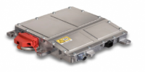
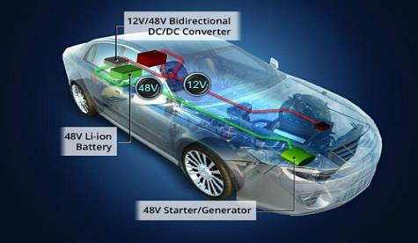
Existing drivers HVIC drivers for 48V systems
FAN7191_F085/NCV5183 for cost effective solution
NCV51511 for high performance
600V drivers in SOIC8 – mature junction isolated process
> 4A drive capability
Synchronous Buck Converters
48 V System in Automotive
Better dyn perf and internal BST
Synchronous Buck Converters
P2P with UCC272xx
Possible in DFNW10 4*4 or SOIC8

Slide 14
Technology/Design sets JI driver performance
Comparison table of the drivers
HD4G/VHV3
FS35
UH7-HB
Parameter & Symbol |  | FAN73xx_F085/NCV51xx | NCV51511 | NCV51513 | Unit
Boot Pin Voltage | V_{B} | Max. 620 | Max. 100 | Max. 150 (720 V) | V
Supply Voltage | V_{CC} | Max. 18 | Max. 18 | Max. 20 | V
V_{DD} Under voltage Lockout | V_{UVLO} | 8.8 | 6.8 | 6.4 | V
 | V_{HYS} | 0.5 | 0.6 | 0.35 | V
HB Under voltage Lockout | V_{HBR} | 8.8 | 6.3 | 6.4 | V
 | V_{HBH} | 0.5 | 0.5 | 0.35 | V
Input Logic Levels |  | TTL | TTL | TTL
Bootstrap Diode |  | NO | YES | NO
Driving current capability | I_{SOURCE} | 0.2 to 4.5 | 3 | 0.2 to 6 | A
 | I_{SINK} | 0.2 to 4.5 | 6 | 0.2 to 6 | A
LO/HO Rise Time (Typ). | t_{R} | 15 to 50/1nF | 6/1nF | 9/1nF | ns
LO/HO Fall Time (Typ). | t_{F} | 15 to 50/1nF | 4/1nF | 7/1nF | ns
Low Side Propagation Delay (Typ.) | t_{PHL} | 100 to 300 | 28 | 20/60(incl. filter) | ns
High Side Propagation Delay (Typ) | t_{PLH} | 100 to 300 | 30 | 20/60 (incl. filter) | ns
Delay Matching (Max) | t_{MON} | 50 | 10 | 7 | ns

Slide 15
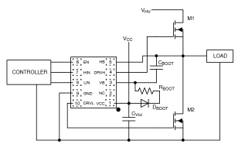
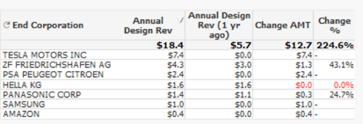

NCV51513 – 130 V/2.5-3 A, H/L Driver with Dead Time & Interlock
The NCV51513xy are 130 V high frequency high-side and low-side drivers with very low and matched propagation delays for direct drive of 2 N-channel power MOSFETs in high performance 48V Automotive converters.
Input range: 130V
Drive capability: 2.5/3 A peak Source/sink
20/50 ns propagation delay (B/A)
Interlock and 3 options for Dead time (0/80/200 ns)
Fit 48V systems with margins
Strong driver and fast turn On/Off
Suitable for high speed with trade off noise/Fsw
Design and topology flexibility
3.3 V and 5 V input logic
dV/dt Immunity: 50 V/ns & improved robustness
Max Vcc : 20V
Dedicated Enable pin
Under voltage lockout for both inputs
AEC-Q100 qualified (-40°to 125°C)
High performance Automotive DC/DC converters
Multi-phase Permanent Magnetic Synchronous Motor
NCV51513xyMNTWG DFN10 3*3
  x with or w/o input noise filter
  y DT value
Possible in SOIC10
AB RTM
AA RTM

Slide 16
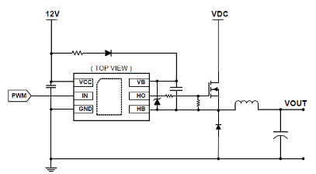

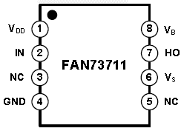

NCV51313 – 130 V/2.0-3.0 A, High-Side Driver
The NCV51313xy are 130 V high frequency high-side drivers with very low propagation delays for direct drive of N-channel power MOSFETs in high performance 48V Automotive converters. It embeds protections that simplify design and reduce BOM cost.
Input range: 130V
Drive capability: 2.0/3 A peak Source/sink
20/50 ns propagation delay (B/A)
Fit 48V systems with margins
Strong driver and fast turn On/Off
Suitable for high speed with trade off noise/Fsw
3.3 V and 5 V input logic
dV/dt Immunity: 50 V/ns & improved robustness
Max Vcc : 20V
Under voltage lockout for both inputs
AEC-Q100 qualified (-40°to 125°C)
Samples Q1-23
V51313x
High performance Automotive DC/DC converters
Multi-phase Permanent Magnetic Synchronous Motor
NCV51313xMNTWG DFNW6 3*3
NCV51313xDR2G SOIC8
  x with or w/o input noise filter

Slide 17



100-150 V Drivers Roadmap
Existing
Developing
Planning
Exploring
Automotive
48/12 V Conversion, Motor Drive
VHV3/HDG4 & UH-7 v1
UH-7 v1 VISON
NCP51513 – 130 V H/L
3.0 A with EN & Interlock/Fixed DT - DFN10 3*3
NCV51515 – VIS SOI 120 V H/L
2.5-4 A Driver with BST/Interlock/DT – DFN14
NEW
NCV51313 – 130 V HS
2.5 & 5 A - DFN6 3*3
NCV51516 – SOI GaN 200 V H/L
2-3 A Driver with BST/Interlock/DT/Gate control– DFNx
NCV51511 – 100 V H/L
3/6A – Integrated Bst diode – 4/6 ns R/F time – 2ns Delay matching – SOIC8-EP
NCV51514 – VIS SOI 120 V H/L
2.5-4 A Driver with BST/Interlock/DT – DFNW10
Cloud & Server
24 & 48 V Bus conversion
NCP51513 – 130 V H/L
3.0 A with EN & Interlock/Fixed DT - DFN10 3*3
NEW
NCP51612/3 – 150 V 3-Ph
0.5 /1.0A –QFN 20/28 VIS SOI
FAN8811 – 100 V H/L
3/6A – Integrated Bst diode – 4/6 ns R/F time – 2ns Delay matching – DFN10 4*4
NCP51514 – VIS SOI 120 V H/L
2.5-4 A Driver with BST/Interlock/DT – DFN8/10 (UCC2728x)
NCP5109A/B - 200 V H/L
0.25/0.5A - 85/35 ns R/F time – 20 ns Delay matching – 100 ns Prop delay – DFN10 3*3
NCP51515 – VIS SOI 120 V H/L
2.5-4 A Driver with BST/Interlock/DT – DFN14
NCP51512x – 130 V H/L
0.5 /1.0A – Single In and LINAK features
Existing
2022
2023-25

Slide 18
AEC Galvanically Isolated Drivers

Slide 19
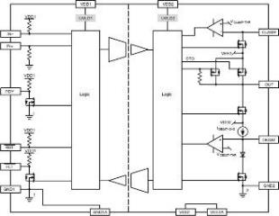
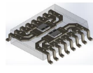
Construction of our isolated gate drivers
Multichip module
NCD57000 – 1-Ch Isolated Driver
Transmitter
Isolator
Receiver + Driver
2-Way
Comm.
transformer
NCV51563 – 2-Ch Isolated Driver
Data in
Tx
Bonding
Rx
Data out
wire
Primary Die
Secondary Die
1-Way
Comm.

Slide 20
Galvanic Isolation Roadmap
Gen2
NCP/V5156x (DUAL / SINGLE)
SO-16 & DFN 8/16
Gen1+
CMTI = > 200V/ns
T-Prop < 30ns +/- 20%
Prop Delay Match 5 ns
Improved transformer
Lower capacitance -> better CMTI, possibly lower power
Transceiver with better Temp Coef
NCP/V5156x (DUAL / SINGLE)
SO-8 & SO16
ASG
IBGT
MOS
SiC/GaN
CMTI = 200V/ns
T-Prop = 35ns +/- 33%
Prop Delay Match = 8ns
Same Xmer
Better TX
IPT
CMTI = 100V/ns
T-Prop = 60ns +/- 50%
Prop Delay Match = 20ns
CMTI = 100V/ns
T-Prop = 60ns +/- 50%
Prop Delay Match = 20ns
PSG
NCP/V5700x (SINGLE)
SO-16
NCP/V57252 & 5708x
(DUAL / SINGLE)
SO-8 & SO16

Slide 21
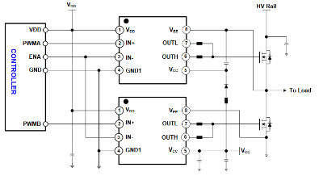
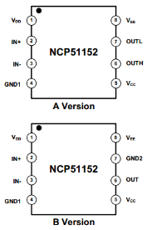
NCP/V51152 – 3.7 kV Isolated High Performance MOS/SiC Drivers
The NCP/NCV51152 is isolated 1-channel gate driver with up to 4.5-A/9-A source and sink peak current. It is designed for very fast switching to drive power MOSFETs power switches.
The NCP/NCV51152 offers short and matched propagation delays. Internal functional isolation between the two secondary-side drivers allows a working voltage of up to ~1,200 VDC. It offers other important protection functions such as under-voltage lockout for each drivers and enable function.
Input side isolated from output drivers
by 3.7-kVRMS isolation barrier
45 ns Prop Delay & +/-5 ns Max PWD
>= 200 V/ns dV/dt Immunity
20 ns Max. part-to- part Skew
Vdd up to 20V
Give reliable operation and safety
Efficient switching
High Robustness
Easier design
Can work with both Analog and Digital Controllers
Typical Source/Sink Current Capability up to 4.5-A/9-A
Programmable Input Logic
Split Outputs for easier control or true Vcc UVLO
  Enable/IN+
Different UVLO options: 5/8-V & 12/17-V
Sampling Now !!
Isolated Converters in Offline AC-to-DC Power Supplies
Motor Drive and DC-to-AC Solar Inverters
HEV and EV On-Board chargers
SOIC-8 NB for space saving
OPN : NCP/NCV51152xyDR2G
x: (A/B/C/D) UVLO level
y: A or B
A: Split Output
B: VEE-GND for true UVLO

Slide 22
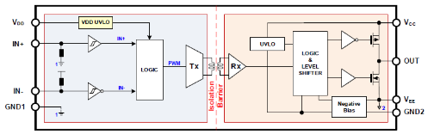
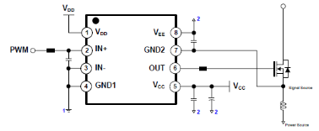
NCP/V51752 – 3.7 kV Isolated High Performance SiC Drivers
The NCP/NCV51752 is isolated 1-channel gate driver with up to 4.5-A/9-A source and sink peak current. It is designed for very fast switching to drive power SiC power switches.
The NCP/NCV51752 offers short and matched propagation delays and has integrated mechanism to generate negative bias in the gate drive loop to offer safe OFF state for any type of SiC.
Input side isolated from output drivers
by 3.7-kVRMS isolation barrier
45 ns Prop Delay & +/-5 ns Max PWD
>= 200 V/ns dV/dt Immunity
20 ns Max. part-to- part Skew
Embedded neg bias voltage generation
Give reliable operation and safety
Efficient switching
High Robustness
Easier design
Simple and Safe SiC turn-off
Typical Source/Sink Current Capability up to 4.5-A/9-A
Vdd up to 20V
Programmable Input Logic
  Enable/IN+
Different UVLO options: 5/8-V & 12/17-V
Different Neg bias voltages : -2/-3/-4/-5 V
Sampling Now !!
Isolated Converters in Offline AC-to-DC Power Supplies
Motor Drive and DC-to-AC Solar Inverters
HEV and EV On-Board chargers
SOIC-8 NB for space saving
OPN : NCP/NCV51752xyDR2G
x: A/B/C/D UVLO levels
y: A/B/C/D Neg. bias levels

Slide 23
Negative Bias control for NCP51752
  Negative bias in the gate drive loop
    The GND2 capacitor between GND2 and V_{EE} pins, C_{GND2}, will develop a voltage across the pins. This capacitor voltage is controlled by charging and discharging current sources.
    The pre-charge current, I_{PRECHG}, serves to reach quickly the specified target threshold voltage in advance before starting

Slide 24
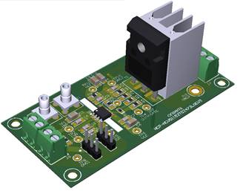
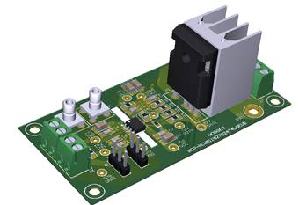
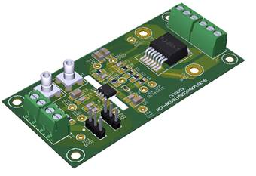
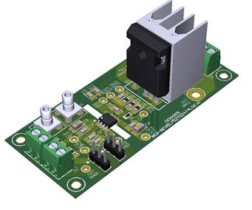
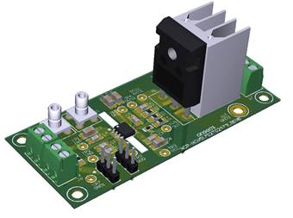
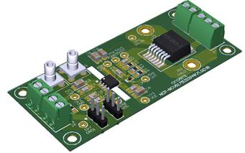
NCP/V51152/752 Eval boards
NCP-NCV51152xTO2473LGEVB (TYPE-A) NCP-NCV51152xTO2474LGEVB (TYPE-B) NCP-NCV51152xD2PAK7LGEVB (TYPE-C) -- Planned
NCP-NCV51752xTO2473LGEVB (TYPE-A) NCP-NCV51752xTO2474LGEVB (TYPE-B) NCP-NCV51752xD2PAK7LGEVB (TYPE-C)

Slide 25
NCP/V51755 Key Features
Key Features
  Split output (OUTH & OUTL) with 10-A peak source and 10-A sink current driving capability
  Integrated GND_VEE supply for negative gate drive
  Active Miller clamp
  Desat and Over-current protection
  Temperature sensing
  Output 2-level turn-off
  Under voltage protection of the V_{DD}, V_{CC} and GND_VEE supplies
  Active output pulldown with low V_{CC} supply or floating inputs
  Diagnostic status output (/FLT1 and /FLT2)
  2 options High voltage clamping Control (VCLP) for Concept-A or Asynchronous stop command (ASC) for Concept-B
  SPI interface for parameter configuration
Configurable Protections
  DESAT based short circuit protection
  Shunt resistor based over-current and short circuit protection
  NTC based over-temperature protection
  Programmable soft turn-off and two-level turn-off during fault condition
  Under voltage protection level of the V_{DD}, and V_{CC} supplies.
  Programmable voltage of the GND_VEE supply for negative bias
  Programmable dead-time for shoot-through prevent
  Programable minimum input pulse rejection
  Programmable input glitch filter
10/19/2022

Slide 26
NCP51755 Concept – Functional Block Diagram
Note: Pin configuration can be changed after review

Slide 27
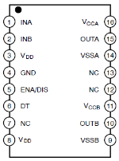
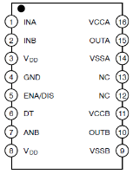
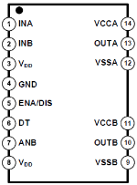
2-Ch Iso drivers NCP5156x/NCV5156x Comparison
Bold : RTM
 | NCP51560 | NCP/NCV51561 | NCP/NCV51563
OPNs | NCP51560AB NCP51560BB | NCP51561BA NCP51561BB / NCV51561BB NCP51561DA / NCV51561DA NCP51561DB | NCP51563BB / NCV51563BB NCP51563CA / NCV51563CA
Pin Assignment
Pin #7 | NC | ANB (pull-up/down) | ANB (pull-up/down)
Ch to Ch voltage | 1,500 V | 1,500 V | 1,850 V
INA, INB | Min. -5 V / Max. 20 V | Min. -5 V for 50ns / Max. 20 V | Min. -5 V for 50ns / Max. 20 V
Power up sequence | Power-up delay time during Vccx start-up | Internal settling time tPORUV,OUT = 18us | Internal settling time tPORUV,OUT = 18us
PKG | SOIC-16 WB | SOIC-16 WB | SOIC-16 WB (pin #12/13 removed)
Automotive Part | On demand (AB RTM) | NCV51561 (BB/DA RTM) | NCV51563 (CA RTM)

Slide 28

NCV51561 – 5 kV Isolated High Speed Dual MOS/SiC Drivers
The NCV51561 are isolated dual-channel gate driver with up to 4.5-A/9-A source and sink peak current. It is designed for fast switching to drive power MOSFETs power switches. The NCV51561 offers short and matched propagation delays. Internal functional isolation between the two secondary-side drivers allows a working voltage of up to ~1,200 VDC. The NCV51561 offers other important protection functions such as independent under-voltage lockout for each drivers and disable function.
Input side isolated from output drivers
by 5-kVRMS isolation barrier
36 ns Prop Delay & 5 ns Delay Match
>= 200 V/ns dV/dt Immunity
4.5-A/9-A Typical Source/Sink Current Capability
Give reliable operation and safety
Efficient switching
High Robustness
Driver to accommodate diff MOS load
Matched Propagation Delays : Max. 8 ns
User Programmable Input Logic
  Single or Dual-input modes via ANB
  DISABLE or ENABLE mode
User Programmable Dead-Time Control
Different UVLO options: 5-V,8-V, 13-V, & 17-V
HEV and EV On-Board chargers
HV DC/DC converters
SOIC-WB16 with high DTI
OPN : NCV5156xyzDWR2G
x: Drive capability – Single/Dual Input
y: UVLO level
z: Enable/Disable

Slide 29
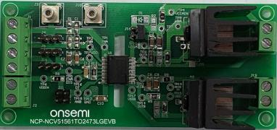
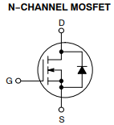
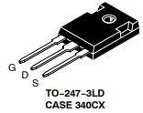
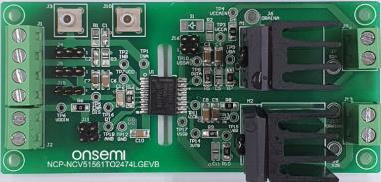
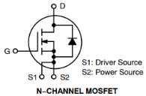
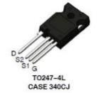
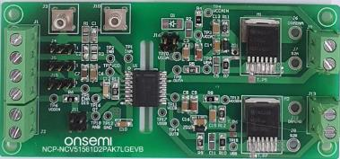
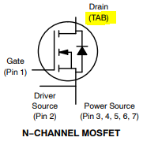
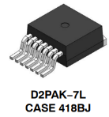
NCV51561 – EVB’s (EVBUM2817/D)
Link:
https://www.onsemi.com/products/power-management/gate-drivers/ncp51561
Type A (3LD):
Breakdown Voltage: | SiC: TO-247-3LD
 | R_{DSON} Range (25C)
1200V: | 20mΩ to 160mΩ
900V: | 20mΩ to 60mΩ
650V | 12mΩ to 57mΩ
Type B (4LD):
Breakdown Voltage: | SiC: TO-247-4LD
 | R_{DSON} Range (25C)
1200V: | 20mΩ to 160mΩ
900V: | 20mΩ to 60mΩ
750V | 13.5mΩ
650V | 12mΩ to 57mΩ
NCP51561
Type C (7LD):
Breakdown Voltage: | SiC: TO-247-7LD
 | R_{DSON} Range (25C)
1200V: | 20mΩ to 160mΩ
900V: | 20mΩ to 60mΩ
650V | 12mΩ to 43.5mΩ
Notes:
This is MP as of 1/21/2022.

Slide 30
Collaterals List & Links / Contacts
Datasheet, Application Note(SiC driving), Pd calculator, EVB doc, Sim Models
  NCV51561 - 5 kVrms 4.5-A/9-A Isolated Dual Channel Gate Driver
  NCV51563 - 5 kVrms 4.5-A/9-A Isolated Dual Channel Gate Driver w/ High Ch-Ch Spacing
MKT Collaterals
  xEV Auxiliary Power Supply Overview
  ASG Isolated Drivers
MKT Contacts
  Marc Barboni (marc.barboni@onsemi.com), EU/Global
  Steve Yoo (steve.yoo@onsemi.com), Korea/APAC
AE Contacts (located in Korea)
  Inki Park (inki.park@onsemi.com)
  YS Lee (ys.lee2@onsemi.com)
  Jonghyun Jang (jonghyung.jang@onsemi.com)

Slide 31

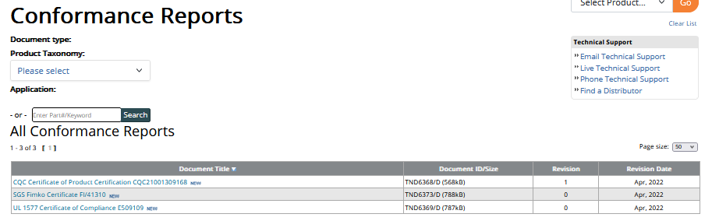
Isolated Drivers Certification

Slide 32

NCP/NCV51563 – Isolated Dual MOS/SiC Drivers with 3.3mm creepage
The NCP/V51563 are isolated dual-channel automotive gate driver with up to 4.5-A/9-A source and sink peak current. It is designed for fast switching to drive power MOSFETs power switches. The NCP/V51563 offers short and matched propagation delays. Internal functional isolation between the two secondary-side drivers allows a working voltage of up to ~1,200 VDC. The NCP/V51563 offers other important protection functions such as independent under-voltage lockout for each drivers and disable function.
Input side isolated from output drivers
by 5-kVRMS isolation barrier
Increased Channel-to-Channel Spacing
36ns Prop Delay & 8ns Delay Match
>= 200 V/ns dV/dt Immunity
Typical Source/Sink Current Capability of 4.5-A/9-A
Give reliable operation and safety
3.3 mm for higher functional isolation up to 1850-V
Efficient switching
High Robustness
Strong Driver to optimize losses
Higher creepage distance between channel offers better immunity in polluted environments
Matched Propagation Delays : Max. 15 ns
User Programmable Input Logic
Single or Dual-input modes via ANB
DISABLE or ENABLE mode
User Programmable Dead-Time Control
Different UVLO options: 8-V & 13-V
NCV51563CA RTM done
P2P with UCC21530-Q1
Isolated Converters in Offline AC-to-DC Power Supplies
Motor Drive and DC-to-AC Solar Inverters
HEV and EV On-Board chargers
SOIC-WB16 LESS Pins 12 & 13 with high DTI
OPN : NCV51563xyDWR2G
x: UVLO level
y: Enable/Disable

Slide 33
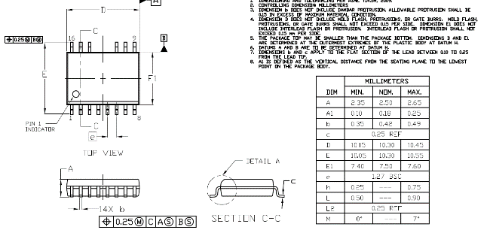
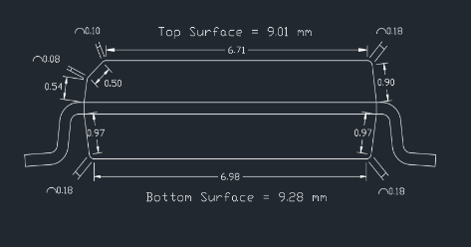
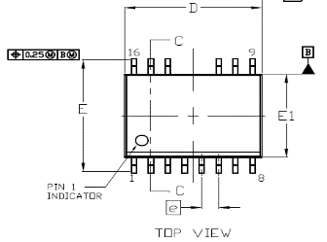
NCV51563 Package details
Clearance: shortest pin to pin distance in the air
Creepage: shortest pin to pin across package surface
I/O Creepage is actually 9.01 mm
3.81
Channel Creepage: 3.81 – 0.49 = 3.32 mm

Slide 34
Isolated Drivers Selection Guide

Slide 35
Isolated Drivers Roadmap
Existing
Developing
Planning
Exploring
ONC25 + GI V1₊
ONC25 + GI V2 ONC25 + GI V2.x
Full Features & Performance
SiC GaN
NCV58981/3
Single Iso-GaN, 650V, 30mOhm/50mOhm, 2.5kV Galvanic Isolation, SCP, Fault Reporting, PQFN 12x12 Top-Cool
NCP/NCV51755 (1-Ch 10-15A)
Gen2 GI + Dig Interface/Protections & Sensing
SOIC-20/24WB
NCP/NCV5175x (1-Ch Bidirectional)
Improved 755 (GI - Drive cap, …)
NCP/NCV51753 (SGL SiC)
NCP51752 in SOIC-8 WB
Sampling now
NCP/NCV51752 (SGL 4.5/9A SiC)
Gen1+ + DRIVER With Neg Bias – SOIC-8 NB
Performance MOS & SiC
1-Ch 2-Ch
NCP51560 (4.5/9A)
NCP51561 with Pin #7 NC
NEW
NCP/NCV51564 (4.5/9A)
NCP51560 in SOIC16WB Less pins 12 & 13
NCP/NCV51563 (4.5/9A)
Gen 1+ GI MOS DRIVERS-
SOIC16WB Less pins 12&13
NEW
NCP/V51565/66 (4/8A)
Gen 2.x GI + Cost optimized NCP51560/61 DRIVERS
NCP/NCV51561 (4.5/9A)
Gen 1+ GI MOS DRIVERS-SOIC16WB
NEW
NCP51562 (4/6A)
Gen 2 GI/Sgl Xmer MOS drivers in LGA5x5 & SOIC16NB
NCP/NCV51153 (4.5/9A)
Gen 1+ GI + DRIVER- SOIC8-WB
NCP5815x (ISO DrMOS)
NCP51153 ISO DRIVERS + MOS – Power Package
Sampling now
NCP/NCV51152 (4.5/9A)
Gen 1+ GI + DRIVER- SOIC8-NB
Existing
2022
2023-25

Slide 36




Integrated GaN Product Roadmap
Cloud
xEV
NCP5892x
Single Driver-GaN, 650V, 50mΩ/78mOhm/150mOhm, PQFN 8x8
Cloud Server &
High-Performance Computing
NCP58921A
Single Driver-GaN, 650V, 50mOhm, PQFN 12x12 bottom cool
NCP58923B
Single Driver-GaN, 650V, 25mOhm, PQFN 12x12 Top-Cool
NCP5898x
Single Iso-GaN, 650V, 25mOhm/50mOhm, 2.5kV Galvanic Isolation, SCP, PQFN 12x12 Bottom-Cool
NCP5881x
Half-Bridge Driver-GaN, 100V, 3mOhm/5mOhm, PQFN 4x5 Top-Cool
xEV OBC & 48V DCDC
NCV5898x
Single Iso-GaN, 650V, 25mOhm/50mOhm, 2.5kV Galvanic Isolation, SCP, Fault Reporting, PQFN 12x12 Top-Cool
NCV5888x
Half-Bridge Iso-GaN Module, 650V, 25mOhm/50mOhm, 2.5kV Galvanic Isolation, SCP, Fault Reporting, PQFN 16x18 Top-Cool
NCV5881x
Half-Bridge Driver-GaN, 100V, 3mOhm/5mOhm, PQFN Top-Cool
2022
2023
2024
2025+
Developing
Planning
Exploring

Slide 37
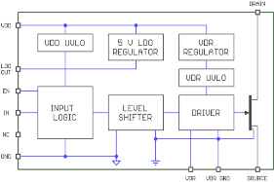
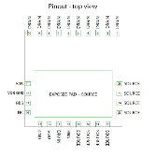
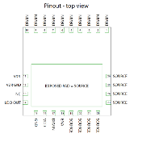

NCP5892x 650 V Integrated GaN PQFN 8 x 8 mm
High performance integrated gate driver with GaN. Built in 6 V clamped gate drive for optimal and robust GaN operation at high switching frequency. Device is available in low inductance PQFN bottom cool package.
Integrated gate driver + E-mode GaN
50 mOhm, 78 mOhm & 150 mOhm typical R_{ds( on)}
35 ns typical driver propagation delay time
Low inductance PQFN 8 x 8 mm with bottom side cooling
2.75 mm creepage distance
650 V breakdown voltage rating
Driver VCC rating 20 Vmax
6 V internal clamped GaN gate drive voltage
UVLO protections for VCC and VDD supplies
NCP58920/2
NCP58921
Cloud-Server, Telecom & Industrial
Totem pole PFC and LLC
Samples Now
Production Q1 ‘23
Bottom cool 8x8 mm PQFN

Slide 38
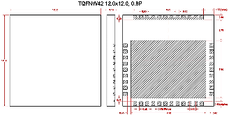

NCP5892x 650 V Integrated GaN PQFN 12 x 12 mm
High performance integrated gate driver with GaN. Built in 6 V clamped gate drive for optimal and robust GaN operation at high switching frequency. Device is available in low inductance PQFN 12x12 mm package
Integrated gate driver + E-mode GaN
NCP58921A: 50 mOhm/NCP58923B: 25 mOhm typ R_{ds( on)}
35 ns typical driver propagation delay time
Low inductance PQFN 12 x 12 mm
2.75 mm creepage distance
NCP58921A: Bottom side cool/NCP58923B: Top side cool
650 V breakdown voltage rating
Driver VCC rating 20 Vmax
6 V internal clamped GaN gate drive voltage
UVLO protections for VCC and VDD supplies
Bottom cool 12x12 mm PQFN
Cloud-Server, Telecom & Industrial
Totem pole PFC and LLC
NCP58921A
Samples Q3 ‘22
Production Q2 ‘23
NCP58923B
Samples Q1 ‘23
Production Q4 ‘23
Top cool 12x12 mm PQFN

Slide 39

NCV58981/3 650 V Integrated GaN (iGaN)
High performance integrated gate driver with GaN. Built in galvanically isolated gate driver provides excellent immunity and robustness against high dv/dt related noise generated in the system. Device is available in PQFN package
Integrated gate driver + E-mode GaN
30 mOhm & 50 mOhm typical R_{ds( on)}
Built in 2.5 kV_{rms} galvanic isolation from input to output
6 V internal clamped GaN gate drive voltage
35 ns typical driver propagation delay time
Low inductance PQFN 12 x 12 mm with WF (Top/bottom side cool)
650 V breakdown voltage rating
Short circuit protection
Fault reporting
xEV OBC Totem Pole PFC and LLC
HV to LV xEV Converters
Eng. Samples H1 ‘23
Production H2 ‘24
Top Cooled 12x12mm PQFN

Slide 40
xEV OBC Block Diagram
GI Gate Driver
NCV5156x
GI Gate Driver
NCV5156x
GI Gate Driver
NCV5156x

Slide 41
xEV Inverter Block Diagram
GI Gate Driver
NCV5156x

Slide 42
xEV DC/DC Converter Block Diagram
GI Gate Driver
NCV5156x
GI Gate Driver
NCV5156x

Slide 43

xEV e-Comp Block Diagram
IGBT/SiC
Gate Driver IC
NCV51563CA
HV Battery
Gate Driver IC
NCV51563CA
+
Gate Driver IC
NCV51563CA
Motor
15V
6V
Current Sensing
MCU
LDO 3.3V
(NCV1117)
SMPS
NCV12711
12V Battery
CAN Interface
No iso DC/DC
ESD protection

Slide 44
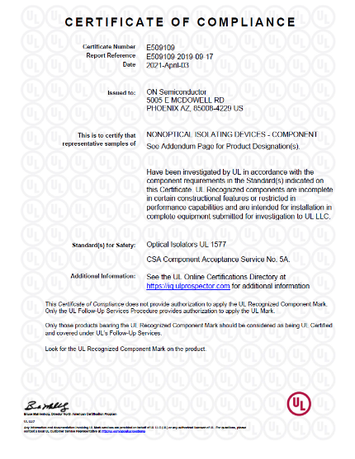
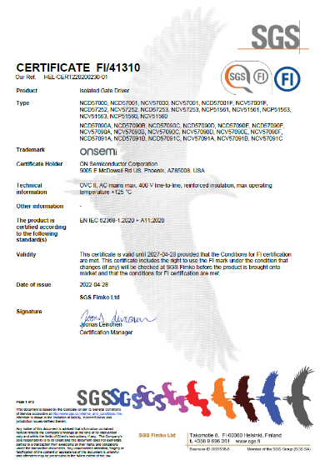
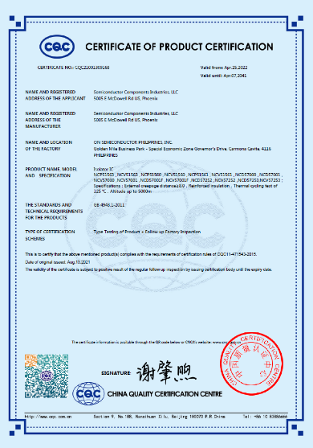
Appendix - Certifications
UL 1577
SGS Fimko EN IEC 62368-1
CQC GB 4943-1

Slide 46
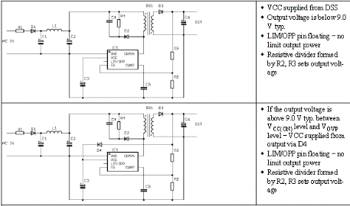
NCV1060/63 – 11 & 34 Ω Switchers for low power Buck
The NCV1060~63 products integrate a 670V MOSFET for cost effective isolated & non isolated switching power supply capable of delivering from few Watts to 12 W.
  34 Ω (NCV1060) & 11 Ω (NCV1063) – Other RdsON on demand
  Frequency foldback and skip
  Mode
  Direct FB connection
  Power scalability
  Improved efficiency at light
  loads
  Easy implementation of buck/buck-boost or flyback
  Short circuit protection Independent of the aux. Winding
  Adjustable Ipeak: 250 mA & 650 mA
  OPP thru Aux winding
  Soft start: 4 ms (TBC)
  Internal switching frequency: 65 & 100 kHz
  Frequency jittering
  Wide Start-up voltage down to 20 Vdc
  Auxiliary Supply for EV – OBC & Traction Inverters
  NCV1060: 34 Ω / 250 mA in SOIC-10
  NCV1063: 11.4 Ω / 650 mA in SOIC-16
  A : with Brown-in – B : w/o Brown-in
Notes:
46

Slide 47


NCV1070~77 – 4.7 to 22 Ω 650V Integrated Switchers
The NCV1070~1077 products integrate 670V MOSFET providing for a switching power supply capable of delivering up to 2~20 watts of output power.
  Frequency foldback and skip mode
  Internal HV Startup featuring Dynamic Self Supply (DSS)
Ease of design
Ability to change peak current limit
Improved efficiency at light loads
Loss less startup sequence
Short circuit protection Independent of the aux. winding when the DSS is used
Soft start: 1 ms
Internal switching frequency: 65, 100 and 130 kHz
Frequency jittering
Over Voltage Protection – Vcc pin
RTM’d versions
NCV1075P065G/NCV1075P100G
NCV1076P065G/NCV1076P100G
NCV1077STBT3G
  Auxiliary Supply for EV – OBC & Traction Inverters
NCP107XSTYT3G – SOT-223 / Y A:65 kHz/B/100kHz/C:130 kHz
NCP107XPxxxG – PDIP7 / 65/100/130 kHz

Slide 48
NCV1034 – 100 V Synchronous Controller
The NCV1034 is a flexible synchronous PWM controller designed to operate from wide input supply voltage range up to 100 V. The NC1034 provides a 2 A gate drive and is capable of producing output voltages as low as 1.25 V.
Up to 100V input
2 A Drive Capability
Synchronization
Suitable for +48 V, +60 V, +100 V supplies
Drive High Efficiency FETs
Fixed frequency for 1 or more devices
External frequency adjustment
Programmable Soft-Start
Programmable Over Current Protection
Hiccup Current Limit Using MOSFET RDS(on)
Wide Input Voltage Range
Automotive: CLA, Infotainment, Navigation
SOIC-16
NCV1034DR2G: -40 to +125°C Tj

Slide 49
NCV1397 – High Performance Resonant Mode Controller
The NCV1397 is a high-performance controller for half bridge LLC resonant converters supporting operation over a wide range of bulk or line voltages.
Built-in drivers
Adjustable & accurate minimum frequency
Fast and slow fault detection, Broken FB loop detection
Compact design
Keeps the converter in the right region & ease the design
Robust and rugged power supply & help to be compliant with safety standards
Latch input, brownout
Adjustable dead-time
Adjustable soft start
Easy no-Load operation and low standby power due to programmable skip cycle
Enable capability
Offline battery chargers
Automotive LLC Power Supply
NCV1397ADR2G (SOIC-16) = Auto-recovery
NCV1397BDR2G (SOIC-16) = Latch

Slide 50


NCV4390 – Secondary Side LLC and SR Controller
The NCV4390 is an advanced PFM controller for LLC resonant converters with Synchronous Rectification (SR). It employs a current mode control technique based on charge control to simplify the feedback loop design and allow true input power limit capability. A dual edge tracking adaptive dead time control minimizes body diode conduction thus maximizing efficiency.
Analog Control
Charge Current Control
Adaptive SR with Dual edge Tracking
Green Functions (Symmetric PWM Control and SR Disabling)
Closed Loop Soft Start
No Need for Expensive, Complex Digital MCU
Excellent Transient response and Easy feedback Loop Design
Best In Class Efficiency
Improved Light Load Efficiency
Monotonic Rising Output
Over Current Protection (OCP)
Output Short protection (OSP)
Non ZVS Prevention
Power Limit by Compensation Cutback
Overload Protection with Programmable Shutdown Delay
Wide Operating Temperature Range –40°C To 125°C
On Board Charger
HV DC-DC converters
NCV4390DR2G, SOIC16-NB, AEC-Q100 qualified

Slide 51
AEC Low Side Drivers

Slide 52
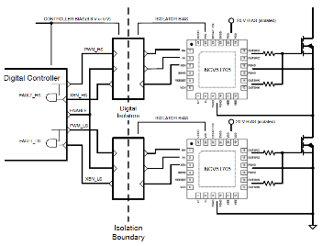

NCV51705 – 6A SiC MOSFET Fully integrated Gate Driver
The NCV51705 driver is designed to primarily drive SiC MOSFET transistors. For the lowest possible conduction losses, the driver is capable to deliver the maximum allowable gate voltage to the SiC MOSFET device. For improved reliability, dV/dt immunity and even faster turnoff, the NCV51705 can utilize its on-board charge pump to generate a user selectable negative voltage rail.
  Adjustable, on-board regulated negative charge pump
  Negative voltage drive for fast turn-off (same as above)
  5V Reference/Bias Rail
  Adjustable UVLO levels
Simplified BOM and no need for extra DC/DC
Easy digital isolator Vcc supply
Can work with diff SiC FET’s
High peak output current - 6A
Extended positive voltage rating for efficient SiC MOSFET operation during the conduction period
Thermal shutdown function
DESAT detection for short circuit protection
Inverting/Non-inverting Input
Industrial Inverters, Motor drives
High Performance PFC, AC/DC & DC/DC Converters
QFN24 4mm x 4mm With Wettable Flanks
OPN : NCV51705MNTXG

Slide 53
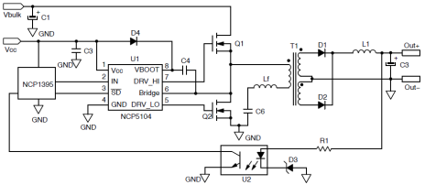
NCV5104 – Dual Inputs High and low side Power MOSFET Driver
The NCV5104 is a High Voltage Power gate Driver providing two outputs for direct drive of 2 N-channel power MOSFETs or IGBTs arranged in a half-bridge configuration.
Pin to pin compatible with industry standards
Voltage range: 600 V
dV/dt Immunity: 50 V/ns
Source/Sink capability: 250 mA/500 mA
Reduced design efforts
Rugged and flexible design
Robust design
Suitable for low to mid power applications
3.3 V and 5 V input logic
Up to Vcc swing on input pins
Matched propagation delays between both channels
Outputs in phase with the inputs
1 input with fixed 520 ns dead-time
Dedicated Shut-down pin
Under Vcc LockOut (UVLO) on both channels
Mid Power 48V Sync Buck
Half-bridge and full-bridge PSUs
NCV5104DR2G: SOIC-8

Slide 54

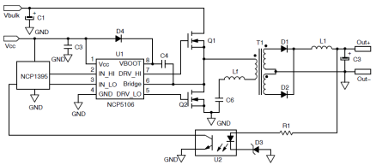
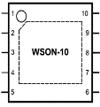

NCV5106-09A/B – Dual Inputs HB MOSFET Driver in SO8/DFN-10
The NCV5106-NCV5109 is a High Voltage gate Driver IC providing two outputs for direct drive of 2 N-channel power MOSFETs or IGBTs arranged in a half-bridge configuration (ver. B) or any other high-side + low-side configuration (ver. A).
New DFN tiny package
Voltage range:
  600 V NCV5106A/B
  200 V NCV5109A/B
dV/dt Immunity: 50 V/ns
Source/Sink capability: 250 mA/500 mA
Save PCB and improve creepage distance
Rugged and flexible design
Robust design
Suitable for low to mid power applications
3.3 V and 5 V input logic compatible
Matched propagation delays between channels
Independent Logic inputs to accommodate all topologies (Version A)
Outputs in phase with the inputs
Cross conduction protection with 100 ns internal fixed dead time (Version B )
Under Vcc LockOut (UVLO) on both channels
Vcc
VBOOT
IN_HI
IN_LO
DRV_HI
GND
DRV_LO
BRIDGE
Active clamp, asymmetrical, half and full-bridge PSUs
48 V Power converter Automotive
NCV5106AMNTWG - NCV5106BMNTWG (DFN 4*4)
NCV5109AMNTWG - NCV5109BMNTWG (DFN 3*3)

Slide 55
NCV5183 – 600 V/4.3 A, High and Low side Driver
The NCV5183 are 600 V high frequency high-side and low-side drivers with very low and matched propagation delays for direct drive of 2 N-channel power MOSFETs in high performance Telecom and Automotive converters.
Pin to pin compatible with industry standards
Input range: 600 V
dV/dt Immunity: 50 V/ns & improved robustness
Drive capability: 4.3 A peak Sink/Source
Reduced design efforts and rugged design
Robust design
Suitable for high power
3.3 V and 5 V input logic
15 ns Rise & Fall Times
90 ns propagation delay
Max Vcc : 18 V
Under voltage lockout for both inputs
AEC-Q100 qualified (-40°to 125°C)
NCV5183DR2G: SOIC-8
High performance Automotive DC/DC converters

Slide 56


NCV51511 - 3A/6A 100V High/Low Side Gate Driver
The NCV51511 is a is high side and low side gate-drive IC designer for high speed, high current/voltage driving MOSFET up to 100 V
High frequency operating with low power loss
Small package & good thermal char.
Integrated Bootstrap diode
Excellent dynamic
  30 ns Prop delay (typ)
  2 ns Delay Matching
  6 ns Rise & Fall Times
New SOIC8 with Exp PAD
Dual input logic with TTL compatible
3 A/6 A sourcing/sinking currents
Wide supply voltage range up to 18 V max.
50ns Min pulse width
Under voltage lockout for both inputs
Operating TJ range of 40°C up to 150°C
48V/12V Conversion
Half Bridge and Full Bridge Converter
48 V Motor drive
NCV51511PDR2G : SOIC8-EP

Slide 57
NCP/V51153 – 5 kV Isolated High-Performance MOS/SiC Drivers
The NCP51157 is isolated 1-channel gate driver with up to 4.5-A/9-A source and sink peak current. It is designed for very fast switching to drive power MOSFETs power switches.
The NCP51157 offers short and matched propagation delays. Internal functional isolation between the two secondary-side drivers allows a working voltage of up to ~1,200 VDC. It offers other important protection functions such as under-voltage lockout for each drivers and enable function.
Input side isolated from output drivers
by 5-kVRMS isolation barrier
45 ns Prop Delay & +/-5 ns Max PWD
>= 200 V/ns dV/dt Immunity
20 ns Max. part-to- part Skew
Vdd up to 20V
Give reliable operation and safety
Efficient switching
High Robustness
Easier design
Can work with both Analog and Digital Controllers
Typical Source/Sink Current Capability up to 4.5-A/9-A
Programmable Input Logic
Split Outputs for easier control or true Vcc UVLO
  Enable/IN+
Different UVLO options: 5/8-V & 12/17-V
Isolated Converters in Offline AC-to-DC Power Supplies
Motor Drive and DC-to-AC Solar Inverters
HEV and EV On-Board chargers
SOIC-8 WB with high DTI
OPN : NCV51153xyDWR2G
x: A or B
A: Split Output
B: VEE-GND for true UVLO
y: (A/B/C/D) UVLO level

