Slide 1
High Performance Isolated Drivers
PCS Q1 - 2022

Slide 2
Gate Driver Category Definition
Non-isolated
Junction Isolated
Galvanic Isolated
https://www.onsemi.com/products/discretes-drivers/gate-drivers
Single - Channel
Multiple - Channel
High - Side
High/Low
Half-Bridge
Three-Phase
1-Channel
2-Channel
Non-isolated | Junction Isolated | Galvanic Isolated
Single or multiple channel Cheapest, simple solution for many applications where only a low-side driver is needed Automotive Industrial Systems Consumer Devices | High Side, High/Low and Half Bridge Floating HV well From LV to 1200V breakdown voltage Appliances Consumer Devices & Power Tools Auxiliary Automotive & Motors Drives Offline Power | Normally needed in very high power/high voltage systems. Three options: Optical, Inductive, Capacitive Automotive traction inverters Industrial Drive Server Rack Power Solar and Energy Storage
Applications
Products
FAN3111
FAN31xx
NCP51705 (SiC)
FAN321x
FAN322x
FAN73611
FAN8811
FAN7392
NCP51530
NCP5183
FAN7382
FAN73833
FAN73912
NCP5106B
FAN7382
FAN73833
FAN73912
NCP5106B
NCD5708x
NCP5115x
NCP5175x
NCD5725x
NCP5156x

Slide 3
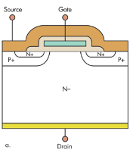
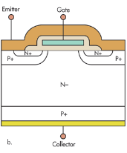
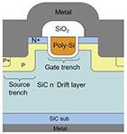
The Right Driver for the right Application
MOSFET Driver | IGBT Drivers | SiC MOSFET Driver
NCP51xxx | NCD57xxx | NCP51xxx
5 & 8 V UVLO Fast Prop Delay | 13 V UVLO DESAT and AMC | 13 & 17 V UVLO Fast Prop Delay
Server Cloud Computing Automotive OBC & HV DC/DC | Automotive (PTC, OBC & Traction Inverters) Industrial Automation | Solar Inverters Automotive OBC & HV DC/DC
Marc Barboni/Steve Yoo | Guy Rahamim | Marc Barboni/Steve Yoo
Paired
Power
Device
Nomenclature
Key Points
Target Markets
Contact

Slide 4
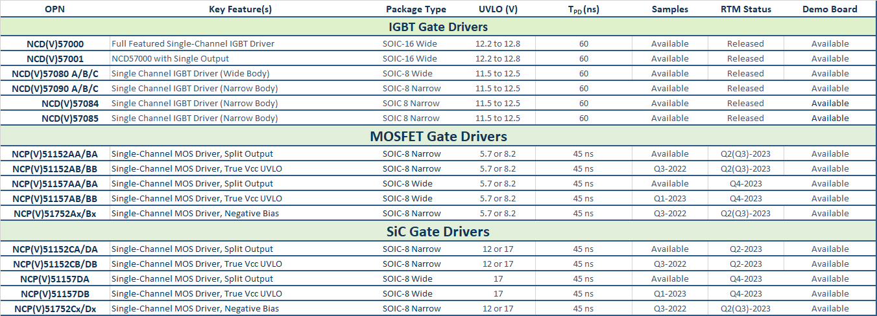
Isolated 1-Channel Gated Drivers
*T_{PD} (ns, Out-H Typ @ 25C)

Slide 5




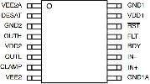




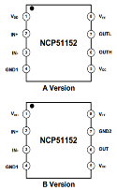
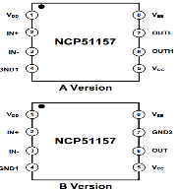
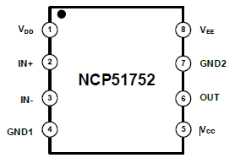
Isolated 1-Channel Gated Drivers
IGBT
NCD(V)57084
Option A: Active Miller Clamp
Option B: Negative Output Supply
Option C: Separate V_{OL}/V_{OH} Outputs
NCD(V)57000/01
*NCD(V)57000 only
NCD(V)57085
Option D: Active Miller Clamp
Option E: Separate VOL/VOH Outputs
Option F: Active Miller Clamp
NCP51152xA : Split Output
NCP51157xA : Split Output
MOS/SIC
NCP51152xB : True Vcc UVLO
NCP51157xB : True Vcc UVLO
Negative Bias Control (SOIC-8 Narrow)

Slide 6
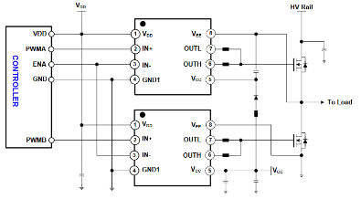
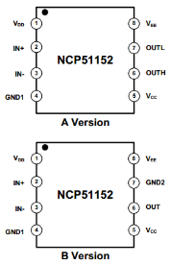
NCP/V51152 – 3.7 kV Isolated High Performance MOS/SiC Drivers
The NCP51152 is isolated 1-channel gate driver with up to 4.5-A/9-A source and sink peak current. It is designed for very fast switching to drive power MOSFETs power switches.
The NCP51152 offers short and matched propagation delays. Internal functional isolation between the two secondary-side drivers allows a working voltage of up to ~1,200 VDC. It offers other important protection functions such as under-voltage lockout for each drivers and enable function.
Input side isolated from output drivers
by 3.7-kVRMS isolation barrier
45 ns Prop Delay & +/-5 ns Max PWD
>= 200 V/ns dV/dt Immunity
20 ns Max. part-to- part Skew
Vdd up to 20V
Give reliable operation and safety
Efficient switching
High Robustness
Easier design
Can work with both Analog and Digital Controllers
Typical Source/Sink Current Capability up to 4.5-A/9-A
Programmable Input Logic
Split Outputs for easier control or true Vcc UVLO
  Enable/IN+
Different UVLO options: 5/8-V & 12/17-V
Sampling Avail in A version
Isolated Converters in Offline AC-to-DC Power Supplies
Motor Drive and DC-to-AC Solar Inverters
HEV and EV On-Board chargers
SOIC-8 NB for space saving
OPN : NCP51152xyDR2G
x: (A/B/C/D) UVLO level
y: A or B
A: Split Output
B: VEE-GND for true UVLO

Slide 7
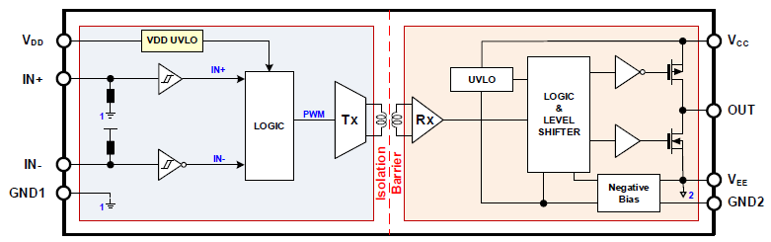
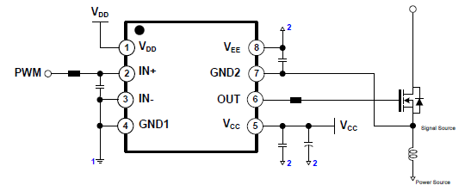
NCP/V51752 – 3.7 kV Isolated High Performance SiC Drivers
The NCP51752 is isolated 1-channel gate driver with up to 4.5-A/9-A source and sink peak current. It is designed for very fast switching to drive power SiC power switches.
The NCP51152 offers short and matched propagation delays and has integrated mechanism to generate negative bias in the gate drive loop to offer safe OFF state for any type of SiC.
Input side isolated from output drivers
by 3.7-kVRMS isolation barrier
45 ns Prop Delay & +/-5 ns Max PWD
>= 200 V/ns dV/dt Immunity
20 ns Max. part-to- part Skew
Embedded neg bias voltage generation
Give reliable operation and safety
Efficient switching
High Robustness
Easier design
Simple and Safe SiC turn-off
Typical Source/Sink Current Capability up to 4.5-A/9-A
Vdd up to 20V
Programmable Input Logic
  Enable/IN+
Different UVLO options: 5/8-V & 12/17-V
Different Neg bias voltages : -2/-3/-4/-5 V
Isolated Converters in Offline AC-to-DC Power Supplies
Motor Drive and DC-to-AC Solar Inverters
HEV and EV On-Board chargers
SOIC-8 NB for space saving
OPN : NCP51752xyDR2G
x: A/B/C/D UVLO levels
y: A/B/C/D Neg. bias levels

Slide 8
NCP51152, NCP51752 Competitive Landscape
Feature | Unit | ON |  | Competitor A |  |  | Competitor B | Competitor C
 |  | NCP51152A/B/51752 | NCD57080A/B/C | Competitor’s Device 1 | Competitor’s Device 2 | Competitor’s Device 3 | Competitor’s Device 4 | Competitor’s Device 5
Max Vdd (1ry die) | V | 20 | 20 | 18 | 18 | 18 | 5.5 | 7
Drive Current, Sourcing | A | typ. 4.5 @VCC=12V | typ. 6.5 @VCC=15V | typ. 8.5 @VCC=15V | typ. 10 @VCC=15V | typ. 4.3 @VCC=15V | typ. 4.0 @VCC=12V | min. 4 @VCC=18V
Drive Current, Sinking | A | typ. 9.0 @VCC=12V | typ. 6.5 @VCC=15V | typ. 10 @VCC=15V | typ. 10 @VCC=15V | typ. 4.3 @VCC=15V | typ. 4.0 @VCC=12V | min. 4 @VCC=18V
Split Outputs(OUTH/OUTL) |  | 51152A | 57080C | O | X | X | O | X
VCC True UVLO |  | 51152B | 57080B | X | X | O | X | X
Active Miller Clamp |  | X | 57080A | X | O | X | X | O
GND2-VEE Regulation (Neg. Bias) |  | 51752 | X | X | X | X | X | X
Desat Protection |  | X | X | X | X | X | X | X
Propagation Delay (Ton, Toff) | ns | - / 45 / - | 40/60/90 | - / 65 / 100 | - / 65 / 100 | - / 60 / 72 | 10 / 19 /30 | 45 / 55 /65
Pulse Skew ABS[Ton - Toff] | ns | +/-5 | +/-25 | max. 20 | max. 20 | max. 20 | max. 5 | max. 10
Pulse Skew Part-to-part | ns | +/-20 | +/-30 | max. 25 | max. 25 | max. 25 | max. 4.5 | max. 20
UVLO2 UV+ | V | 5.7/ 6.0 / 6.3 8.3 / 8.7 / 9.2 11/12/13 17/18 / 20 | 12.4/12.9/13.4 | - / 8.7 / 9.4 | - / 12/ 13 | - / 12/ 13 | 5.6 / 6.1 / 6.6 7.5 / 8.1 / 8.8 11.3 / 12.2 / 13.4 | 14.6 / 15 / 15.4
UVLO2 UV- | V | 5.4/ 5.7 / 6.0 7.8 / 8.2 / 8.7 10/11/12 16/17 / 18 | 11.5/12/12.5 | 7.3 / 8.0 / - | 10.3 / 11 / - | 10.3 / 11 / - | 5.4 / 5.8 /6.3 7.0 / 7.6 / 8.2 10.3 / 11.1 /12.0 | 14.1 / 14.5 / 14.9
UVLO2 Variation | V | 0.3, 0.5,1 | 1.0 | 0.7 | 1.0 | 1.0 | 0.32 (A)/ 0.55(B)/1.2( C) | 0.5
Clamp Voltage Threshold | V | N/A | 2.0 | N/A | 2.1 | N/A | N/A | 2.0
Input Logic Compatibility | - | TTL | 5-V CMOS | CMOS | CMOS | CMOS | TTL | TTL
Isolation Voltage (1min) | V_{rms} | 3750 | 3750 | 3000 | 3000 | 3000 | 3750 | 3750
CMTI | kV/us | 200 / - /- | 100 | 100 / 120 /- | 100 / 120 /- | 100 / 120 /- | 125 / - /- | Mmin. 100
CM Voltage for CMTI Test | V | 1500 | 1500 | 1200 | 1200 | 1200 | 1500
Isolation Technology | - | Inductive | Inductive | Capacitive | Capacitive | Capacitive | Capacitive | Inductive
Package |  | SOIC-8NB | SOIC-8NB | SOIC-8NB | SOIC-8NB | SOIC-8NB | SOIC-8NB | SSOP-B10W
Type of Power Switch |  | IGBT/MOS/SiC | IGBT/MOS | MOS/SIC | MOS/SIC | MOS/SIC | IGBT/MOS | IGBT/SiC

Slide 9
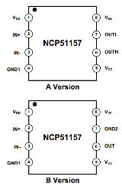
NCP51157 – 5 kV Isolated High-Performance MOS/SiC Drivers
The NCP51157 is isolated 1-channel gate driver with up to 4.5-A/9-A source and sink peak current. It is designed for very fast switching to drive power MOSFETs power switches.
The NCP51157 offers short and matched propagation delays. Internal functional isolation between the two secondary-side drivers allows a working voltage of up to ~1,200 VDC. It offers other important protection functions such as under-voltage lockout for each drivers and enable function.
Input side isolated from output drivers
by 5-kVRMS isolation barrier
45 ns Prop Delay & +/-5 ns Max PWD
>= 200 V/ns dV/dt Immunity
20 ns Max. part-to- part Skew
Vdd up to 20V
Give reliable operation and safety
Efficient switching
High Robustness
Easier design
Can work with both Analog and Digital Controllers
Typical Source/Sink Current Capability up to 4.5-A/9-A
Programmable Input Logic
Split Outputs for easier control or true Vcc UVLO
  Enable/IN+
Different UVLO options: 5/8-V & 12/17-V
Sampling Avail in A version
Isolated Converters in Offline AC-to-DC Power Supplies
Motor Drive and DC-to-AC Solar Inverters
HEV and EV On-Board chargers
SOIC-8 WB with high DTI
OPN : NCV51157xyDWR2G
x: (A/B/C/D) UVLO level
y: A or B
A: Split Output
B: VEE-GND for true UVLO

Slide 10
NCP51157 Competitive Landscape
Feature | Unit | ON |  | Competitor A |  | Competitor B |  |  | Competitor C
 |  | NCP51157A/B | NCD5709B/D | Competitor’s Device 1 | Competitor’s Device 2 | Competitor’s Device 3 | Competitor’s Device 4 | Competitor’s Device 5 | Competitor’s Device 6
Max Vdd (1ry die) | V | 20 | 20 | 17 | 17 | 18 | 18 | 18 | 5.5
Drive Current, Sourcing | A | typ. 4.5 @VCC=12V | typ. 8@VCC=15V | typ. 5.5 @VCC=15V | typ. 10 @VCC=15V | typ. 4.3 @VCC=15V | typ. 4.3 @VCC=15V | typ. 17 @VCC=15V | typ. 4.0 @VCC=12V
Drive Current, Sinking | A | typ. 9.0 @VCC=12V | typ. 8 @VCC=15V | typ. 5.5@VCC=15V | typ. 9@VCC=15V | typ. 4.4 @VCC=15V | typ. 2.2 @VCC=15V | typ. 17 @VCC=15V | typ. 4.0 @VCC=12V
Split Outputs(OUTH/OUTL) |  | 51157A | 57090C | O | X | O | X | X | O
VCC True UVLO |  | 51157B | 57090B | X | O | X | X | O | X
Active Miller Clamp |  | X | 57090A | X | X | X | O | X | X
Desat Protection |  | X | X | X | X | X | X | X | X
OCP |  | X | X | X | X | X | X | X | X
Propagation Delay (Ton, Toff) | ns | - / 45 / - | 45/60/85 | 80 / 90 / 100 | 80 / 90 / 100 | - / 60 / 72 | - / 60 / 75 | - / 65 / 100 | 10 / 19 /30
Pulse Skew ABS[Ton - Toff] | ns | +/-5 | +/-15 | +/-5 | +/-5 | max. 20 | max. 20 | max. 20 | max. 4.5
Pulse Skew Part-to-part | ns | +/-20 | +/-30 | max. 7 | max. 7 | max. 25 | max. 25 | max. 25 | max. 5
UVLO2 UV+ | V | 5.7/ 6.0 / 6.3 8.3 / 8.7 / 9.2 11/12/13 17/18 / 20 | 12.4/12.9/13.4 | - / - / 10 (1ED3120) - / - / 12.5(1ED3121) | - / - / 10 | - / 12 / 13 | - / 12 / 13 | - / 12 / 13 | 5.6 / 6.1 / 6.6 7.5 / 8.1 / 8.8 11.3 / 12.2 / 13.4
UVLO2 UV- | V | 5.4/ 5.7 / 6.0 7.8 / 8.2 / 8.7 10/11/12 16/17 / 18 | 11.5/12/12.5 | 8.0 / - / - 10.5 / - / - | 8.0 / - / - | 10.3 / 11 / - | 10.3 / 11 / - | 10.3 / 11 / - | 5.4 / 5.8 /6.3 7.0 / 7.6 / 8.2 10.3 / 11.1 /12.0
UVLO2 Variation | V | 0.3, 0.5,1 | 1.0 | 0.8 | 0.8 | 1.0 | 1.0 | 1.0 | 0.32 (A)/ 0.55(B)/1.2 ( C)
Clamp Voltage Threshold | V | N/A | 2.0 | N/A | 2.0 | N/A | 2.1 | N/A | N/A
Input Logic Compatibility | - | TTL | 5-V CMOS | TTL | TTL | CMOS | CMOS | CMOS | TTL
Isolation Voltage (1min) | V_{rms} | 5000 | 5000 | 5700 | 5700 | 5000 | 5000 | 5000 | 5000
CMTI | kV/us | 200 / - /- | 100 | 200 / - /- | 200 / - /- | 100 / 120 /- | 100 / 120 /- | 100 / 120 /- | min. 125
CM Voltage for CMTI Test | V | 1500 | 1500 | 1500 | 1500 | 1200 | 1200 | 1200 | 1500
Isolation Technology | - | Inductive | Inductive | Inductive | Inductive | Capacitive | Capacitive | Capacitive | Capacitive
Package |  | SOIC-8WB | SOIC-8WB | SOIC-8WB | SOIC-8WB | SOIC-8WB | SOIC-8WB | SOIC-8WB | SOIC-8WB
Type of Power Switch |  | IGBT/MOS/SiC | IGBT/MOS | IGBT/MOS | IGBT/MOS | MOS/SIC | MOS/SIC | MOS/SIC | IGBT/MOS

Slide 11
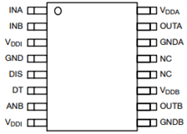
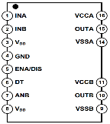
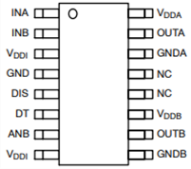
Isolated 2-Channel Gated Drivers
*T_{PD} (ns, Out-H Typ @ 25C)
Length x Width
10.3 x 7.5 mm | 9.9 x 6.0 mm
V_{IORM} (Max Working Insulation Voltage)
1200 V_{PK} | 1200 V_{PK}
V_{IOTM} (Max Allowable Over Voltage)
8400 V_{PK} | 4200 V_{PK}
Creepage & Clearance
8 mm | 4 mm
SOIC 16 Wide
SOIC 16 Narrow

Slide 12
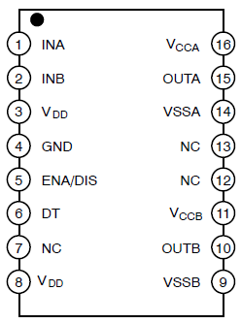
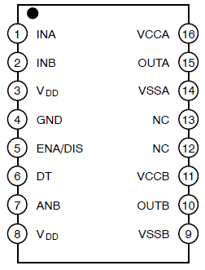
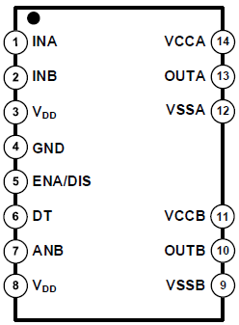
NCP5156x Comparison
 | NCP51560 | NCP51561 | NCP51563
OPNs | NCP51560AB NCP51560BB | NCP51561BA NCP51561BB NCP51561DA NCP51561DB | NCP51563BB NCP51563CA
Pin Assignment
Pin #7 | NC | ANB (pull-up/down) | ANB (pull-up/down)
Ch to Ch voltage | 1,500 V | 1,500 V | 1,850 V
INA, INB | Min. -5 V / Max. 20 V | Min. -5 V for 50ns / Max. 20 V | Min. -5 V for 50ns / Max. 20 V
Power up sequence | Power-up delay time during Vccx start-up | Internal settling time tPORUV,OUT = 18us | Internal settling time tPORUV,OUT = 18us
PKG | SOIC-16 WB | SOIC-16 WB | SOIC-16 WB (pin #12/13 removed)
Automotive Part | On demand | NCV51561 | NCV51563

Slide 13

NCP51561 – 5 kV Isolated High-Speed Dual MOS/SiC Drivers
The NCP51561 are isolated dual-channel gate driver with up to 4.5-A/9-A source and sink peak current. It is designed for fast switching to drive power MOSFETs power switches.
The NCP51561 offers short and matched propagation delays. Internal functional isolation between the two secondary-side drivers allows a working voltage of up to ~1,200 VDC. The NCP51561 offers other important protection functions such as independent under-voltage lockout for each drivers and disable function.
Input side isolated from output drivers
by 5-kVRMS isolation barrier
36 ns Prop Delay & 8 ns Delay Match
>= 200 V/ns dV/dt Immunity
4.5-A/9-A Typical Source/Sink Current Capability
Give reliable operation and safety
Efficient switching
High Robustness
Driver to accommodate diff MOS load
Matched Propagation Delays : Max. 8 ns
User Programmable Input Logic
  Single or Dual-input modes via ANB
  DISABLE or ENABLE mode
User Programmable Dead-Time Control
Different UVLO options: 8-V & 17-V (5 & 13 V On demand)
RTM Product
Isolated Converters in Offline AC-to-DC Power Supplies
Motor Drive and DC-to-AC Solar Inverters
HEV and EV On-Board chargers
SOIC-WB16
OPN : NCP51561xyDWR2G
x: UVLO level
y: Enable/Disable

Slide 14
NCP51561 Competition X-Ref

Slide 15
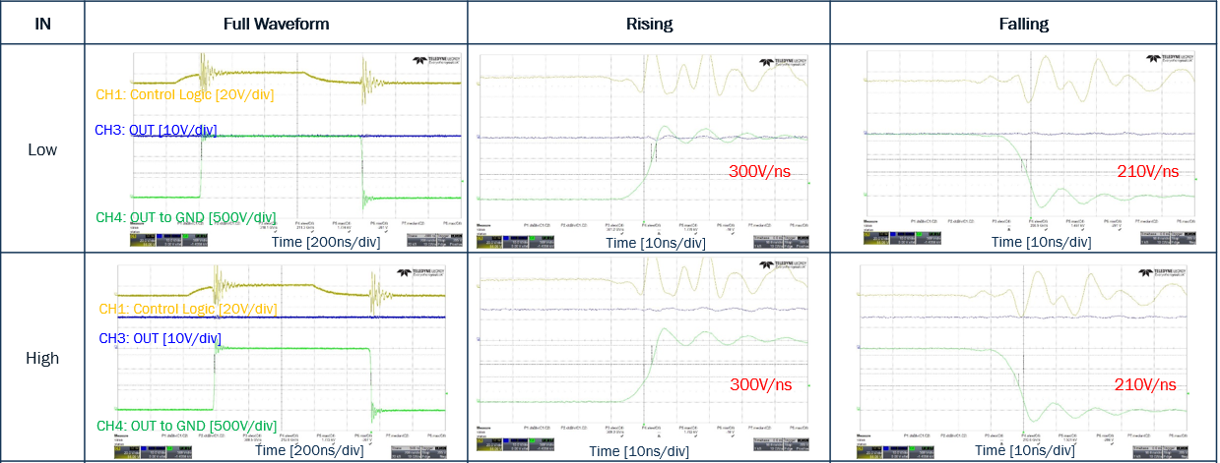
NCP51561 – CMTI Characteristics
We can ensure no failures up to 210V/ns globally. Rising pulse : 5 ~ 300V/ns,
Falling pulse : 15 ~ 210V/ns
※ See the dynamic CMTI
(※ All waveforms are referenced to VSS)

Slide 16
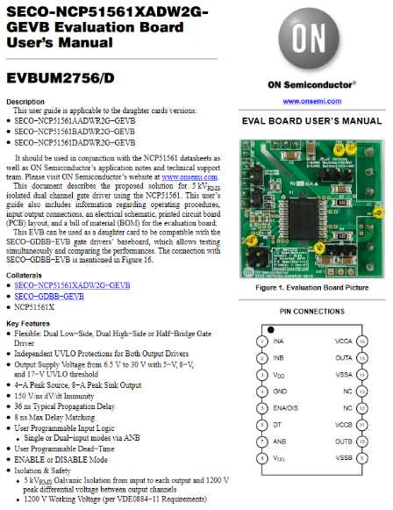
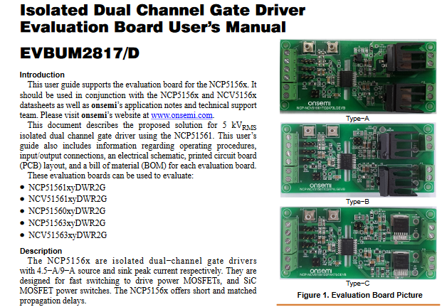

NCP51561 – Evaluation Boards
NCP51561

Slide 17
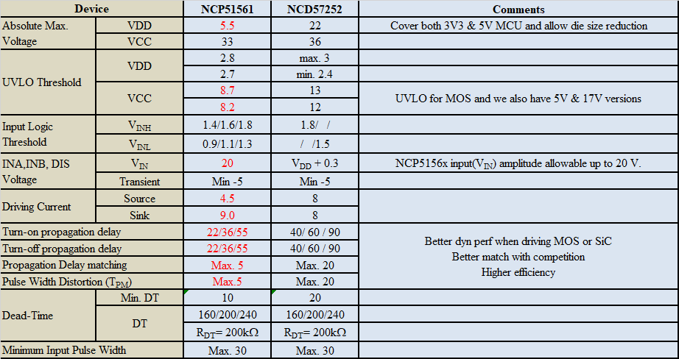
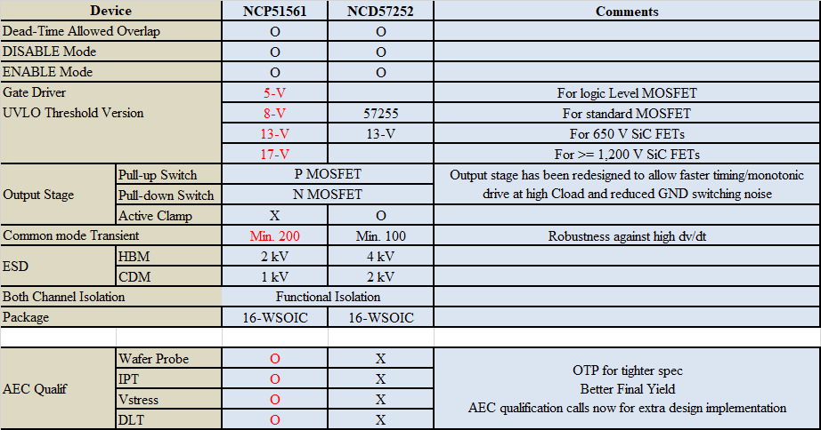
NCP5156x versus NCD5725x
Higher switching performance – Better fit for MOS & SiC

Slide 18
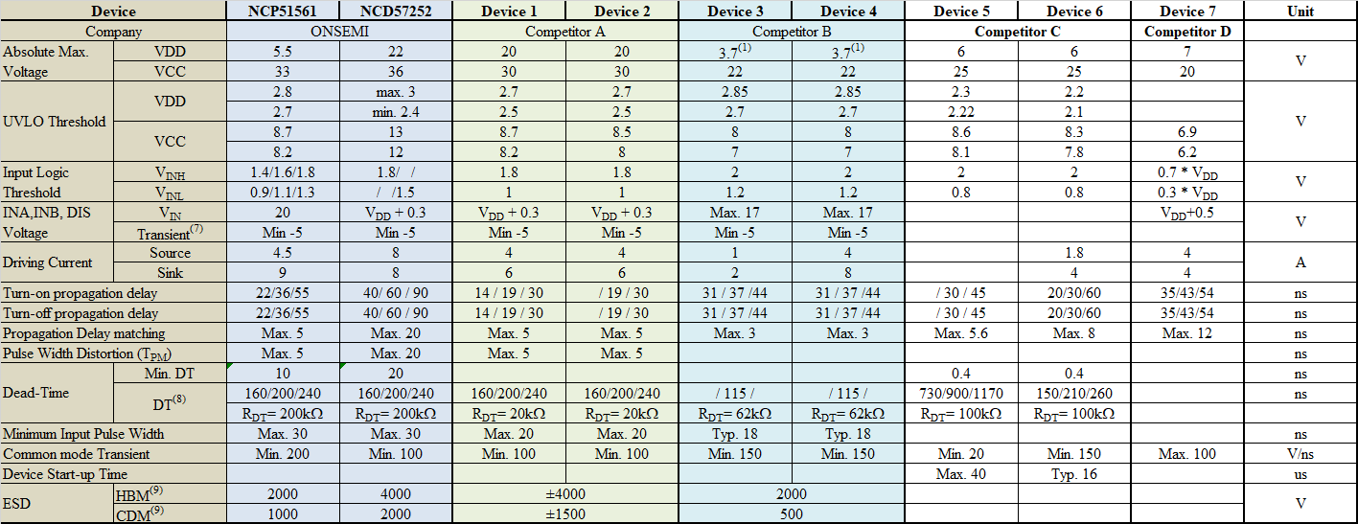
NCP/NCV5156x Competitive Landscape

Slide 19
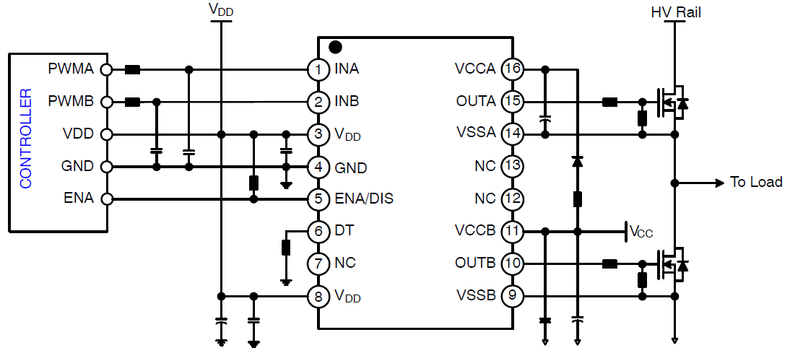
NCP51560 – 5 kV Isolated High-Speed Dual MOS/SiC Drivers
The NCP51560 is isolated dual-channel gate driver with up to 4.5-A/9-A source and sink peak current. It is designed for fast switching to drive power MOSFETs power switches.
The NCP51560 offers short and matched propagation delays. Internal functional isolation between the two secondary-side drivers allows a working voltage of up to ~1,200 VDC. The NCP51560 offers other important protection functions such as independent under-voltage lockout for each drivers and disable function.
Input side isolated from output drivers
by 5-kVRMS isolation barrier
38 ns Prop Delay & 5 ns Delay Match
>= 200 V/ns dV/dt Immunity
4.5-A/9-A Typical Source/Sink Current Capability
Give reliable operation and safety
Efficient switching
High Robustness
Driver to accommodate diff MOS load
Industrial pin to pin compatibility
Matched Propagation Delays : Max. 5 ns
User Programmable Input Logic
  Dual-input modes
  DISABLE mode
User Programmable Dead-Time Control
Different UVLO options: 8-V & 17-V (5 & 13 V On demand)
Improved negative immunity in INA & INB
Sampling Now
RTM : March-2022
Isolated Converters in Offline AC-to-DC Power Supplies
Motor Drive and DC-to-AC Solar Inverters
HEV and EV On-Board chargers
SOIC-WB16
OPN : NCP51560BBDWR2G
NCP51560DBDWR2G
x: UVLO level
y: Enable/Disable

Slide 20
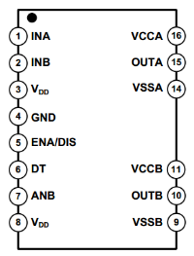
NCP/NCV51563 – Isolated Dual MOS/SiC Drivers with 3.3mm creepage
The NCP51563 are isolated dual-channel gate driver with up to 4.5-A/9-A source and sink peak current. It is designed for fast switching to drive power MOSFETs power switches.
The NCP51563 offers short and matched propagation delays. Internal functional isolation between the two secondary-side drivers allows a working voltage of up to ~1,200 VDC. The NCP51563 offers other important protection functions such as independent under-voltage lockout for each drivers and disable function.
Input side isolated from output drivers
by 5-kVRMS isolation barrier
Increased Channel-to-Channel Spacing
36ns Prop Delay & 8ns Delay Match
>= 200 V/ns dV/dt Immunity
Typical Source/Sink Current Capability of 4.5-A/9-A
Give reliable operation and safety
3.3 mm for higher functional isolation up to 1850-V
Efficient switching
High Robustness
Strong Driver to optimize losses
Higher creepage distance between channel offers better immunity in polluted environments
Matched Propagation Delays : Max. 15 ns
User Programmable Input Logic
Single or Dual-input modes via ANB
DISABLE or ENABLE mode
User Programmable Dead-Time Control
Different UVLO options: 5-V,8-V & 17-V
Sampling Now
NCP RTM : April-2022
NCV RTM : Q2-2022
Isolated Converters in Offline AC-to-DC Power Supplies
Motor Drive and DC-to-AC Solar Inverters
HEV and EV On-Board chargers
SOIC-WB14 with high DTI
OPN : NCP51563xyDWR2G
x: UVLO level
y: Enable/Disable

Slide 21
NCP/NCV51563 Competitor’s offer coverage

Slide 22
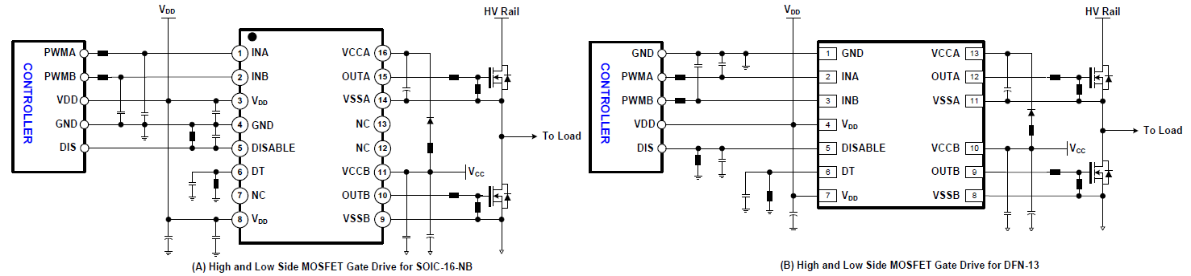
NCP51562 – 2.5 kVRMS 4.5-A / 9-A Isolated Dual Channel Gate Driver
The NCP51562 is isolated dual-channel gate drivers with 4-A/6-A source and sink peak current respectively. They are designed for fast switching to drive power MOSFETs and SiC MOSFET power switches. The NCP51562 offers short and matched propagation delays
3 kVRMS and 2.5 kVRMS internal galvanic isolation from input to each output for 16-SOIC-NB and LGA-13 package respectively
CMTI >100 V/ns
VDD up to 20 V
Give reliable operation and safety
Efficient switching
High Robustness
Driver to accommodate diff MOS load
Small package to save PCB space
High peak output current 4 A/-6 A
Extended positive voltage rating for efficient SiC MOSFET operation during the conduction period
Different UVLO options : 5 V/8 V
Sampling Q2-23
Server, Telecom and Industrial Infrastructures
UPS and Solar Inverters
Motor Drives
Isolated Converters in Higher Performance PFC, DC-DC and AC-DC Power Supply
LGA-13 / SOIC-16 NB
OPN : NCP51562xMNTWG
NCP51562xDR2G
x: (B/D) UVLO Level

Slide 23
Isolated Drivers Selection Guide

Slide 24
Isolated Drivers Roadmap
Existing
Developing
Planning
ONC25 + GI V1₊
ONC25 + GI V1₊ ONC25 + GI V2
Full Features & Performances
SiC GaN
NCP/NCV51753 (SGL SiC)
NCP51752 in SOIC-8 WB
NCP/NCV51752 (SGL SiC)
Gen1+ + DRIVER With Neg Bias – SOIC-8 NB
Performance
1-Ch 2-Ch
NCP51560 (4.5/9A)
NCP51561 with Pin #7 NC
NCP/NCV51564 (4.5/9A)
NCP51560 die in SOIC14WB
NCP/NCV51563 (4.5/9A)
Gen 1+ GI MOS DRIVERS-SOIC14WB
NCP/NCV51561 (4.5/9A)
Gen 1+ GI MOS DRIVERS-SOIC16WB
NCP51562
Gen 2 GI/Sgl Xmer MOS drivers in LGA5x5 & SOIC16NB
NCP/NCV51157 (4.5/9A)
Gen 1+ GI + DRIVER- SOIC8-WB
NCP/NCV51152 (4.5/9A)
Gen 1+ GI + DRIVER- SOIC8-NB
Existing
2022
2023-25

Slide 25
Isolated Gate Drivers Value Proposition
Performance:
  30% faster propagation delay and CMTI up to 200V/ns
  New GI structure with CMTI above 200V/ns and tighter dynamic spec in 2022
Reliability & Robustness:
  DESAT, Adj UVLO, TSD, Neg. Ch. Pump, I2C , FLT, Enable
  Embedded Vstress and IPT
  Low pulse-width distortion, Low part-part variation in delay times
Cost/Convenience:
  Simplified BOM due to high integration
  Elimination of buffers for most applications
  Dedicated features for each power switch type

Slide 26
Thank you – Stay Tuned
PCS Gate Driver Product Line Managers
Marc Barboni (marc.barboni@onsemi.com)
Steve Yoo (steve.yoo@onsemi.com)

