Slide 1
Global Strategy Focus Area Map
PSG Lead
ASG Lead
ISG Lead
AMR | EMEA | APAC
1) PoE, Smart Building and Connected Lighting (Ale)
2) USB Type-C Solutions (Jagger)
Brushless DC Motor Control
UHD Power Conversion
Silicon Carbide
3) Wireless Connectivity vs. Coin Cell Battery Life (Bob)
4) Voice user Interface (VUI) Bob | 5) Industry 4.0 / Factory Automation (Ale) | 6) 5G Telecom Power/Small Cell/Edge Computing (Jagger)
AR0234CS Image Sensor – (Robotics, Future Retail, Surveillance, Biometrics)
VEGA Image Sensors – (Robotics)
XGS Image Sensors – Industrial Robotics, ITS, Manufacturing, Failure Analysis)
 |  | 7) Body Control Modules (Minsu)

Slide 2
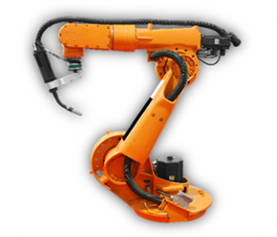
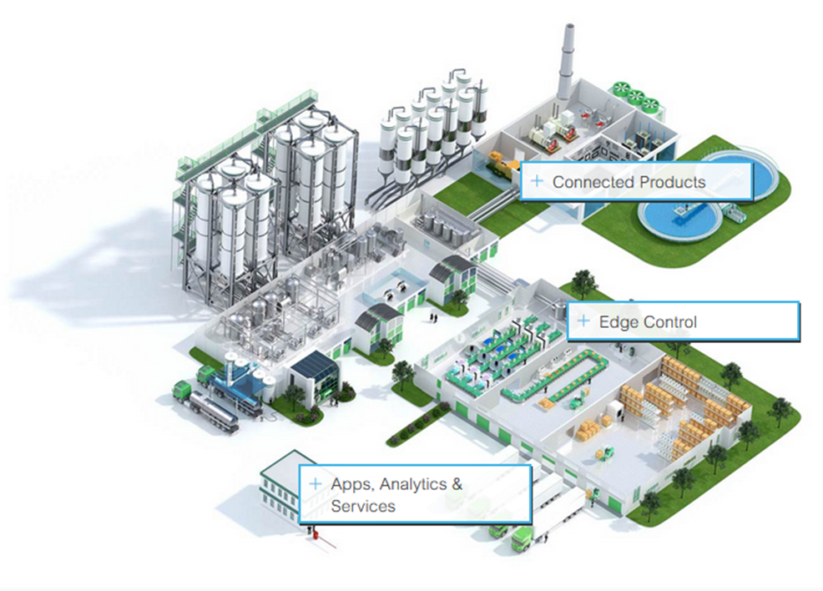
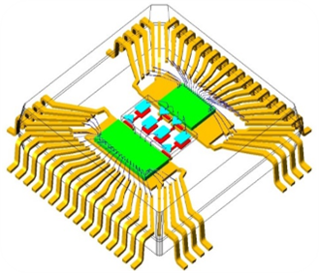
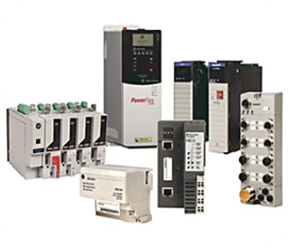
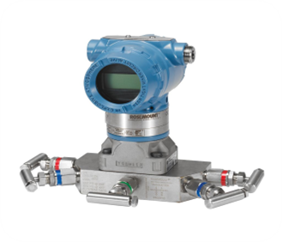
Value Proposition: Industry 4.0 Factory Automation
Position Sensor (Palawan)
Enabling I4.0 with sensing, processing and networking solutions for the next generation of industrial applications
Industrial Ethernet (Cascade)
Isolated Controller (Naya Controller)
Significant growth of semiconductor demand in industrial market to support higher connectivity, sensing, and computation to the edge
Industry 4.0 Digital and MS ASICs
Edge-Node Sensing & Processing
Replacement of optical position sensors with a more robust solution at less than half the cost and multi-drop Ethernet communication using existing twisted-pair wire infrastructure. BOM, complexity and area reduction

Slide 3
Industry 4.0 and Factory automation
Target Segments & Applications
Industry 4.0: Process and Factory automation
Launch Date
Q4’21
Key Technologies
Rotary Position Sensor Encoder NCS32100 Linear Position Sensor Encoder NCS32200 Industrial Ethernet 10Base-T1S NCN2600x Isolated Controller Naya Controller
ASG Marketing Owner
Alessandro Maggioni
Regional Focus
EMEA
Value Proposition
Replacement of optical position sensors with a more robust solution at less than half the cost and multi-drop Ethernet communication using existing twisted-pair wire infrastructure. BOM, complexity and area reduction
Competitive Landscape
Objectives & KPIs
Inform the Channel that we have the full solution for Industry 4.0 application tying it all together Motion, Power Increased design-in activities (increased registrations). Deep campaign and dedicated promotion with the main Channel partners .
Support/Resources/Collateral Available
BU is working on EVBs, Reference Designs, User’s Manuals, etc. White papers
Support/Resources/Collateral Needed
Experts identified and trained at each participating channel partner Recorded FAE and Sales trainings Application notes Articles and blogs

