Slide 1
C & J Series SiPM Technology & Markets
onsemi Depth Sensing
June 2022

Slide 2
Introduction & Target Markets

Slide 3
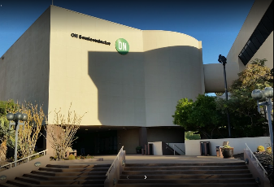
Depth Sensing Division, ISG
ON Semiconductor HQ
Phoenix, AZ
Hassane El-Khoury, CEO
Analog Solutions Group (ASG)
Power Solutions Group (PSG)
Intelligent Sensing Group (ISG)
Industrial & Consumer Solutions Division (ICSD)
Corporate Marketing
Sales
Finance
Mfg/Ops
Corporate R&D
Automotive Sensing Division (ASD)
Depth Sensing Division
SensL Technologies, now Depth Sensing Division, was acquired by ON Semiconductor May 2018
Independent division within Intelligent Sensing Group (ISG) focused on Medical Imaging and LiDAR solutions
Division engineering remains in Cork Ireland
Leveraging resources of all 34,000 ON employees
World HQ
Phoenix, AZ USA
ISG HQ
Santa Clara, CA USA
Depth Sensing Division HQ
Cork, Ireland

Slide 4
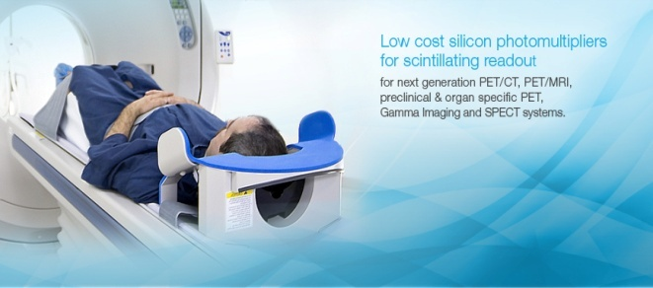
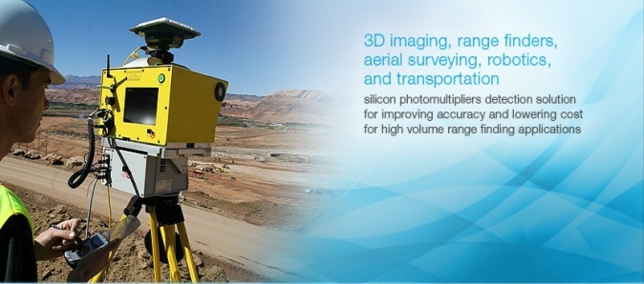
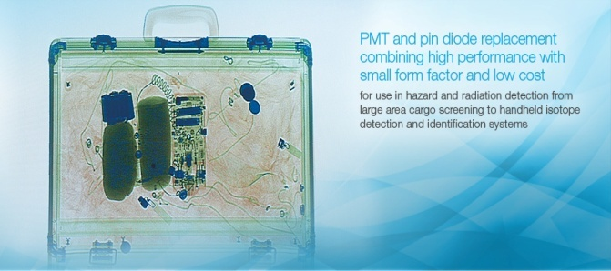
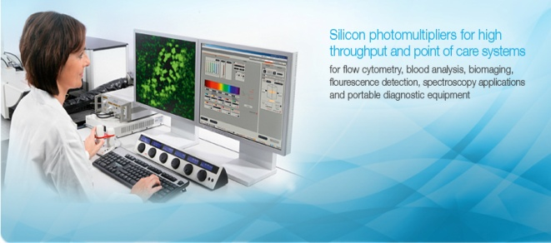
Target Markets Overview
Medical Imaging PET, SPECT, PET-CT, PET-MR, Bone densitometry, Surgical probes
Automotive and Industrial Advanced Driver Assist Systems, Laser Range Finding, Robotic Automation
(likely more relevant to R-Series Products)
Hazard and Threat Detection Radiation Detection, Contraband Detection, Cargo Scanning, Contamination Monitors
Biophotonics
Haematology, Flow Cytometry, DNA Analysis, Continuous Glucose Monitoring

Slide 5
Established Markets
Medical Imaging
Radiation Detection

Slide 6
SiPM Technology

Slide 7
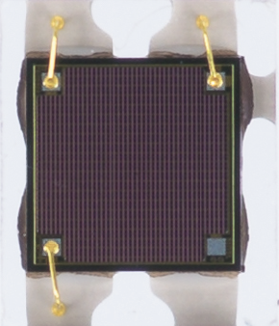
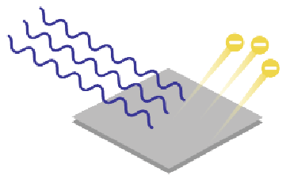
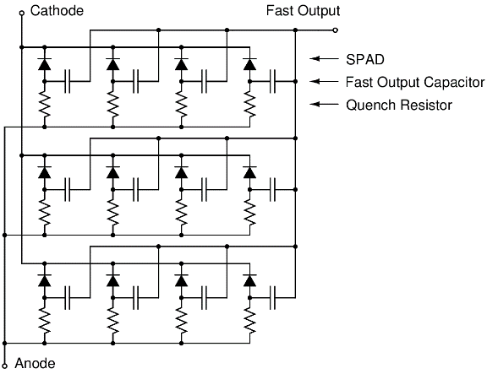
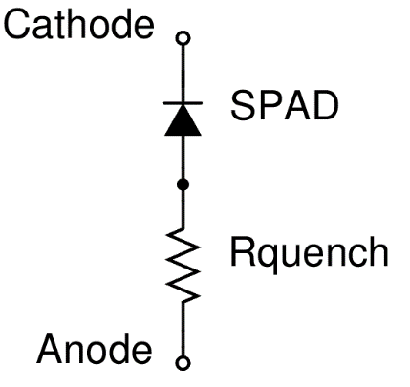
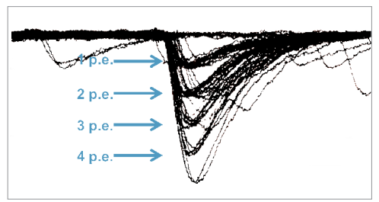
What is a SPAD/SiPM?
Used to time or count photon arrival
Sensitive to single photons from 200nm to 1000nm (silicon)
Critical figures of merit:
Photon Detection Efficiency (PDE)
Dark Count
Gain/Responsivity
Operating Voltage
Temperature Coefficient
Sensor Uniformity
Depth Sensing SPAD/SiPM lead in all categories & are widely adopted in multiple markets today
MicroRB-10020-MLP
SiPM Sensor (1590 element SPAD Array)
Photons detected by a SPAD
produce a measurable current pulse
SiPM example created from a 12 microcell SPAD array
Single SPAD based microcell
SPAD/SiPM time or count multiple photons

Slide 8
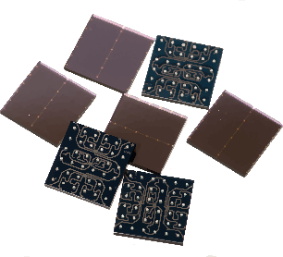
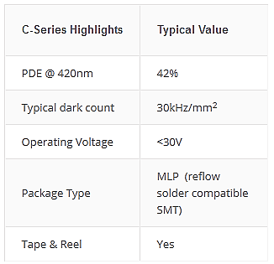
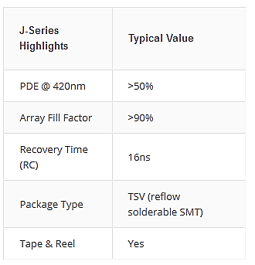
Blue Sensitive SiPM Families
C-Series
J-Series
High volume, low noise, MLP package
Highest PDE and timing resolution, TSV package

Slide 9
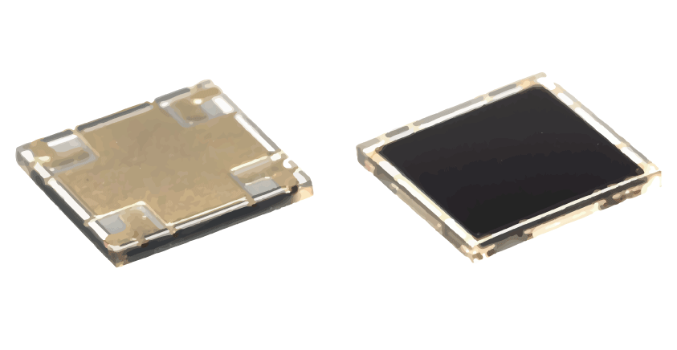
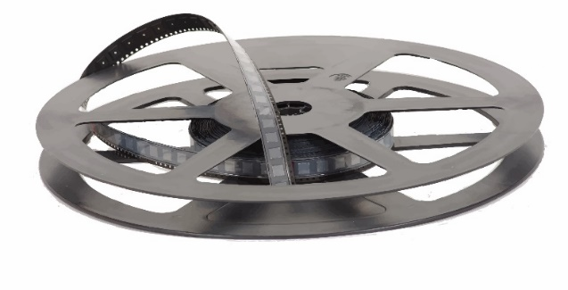
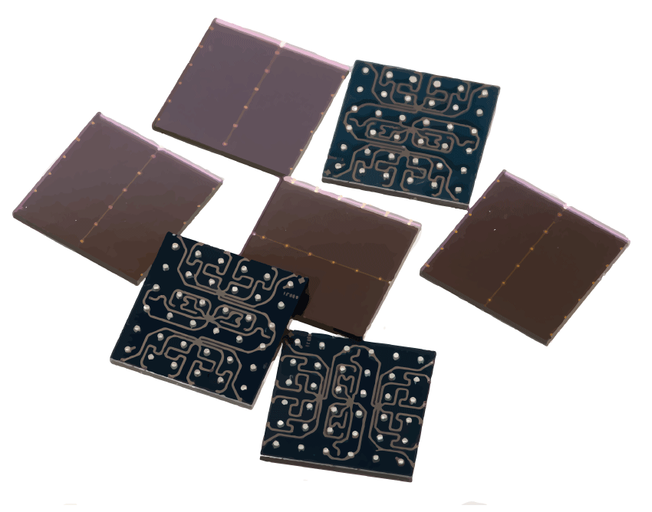
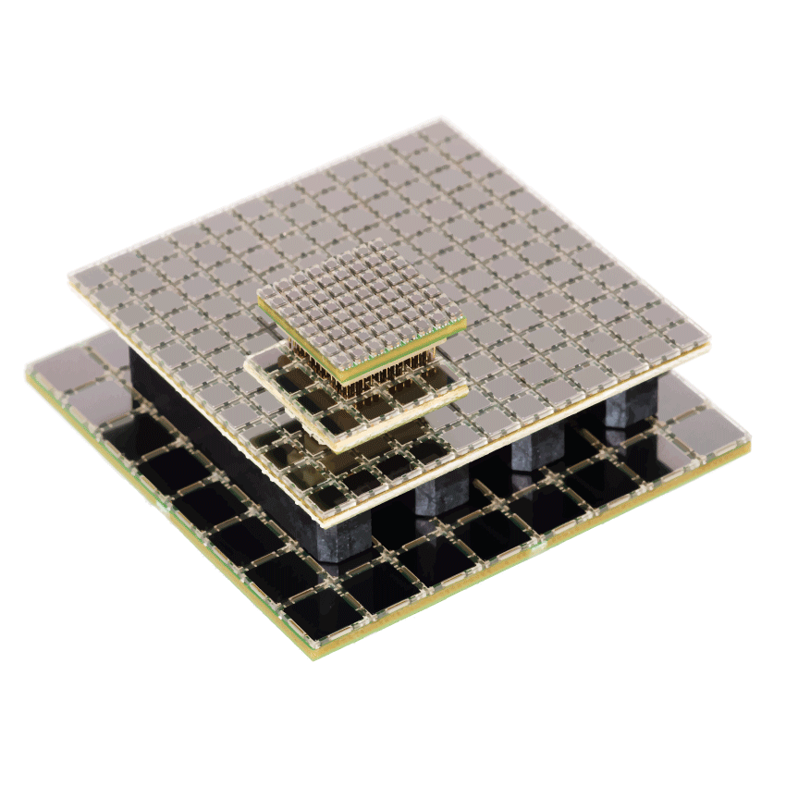
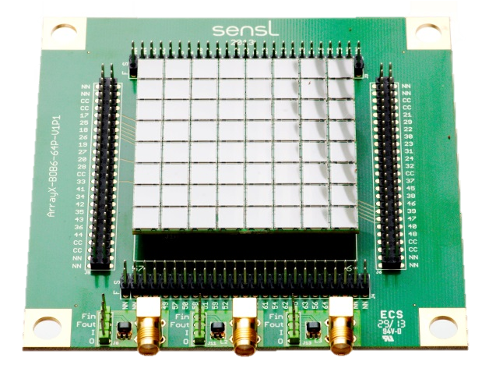
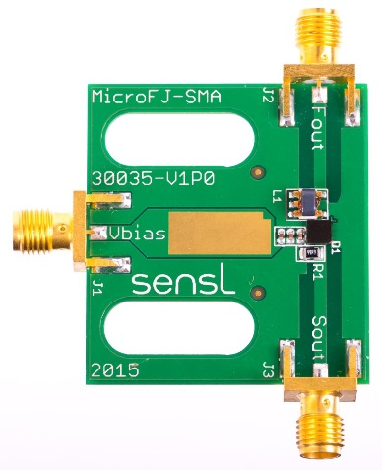
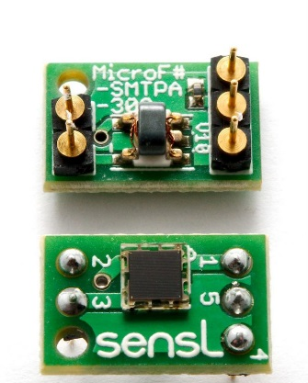
Depth Sensing Division C & J Series SiPM Product Portfolio
C-Series & J Series SiPM
Standard Arrays
Evaluation

Slide 10
C & J Series Overview

Slide 11
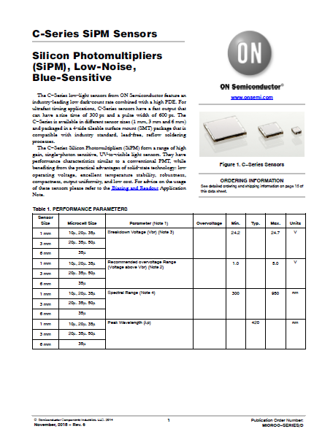
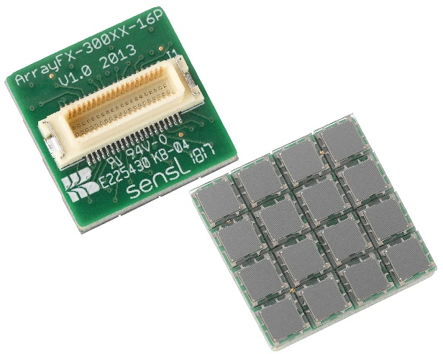
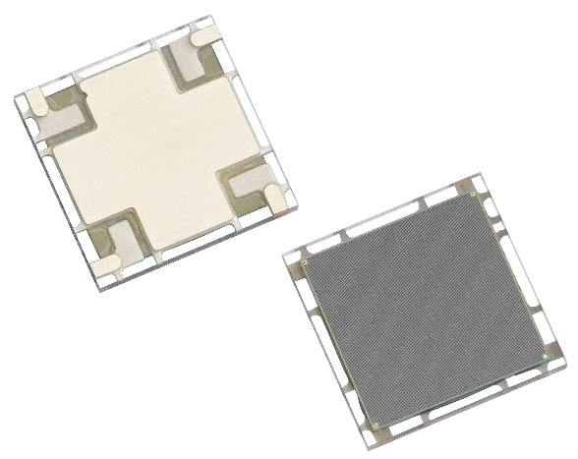
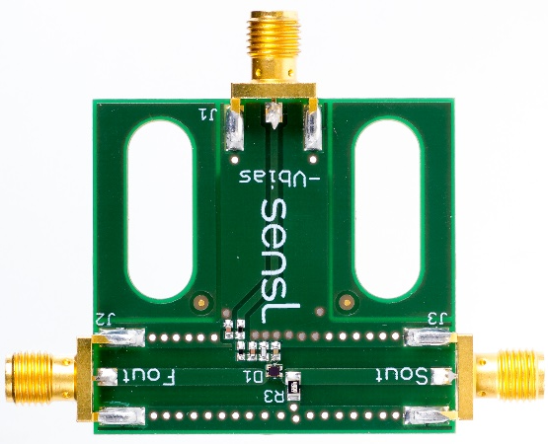
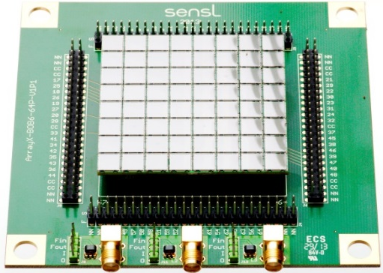
C-Series SiPMs
Blue sensitive (420 nm peak) SiPM, with high PDE and lowest dark count
Available in 1 mm, 3 mm and 6 mm sizes
Various microcell sizes from 10 mm to 35 mm
Robust, low cost MLP package
Single pixels
Evaluation board
Array
Array breakout board

Slide 12
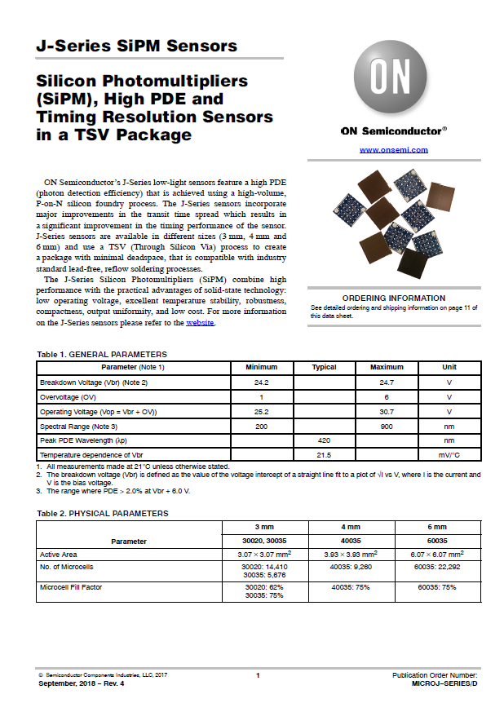
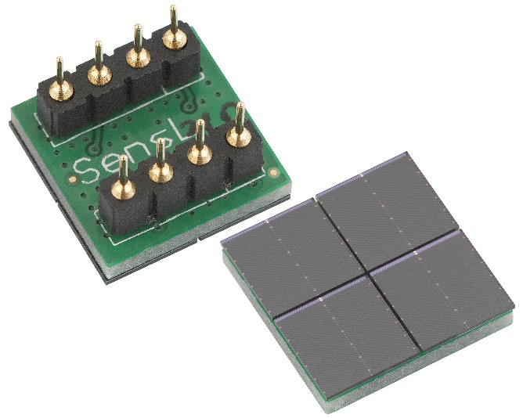
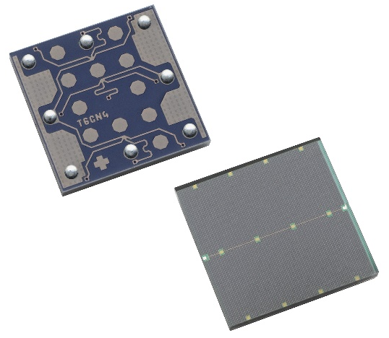
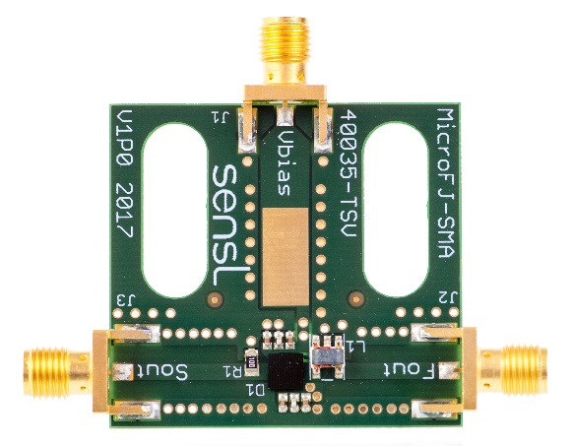
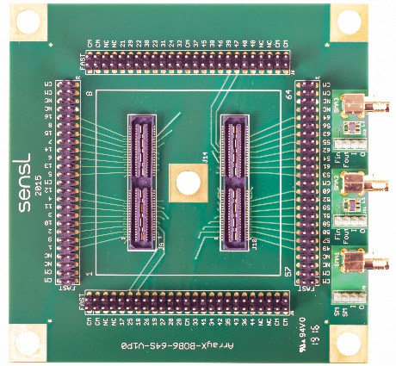
J-Series SiPMs
Blue sensitive (420 nm peak) SiPM, with highest PDE and low dark count
Available in 3 mm, 4 mm and 6 mm sizes
35 mm cells size
Compact, low dead space TSV package
Single pixels
Evaluation board
Array
Array breakout board

Slide 13
SiPM Array Technology

Slide 14
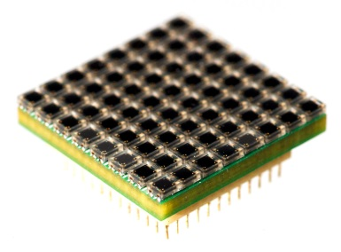
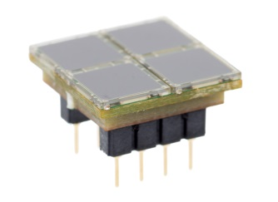
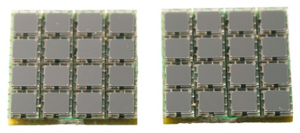
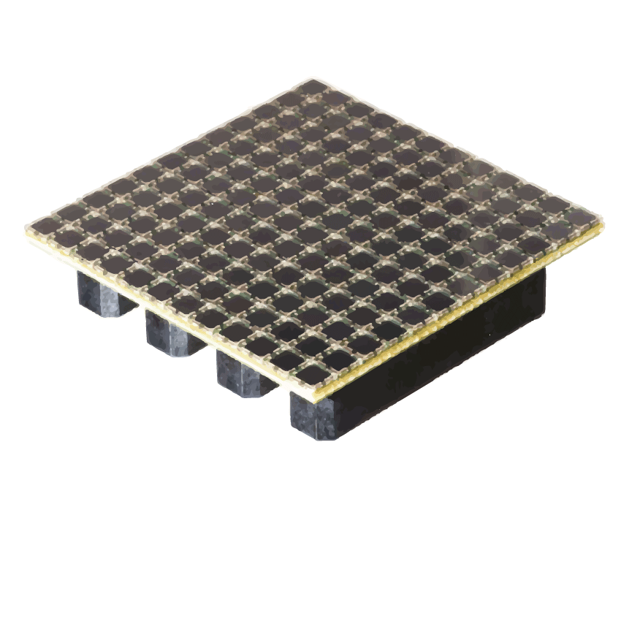
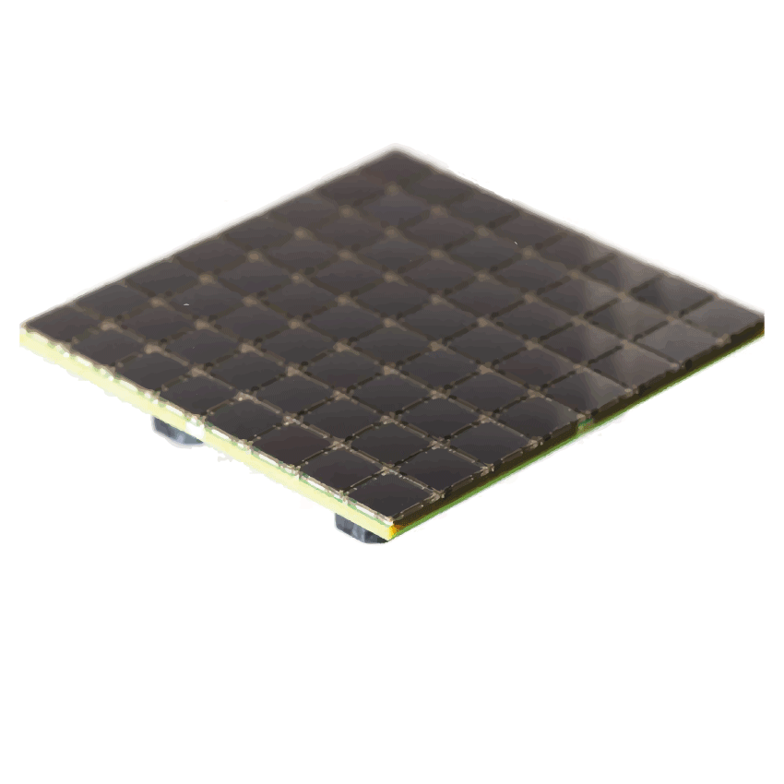
C-Series SMT Array Variants
Available for rapid testing
8x8 of 1mm SMT/MLP
1.7mm pitch
4x4 of 3mm SMT/MLP
4.2mm pitch
12x12 of 3mm SMT/MLP
4.2mm pitch
8x8 of 6mm SMT/MLP
7.2mm pitch
Passive Breakout Board (BoB)
Ability to readout any pixel
3 SMA connection options
Full Reference Design Available
8x8 of 1mm (2.49 cm²)
4x4 of 3mm (2.74 cm²)
2x2 array of
6x6mm MLP
12x12 of 3mm (25.2 cm²)
8x8 of 6mm (32.94 cm²)

Slide 15
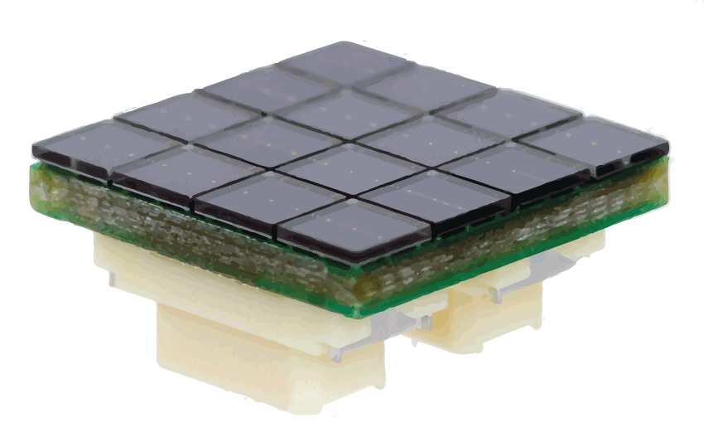
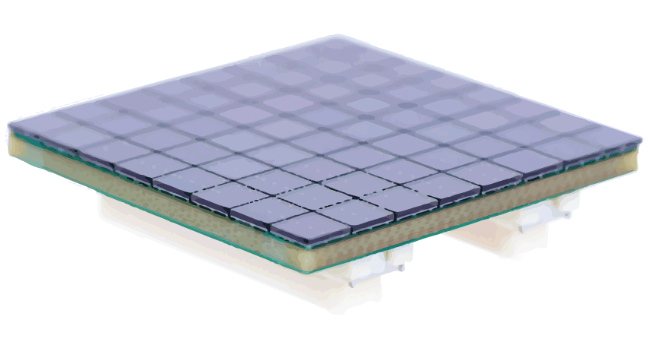
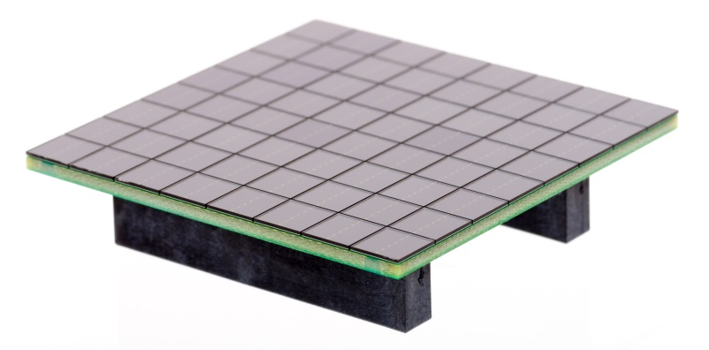
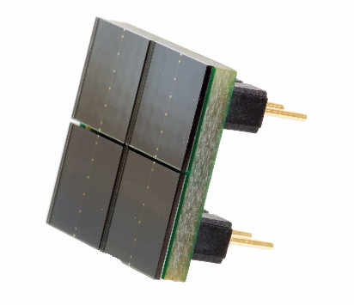
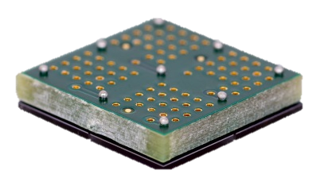
J-Series TSV Array Variants
Available for rapid testing
8x8 of 3mm TSV
3.3mm pitch
4x4 of 3mm TSV
3.3mm pitch
2x2 of 6mm TSV (BGA & pin)
6.3mm pitch
8x8 of 6mm TSV
6.3mm pitch
Passive Breakout Board (BoB)
Ability to readout any pixel
Summed variant available
4x4 of 3mm TSV
8x8 of 3mm TSV
8x8 of 6mm TSV
2x2 of 6mm TSV (BGA & pin variants)

Slide 16
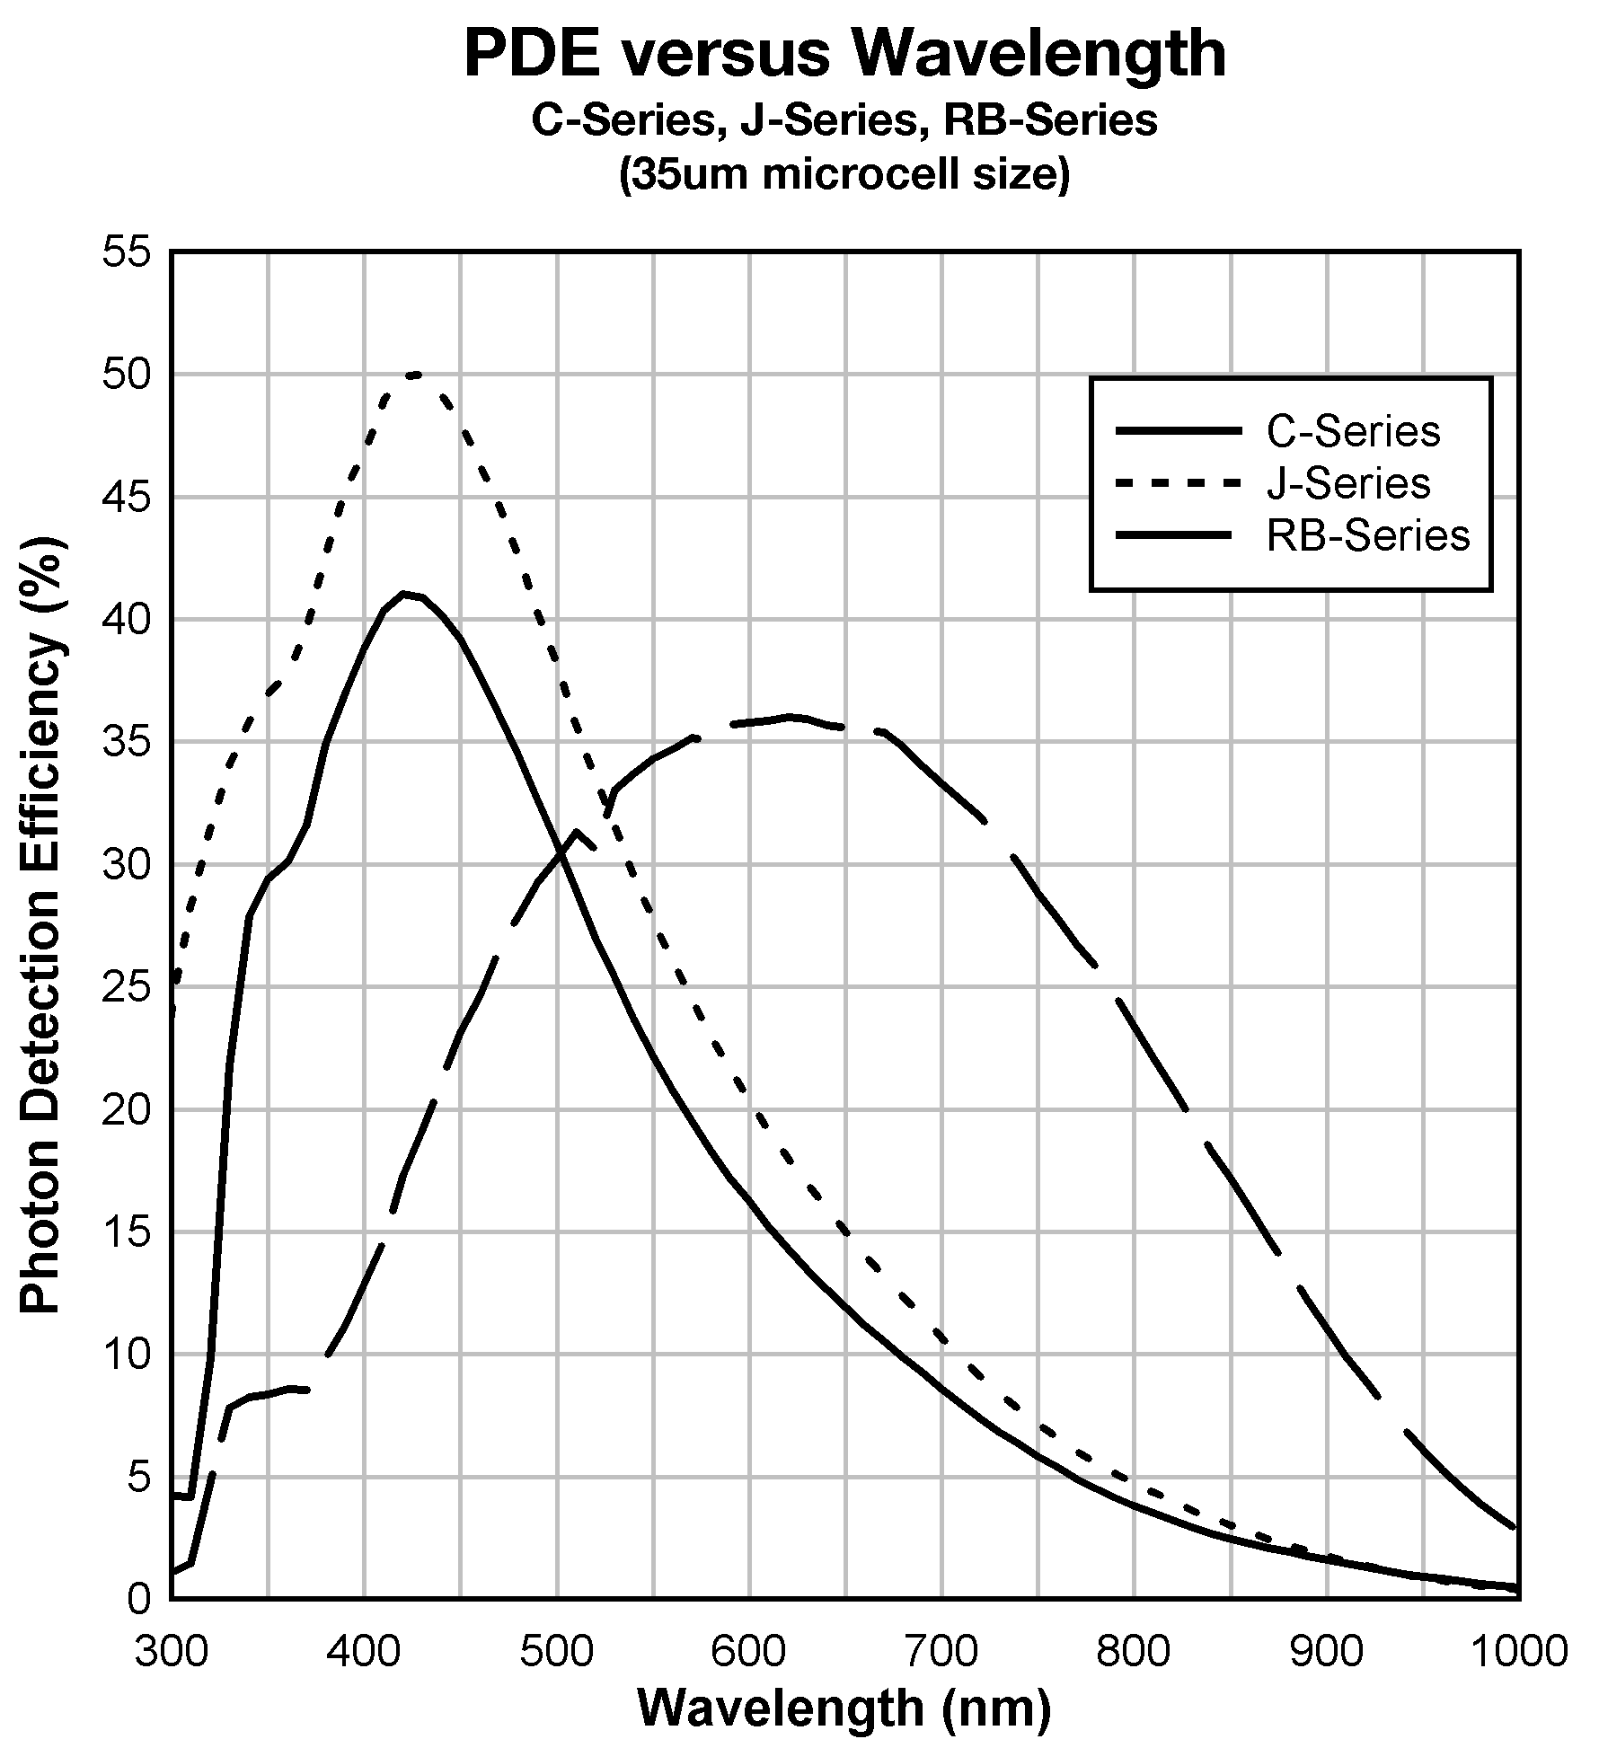
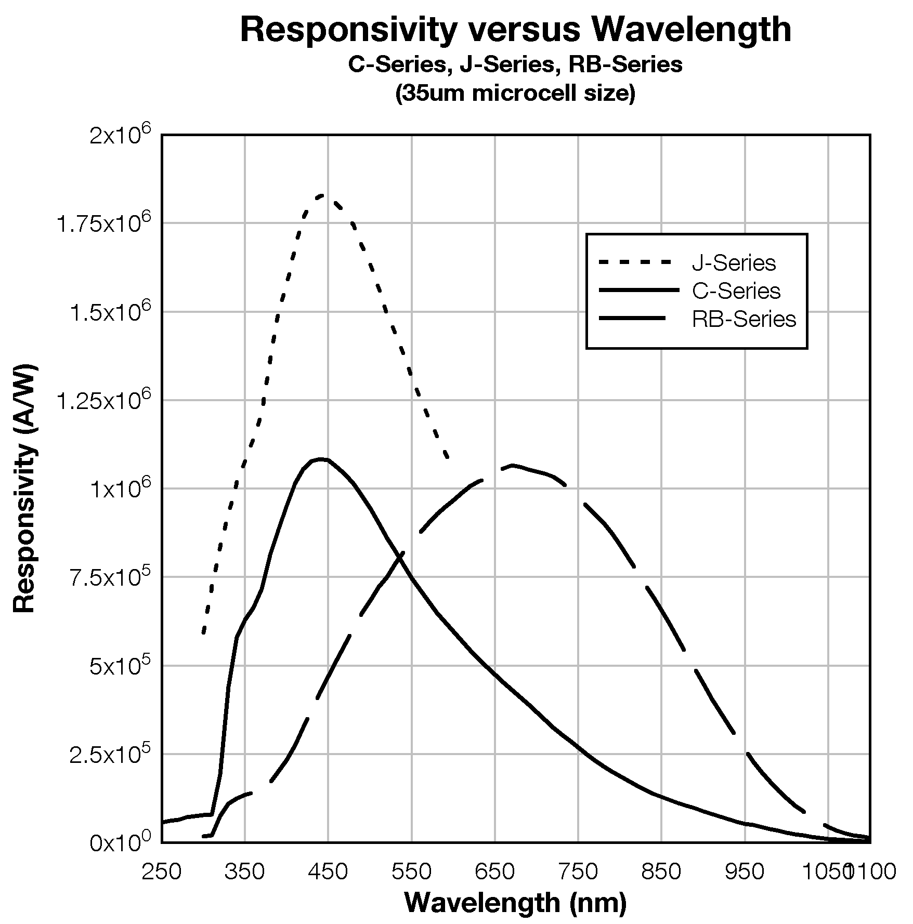
C-Series, J-Series, R-Series PDE Comparison

Slide 17
Sample Applications for C & J Series

Slide 18
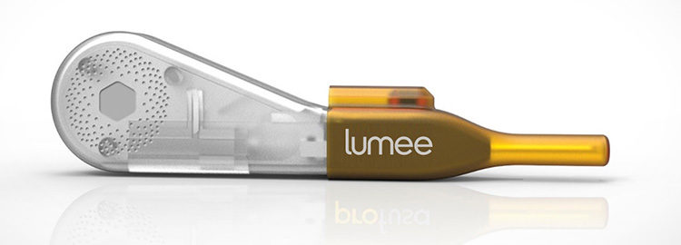
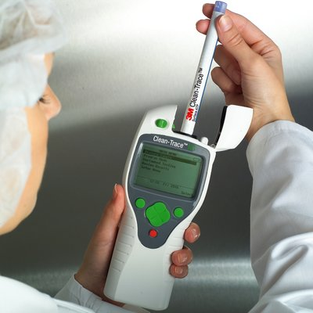
Biophotonic Applications
Depth Sensing division detectors are attractive to numerous biophotonic analysis applications where legacy detectors are unsuited, including:
Flow cytometry
Continuous glucose monitoring (CGM)
Blood oxygen (pulsed oximeter) systems
Kidney function monitors
Fluorescence analysis
Luminometers
Particulate analysis
DNA analysis
Retinal Scanning
Microscopy

Slide 19
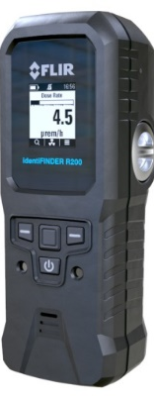
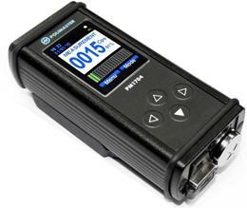
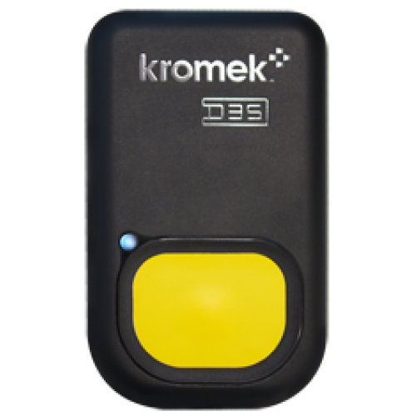
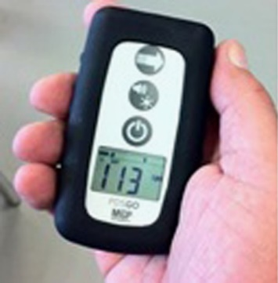
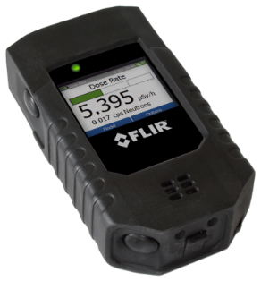
Gamma Radiation Detection
SPRD – Spectroscopic Portable Radiation Detector
Based on scintillation detector – CsI(Tl), NaI(Tl), CeBr3 crystal etc + photodetector
Some models based on CZT (direct detection)
Some include He3-based systems or Li-6 scintillation materials for simultaneous neutron detection
Required energy range – from around 30keV to around 3 MeV typically
Temp operating range -20C to +50C typically
CZT systems can provide around 3.5% FWHM at 662keV, but CsI(Tl) are around 6-7% FWHM typically
Wireless connectivity often use, long battery life desirable
Several examples of typical SPRDs are shown below

Slide 20
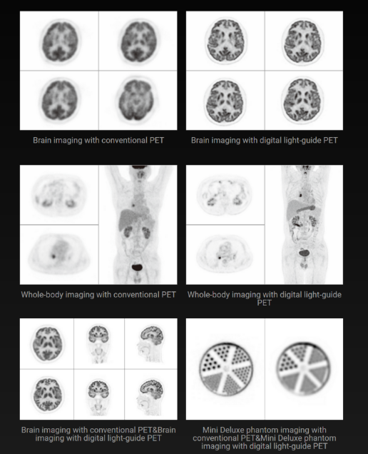
Cancer Detection - Positron Emission Tomography (PET)
Major design win with leading Chinese medical imaging customer, United Imaging Healthcare
Market Trend: SiPMs are replacing old Photomultiplier Tube (PMT’s) in all new PET designs

Slide 21
PET Detector Block
Array of SiPMs
30,000 SiPMs are in a full body PET scanner

Slide 22
Medical Imaging
World’s first total-body PET/CT system
UC Davis, LBNL, U Penn
5 year, $15.5M program awarded 2015
Industry partners announced January 2017
United Imaging Healthcare
SensL Technologies / ON Semiconductor
Depth Sensing Division Sensors
MicroFJ-30035-TSV
53,760 SiPM
First human scan in Sept 2018
Nature article over published June 2019

Slide 23
Key SiPM Parameters for Nuclear Imaging
High PDE at the desired wavelength
More efficient photon detection reduces timing uncertainty
Signal rise time and recovery time
Short rise time for better CRT
Faster recovery time for DR and to allow high event rate (NEMA standard)
Low noise
Excess noise affects energy resolution and CRT
Package and form factor
Sensor or array size should match scintillator dimensions
SiPM must be optically coupled to scintillator
Temperature stability
Products for Nuclear Imaging
J-Series SiPM
C-Series SiPM
SiPM Arrays

Slide 24
Quality & Reliability

Slide 25
SiPM Shipment – Tape & Reel
Tape & Reel
1mm MLP
3mm MLP
6mm MLP
All parts shipped as tape and reel in moisture barrier bag to J-ST 033
MSL=3 reflow solder compliant
All parts ship 3000 units per tape
1mm on 7” diameter (8mm width)
3mm on 13” diameter (12mm width)
6mm on 13” diameter (16mm width)
Full SMT Handling Guide & Array Reference Design available
J-Series now shipping on Tape & Reel
Cut Tape

Slide 26
SPIE Publication
Citation:
Carl Jackson ; Kevin O’Neill ; Liam Wall and Brian McGarvey "High-volume silicon photomultiplier production, performance, and reliability", Opt. Eng. 53(8), 081909 (Aug 15, 2014). http://dx.doi.org/10.1117/1.OE.53.8.081909

Slide 27
Reliability Test of Silicon
All stress and test steps were carried out as per Joint Electron Device Engineering Council (JEDEC) standard conditions – JESD22-A108D “Temperature, bias and operating life”

Slide 28
Additional SiPM Temperature Stress Details
1000hr @ 85˚C
1000hr @ 105˚C
No change in optical performance for 85˚C and 105 ˚ C 1000hr temperature stress.
All data within PDE measurement system error.

Slide 29
Evaluation Boards & Documentation

Slide 30
C & J-Series SMA / SMTPA Test Boards
3x3mm Sensors
C-Series SMTPA Test Board
J-Series SMA Test Board

Slide 31
Useful Application Notes
Building Arrays of SiPM Array Readout Methods Scintillator Coupling

