Slide 1
FAN73912, FAN73912A – 1200V Half-Bridge, High & Low side Gate Driver IC
2022

Slide 2
Contents
1. 1 Pager & Comparison table
2. Key Features and Applications
3. Pin Configuration
4. Typical Application Circuit
5. Timing Diagram
6. Shoot-Through Prevention
7. Advanced Input Filter (HIN,LIN)
8. Promotion Tool [EVB]
9. Benchmarking vs. I-Product
10. What is Considering points for COM-VSS Immunity?
11. Design recommendation
Appendix : Test condition for COM-VSS Immunity

Slide 3
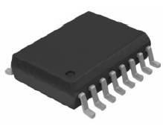
FAN73912 : 1200 V 2A/-3A Half-bridge Gate Driver IC
The FAN73912 is a monolithic half bridge gate-drive IC designed for high-voltage and high-speed driving for MOSFETs and IGBTs that operate up to +1200 V
  Separate logic supply(VDD) from 3 V to 20 V
  Built-in advanced input filter
  Shoot-through prevention
Strong immunity for dVs/dt
Adjustable input threshold
Reliable design
Gate driver supply(VCC) range from 12 V to 20 V
Cycle-by-cycle edge-triggered shutdown logic
UVLO functions for VDD/VBS
Matched propagation delay below 50 ns
Outputs in-phase with input signal
Logic and power ground +/- 10 V offset
Typical 330ns dead-time
Industrial Motor Driver
UPS & Solar Inverter
Ballast
Half-bridge Converter
FAN73912MX : SOICW-16

Slide 4

FAN73912A : 1200 V 2A/-3A High & Low Side Gate Driver
The FAN73912A is a monolithic high and low-side gate-drive IC designed for high-voltage and high-speed driving for MOSFETs and IGBTs that operate up to +1200 V
  Separate logic supply(VDD) from 3 V to 20 V
  Built-in advanced input filter
  W/O Shoot-through prevention
Strong immunity for dVs/dt
Adjustable input threshold
Reliable design
Gate driver supply(VCC) range from 12 V to 20 V
Cycle-by-cycle edge-triggered shutdown logic
UVLO functions for VDD/VBS
Matched propagation delay below 60 ns
Outputs in-phase with input signal
Logic and power ground +/- 10 V offset
Electrical Contactor
Industrial Motor Driver
UPS & Solar Inverter
Ballast
Half-bridge Converter
FAN73912AMX : SOICW-16
SOICW-16

Slide 5
Comparison Table
※ All voltage parameters are absolute voltages referenced to COM unless otherwise specified.
Similar Spec.
Differentiated Spec.
Blue : Better Spec.
 | Competitor | FAN73912A
Qual Level | Industrial | Industrial
MSL | 3 | 3
Output Phase | In Phase with Input | In Phase with Input
Package | 16 Wide-SOP | 16 Wide-SOP
Channels | 2 | 2
Two stage turn-on for di/dt control | NO | NO
Shoot-Through Prevention | NO | NO
Shut down | YES | YES
VDD for Logic supply | YES | YES
VIH @ VDD=15V [V] | Min 9.5 | Min 9.5
VIL @ VDD=15V [V] | Max 6.0 | Max 6.0
 | Competitor (Referenced to T_{A}@25℃) | FAN73912A (Referenced to T_{J}@Full Temp) | FAN73912 (Referenced to T_{A}@25℃)
Max TJ | 125 ℃ | 150 ℃
VB-GND [V] | Max 1225 @ T_{A}=25℃ | Max 1225 @ T_{J}=25℃ Max 1225 @ T_{J}=150℃ Max 1100 @ T_{J}=-40℃
Advanced Input filter | NO | Yes (Typ 150ns)
Shoot-Through Prevention | NO | NO | Yes
IO+/IO- [A] | Typ 2.0 / -2.5 | Typ 2.0 / -3.0
VCCUV- / VBSUV- [V] | 7.9/9.3/10.7 | 9.2/10.5/11.4
VCCUV+ / VBSUV+ [V] | 8.7/10.2/11.7 | 9.7/11.0/12.0
VCCUVH/ VBSUVH [V] | Typ 0.9 | Typ 0.5
ILK [uA] | Max 50 | Max 100 | Max 50
IQCC [uA] | Typ 180/ max 340 | Typ 170/ max 350 | Typ 170/ max 300
IQDD [uA] | Typ 15/max 30 | Max 20 | Max 10
IQBS [uA] | Typ 125 / max 130 | Typ 50 / max 100
Separate Power and Logic Ground [V] | Yes (+/- 5V offset) | Yes (+/- 10V offset)
Logic input voltage [V] (HIN, LIN and SD) | Min VSS | Min VSS+VDD-20
Negative Vs [V] | -5V | 8-VCC
T on propagation delay [ns] | Typ 280 | Typ 500 (influenced by Advanced input filter)
Toff propagation delay [ns] | Typ 225 | Typ 550 (influenced by Advanced input filter)

Slide 6
2-1. FAN73912 Key Feature and Applications
Key Features
1200V Off-set
Typically IO+ 2A/ IO- 3A Capability for Both Channels
Gate Driver Supply (VCC) Range from 12 to 20V
Separate Logic Supply(VDD) Range form 3V to 20V
Cycle-by-Cycle Edge-Triggered Shutdown Logic
UVLO Functions for VDD/VBS
Built-in Advanced Input Filter (typ 250ns)
Matched Propagation Delay Below 50ns
Outputs in-Phase with Input Signal
Logic and power ground +/- 10V offset
Shoot-Through Prevention
Applications
Industrial Motor Driver
UPS & Solar Inverter
Ballast
Half-bridge Converter
Block Diagram

Slide 7
2-2. FAN73912A Key Feature and Applications
Key Features
1200V Off-set
Typically IO+ 2A/ IO- 3A Capability for Both Channels
Gate Driver Supply (VCC) Range from 12 to 20V
Separate Logic Supply(VDD) Range form 3V to 20V
Cycle-by-Cycle Edge-Triggered Shutdown Logic
UVLO Functions for VDD/VBS
Built-in Advanced Input Filter (typ 250ns)
Matched Propagation Delay Below 50ns
Outputs in-Phase with Input Signal
Logic and power ground +/- 10V offset
Applications
Electrical Contactor
Industrial Motor Driver
UPS & Solar Inverter
Ballast
Half-bridge Converter
Block Diagram

Slide 8
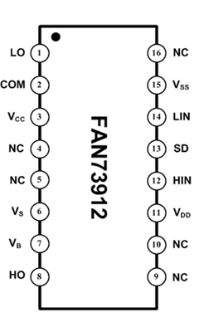
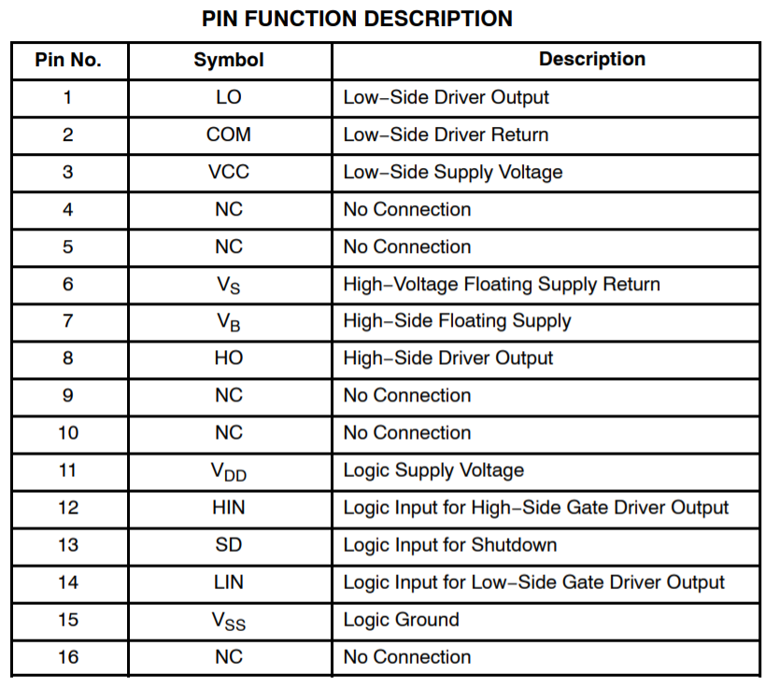
3. FAN73912 & FAN73912A Pin Configuration
※ Same Pin configuration

Slide 9
4. Typical Application Circuit
※Definition for VCC and VDD
VCC: L/S supply voltage of which range is from 12 to 20V. VCC determine the gate driving voltage of IGBT.
VDD: A separated logic supply voltage of which range is from 3 to 20V. VDD determine the threshold level of input signal.
[Table 1] VDD vs. Input threshold
Symbol | Parameter | Condition | Min. | Typ. | Max. | Unit
V_{IH} | Logic "1" input voltage | V_{DD}=3V | 2.4 |  |  | V
 |  | V_{DD}=15V | 9.5
V_{IL} | Logic "0" Input Voltage | V_{DD}=3V |  |  | 0.8 | V
 |  | V_{DD}=15V |  |  | 6.0

Slide 10
5-1. FAN73912 Timing Diagram
(Forced Shutdown)
※ Cycle-by-Cycle Edge-Triggered Shutdown
: After shutdown input is fallen, output drivers keep low until the next Input transition

Slide 11
5-2. FAN73912A Timing Diagram
( Forced Shutdown )
※ Cycle-by-Cycle Edge-Triggered Shutdown
: After shutdown input is fallen, output drivers keep low until the next Input transition

Slide 12
6. FAN73912 Shoot-Through Prevention
The shoot-through protection circuitry prevents both high- and low-side switches from conducting at the same time, as shown below figure

Slide 13
7. FAN73912 & FAN73912A Advanced Input Filter
Once the IN pulse-width exceeds input filter time, the OUT pulse-width matches the IN pulse-width.
i) IN pulse-width exceeds t_{FILTIN}
ii) IN pulse-width is less than t_{FILTIN}

Slide 14
8. Promotion Tool [EVB]

Slide 15
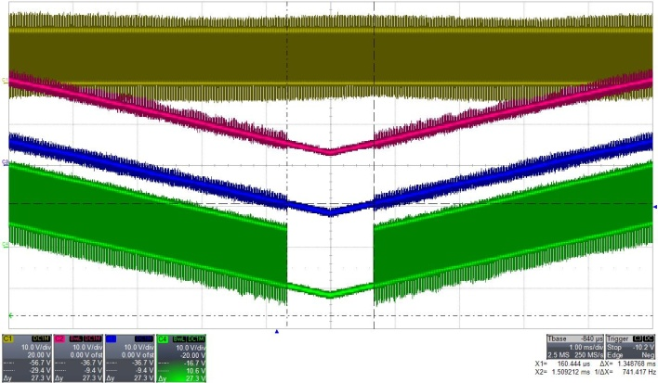
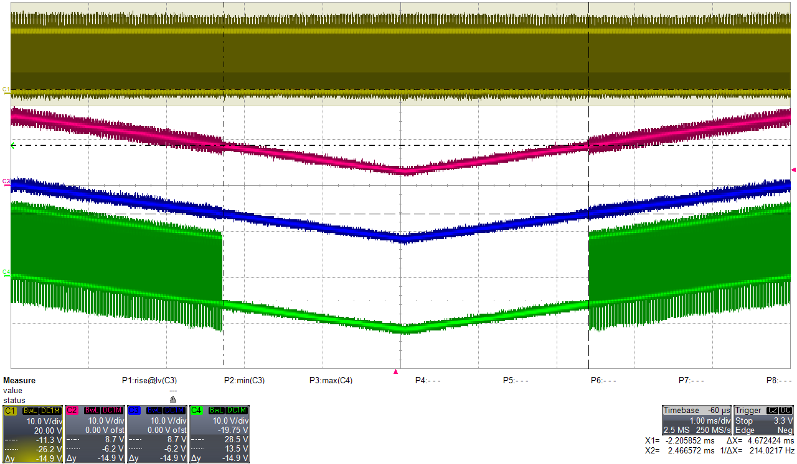
9. Benchmarking vs. I-Product
: DC Negative VS
※ Allowable negative VS voltage of FCS HVIC is lower about -3.5V compared to I-Product.
 | FAN73912, FAN73912A |  | I-Product
V_{HN} [10V/div] V_{B} [10V/div] V_{S} [10V/div] V_{HO} [10V/div] 1ms/div |  | V_{HN} [10V/div] V_{B} [10V/div] V_{S} [10V/div] V_{HO} [10V/div] 1ms/div
-9.4V
-6.2V

Slide 16
9. Benchmarking vs. I-Product
: Negative VS Pulse (NPSOA) @ HIN =0V
Tested by
ONSEMI Lab
FAN73912, FAN73912A
I-Product
※“Negative Vs” is measured Value
Note
Transient negative Vs SOA characteristic was only bench test result.

Slide 17
9. Benchmarking vs. I-Product
: Negative VS Pulse Immunity @ HIN Switching ( W/O BSD, CBOOT: 0.1uF)
Tested by ONSEMI Lab
I-Product
FAN73912, FAN73912A
Better Ruggedness
※“Negative Vs” is measured Value
Note
Transient negative Vs SOA characteristic was only bench test result.

Slide 18
9. Benchmarking vs. I-Product
: Negative VS Pulse Immunity @ HIN Switching (W/ BSD + 10Ω, CBOOT: 0.1uF)
Tested by
ONSEMI Lab
I-Product
FAN73912, FAN73912A
Better Ruggedness
※“Negative Vs” is measured Value
Note
Transient negative Vs SOA characteristic was only bench test result.

Slide 19
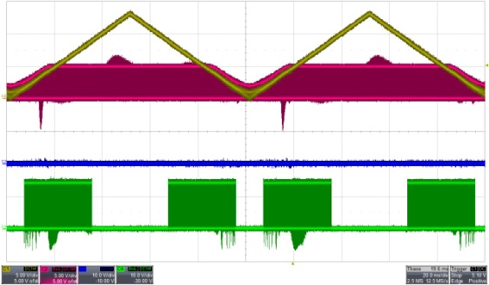
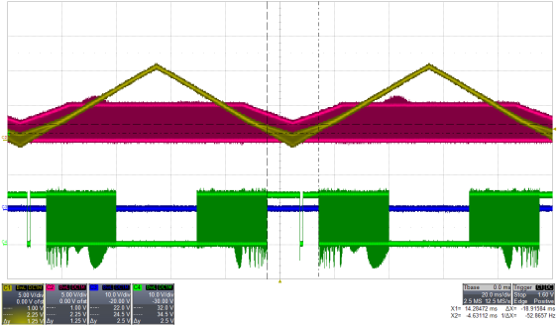
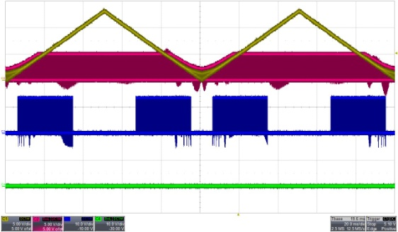
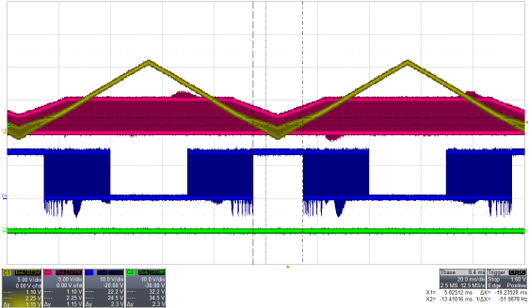
9. Benchmarking vs. I-Product
: VDD Swing Test (VDD : 0 ~15V)
V_{HIN} =0V V_{LIN} = 5Vp-p 20khz | FAN73912, FAN73912A NO Error | I-PRODUCT LO high @ VDD < 1.0V
V_{DD} [5V/div] V_{LIN} [5V/div] V_{HO} [10V/div] V_{LO} [10V/div] 20ms/div
V_{LIN} =0V V_{HIN} = 5Vp-p 20khz | FAN73912, FAN73912A NO Error | I-PRODUCT HO high @ VDD < 1.1 V
V_{DD} [5V/div] V_{HIN} [5V/div] V_{HO} [5V/div] V_{LO} [10V/div] 20ms/div

Slide 20
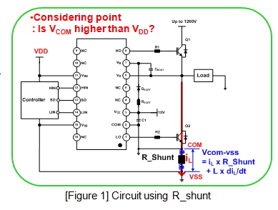
9. Benchmarking vs. I-Product
: COM-VSS immunity test
※ All voltages are referenced to VSS unless otherwise noted.
COM Swing Test
COM Pulse test
COM waveform
COM Waveform
Test Result
Test Result
V_{DD} | V_{PEAK} of COM | Output Behavior
 |  | FAN73912, FAN73912A | I-Product
3V | 0~3.7V | H/S : Normal L/S : Normal | H/S : Normal L/S : Normal
 | > 3.7V | H/S : OFF L/S : OFF | H/S : OFF, Short-on, Latch-on L/S : Normal
5V | 0~5.6V | H/S : Normal L/S : Normal | H/S : Normal L/S : Normal
 | > 5.6V | H/S : OFF L/S : OFF | H/S : OFF, Short-on, Latch-on L/S : Normal
10V | 0~10.7V | H/S : Normal L/S : Normal | H/S : Normal L/S : Normal
 | > 10.7V | H/S : OFF L/S : OFF | H/S : OFF, Short-on, Latch-on L/S : Normal
V_{DD} | V_{PEAK} of COM | Output Behavior
 |  | FAN73912, FAN73912A | I-Product
3V | 0~4V | H/S : Normal L/S : Normal | H/S : Normal L/S : Normal
 | 4~6V | H/S : Normal L/S : Normal | H/S : Latch-on L/S : Normal
 | > 6V | H/S : OFF L/S : Normal | H/S : Latch-on L/S : Normal
5V | 0~6V | H/S : Normal L/S : Normal | H/S : Normal L/S : Normal
 | 6~19V | H/S : Normal L/S : Normal | H/S : Latch-on L/S : Normal
 | > 19V | H/S : Normal L/S : OFF | H/S : Latch-on L/S : OFF
10V | 0~11V | H/S : Normal L/S : Normal | H/S : Normal L/S : Normal
 | 11~21V | H/S : Normal L/S : Normal | H/S : Latch-on L/S : Normal
 | =21V | H/S : Normal L/S : Normal | H/S : Latch-on L/S : OFF

Slide 21
10. What is Considering points for COM-VSS immunity?
If a shunt resistor is applied to system as shown in [Figure 1], It may happen that COM voltage exceeds VDD referenced to VSS during over-current status. At this time, the FAN73912, FAN73912A turns off the output without shoot-through events, which can prevent breakdown of the system.
Considering point
: Is V_{COM} higher than V_{DD}?
[Figure 1] Circuit using R_shunt
[Figure 2] I-V Curve @ VCOM > VSS

Slide 22
11. Design recommendation
Common-grounded power supplies, VDD, are used for MCU and FAN73912, FAN73912A product operation.
The MLCC placed between VDD-VSS (C1) and VCC-COM(C2) should be over 100nF and mounted as close to the pins of the FAN73912, FAN73912A product as possible.
The bootstrap capacitor (C_{BOOT}) uses a low-ESR capacitor such as ceramic capacitor. The capacitor from VDD to COM (C3) supports both the low-side driver and bootstrap recharge, The recommended value C3 is higher than the recommended C_{BOOT} at least ten times.
Gate Resistors (R1~R4) should be check whether it is suitable for switching characteristics in accordance with IGBTs or MOSFETs
Shunt Resistor, R_{SHUNT} is related with trip level of over current. (Equation: I_{TRIP} = V_{TRIP}/ R_{SHUNT} )
The layout for minimizing parasitic inductances are required.
※ For further details, see the datasheet and application note (AN-6076)

Slide 23
Appendix : Test condition for COM-VSS Immunity
Test Circuit
Test Condition
T_{A} : 25+/- 3℃
VCC: 15VDC
VDD: 3~10V
HIN : 20khz, 50%, 0~VDD
LIN : Inverted HIN, 0~VDD
COM : Triangle wave (3ms Period, 50% duty 0 ~ 15V) or
Square wave (15khz, 2us pulse width 0~20V)
※ Note : All voltages are referenced to VSS unless otherwise noted.

