Slide 1
SiC Fighting Guide
January 2023

Slide 2

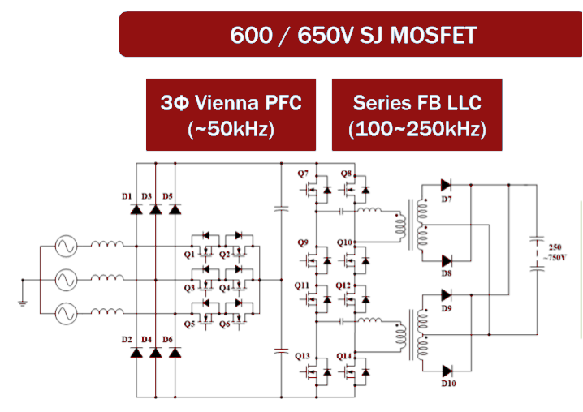

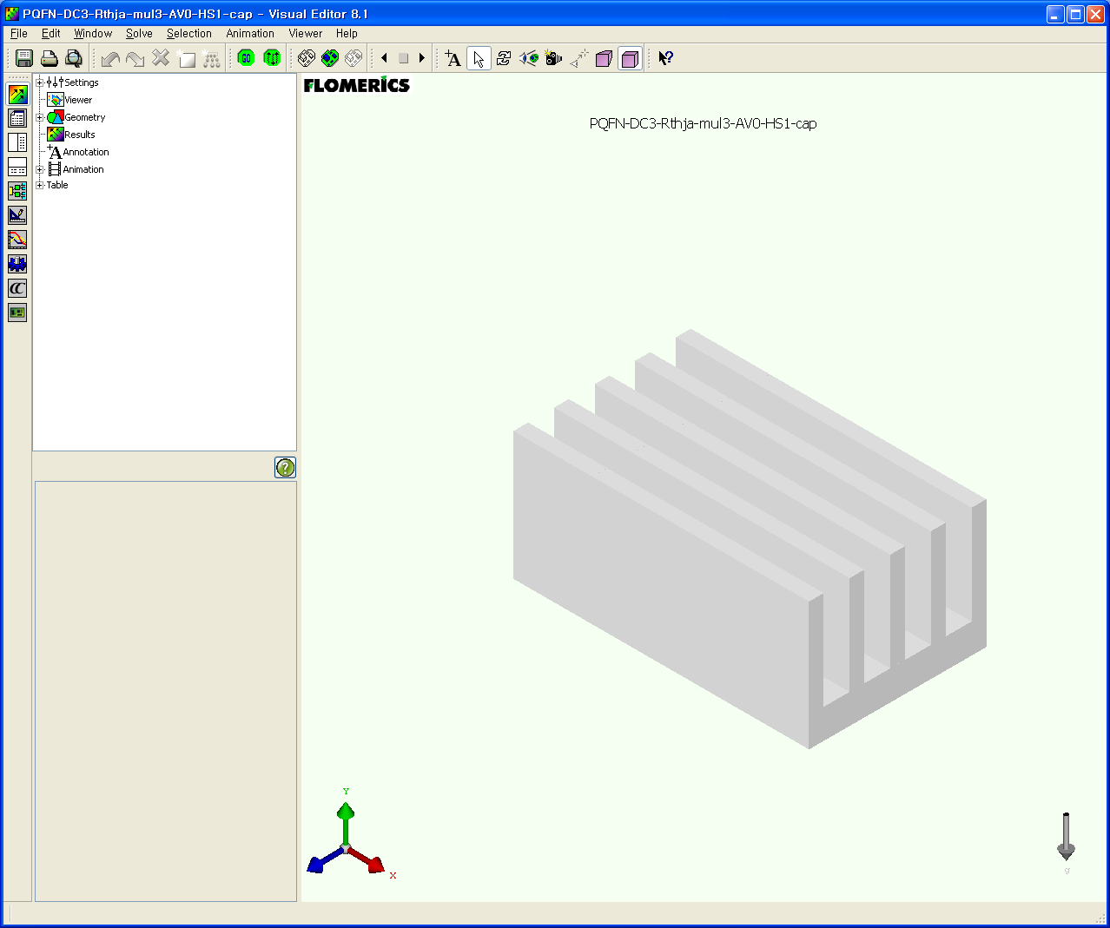

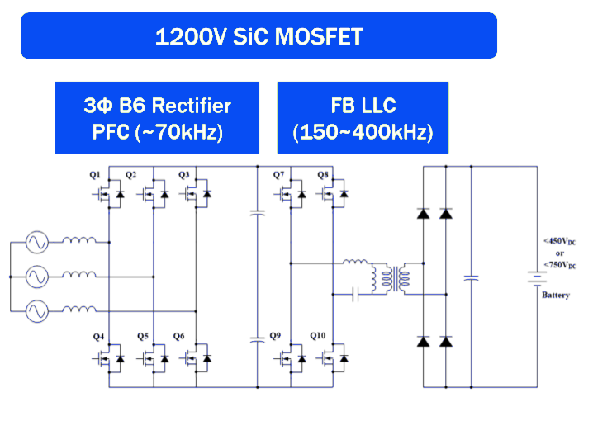
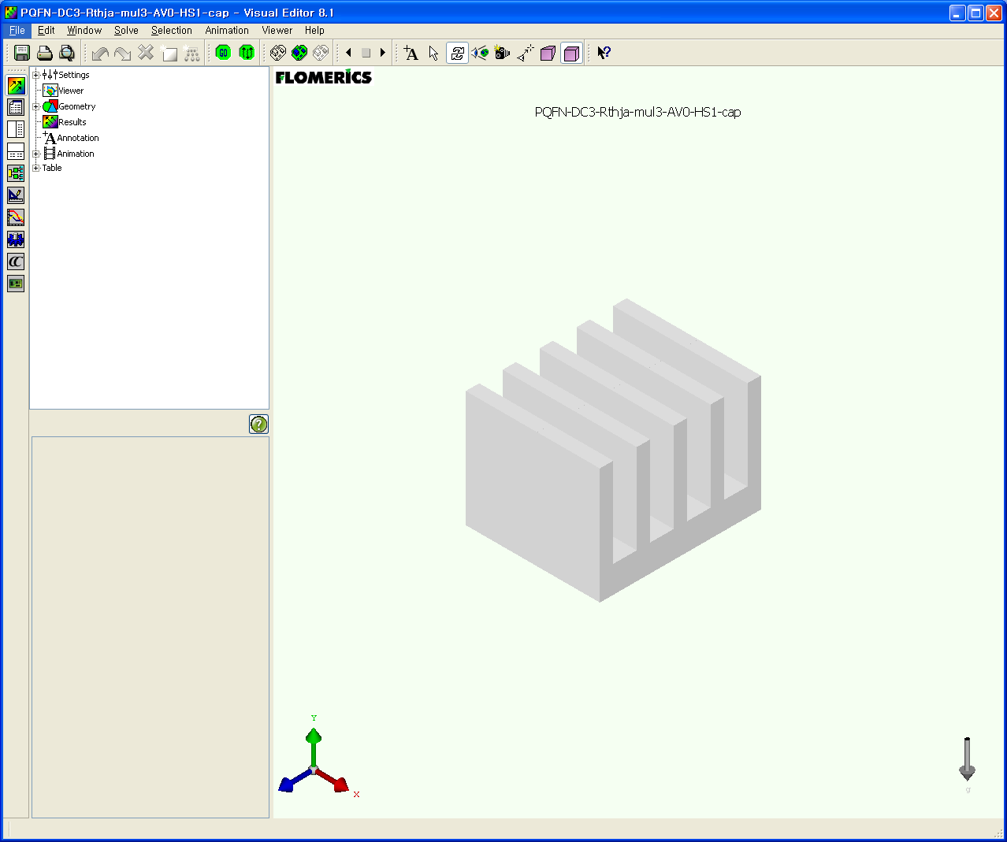
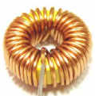
Si vs. SiC – Silicon Carbide Drives Increased Power Density!
Higher Efficiency by Lower Power Losses
System
Small Size
Light Weight
Cost benefits
Simpler topology : higher BVdss with lower Rds(on)
Si
Solution
SiC
Solution
Smaller heatsink and packaging
Higher Switching Frequency
Fewer Cooling
Smaller passives
Notes:
During many year, to overcome low performances of high voltage silicon, stacked or complex structure have been used. SiC devices have high voltage breakdown capability with much lower losses than regular Silicon devices. Using SiC devices simplify high-voltage and high-power design by simplifying topologies.
SiC Switching speed allows high frequency operation for the same application power rating. The direct consequence is the reduced size of passive like inductors and capacitors. With less devices and less losses, the need in cooling is lower and heatsink size is reduced.
All of those improvement lead to a smaller system size for same or better performances.

Slide 3
Advantages of onsemi EliteSiC technology
Proven Quality / Robust Planar Design
  In-process Control and Burn-in
  Defect Scanning during Manufacturing
  100% Avalanche testing of All Dies
  No Drift in Threshold or Parameters
  High Reliability Gate Oxide
  Automotive Qualification AECQ-100
Best in class design tools
  Physical & Scalable accurate
  Simulation Models
  Application notes and Design guides
Fully Integrated Manufacturing
  Form Powder to Products
New 3rd generation SiC offering
  Optimized for High temperature operation
    Diodes : Low series-resistance temperature dependency
    MOSFETs : Stable reverse recovery over temperature
  Improved parasitic capacitances for
  High Frequency High Efficiency application
  Large die with low R_{DS(on)} available
Automotive or Industrial grade
for All Values and Packages
Wide offering in Standard and Custom Power Integrated Modules (PIM)
Large portfolio of Voltages and R_{SD(on)}
available in 3- and 4-Leads packages
Notes:
Here : 2 Options.
Just a brief summary because all points will be detailed in the next slides
onsemi puts a lot of effort to ensure SiC devices reliability and robustness. A lot of action has been taken like defect scanning, in-process control and burn-in, …
onsemi invests in a new modeling technic and tools to facilitate SiC adoption by customers.
onsemi is a full integrated manufacturer form the wafer to the devices.
The third generation of Diodes and MOSFETs are currently released with improved performances dedicated for high frequency operation.
onsemi offers both grade (automotive and industrial) for all device values.
onsemi SiC products are available in various discrete packages or modules with a large range of on-resistance values.
2) Full details in one slide and others detailed slides are not shown…
To insure SiC quality, onsemi puts many controls during the full manufacturing process. During device design, parameters have been measured and checked to have almost no drift and stable performance within temperature and lifetime. onsemi took a particular attention to the reliability of its gate oxide. onsemi gate oxide is robust and withstand very high dv/dt link to SiC devices operating conditions. To catch and remove bad parts, defect scanning is used during manufacturing. At the end of the manufacturing process, a burn-in complete this approach to eliminate all possible remaining bad parts. All dies, devices or modules are fully tested before shipment even in extreme condition like avalanche. Parts for both standard Industrial and Automotive are made with the same design and test requirements. Some production lines are automotive qualified and produce parts with AECQ-100 certification.
onsemi offers best in class tools to help and facilitate customers designs. onsemi invests a lot of effort in creating very accurate simulation models using Silicon Carbide physical equations embedded in those models. onsemi has published many application notes and design guides to teach customers how to use SiC devices. A new online simulation platform will also be available early next year.
onsemi has an integrated manufacturing chain from the sand to the system solutions. It insures onsemi supply impedance and quality.
The new third diodes and MOSFETs generation offer much more optimized performances over temperature. Diodes equivalent series resistor is smaller and less affect by temperature variation. MOSFET body diode reverse recovery is now almost independent of temperature. With reduced parasitic capacitors, new MOSFET generation can operate at high frequency with much less losses than previous generation. Large die with very low on-resistance are available and demonstrate onsemi capability to master technology performances and soldering quality.

Slide 4
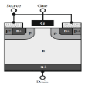
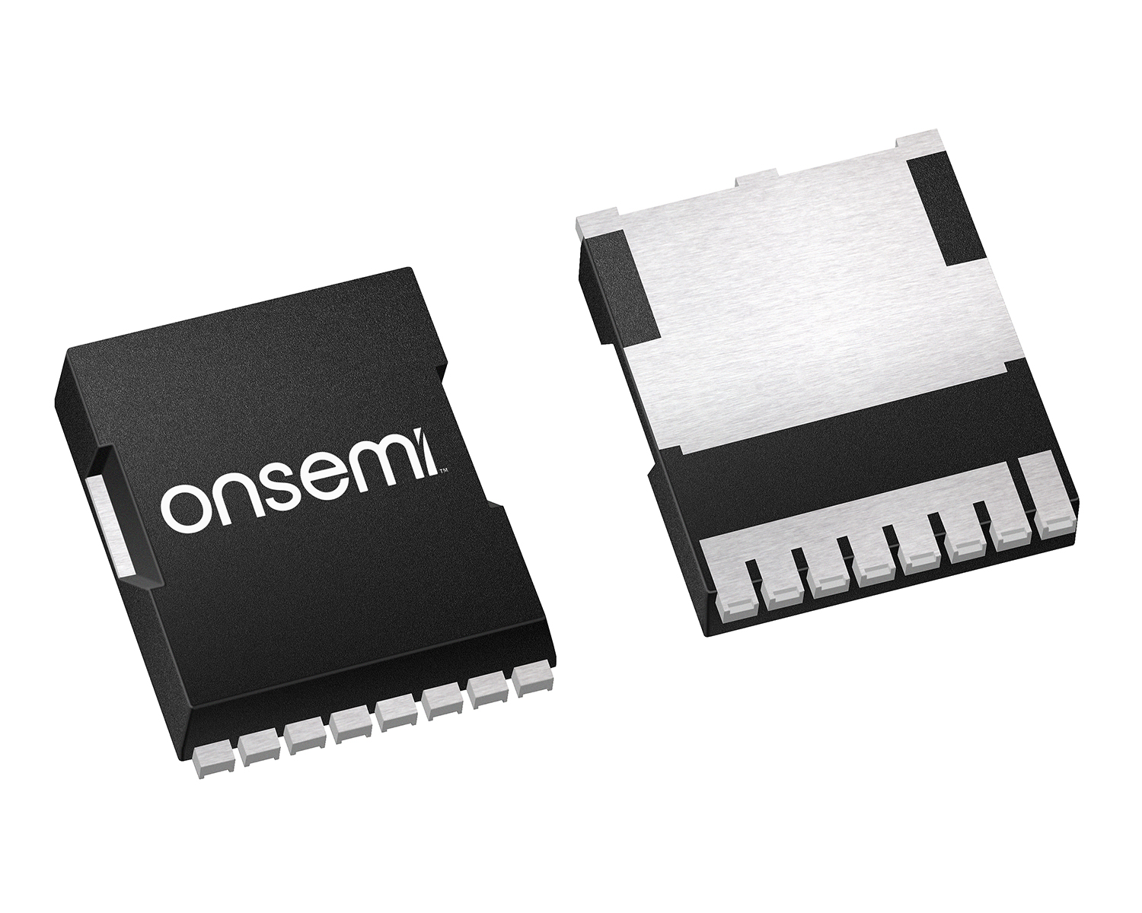
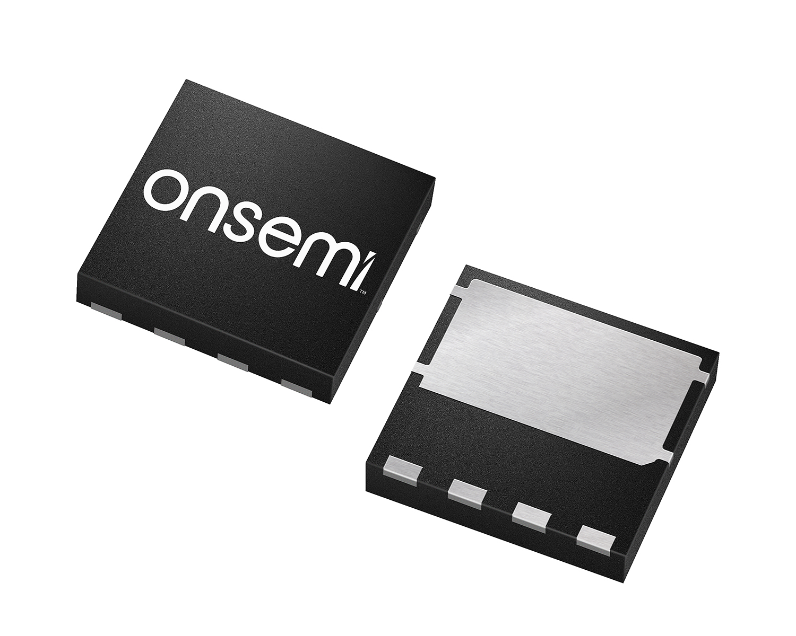
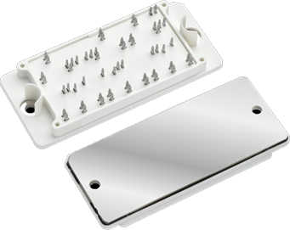



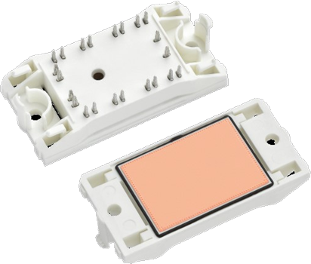
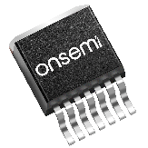
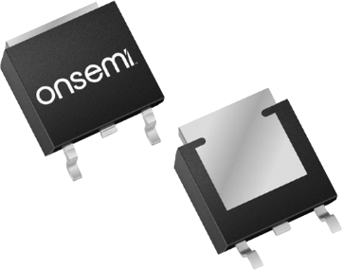

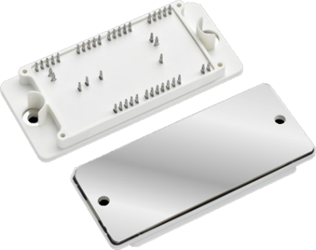


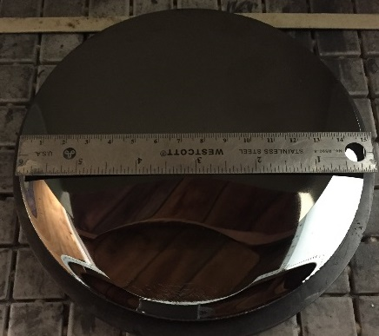
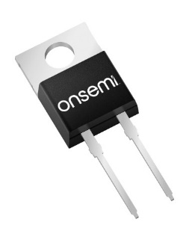
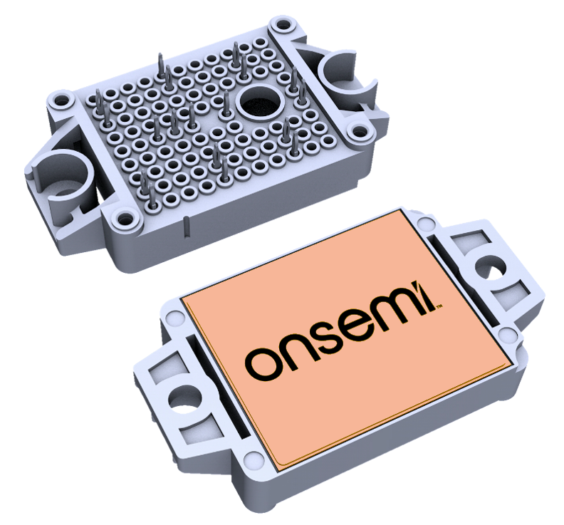
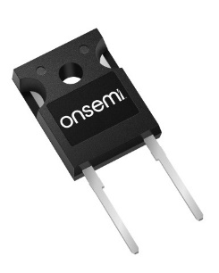
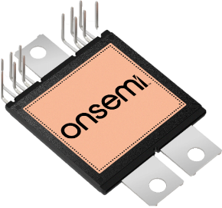



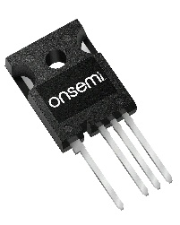
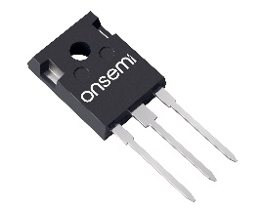
onsemi EliteSiC Leadership: From Substrate to Systems
Substrates / Epi
Fab
Devices / Die
Modules
Systems
SiC Planar available
today
Working on trench for the future
200mm
migration
ready
150/200mm SiC
wafering & epi fully
internal in onsemi today
Fabs ready today for 150mm→200mm migration
Full portfolio of diodes
& MOSFETs
Broad base of packages
Die only & metal options
Auto & Industrial devices
Case & transfer molded options
Full portfolio of hybrid & full SiC modules
Single & dual cooling, direct & indirect
Deep application & system know-how for automotive & industrial
EMEA, US, Asia based apps support
Notes:
onsemi has an integrated manufacturing chain from the sand to the system solutions. onsemi has its own SiC boule and wafer production. Then, onsemi design its own diode or MOSFET cell structures. onsemi manufactures dies using this cell structure on 6 inches and migrate to ! Inches wafer. Then, those dies are encapsulated in discrete and module package and tested inside onsemi manufacturing plans. Deep application knowledge and system know-how coming form application engineering team are shared by onsemi in various forms like application notes, seminars, tutorials available online but also with local support team.

Slide 5
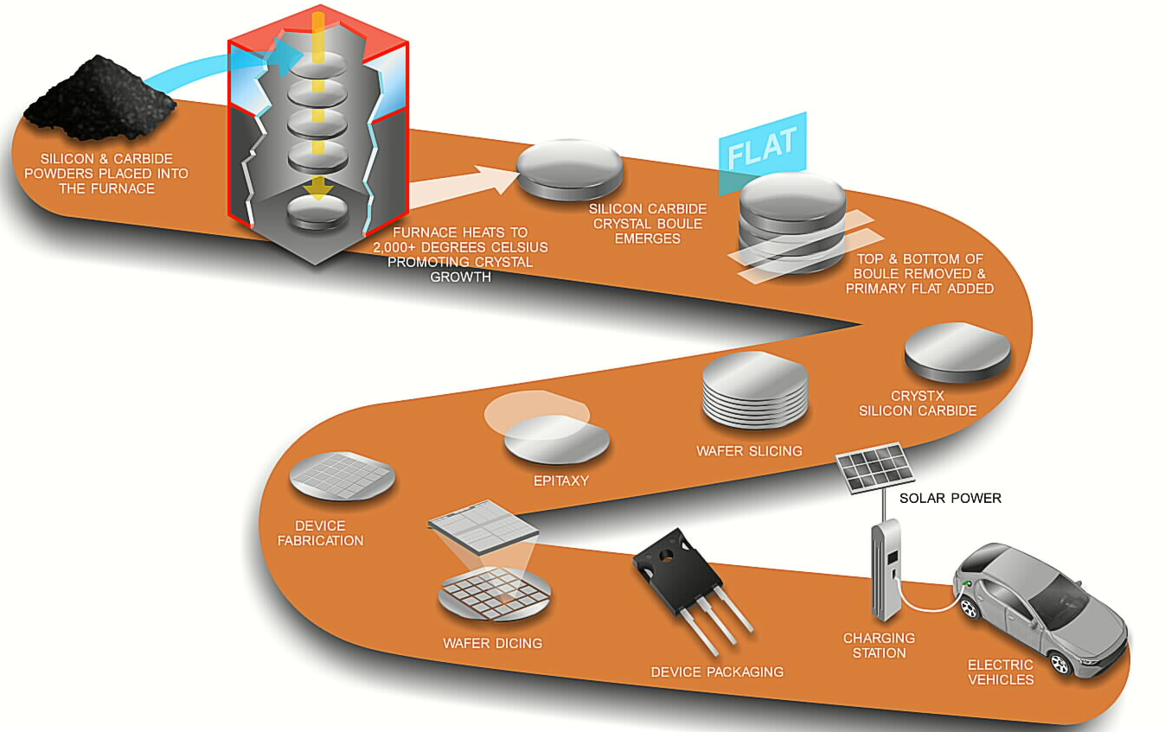
onsemi EliteSiC vertical integration – Unique for the industry
Notes:
This completed Silicon Carbide integration is also explained here with the various steps involved from the silicon and carbide powder to the application. The major steps are growing the boule in the furnace, slicing wafers, making the epitaxy layer, wafer diffusion, wafer dicing and dies packaging.

Slide 6

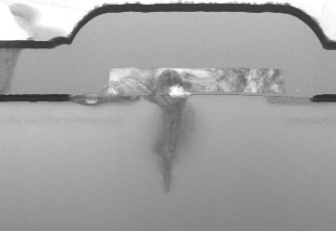
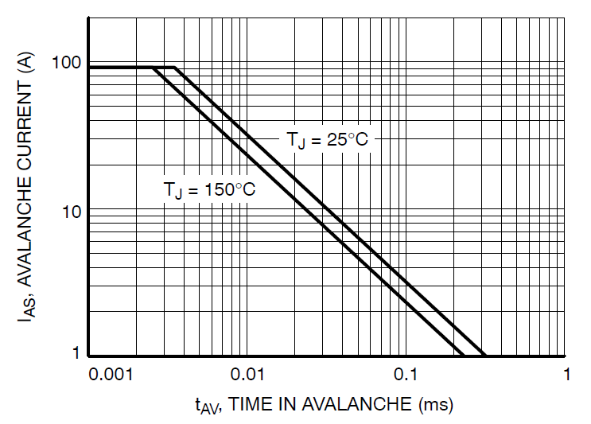
onsemi EliteSiC >>> Proven Quality & Robust Planar Design
  In-process Control and Burn-in
  Defect Scanning during Manufacturing
  100% Avalanche testing of All Dies
  No Drift in Threshold or Parameters
  High Reliability Gate Oxide
  Automotive Qualification AECQ-100
Contaminants in gate oxide
Real SiC crystals
have defects
No drift in Threshold and Gain
Avalanche Capability
Burin-In Climatic chamber
Notes:
To insure SiC quality, onsemi puts many controls during the full manufacturing process. During device design, parameters have been measured and checked to have almost no drift and stable performance within temperature and lifetime. onsemi took a particular attention to the reliability of its gate oxide. onsemi gate oxide is robust and withstand very high dv/dt link to SiC devices operating conditions. To catch and remove bad parts, defect scanning is used during manufacturing. At the end of the manufacturing process, a burn-in complete this approach to eliminate all possible remaining bad parts. All dies, devices or modules are fully tested before shipment even in extreme condition like avalanche. Parts for both standard Industrial and Automotive are made with the same design and test requirements. Some production lines are automotive qualified and produce parts with AECQ-100 certification.

Slide 7
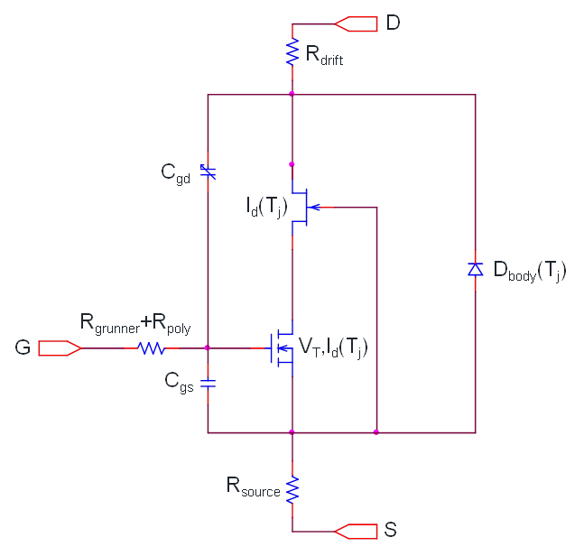
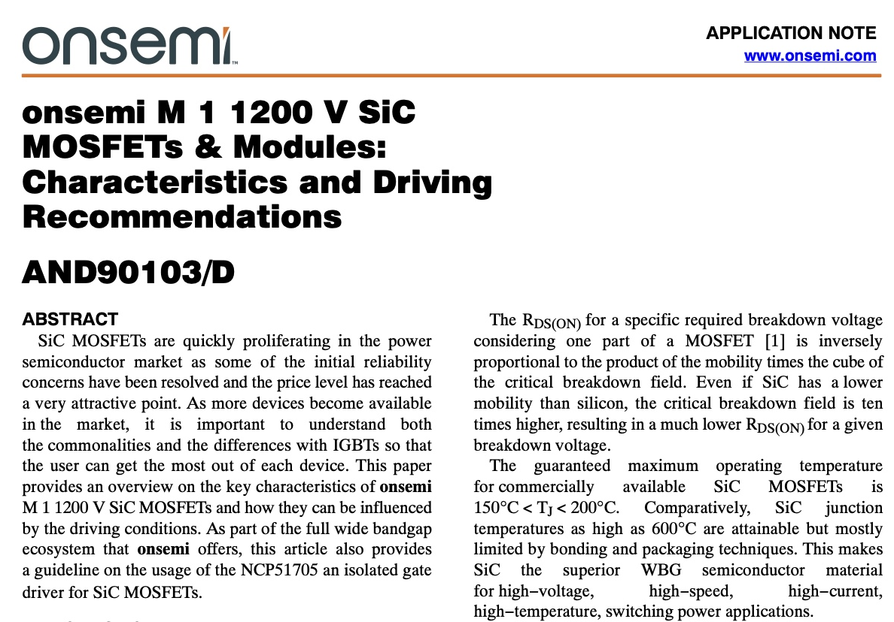
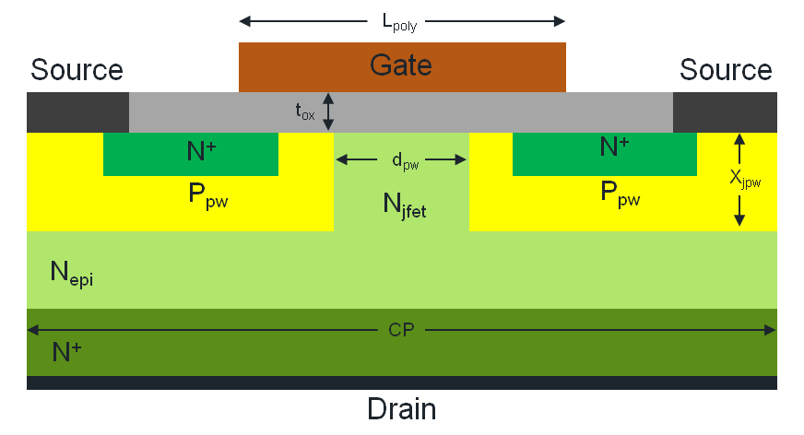
onsemi EliteSiC >>> Best in Class SiC design tools
Best in class design tools
  Physical & Scalable accurate
  Simulation Models
  Application notes and Design guides
  New online System design tool
    Available soon – will be dynamic and include parasitics and peak currents impacts in loss projections !
Physical & Scalable Model
Physical Structure
Notes:
onsemi offers best in class tools to help and facilitate customers designs. onsemi invests a lot of effort in creating very accurate simulation models using Silicon Carbide physical equations embedded in those models. onsemi has published many application notes and design guides to teach customers how to use SiC devices. A new online simulation platform will also be available early next year.

Slide 8
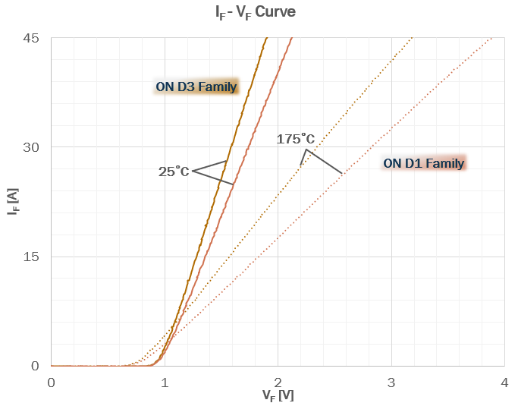
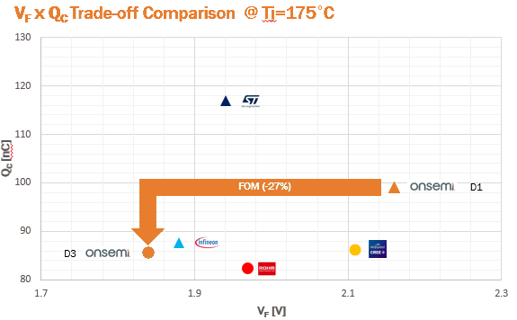
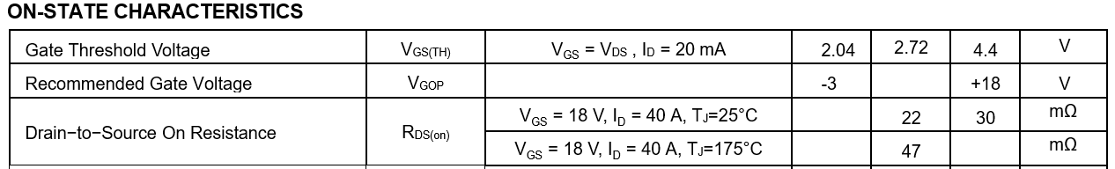
onsemi EliteSiC >>> Benefits of 3rd Generation SiC technology
New 3rd generation SiC offering
  Optimized for High temperature operation
    Diodes : Low series-resistance temperature dependency
    MOSFETs : Stable reverse recovery over temperature
  Improved parasitic capacitances for
  High Frequency High Efficiency application
  Large die with low R_{DS(on)} available
Reverse Recovery
Almost
T-independent
M1
M1
M1
M3
M3S
M3S
M3S
Notes:
The new third diodes and MOSFETs generation offer much more optimized performances over temperature. Diodes equivalent series resistor is smaller and less affect by temperature variation. MOSFET body diode reverse recovery is now almost independent of temperature. With reduced parasitic capacitors, new MOSFET generation can operate at high frequency with much less losses than previous generation. Large die with very low on-resistance are available and demonstrate onsemi capability to master technology performances and soldering quality.

Slide 9
Competitive analysis (January 2023)
NTH4L022N120M3S – onsemi 22mΩ M3S
Competitor A – 1200V 21mΩ (Last generation)
Competitor B – 1200V 20mΩ (Last generation)
Test setup : Standard double pulse test
  Inductive load
  Free welling diode :
  50A onsemi D3 1200V SiC Diode in TO247
  SiC Mosfet 1200V
  Driver – NCD57000 with Bipolar Buffer
  Rg = 8.2/8.2Ω
  Vdc = 600V
  Vgs = (+15 / -5V)
  Temp = 125°C
  Current transformer ID measurement
  Ls ~ 30nH
Eon losses (mJ) vs Drain Current :
Eoff losses (mJ) ve Drain Current
Notes:
Due to very good performances of onsemi M3S MOSFET body diode reverse recovery over the full temperature range, onsemi M3S new EliteSiC 22 milli-Ohms MOSFET exhibits lower switching losses on a standard double pulse tester over the full drain current range. Both turn-on and turn-off losses are better. Total losses at maximum current are 20% lower with onsemi new M3S EliteSiC MOSFET.

Slide 10

Losses vs Gate Drive Voltages with 1200V M3S SiC MOSFETs
Conclusion:
15V/0V is totally fine with onsemi
18V drive always technically better
18V/-3V drive gives the best results
25% lower
losses
Conduction Losses highest with VGS 15V
Conduction Losses Lower with VGS 18V
25% lower
losses
3% lower
losses
EON Losses highest with VGS 15V/0V
EON Losses Losses Lower with VGS 18V/0V
EON Losses Losses Lowest with VGS 18V/-3V
Lower Rg:
Lower losses
Higher dv/dt
Higher di/dt
3% lower
losses
25% lower
losses
Lower Rg:
Lower losses
Higher dv/dt
Higher di/dt
EOFF Losses highest with VGS 15V/0V
EOFF Losses Losses Lower with VGS 18V/0V
EOFF Losses Losses Lowest with VGS 18V/-3V
Notes:
Using 15V Turn-on gate voltage and 0V turn-off gate voltage is totally fine with all onsemi SiC MOSFETs. But, to get most out of onsemi SiC MOSFET, 18V Turn-on gate voltage saves 25% conduction losses and 25% turn-on losses (or Eon). Using negative Turn-off gate voltage saves 25% more on Turn-off losses (or Eoff). So 18V/-3V is the best combination for Gate drive voltage and gives the best results possible in the final application.
Lowering the Gate drive resistance (or Rg) lowers the losses also, but this also increases dv/dt and di/dt, and so EMI. All onsemi SiC MOSFETs have been tested to withstand dv/dt up to 50V/ns.

Slide 11
onsemi EliteSiC Driver requirements
Gate drive voltage :
  Fast switching speed devices, up to 200V/ns on the drain
    Miller capacitor (Drain-to-Gate) can inject large current on the Gate
  Large Gate voltage amplitude : -5V to 20V
Fast dynamic performances (Delay, rise and fall time)
Embedded negative voltage bias
UVLO : 12V to 18V
Isolation helps high speed driving and breaking Ground Loop noise
Extra Protection features
  Miller Clamp
  Fast DESAT for over-current protection
  Soft Turn-off
  Over temperature protection via external sensor (Example NTC)
Notes:
As SiC MOSFET is more a variable resistor as a function of the gat voltage, the device need to be driven with the maximum gate voltage possible to get the most out. So large supply voltage is required for SiC Gate drivers. As switching speed can be as high as 100V/ns, Gate Driver need to have larger dv/dt immunity. onsemi gate drive can withstand up to 200V/ns. Strong gate current capability (and clamp) is also needed because the MOSFET high speed switching injects a large amount of current in the gate via the Miller (Drain-to-Gate) parasitic capacitor. Dynamic performances should match also MOSFET dynamics, and all timing should be as short as possible. Isolation is almost a mandatory feature at such high switching speed. It avoids facing complicate ground loop problems.
Extra features available in onsemi Gate Drive can be helpful for customers and will secure the system behaviors.

Slide 12
Portofolio
Discrete MOSFETs and Diodes

Slide 13
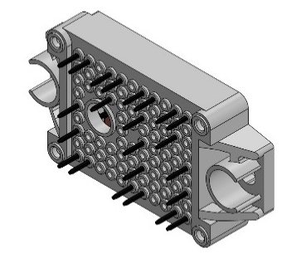
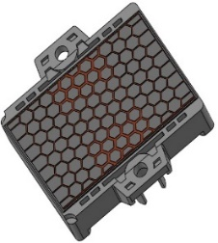
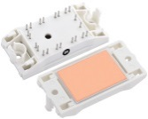
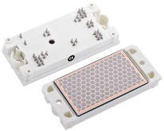

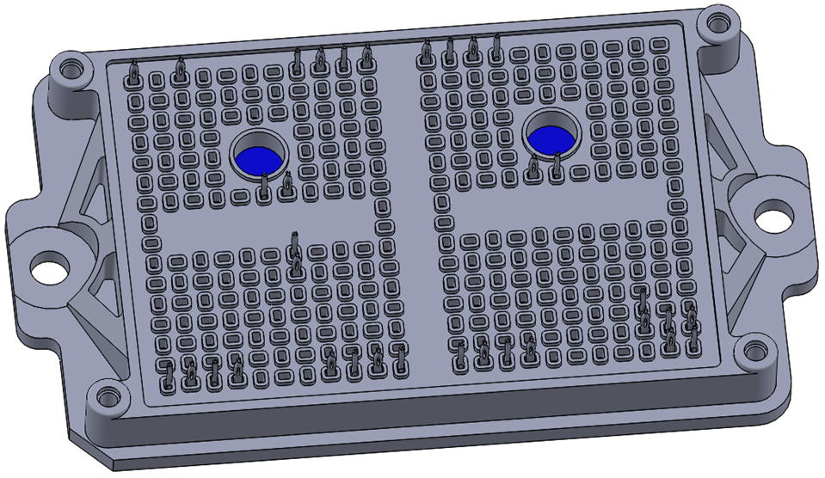
Power Integrated Modules (PIM)
Product | Description | Configuration | Package
NXH006P120MNF2 | Half Bridge 2-PACK 1200V 6mΩ M1 SiC MOSFET | Press-fit pins TIM option | F2
NXH010P120MNF1 | Half Bridge 2-PACK 1200V 10mΩ M1 SiC MOSFET |  | F1
NXH020P120MNF1 | Half Bridge 2-PACK 1200V 20mΩ M1 SiC MOSFET
NXH040P120MNF1 | Half Bridge 2-PACK 1200V 40mΩ M1 SiC MOSFET
NXH010P090MNF1 | Half Bridge 2-PACK 900V 20mΩ M2 SiC MOSFET
NXH020U90MNF2 | Vienna Module 900V 10mΩ M2 SiC MOSFET & 1200V 100A D1 SiC Diode | Press-fit pins + TIM | F2
NXH020F120MNF1 | Full Bridge 4-PACK 1200V 20mΩ M1 SiC MOSFET | Press-fit pins TIM option | F1
NXH040F120MNF1 | Full Bridge 4-PACK 1200V 40mΩ M1 SiC MOSFET
NXH40B120MNQ0SNG | 2 channel Boost 1200V 40mΩ M1 SiC MOSFET, 1200V 40A D1 SiC Diode | Solder pin (S) Ni plated DBC | Q0
NXH80B120MNQ0SNG | 2 channel Boost 1200V 80mΩ M1 SiC MOSFET, 1200V 20A D1 SiC Diode
NXH40B120MNQ1SNG | 3 channel Boost 1200V 40mΩ M1 SiC MOSFET, 1200V 40A D1 SiC Diode |  | Q1
NXH100B120H3Q0 | 2 channel Boost 1200V 50A IGBT, 1200V 20A D1 SiC Diode | Solder pins (S) or Press-fit (P) TIM | Q0
NXH240B120H3Q1PG | 3 channel Boost 1200V 60A IGBT, 1200V 20A D1 SiC Diode | Press-fit (P) | Q1
F1
Q0
Q2
F5
F2
Q1

Slide 14


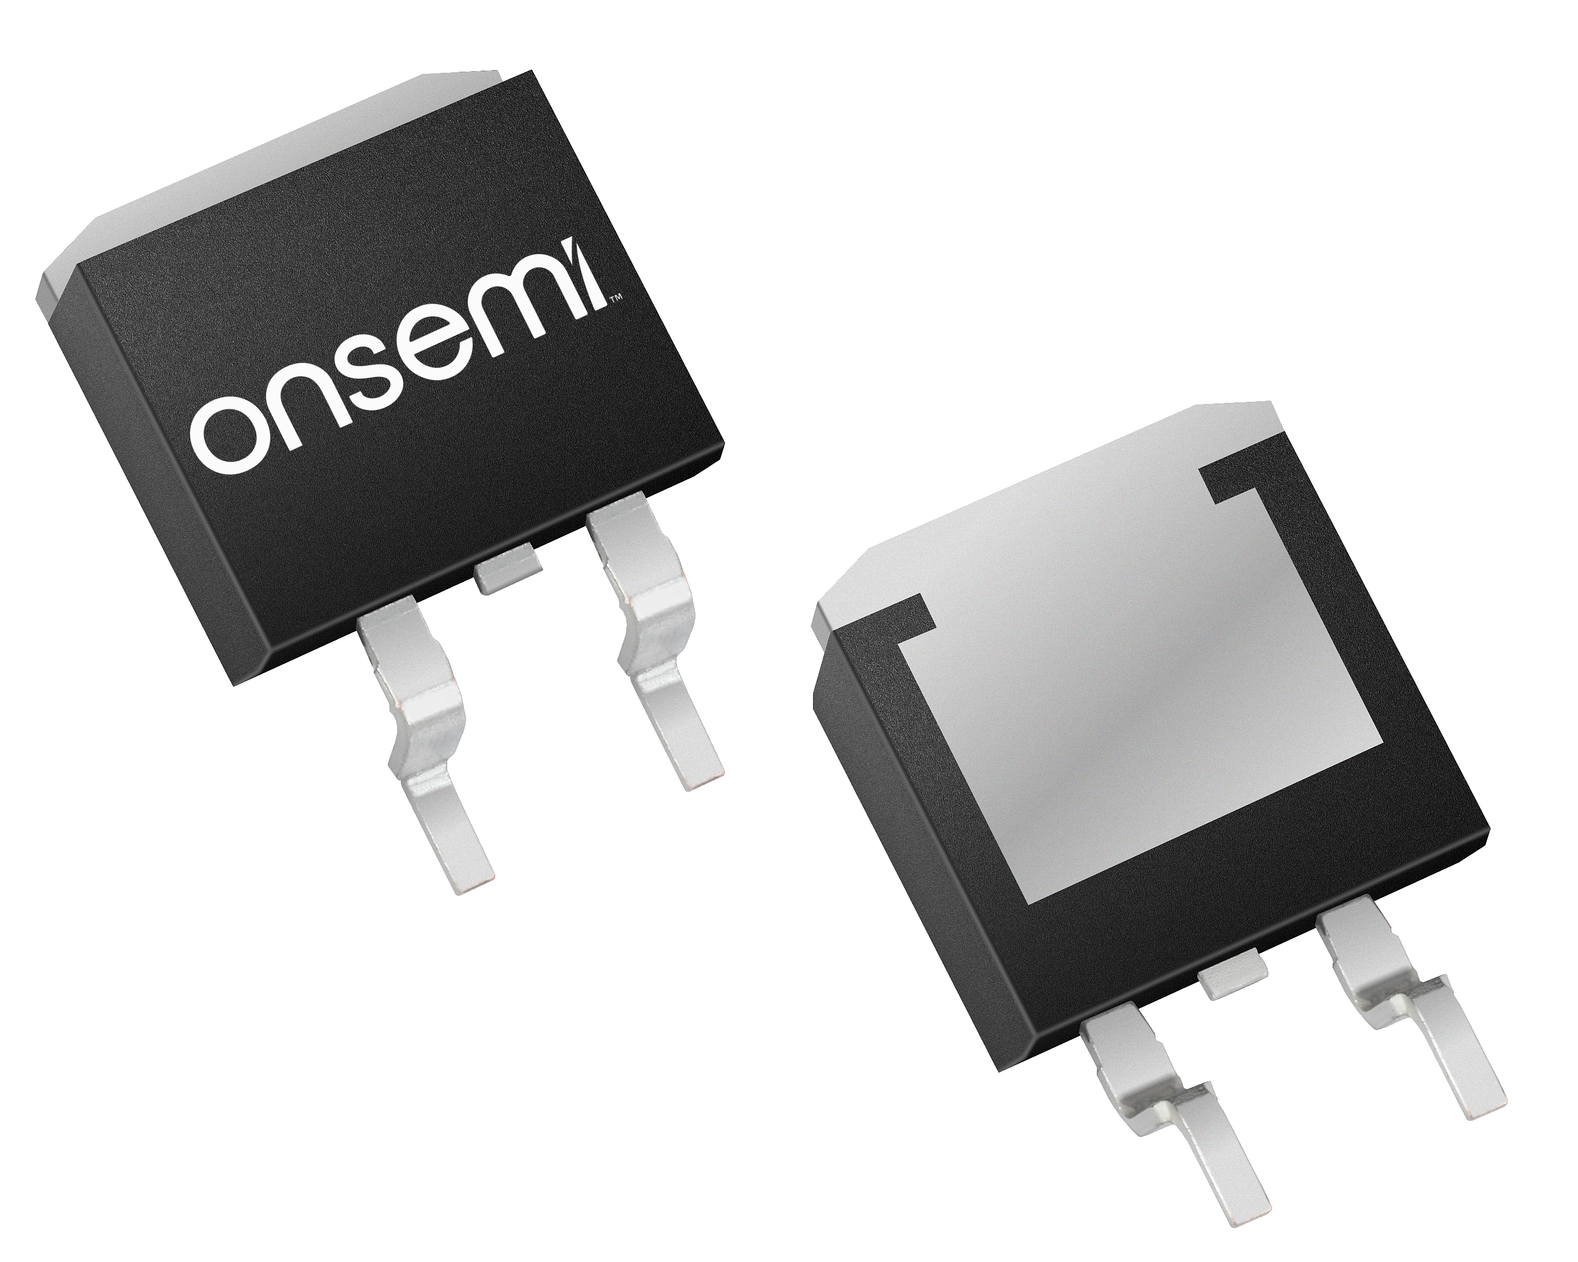
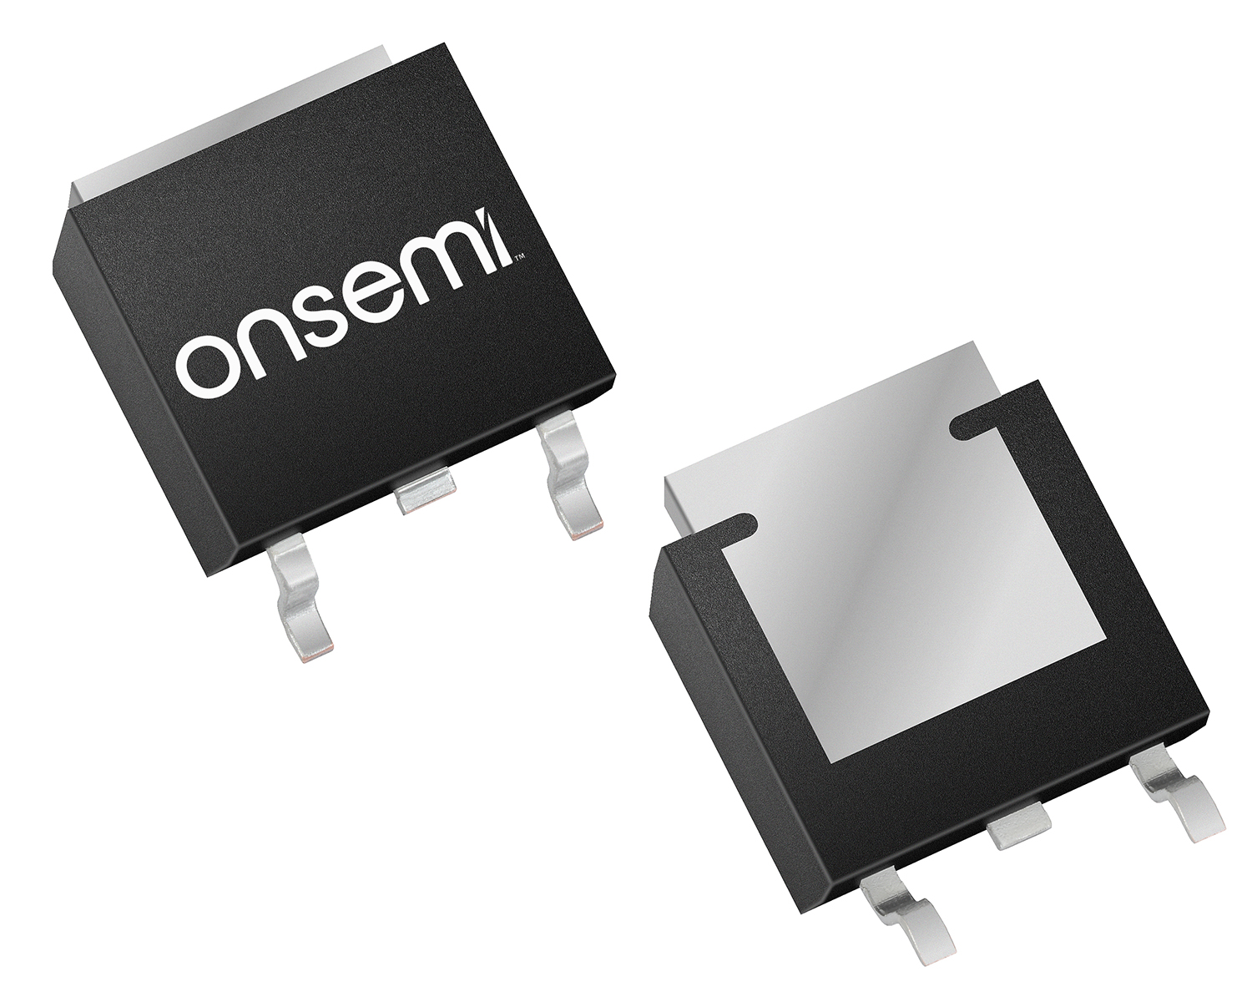
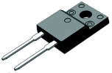

650V SiC Diodes – D1 Family
Automotive grade includes “–F085” OPN suffix
I (A) | VFM (V) | TO-247-3L Dual | TO-247-2L | TO-220-2L | TO-220FP-2L | D2PAK | DPAK | PQFN-88 | Dies
50 | 1.75 | FFSH5065A-F155 | FFSH5065A |  |  |  |  |  | PCFFS5065AF
40 |  | FFSH4065ADN | FFSH4065A |  |  |  |  |  | PCFFS4065AF
30 |  | FFSH3065ADN | FFSH3065A | FFSP3065A |  |  |  |  | PCFFS3065AF
20 |  | FFSH2065ADN | FFSH2065A | FFSP2065A | FFSPF2065A
16 |  | FFSH1665ADN | FFSH1665A | FFSP1665A
12 |  |  |  | FFSP1265A |  | FFSB1265A |  | FFSM1265A
10 |  |  | FFSH1065A | FFSP1065A | FFSPF1065A | FFSB1065A | FFSD1065A | FFSM1065A
8 |  |  |  | FFSP0865A | FFSPF0865A | FFSB0865A | FFSD0865A | FFSM0865A
6 |  |  |  | FFSP0665A | FFSPF0665A | FFSB0665A | FFSD0665A | FFSM0665A
4 |  |  |  | FFSP0465A |  | FFSB0465A | FFSD0465A | FFSM0465A
Single die device (instead of two parallel die) created as Wolfspeed drop-in replacement.

Slide 15
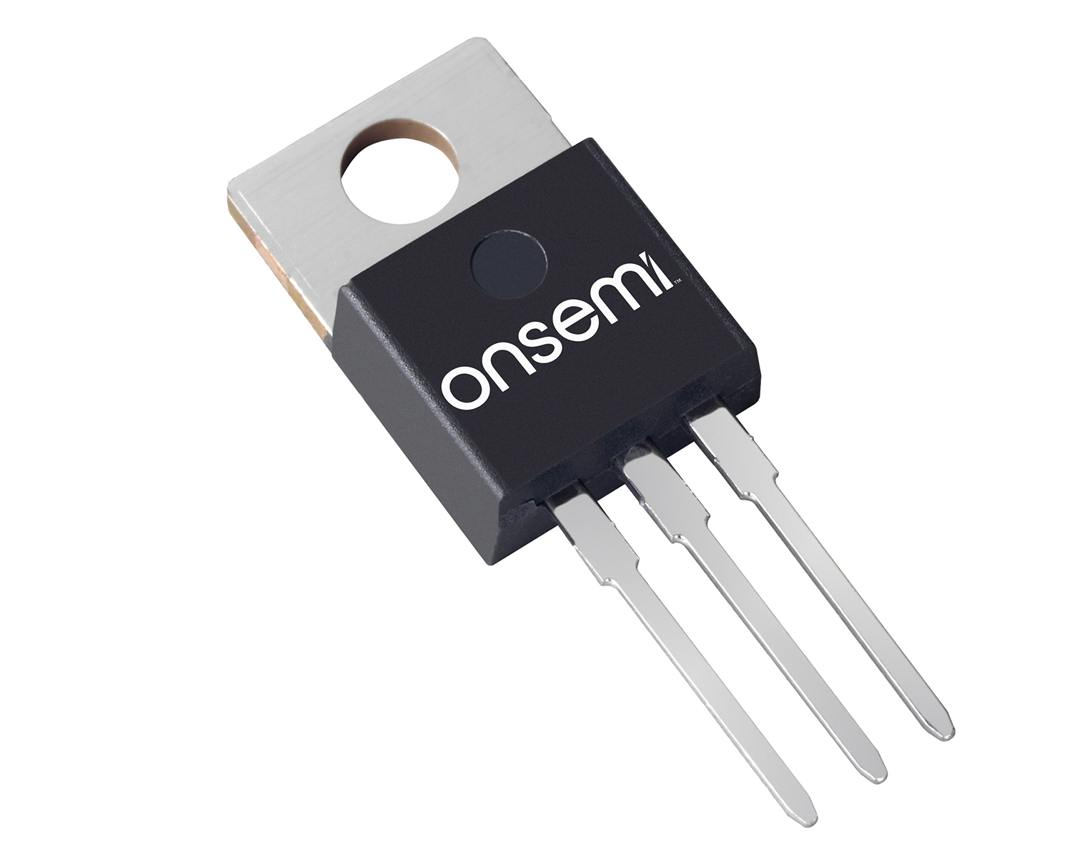
650V SiC Diodes – D2 Family
Automotive grade includes “–F085” OPN suffix
I (A) | VFM (V) | TO-247-3L Dual | TO-247-2L | TO-220-2L | TO-220-3L Dual | D2PAK | DPAK | PQFN-88
50 | 1.7 |  | FFSH5065B
40 |  | FFSH4065BDN |  |  | FFSP4065BDN
30 |  |  | FFSH3065B | FFSP3065B |  | FFSB3065B
20 |  | FFSH2065BDN | FFSH2065B | FFSP2065B | FFSP2065BDN | FFSB2065B FFSB2065BDN | FFSD2065B | FFSM2065B
10 |  |  | FFSH1065B | FFSP1065B |  | FFSB1065B | FFSD1065B | FFSM1065B
8 |  |  |  | FFSP0865B |  | FFSB0865B | FFSD0865B | FFSM0865B
6 |  |  |  | FFSP0665B |  | FFSB0665B | FFSD0665B | FFSM0665B

Slide 16
1200V SiC Diodes – D1 Family
Automotive grade includes “–F085” OPN suffix. Standard 20mm lead length with “-F155” suffix for TO-247.
I (A) | VFM (V) | TO-247-3L Dual | TO-247-2L | TO-220-2L | D2PAK | DPAK | Die
50 | 1.75 |  | FFSH50120A (16mm) |  |  |  | PCFFS50120AF
40 |  | FFSH40120ADN-F155 | FFSH40120A-F155 |  |  |  | PCFFS40120AF
30 |  | FFSH30120ADN-F155 | FFSH30120A-F155 |  |  |  | PCFFS30120AF
20 |  | FFSH20120ADN-F155 | FFSH20120A-F155 | FFSP20120A | FFSB20120A |  | PCFFS20120AF
15 |  | FFSH15120ADN-F155 | FFSH15120A-F155 | FFSP15120A |  |  | PCFFS15120AF
10 |  | FFSH10120ADN-F155 | FFSH10120A-F155 | FFSP10120A | FFSB10120A | FFSD10120A | PCFFS10120AF
8 |  |  |  | FFSP08120A |  | FFSD08120A | PCFFS08120AF
5 |  |  |  | FFSP05120A |  |  | PCFFS05120AF

Slide 17
1200V SiC Diodes – D3 Family
Automotive grade uses “NVD” Industrial grade uses “ND”. 16mm lead length for TO-247-2L
IF (A) | VFM (V) | TO-247-2L | TO-247-3L
50 | 1.75 | NDSH50120C NVDSH50120C
40 |  |  | NDSH40120CDN
20 |  | NDSH20120C NVDSH20120C

Slide 18
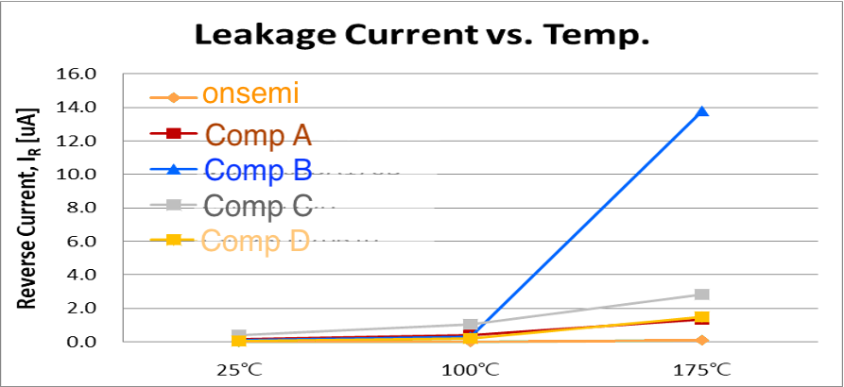
1700V SiC Diodes – D1 Family
IF (A) | VFM (V) | TO-247-2L | Die
100 | 1.75 |  | NDC100170A
25 |  | NDSH25170A | NDC25170A
10 |  | NDSH10170A | NDC10170A
More Stable high voltage operation at high temperature
Higher BV @300uA
Vin [Vac] | Makers | BV @25ºC | BV @175ºC
NDSH10170A | onsemi | 2,090 V | 2,130 V
Competitor A | Comp A | 1,950 V | 2,050 V
Competitor B | Comp B | 1,970 V | 2,015 V
Competitor C | Comp C | 1,990 V | 1,965 V
Competitor D | Comp D | 2,065 V | 2,120 V
Excellent leakage current @1700V

Slide 19
650V SiC MOSFETs – M2 Family
Automotive grade uses “NV” Industrial grade uses “NT”
R_{DS(ON)} (mΩ) Typical @Vgs:15V | R_{DS(ON)} (mΩ) Typical @Vgs:18V | TO-247-3L | TO-247-4L | D2PAK-7L | TOLL | PQFN88
15 | 12 | NVHL015N065SC1 NTHL015N065SC1 | NVH4L015N065SC1 NTH4L015N065SC1 | NVBG015N065SC1 NTBG015N065SC1
25 | 19 | NVHL025N065SC1 NTHL025N065SC1 | NVH4L025N065SC1 NTH4L025N065SC1 | NVBG025N065SC1 NTBG025N065SC1
45 | 33 | NVHL045N065SC1 NTHL045N065SC1 | NVH4L045N065SC1 NTH4L045N065SC1 | NVBG045N065SC1 NTBG045N065SC1 | NTBL045N065SC1 | NTMT045N065SC1
60 | 44 | NVHL060N065SC1 NTHL060N065SC1 | NVH4L060N065SC1 NTH4L060N065SC1 | NVBG060N065SC1 NTBG060N065SC1
75 | 57 | NVHL075N065SC1 NTHL075N065SC1 | NVH4L075N065SC1 NTH4L075N065SC1 | NVBG075N065SC1
95 | 78 |  | NVH4L095N065SC1 | NVBG095N065SC1

Slide 20
900V SiC MOSFETs – M2 Family
Automotive grade uses “NV” Industrial grade uses “NT”
R_{DS(ON)} (mΩ) Typical @Vgs:15V | R_{DS(ON)} (mΩ) Typical @Vgs:18V | TO-247-3L | TO-247-4L | D2PAK-7L
20 | 16 | NVHL020N090SC1 NTHL020N090SC1 | NVH4L020N090SC1 NTH4L020N090SC1 | NVBG020N090SC1 NTBG020N090SC1
60 | 43 | NVHL060N090SC1 NTHL060N090SC1 | NVH4L060N090SC1 NTH4L060N090SC1 | NVBG060N090SC1 NTBG060N090SC1

Slide 21
1200V SiC MOSFETs – M1 Family
Automotive grade uses “NV” Industrial grade uses “NT”
R_{DS(ON)} (mΩ) Typical @Vgs:20V | TO-247-3L | TO-247-4L | D2PAK-7L | Die – Wafer and T&R
20 | NVHL020N120SC1 NTHL020N120SC1 | NVH4L020N120SC1 NTH4L020N120SC1 | NVBG020N120SC1 NTBG020N120SC1 | NVC020N120SC1 NTC020N120SC1
40 | NVHL040N120SC1 NTHL040N120SC1 | NVH4L040N120SC1 NTH4L040N120SC1 | NVBG040N120SC1 NTBG040N120SC1 | NVC040N120SC1 NTC040N120SC1
80 | NVHL080N120SC1A NTHL080N120SC1A | NVH4L080N120SC1 NTH4L080N120SC1 | NVBG080N120SC1 NTBG080N120SC1 | NVC080N120SC1 NTC080N120SC1
160 | NVHL160N120SC1 NTHL160N120SC1 | NVH4L160N120SC1 NTH4L160N120SC1 | NVBG160N120SC1 NTBG160N120SC1

Slide 22
1200V SiC MOSFETs – M3 Family
Automotive grade uses “NV” Industrial grade uses “NT”
R_{DS(ON)} (mΩ) Typical @Vgs:18V | TO-247-3L | TO-247-4L | D2PAK-7L | Die
13
14 |  | NTH4L014N120M3P | NTBG014N120M3P
22 | NTHL022N120M3S | NTH4L022N120M3S NVH4L022N120M3S | NTBG022N120M3S NVBG022N120M3S
30
40 |  | NTH4L040N120M3S NVH4L040N120M3S
70

Slide 23
1700V SiC MOSFETs – M1 Family
R_{DS(ON)} (mΩ) Typical @Vgs:20V | TO-247-3L | TO-247-4L | D2PAK-7L
28 |  | NTH4L028N170M1 | NTBG028N170M1
1000 |  |  | NTBG1000N170M1 ( Sep ’22 / Apr ’23 )

Slide 24
Isolated SiC Gate Drivers Single and Dual
OPN | Key Feature(s) | Package Type | UVLO (V) | T_{PD} (ns)
Single High Speed SiC Gate Drivers for Discretes
NCP(V)51152CA/DA | Single-Channel Driver, Split Output | SOIC-8 Narrow | 12 or 17 | 45 ns
NCP(V)51152CB/DB | Single-Channel Driver, True Vcc UVLO | SOIC-8 Narrow | 12 or 17 | 45 ns
NCP(V)51153DA | Single-Channel Driver, Split Output | SOIC-8 Wide | 17 | 45 ns
NCP(V)51752Cx/Dx | Single-Channel Driver, Negative Bias | SOIC-8 Narrow | 12 or 17 | 45 ns
Single High Current SiC Gate Drivers for Modules
NCD(V)57100 | Full Featured Single-Channel IGBT Driver | SOIC-16 Wide | 12.2 to 12.8 | 60 ns
NCD(V)57101 | NCD57000 with Single Output | SOIC-16 Wide | 12.2 to 12.8 | 60 ns
NCD(V)57080 A/B/C | Single Channel Driver (Wide Body) | SOIC-8 Wide | 11.5 to 12.5 | 60 ns
NCD(V)57090 A/B/C | Single Channel Driver (Narrow Body) | SOIC-8 Narrow | 11.5 to 12.5 | 60 ns
NCD(V)57084 | Single Channel Driver (Narrow Body) | SOIC 8 Narrow | 11.5 to 12.5 | 60 ns
NCD(V)57085 | Single Channel Driver (Narrow Body) | SOIC 8 Narrow | 11.5 to 12.5 | 60 ns
Dual High Speed SiC Gate Drivers for Discretes
NCP51561C/D | Two-Channel Output Driver | SOIC-16 Wide | 13 or 17 | 36 ns
NCV51561C/D | Two-Channel Output Driver | SOIC-16 Wide | 13 or 17 | 36 ns
NCP(V)51563C/D | Two-Channel Driver with high creepage | SOIC-14 Wide | 13 or 17 | 36 ns
NCP51560CB/DB | Two-Channel Output Driver pin#7 NC | SOIC-16 Wide | 13 or 17 | 36 ns

Slide 25
Back Up
Notes:
DONE

Slide 26
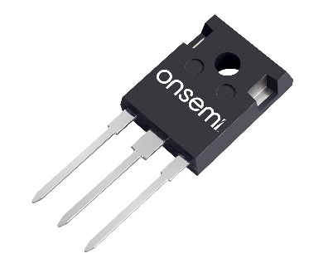
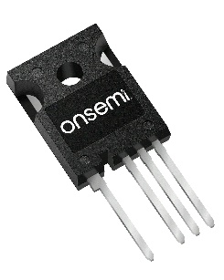
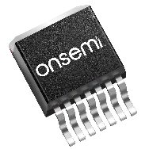


onsemi’s wide range of
SiC Products allows you to choose the power topology best fitting the size, cost
and efficiency constraints
of your design
SiC MOSFETs
Full SiC &
Hybrid SiC Modules
Optimized for superior performance
Lower thermal resistance than discrete devices
Easy to mount packages to fit industry standard pinouts
TO247-3LD
TO247-4LD
D2PAK-7LD
Faster switching
More compact end-product
SiC Diodes
New D3 1200V SiC diode
family minimizes conduction
and switching losses to promote higher end application efficiency
1200V M3S SiC MOSFETs provide up to 20% power loss reduction in hard switching applications compared to industry leading competition
Higher
Efficiency
Notes:
SiC Portfolio Advantages:
SiC technology is robust – 100% avalanche rated
We use larger dies than industry leading competition which improves efficiency – RDS(ON) depends on temperature. By lowering the temperature with a larger die, our dies will then get a lower RDS(ON), improving efficiency and reduces heat output. The exact number depends on the proportion of switching losses to conduction losses which depends on many factors including the application. Applications like DC switches will benefit more from this than high speed switching applications.
Modules - we put capacitors in our modules which reduces the voltage overshoot during ringing. Overshoot is a pain for designers. So you can have faster switching and lower losses with same overshoot, or less overshoot with lower power.

Slide 27






onsemi MOSFET and Diode Families
Family | Series | Optimization | 650V | 900V | 1200V | 1700V | Primary Applications
M1 | M1 | Low RDS(ON) High SCWT |  |  | ..120SC1 | ..170M1
M2 | M2 | Low RDS(ON) High SCWT | ..065SC1 | ..090SC1
M3 | M3S | High speed |  |  | ..120M3S
 | M3T | Low RDS(ON) High SCWT |  |  | ..120M3x SCWT dependent
Family | Optimization | 650V |  | 1200V | 1700V | Primary Applications
D1 | High IFSM | ..65A |  | ..120A | ..170A
D2 | Low QC | ..65B
D3 | Low QC x VF |  |  | ..120C
Traction
On-board Charger
EV Charging Station
UPS/Energy Storage
Solar
High Power Industrial

Slide 28

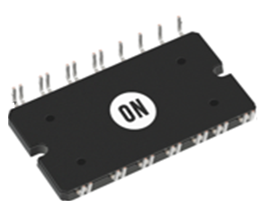
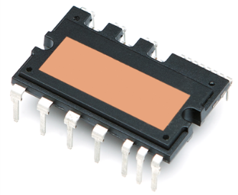
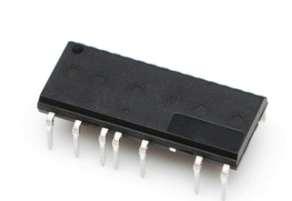
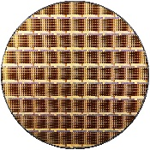
Industrial power solutions target market & products Discrete
Industrial Power solution
SiC MOSFET / Diode
*IPS BU support >650V
  1200V 900V M1 FET
  1200V D1/D2 Diode
  1200V M3 FET
  1700V/2300V M1 FET
Si IGBT / Diode Discrete
  1200V FS7 IGBT
  650V FS4 IGBT
HVAC
Servo
UPS
Full SiC PIM
  F1/F2 2,4,6-PACK
  Pin-compatible w/ IFX, Wolfspeed
IGBT / Hybrid PIM
(Power Integrated Module)
  Q0/Q1/Q2
  F1/F2/F5
  Boost / inverter / xNPC
TMPIM (Transfer Mold PIM)
  FS7 1200V IGBT
  CI/CIB/6pack
Increasing sustainability
Carbon free communities/countries
Vehicle electrification
Industry Automation
Urbanization
Increased Efficiencies
IPM (Intelligent Power module)
  1200V/650V DIP solution
  650V SIP Solution
Wafer sales
Si IGBT / Diode
SiC FET / Diode

