Slide 1
Industrial HART Protocol Modems
Overview
July 2022

Slide 2

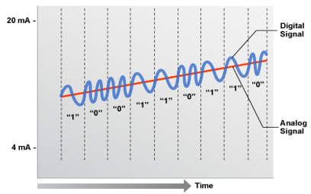
HART protocol and applications
HART protocol
HART (highway addressable remote transducer) is a hybrid protocol, combining analog and digital communication over a single pair of wires
HART technology
HART communicates a single control variable to devices, using a 4-20mA analog signal at Bell 202 shift frequencies of 1200Hz & 2200Hz
HART technology
Additional information (e.g. device status, process variables) is contained in a low-level digital modulation superimposed on the standard 4-to-20mA current loop
HART communication
Transmission of additional information allows HART devices to communicate failure conditions to the host before they cause a major process problem
Smart metering, streetlight control, in-home displays, building automation, solar power
HART applications
Process industry automation: oil & gas, refineries, pharmaceutical, chemical, pulp & paper, food & beverage

Slide 3
onsemi HART product family
Integrated HART transceivers for use as slave or master in twisted pair HART networks
Traditional
HART Communication (1 wire pair)
Host
ONE Analog Variable
Digital status (multiple), analog control signal
Valve (Rx)
Host
Valve (Tx / Rx)
OR
Analog control Signal
Feature | A5191HRT | NCN5192 | NCN5193
Supply range | 3.0 V – 5.5 V | 3.0 V – 5.5 V | 1.8 V – 3.5 V
Clock speed | 60.8 kHz | 1.8432 MHz or 460.8 kHz | 3.6864 MHz
Embedded PA | - | - | Y
Integrated watchdog | - | Y | Y
Integrated POR | - | Y | Y
Integrated DAC | - | Y | Y
Digital communication | UART | UART (data)+ SPI (reconfig) | UART (data)+ SPI (reconfig)
Package | LQFP 32, QFN 32, PLCC 28 | QFN 32 | QFN 32
Ordering information | www.onsemi.com/A5191HRT | www.onsemi.com/NCN5192 | www.onsemi.com/NCN5193

Slide 4
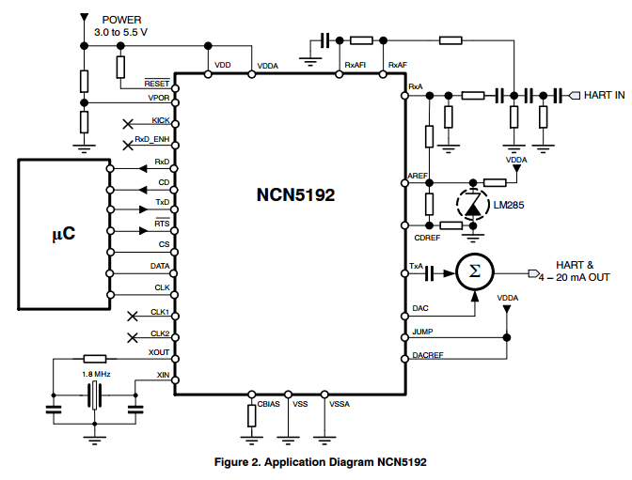
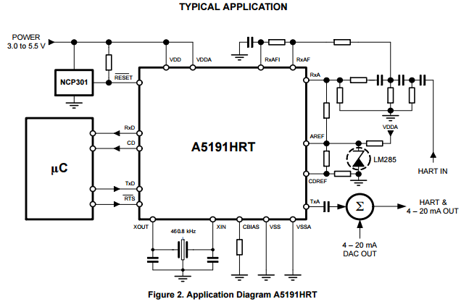
onsemi HART modem features and benefits
Single-chip modem family for use in Highway Addressable Remote Transducer (HART) field instruments and masters
Unique features & benefits
Typical Application Schematic
  Meets HART physical layer requirements
  Half-duplex 1200 baud FSK modem
  Bell 202 shift frequencies of 1200 and 2200 Hz
  Several variants available:
    A5191HRT – De facto standard for HART modem
    NCN5192 – Integrated 16 bit Sigma-Delta DAC
    NCN5193 – Low power – optimal for intrinsically safe applications
Additional features & benefits
  Industrial temperature range: -40 ºC to +85 ºC
  Add-on to standard 4-20 mA communication bus
  3 to 5V power supply range (NCN5193)
  Compatible with 3.3 or 5V microcontrollers (NCN5193)
  Transmit-signal wave shaping
  Receive bandpass filter

