Slide 1
Isolated DC-DC Solutions
PCS BU, MCC, ASG
April. 2022

Slide 2




Isolated DC-DC Flyback Controllers Roadmap
NCL30125 – 2-SW Forward
Enhanced Forward Controller with HB drivers , Current & Voltage Ctrl– QFN24
Power Level
NCP1566 120V AC Forward
Enhanced Active Clamp Forward Controller
Current & Voltage Ctrl– QFN24
Samples Available
NCP1568D AC Flyback
NCP1568 option for DC-DC & POE Applications, TSSOP-18
Sampling, RTM Q2’22
NCP12700 – 9-160 V
Current Mode Flyback Controller
MSOP-10/WQFN10
NCV/P12711 – 4-45 V
Current Mode Flyback Controller, 50 V transient
MSOP-10/DFNW-10
NCV/NCP1362 – QR PSR Flyback
No opto, CC.CV with BO. Target Auto AUX
Existing
2022 +
*AEC-Q100 version
Existing
Developing
Exploring

Slide 3
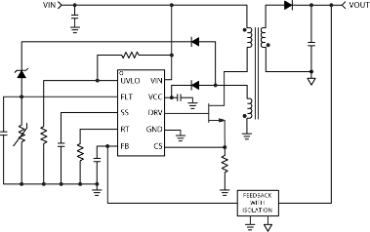
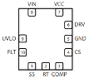
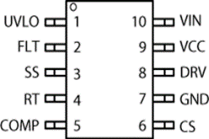
NCP12700 – 9 V to 160 V Flyback Controller
Value Proposition
The NCP12700 is a wide-input range, fixed frequency, peak current mode PWM controller with a highly integrated feature set suitable for implementing single-ended power converter topologies.
Unique Features
Unique Features
Typical Application Schematic & Pin Out
Ultra Wide Range HV (9 – 200 V) startup regulator
User Adjustable Over-Power Protection
Fault pin for thermal and
output over-voltage protection
Eliminate external startup components
Easier design across input voltage range
Interface for thermal and output OVP eliminates external protection
Other Features
Programmable oscillator: 100 kHz – 1 MHz
Internal slope compensation
Adjustable Soft-Start Ramp
Input Voltage UVLO with hysteresis
Shutdown Threshold for External Disable
Overload Protection with 30 ms Overload Timer
1 A / 2.5 A Source / Sink Gate Driver
Market & Applications
Ordering & Package information
Industrial
Telecom
Transportation
Suitable for 2:1, 4:1, 8:1 input range designs
NCP12700xDMR2G in Micro10 3*3 (9-100 V)
NCP12700xMNTWG in WQFN10 3*4 (9-200 V

Slide 4
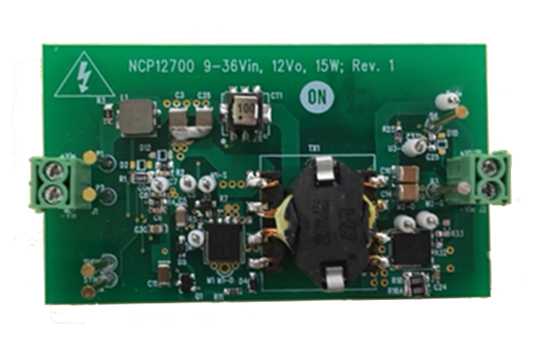
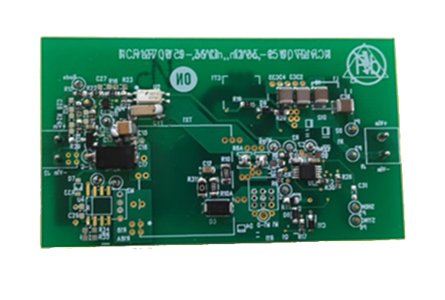
NCP12700 9 – 36 V Input Demoboard
Specifications and Features
Demo Board Photo
4:1 Input Voltage Range: 9 – 36 V
Output: 12 V/1.25 A, 15 W
Full Load Efficiency: > 88 % / 91% peak
Startup time: < 30 ms
Transient Response: < 250 µs
No Load Output Ripple: 200 mVpp Max
No Load Power: 120 mW Max
Overvoltage Protection: 16 VDC Max
Market & Applications
Design Note
OPN: NCP12700LOWVINGEVB
DC/DC Power
DC/DC Modules

Slide 5
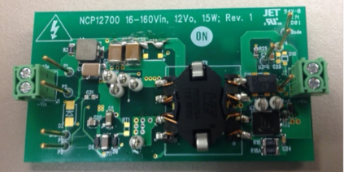
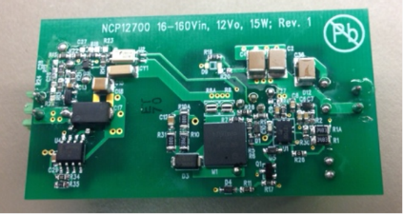
NCP12700 18 – 160 V Input Demoboard
Specifications and Features
Demo Board Photo
9:1 Input Voltage Range: 18 – 160 V
Output: 12 V/1.25 A, 15 W
Full Load Efficiency: > 86 % / 90% peak
Startup time: < 20 ms
Transient Response: < 250 µs
No Load Output Ripple: 150 mVpp Max
No Load Power: 500 mW Max
Overvoltage Protection: 16 VDC Max
Market & Applications
Design Note
DC/DC Modules
Telecom
Power Over Ethernet
OPN: NCP12700WIDEVINGEVB

Slide 6
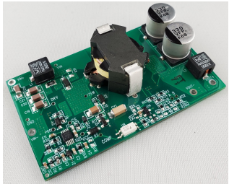
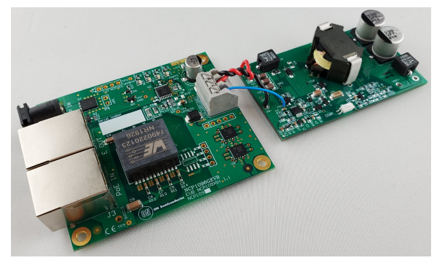
NCP12700 45 W, 24 V Power over Ethernet PD Demo Board
Specifications and Features
Demo Board Photo
Power Over Ethernet Compatible Input Range: 37 V to 57 V
High Full Load Efficiency: >90%
and Average Efficiency
Very Low Ripple and Noise
Smooth Startup Operation
Low Parts Count
Inherent SCP And OCP Protection
Thermal and OVP Protection
Multiple Probe Points for Evaluation
Compatible with the NCP1096GEVB
Market & Applications
Design Note
Power Over Ethernet
Connected to the NCP1096GEVB POE PD Demo

Slide 7
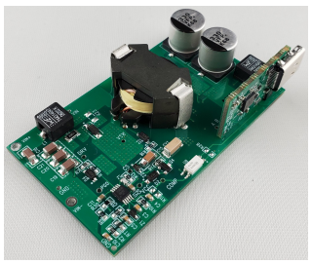
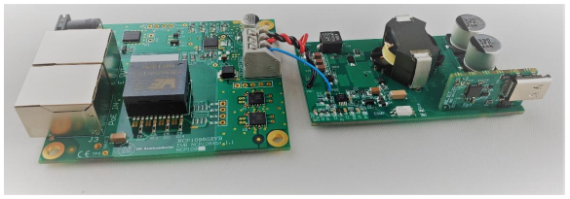
NCP12700 45 W POE TO USB PD Demo
Specifications and Features
Demo Board Photo
Power Over Ethernet Compatible Input Range:37 V to 57 V
USB−PD 5V−20V Operation
High Full Load and Average Efficiency
Very Low Ripple and Noise
Smooth Startup Operation
Low Parts Count
Inherent SCP And OCP Protection
Thermal and OVP Protection
Multiple Probe Points for Evaluation
Compatible with the NCP1096GEVB
Market & Applications
Design Note
Power Over Ethernet to USB PD
Connected to the NCP1096GEVB POE PD Demo

Slide 8
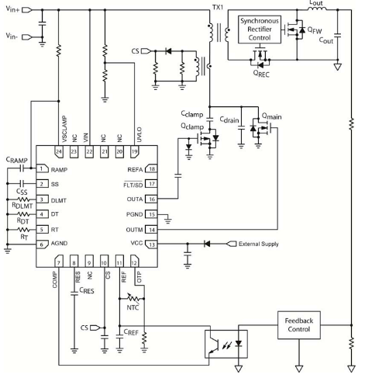
NCP1566 Active Clamp Forward Controller
Value Proposition
The NCP1566 is a highly integrated dual-mode active-clamp PWM controller to implement an isolated active clamp forward or asymmetric half-bridge converter. It which can be configured in either voltage mode control with input voltage feed-forward or peak current mode control. Peak current mode control may be implemented with input voltage feedforward as well.
Unique Features
Unique Features
Typical Application Schematic & Pin Out
Voltage Mode & Current Mode Control
Line feedforward
Adaptive Overlap Time Control
Integrated 120 V HV Startup
Flexible Topology Solution
Stable Constant Crossover Across Input Voltage Range
Extended ZVS Across Input & Output
Lossless Startup & Reduced Vcc Capacitor
Other Features
Vcc: 6.5 V to 20 V
Programmable UVLO
Cycle by Cycle Peak Current Limiting
Adjustable Over Power Production & Overcurrent Protection
Programmable Duty Ratio Clamp
Programmable Oscillator with 1-MHz Max Frequency & Synchronization Pin
Main Switch Drive: -2 A/3 A, Active Clamp Drive: -2 A/1 A
Market & Applications
24 V & 48 V Telecom Systems
Server Power Supplies
48 V Automotive Applications
Ordering & Package information
NCP1566MNTXG in QFN-24

Slide 9
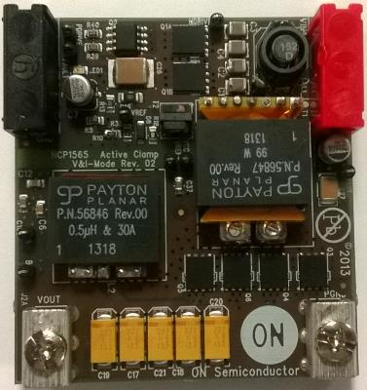
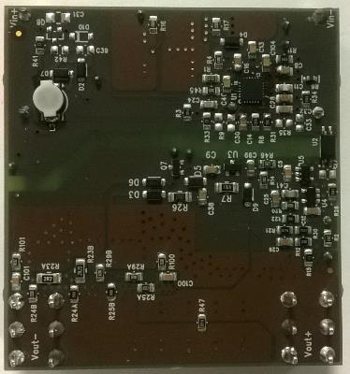
NCP1566 3.3-V/30-A Demoboard for Telecom
Value Proposition
This design is based around active-clamp forward converter operated in current-mode control. This controller offers many features to build an energy efficient converter with all the needed protections like cycle-by-cycle current limit with a 500-mV sense voltage, over current protection (OPP) for a stable maximum output current limit, over temperature protection with a dedicated NTC pin and a pin to sense an output voltage runaway (loop failure for instance).
Key Features
Demo Board Photo
36-72 V dc input
3.3-V/30-A output
>90% efficiency
Internal 120-V start-up source operated in dynamic self-supply during start-up or skip mode.
Voltage- or current-mode control operation
Adaptive dead time for improved efficiency
Line compensation for over power protection
Maximum V-s limit and duty ratio clamp
Short circuit protection
Over voltage protection
5-V/2% voltage reference
Over temperature protection via an NTC
Fault reporting pin also used for shutdown
Synchronization capability via dedicated pin
OPN: NCP1566TELECGEVB

Slide 10
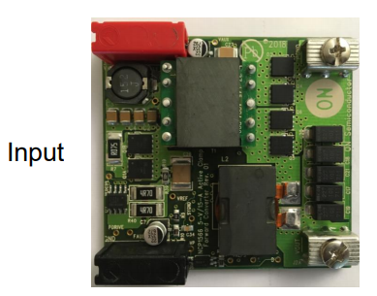
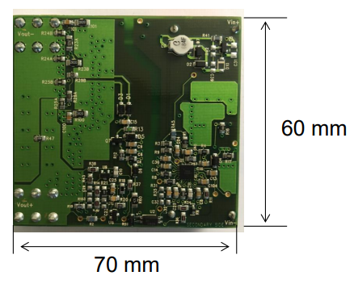
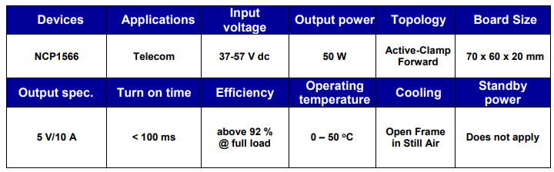
NCP1566 5-V/10-A Active Clamp Foward Demo Board
Value Proposition
This design is based around active-clamp forward converter operated in current-mode control. This controller offers many features to build an energy efficient converter with all the needed protections like cycle-by-cycle current limit with a 500-mV sense voltage, over current protection (OPP) for a stable maximum output current limit, over temperature protection with a dedicated NTC pin and a pin to sense an output voltage runaway (loop failure for instance).
Key Features
Demo Board Photo
Internal 120-V start-up source operated in dynamic self-supply during start-up or skip mode.
Voltage- or current-mode control operation
Adaptive dead time for improved efficiency
Line compensation for over power protection
Maximum V-s limit and duty ratio clamp
Short circuit protection
Over voltage protection
5-V/2% voltage reference
Over temperature protection via an NTC
Fault reporting pin also used for shutdown
Synchronization capability via dedicated pin
Design Note
OPN: NCP1566TEL5V10AGEVB

Slide 11
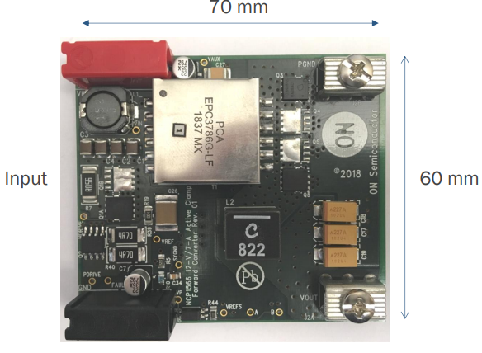
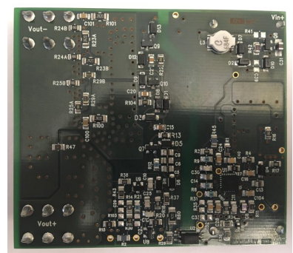
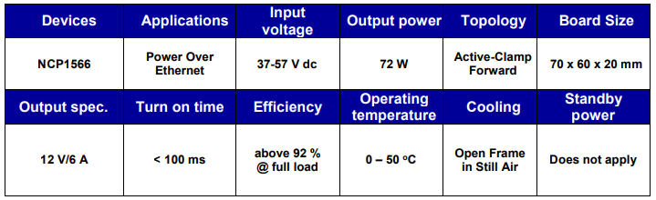
12-V/6-A for Power over Ethernet Demo Board
Value Proposition
This design is based around active-clamp forward converter operated in current-mode control. This controller offers many features to build an energy efficient converter with all the needed protections like cycle-by-cycle current limit with a 500-mV sense voltage, over current protection (OPP) for a stable maximum output current limit, over temperature protection with a dedicated NTC pin and a pin to sense an output voltage runaway (loop failure for instance).
Key Features
Demo Board Photo
Internal 120-V start-up source operated in dynamic self-supply during start-up or skip mode.
Voltage- or current-mode control operation
Adaptive dead time for improved efficiency
Line compensation for over power protection
Maximum V-s limit and duty ratio clamp
Short circuit protection
Over voltage protection
5-V/2% voltage reference
Over temperature protection via an NTC
Fault reporting pin also used for shutdown
Synchronization capability via dedicated pin
Design Note
OPN: NCP1566POE12V6AGEVB

Slide 12
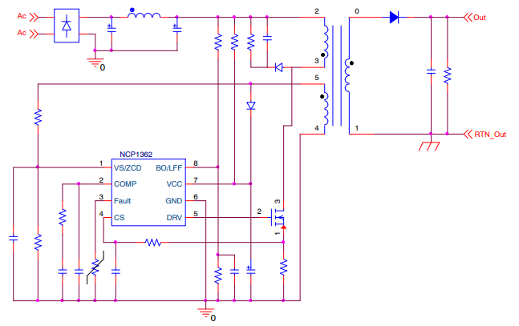

NCP/NCV1362: Primary Side PWM Controller
Value Proposition
The NCV/NCP1362 is a new quasi−resonant peak current mode control mode controller targeting output power levels from a few watts up to 50 W in a flyback application. It is primary side regulated for Constant Voltage and Constant Current regulation, achieving excellent line and load regulation of 5% without requiring the typical opto-coupler and voltage reference for lower cost and improved system reliability. The controller features improved light load efficiency and stand-by performance.
Unique Features
Unique Features
Typical Application Schematic & Pin Out
Dual Frozen Peak Current
Constant Voltage & Current PSR < ±5%
AEC-Q100 Qualified (NCV1362)
Optimize Light Load Efficiency and Standby
Regulated Output without Opto-Coupler
Automotive Applications
Other Features
Quasi-Resonant with Valley Lockout
Max Frequency Clamp (80, 110, 140 kHz and no Clamp)
Frequency Jittering
LFF and BO on Dedicated Pin
Market & Applications
AC/DC Adapters and Power
Industrial Auxiliary Power
Automotive Auxiliary Power
Ordering & Package information
Standard Part #: NCP1362
Package: SOIC-8
AEC-Q100: NCV1362

Slide 13
New Product NCP12711

Slide 14
NCP12711 Low Vin DC-DC Flyback Controller
Sampling, RTM Q2’22
Value Proposition
The NCP12711 is a fixed-frequency peak-current-mode PWM controller containing all of the features necessary for implementing single-ended power converter topologies. The device operates from 4 V to 45 V without auxiliary winding.
Unique Features
Unique Features
Typical Application Schematic & Pin Out
Low Voltage Operation
Adjustable Over Power Protection
NTC-Compatible Fault Interface
Frequency Jitter
Error Amplifier Option
AEC-Q100 Qualified (NCV12711)
4 – 45 V Input Range
Limits Total Power Capability
Provides Thermal Protection
Improves EMI signature
For non-isolated designs
For automotive applications
Other Features
Internal 7.5-V Regulator
0% Duty Ratio Operation in No-Load Condition
Single Resistor Programmable Oscillator – 100 kHz to 1 MHz
Adjustable Soft-Start on Peak Current and Frequency
Output OVP Fault Interface
± 1 A Source / Sink Gate Driver
Market & Applications
DC-DC Converters for Modules and Telecom Application
Industrial Power
Automotive 12 V Auxiliary Power Supply
Ordering & Package information
NCP12711ADNR2G, MSOP-10
AEC-Q100: NCV12711

Slide 15
NCP12711 Pin-out
Pin Name | Pin description
UVLO | Input voltage UVLO and external disable/enable interface Input voltage detection for over-power compensation
FB | FB pin to connect the voltage divider observing the regulated variable
VIN | Connects to the input rail and supplies the IC via a Low voltage dropout (LDO)
RT | Timing resistor for setting of switching frequency
COMP | Op-amp output to which the compensation network connects
SS | Connect a capacitor for setting soft-start duration in both peak current and frequency
CS | Current sense Slope compensation adjustment via a series resistance
GND | IC GND
DRV | Output driver for power switching FET clamped to 10 V.
VCC | Input pin to supply the controller

Slide 16
NCP12711 - Isolated and PSR-type of Converters
Non-isolated primary-side regulation
Isolated primary-side regulation
The NPV12711 includes an op-amp and allows for direction connection to V_{out}
It can also be used in a classical auxiliary-winding-based regulation for raw dc output regulation

Slide 17
Comparative Performance
 | ON NCP12711 | ON NCP12700 | TPS40210(-Q1) | LM5155-Q1 | Benefits
Topology | Iso. Flyback Non-Iso Flyback | Iso. Flyback | Boost/SEPIC Non-Iso Flyback | Boost/SEPIC/ Non-Iso Flyback | Optimized for isolated flyback
Input Voltage Range | 4 – 45 V | 9 - 100 V (MSOP10) 9 – 200 V (WQFN10) | 4.5 – 52 V | 3.5 – 45 V 2.97 – 16 V BIAS=V_{cc} | 4 V required for modules
Switching Frequency | 100 kHz to 1 MHz | 100 kHz to 1 MHz | 35 kHz to 1 MHz | 100 kHz to 2.2 MHz
Soft Start | Adjustable | Adjustable | Adjustable | Adjustable
Current Sense Threshold | 250 mV | 250/495 mV | 150 mV | 100 mV
Programmable Oscillator | Yes | Yes | Yes | Yes
Max duty ratio | 90% | 80% | - | 93%
t_{ON(min)} (typical) | 125 ns | 125 ns | 275 ns @ 12 V | 50 ns
Jitter | Optional | No | No | No | Facilitates EMI
0% duty ratio | Yes | Yes | No | No | Safe no-load operation in low-power isolated converters.
External Sync | No | No | Yes | Yes | Sync to external clock
Faults | OCP, OPP, SCP, UVLO | OCP, OPP, PTP/OVP (FLT), SCP, UVLO | OCP, UVLO | OVP, SCP, Thermal Shutdown, UVLO | Fewer external components, robustness
Auto-recovery | Auto-Recovery/Latch | Auto-Recovery/Latch | OCP Retry | - | Design flexibility
ESD, HBM | 2 kV | 2 kV | 2 kV | 2 kV
Operating Junction Temp | -40 °C to +125 °C | -40 °C to +150 °C | -40 °C to +125 °C | -40 °C to +125 °C | Characterization up to 150 °C
Packages | MSOP10 | MSOP10 WQFN10 | HVSSOP10, VSON10, PDSO10 | 3x2 WSON12 (wettable flank) | Leadless with wettable flanks for inspection

Slide 18
NCP12711 in Details

Slide 19
Overview
Peak-current-mode control with adjustable slope compensation
Adjustable fixed-frequency 100 kHz to 1-MHz operation
Optional internal frequency jitter
Guaranteed startup for V_{in} = 4 V up to V_{in} = 45 V continuously
Guaranteed operation after startup down to V_{in} = 3.7 V
Internal 7.5-V V_{cc} regulator – direct connection to V_{in} up to 30 V
Junction temperature of 125 °C max and characterization data up to 150 °C
Internal over-power protection
OTP/OVP via a multi-function pin
250-mV maximum peak current setpoint
Adjustable soft start in peak current and frequency
90% (typ) max duty ratio limit and 0% operation
Standby mode via UVLO pin
30-ms overload timer with 1-s auto-recovery time
Options for 100 and 200-ms durations

Slide 20
Soft Switching Frequency Increase at Power Up or in Fault
Most controllers start switching at maximum frequency
NCP12711 switches at 30 kHz and increases frequency during the SS sequence
Overall stress is minimized, especially with a secondary-side sync rectifier
F_{sw}
30 kHz
F_{sw}
T_{sw}
30 kHz
5 ms
t
Power up

Slide 21
Smooth Secondary-Side Current
Secondary-side stress is also reduced. Here, a high-line start-up sequence.

Slide 22
Adjustable Compensation Ramp
Compensation ramp is needed for CCM operation and D > 50%
V_{dd}
Adjust compensation level
Select the exact amount of slope compensation in relationship to L_{p}
Avoid peak power limitation at low line inherent to internal compensation ramp
Implemented in numerous controllers
t_{on}
To PWM
CS
R_{ramp}

Slide 23
OverPower Protection - OPP
A converter can deliver more power in high-line conditions
The stress on the switching components increases
Precautions are needed to keep away from failure
4-40 V, 5 V/1 A flyback converter
11.3 W
L_{p} = 1.5 µH
F_{sw} = 250 kHz
R_{sense} = 40 mΩ
I_{out,LL} = 1.3 A
I_{out,HL} = 2.3 A
OPP is needed
6.3 W
4 V

Slide 24
Internal Peak Reduction
Maximum peak current decrease relies on the UVLO pin
A scaled version of V_{in} is sensed and affects V_{CS(max)}
A 20% reduction in V_{CS(max)}
Without OPP
6.3 W
With OPP
7.2 W
4 V
OPP keeps the maximum current under 1.5 A for a 1-A nom. value

Slide 25

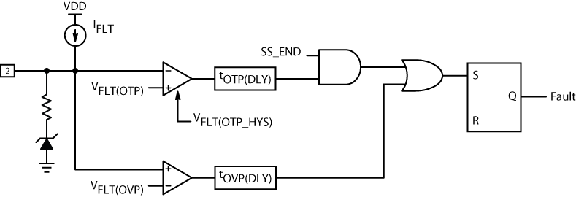

Fault Input for OVP and OTP
You can accurately shut the converter off in overheat conditions
Adding an extra winding and a Zener diode ensure a rugged OVP
V_{CC} from auxiliary winding
Precisely-monitored
operating temperature
Build rugged converters with this 2-function pin

Slide 26
System Performance

Slide 27
Evaluation Board – NCV12711 with SSR Regulation
This board is designed to deliver 12 V/1 A from a 4.5- to 45-V input voltage
Its main purpose is to let the designer test the part along its full operating range

Slide 28
Demonstration Board – NCV12711 with PSR regulation
This board is designed to deliver 12 V/1 A from 4.5 to 45 V
Main application is an automotive converter without optocoupler
The auxiliary winding is used for a simple yet efficient regulation means

Slide 29
Waveforms
Design note will be available soon

Slide 30
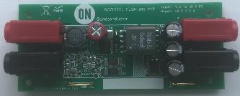
Demonstration Board – NCV12711 Floating PSR
This board is designed to deliver 12 V/1 A from 4.5 to 38 V
Main application is an automotive converter without optocoupler & auxiliary winding.
The MOSFET is floating like a buck converter.

Slide 31
Waveforms
Design note will be available soon

Slide 32
SIMPLIS® Models are Ready
NCV12711
SIMPLIS® application circuit

Slide 33
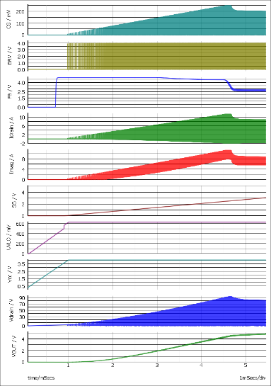
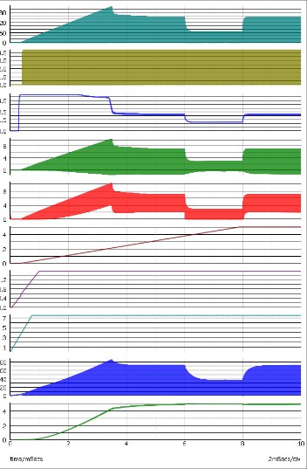
A Smooth Start-Up Sequence
F_{sw} = 30 kHz
F_{sw} = 120 kHz
V_{in} = 4 V – LDO is off
V_{in} = 10 V – LDO is active

Slide 34
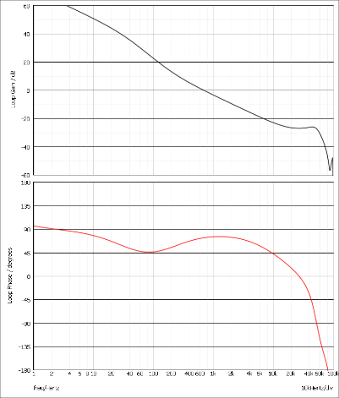
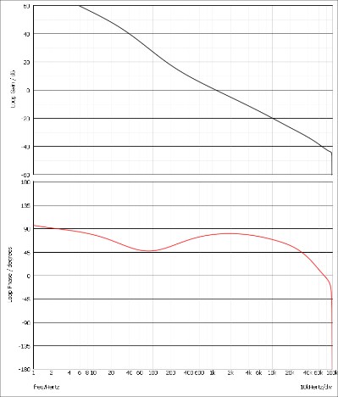
Frequency Response is also Available
Loop gain, V_{in} = 4 V
f_{c} = 700 Hz, ϕ_{m} = 73°
Loop gain, V_{in} = 36 V
f_{c} = 1.2 kHz, ϕ_{m} = 80°

Slide 35
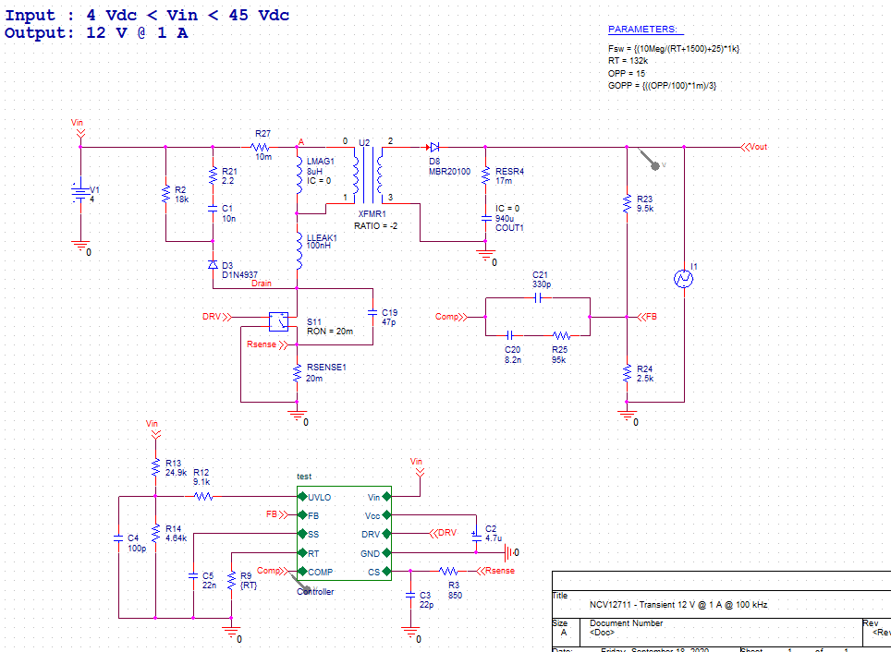
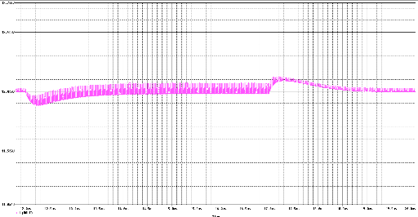
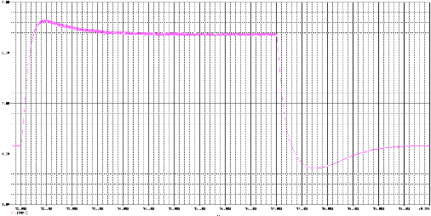
A CADENCE’s PSpice® Model is Available

