Slide 1
KNX Arduino Shield Evaluation Boards
May 2022
Mike Sandyck

Slide 2
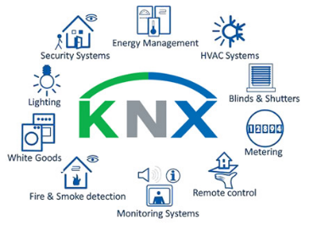
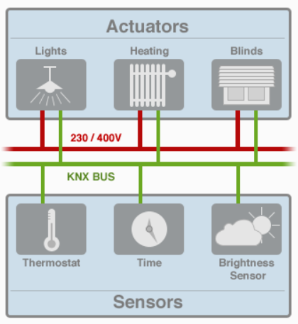
KNX Network and Applications
KNX.org - The world’s most adopted standard for building automation
Worldwide Standard
KNX.org celebrated it’s 30th birthday in 2019, counts 495 members, 8000 certified products, 490 training centres, 90.000 installation partners across 190 countries
Applications
KNX is an intelligent control system standard through which all applications and devices in a building automation system can communicate
The major advantage is the multi-vendor interoperability through certification and training centers for installers
Technology
The communication bus is separated from the actuator power delivery, and can consist of different forms of physical layer (Twisted Pair, IP, RF, Power Line Comms, …)
Typically used is Twisted Pair, that performs a double function: supply enough power for the sensor or switch, and allowing communication at a data rate of 9,6kbps
Network
The KNX network allows for up to 256 devices along one 1000m segment, and up to 256 segments in a network

Slide 3
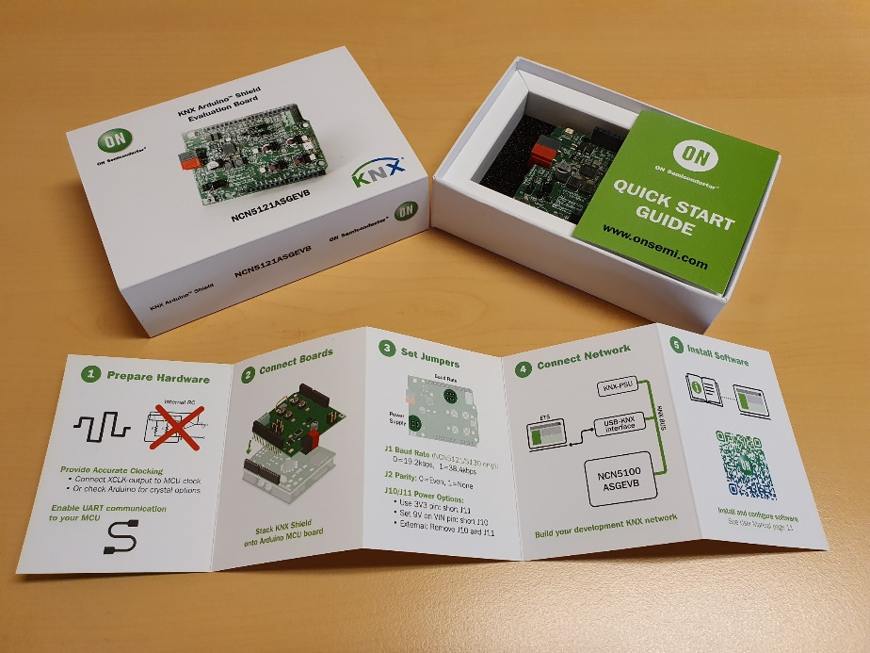
Arduino Shield Evaluation Board Features
Arduino Uno V3 connections compatible with a wide variety of microcontroller boards
Fully TP-UART compatible
Enhanced KNX Transceiver to MCU communication diagnostics
Selectable fan-in:
Up to 40mA on the NCN5130 version
The NCN5121 goes up to 24mA
Two high efficiency DC-DC converters
3.3 V fixed
1.2 to 21 V selectable
Integrated 20 V linear regulator

Slide 4
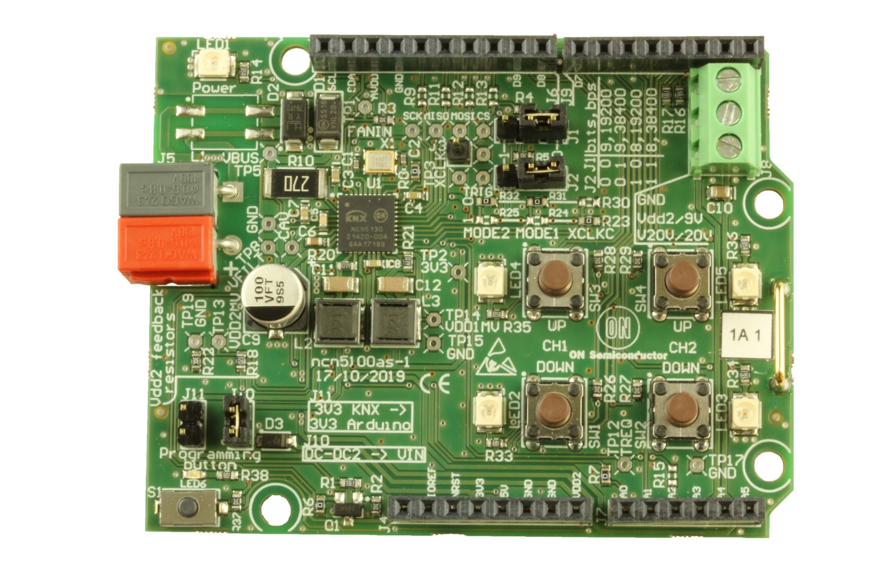
NCN51xxASGEVB – Major components
NCN5130 Transceiver
Generic XTAL 16MHz
Baud Rate Jumpers
Arduino Uno V3 Shield connector
Transceiver Area < 2x2 cm²
Protection Diodes
GND
DCDC2 9V LDO 20V Output
Transmit Resistor
KNX Line In
Buffer Cap
NCN5130ASGEVB
DCDC Coils
4x Pushbutton + LED
Arduino Uno V3 Shield connector

Slide 5
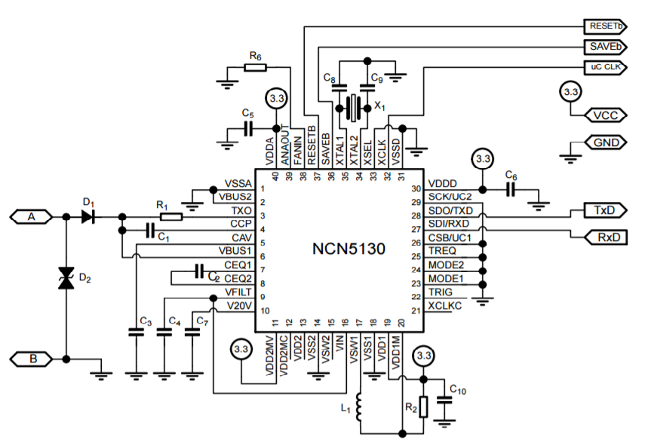
Smallest Footprint Solutions & Lowest BoM Cost
NCN5121/5130 MAC + PHY Transceivers
Only 17 components + IC (DCDC1 and XTAL populated)
Small buffer cap (down to 27µF)
Low cost 16MHz crystal
MCU clock out
Integrated DC-DC convertors (NCN5110/21/30)
LDO (NCN5121/30)

Slide 6
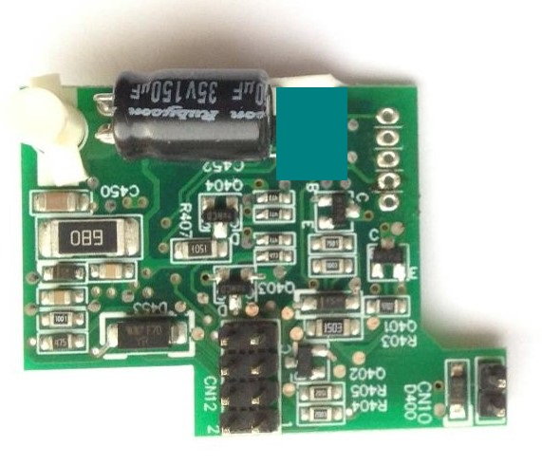
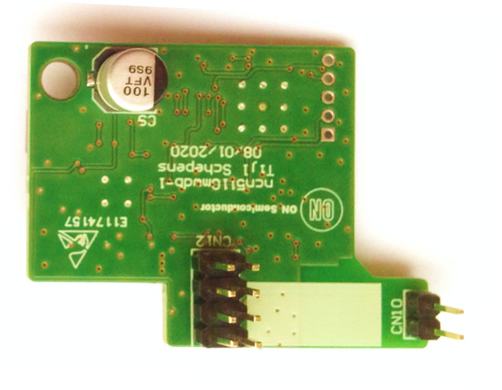
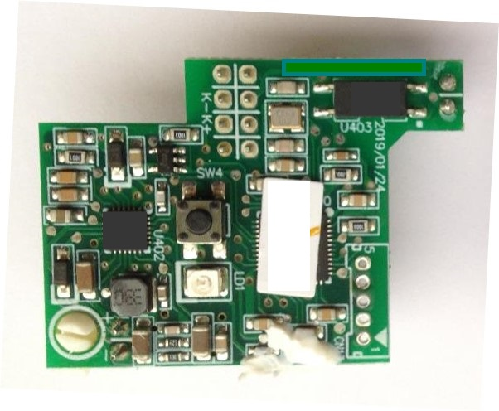
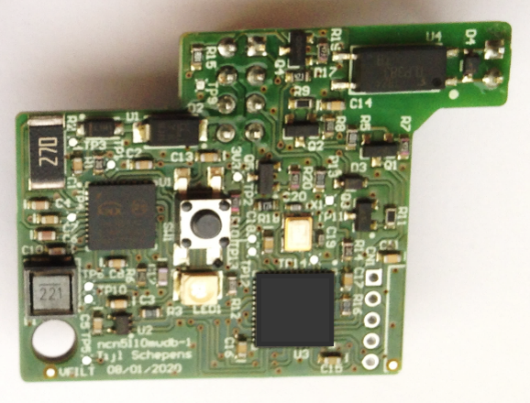
Example Bit Transceiver with minimal footprint
NCN5110 Bit Transceiver
Before Competition solution, on 4-layer PCB
After
NCN5110 based PCB
Lower BOM
Single sided assembly possible
2-layer PCB

Slide 7
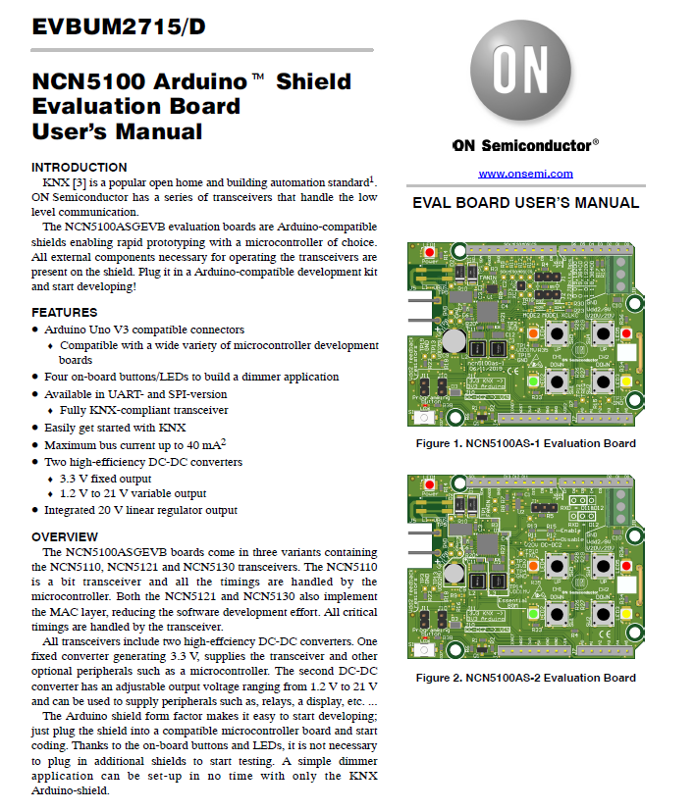
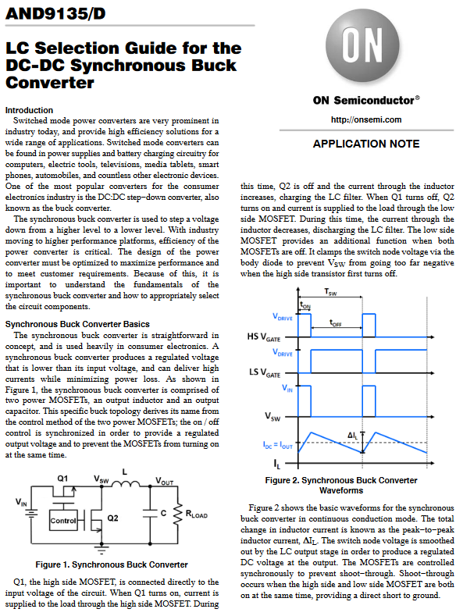
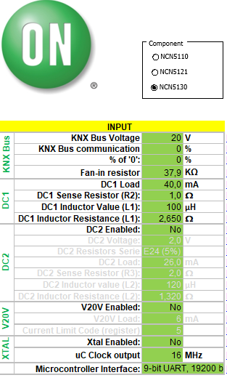
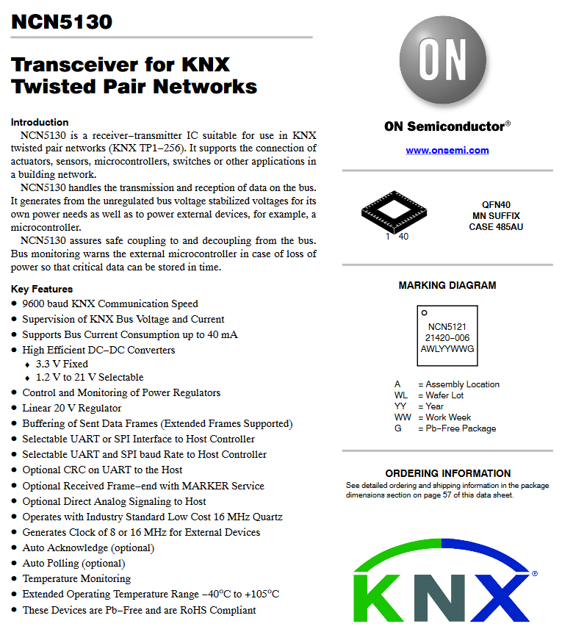
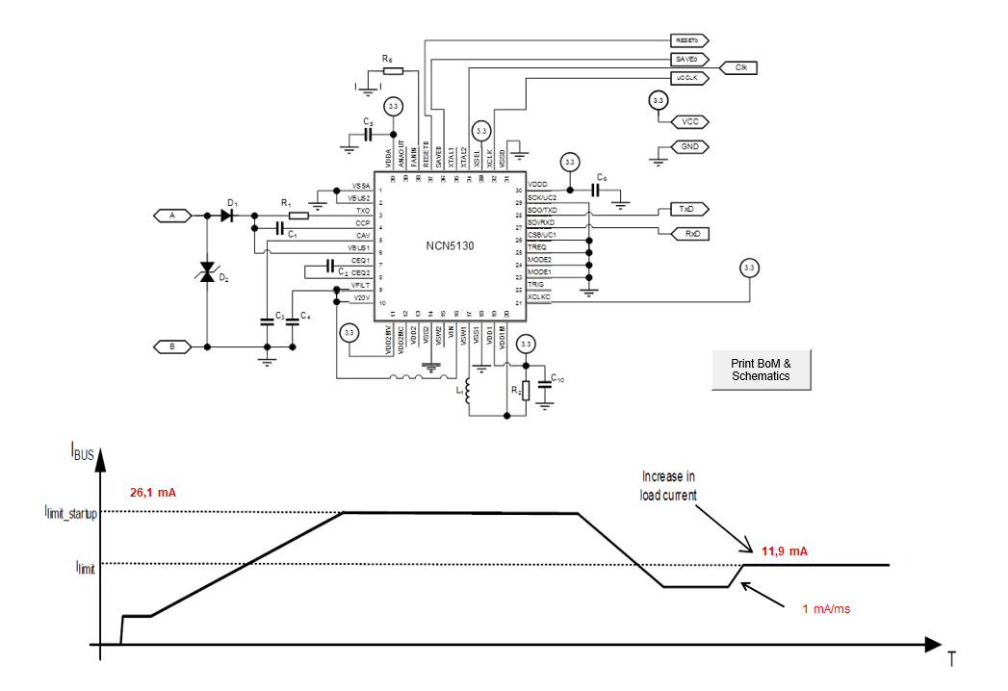
Support and Collateral
* Live weblinks in the headers *
User Manual
User Manual
Datasheets
NCN5130 NCN5121
NCN5110
App Note
LC Selection Guide
Design Tools
Efficiency Calculator

Slide 8
Key Product Information
Devices: NCN5110, NCN5121, NCN5130 Evaluation Boards: NCN51xxASGEVB

Slide 9
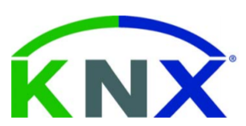
KNX Twisted Pair Modems and Transceivers
Certified KNX transceiver for use in twisted pair networks
Unique Features & Benefits
Typical Application Schematic
Certified KNX transceivers
Two DC-DC converters; 3.3V fixed, 1.2 to 21V selectable
Low voltage drop for increased efficiency
Supervision of KNX bus voltage and current
Supports bus current consumption up to 40mA
Enhanced transceiver to mcu communication diagnostics
Other Features & Specifications
Lower BOM cost
Temperature monitoring
Linear 20V regulator output
Certified software stacks through Weinzierl and Tapko
Extended temperature range: -40 to 105°C
Markets & Applications
Ordering & Package Information
Building Control and Automation
Security and Monitoring
Lighting Control
IP Connectivity and Remote Access
QFN40 6x6
NCN5110: Analog PHY
NCN5121, NCN5130: PHY + MAC
http://www.onsemi.com/PowerSolutions/product.do?id=NCN5130

Slide 10
Existing Family Portfolio
 | NCN5110 | NCN5121 | NCN5130
Implements | PHY | MAC+PHY | MAC+PHY
Analog monitoring of Vbus, Vfilt, DC2, DC1, V20V, Ibus, Temp | No | Yes | Yes
Analog fan-in model (5-40 mA) | Yes | No | Yes
Requires crystal | No | Yes | Yes
Communication interface | Analog | UART/SPI | UART/SPI
DCDC Convertor 3.3V fixed | Yes | Yes | Yes
DCDC Convertor 1.2 to 21V adjustable | Yes | Yes | Yes
LDO 20V adjustable current limit | No | Yes | Yes
EVB Order Code | NCN5110ASGEVB | NCN5121ASGEVB | NCN5130ASGEVB

Slide 11
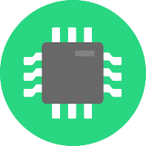
Industry leading KNX Transceivers
onsemi key benefits
High degree of integration, Low BOM cost, compact design size
DCDC1 (3.3V fixed @ 100mA)
DCDC2 (1.2 – 21V @ 100mA), additional, adjustable DCDC convertor
20V LDO
MCU clock out frequency (8 or 16MHz)
Industry leading efficiency
High system efficiency: Low bus current draw, Low bus voltage drop
High efficiency of onboard DCDC convertors (%%%)
High system reliability / robust communication
Diagnostic features on MCU/MAC communication
Extensive system & bus signal monitoring options (Vbus, Vfilt, DC2, DC1, V20V, Ibus, Temp)
Support for TPUART communication and TP1-256 (256 max devices per line)
Additional benefits:
High max current draw from the bus (up to 40mA)
Very fast start-up time
Extended operating temperature range -40° ~ +125°C
A++
A+
A
B
C
11
5/25/2022

Slide 12
Additional Supporting Data
KNX Secure
Notes:
Plots, charts, graphs, and any additional data that supports previous slides.

Slide 13
KNX Secure
The latest addition to the standard is KNX Secure, lifting the platform to new levels of automation security. KNX Secure is implemented into two layers.
KNX Data Security prevents data manipulation, by encrypting all the data that is sent around the network.
Up to 256bit AES encryption can be used to ensure a high level of protection.
Frame format that is unchanged, so secure messages can be routed through existing network
Existing couplers and devices will not be hampered by this new secure communication.
Meaning new secure nodes can be dropped into existing networks without interoperability issues, and be implemented on any physical layer (= including Twisted Pair with ON KNX Transceivers)
KNX IP Secure protects the setup from unauthorized access. In other words no-one without proper access can manipulate the settings of the devices and the network. This can only be used on IP links and is therefor only used on the backbone IP links of the network.

