Slide 1
Metering Bus Transceivers
Jan 2022
Energy Management BU Mike Sandyck

Slide 2
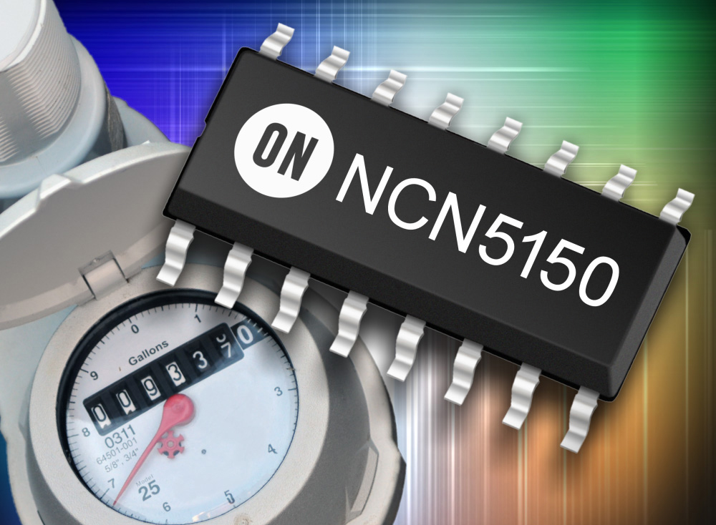
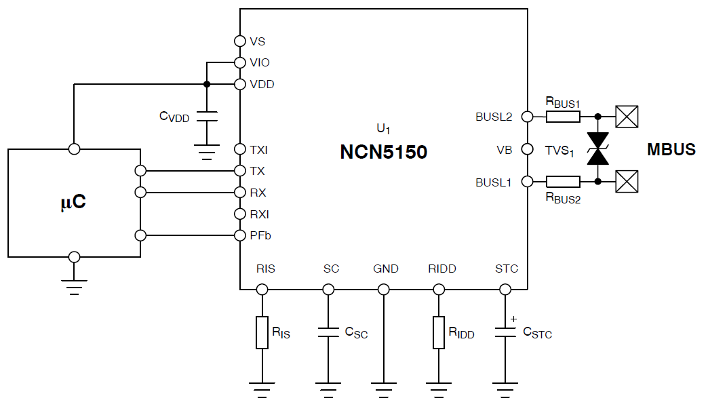
NCN5150/NCN5151
Wired M-BUS Slave Transceivers including Low Power Mode Support
Unique Features & Benefits
Typical Application Schematic
EN 13757-2 and EN 1434-3 compliant
Integrated 3.3 V VDD LDO regulator
Supports powering slave device from the bus
UART communication speeds up to 38,400 baud
Adjustable I/O levels
Adjustable constant current sink up to 2 or 6 Unit Loads
Low bus voltage operation
Extended current budget for external circuits
Polarity independent, Power-Fail function, Fast startup
2 and 3−Wire Low Power Modes with Selection Input Pins (NCN5151)
Supports Powering Slave Device from External Power Supply (NCN5150)
Ordering & Package Information
-40 to +85°C Industrial Temp Range
NCN5150DG: SOIC16, 48pcs Tube
NCN5150DR2G: SOIC16, 3000pcs Reel
NCN5150MNTWG: NQFP20 4x4, 3000pcs Reel
NCN5151MNTWG: NQFP20 4x4, 2500pcs Reel
Applications
Utility Meters: Water, Gas, Heat, Electricity, ...

Slide 3
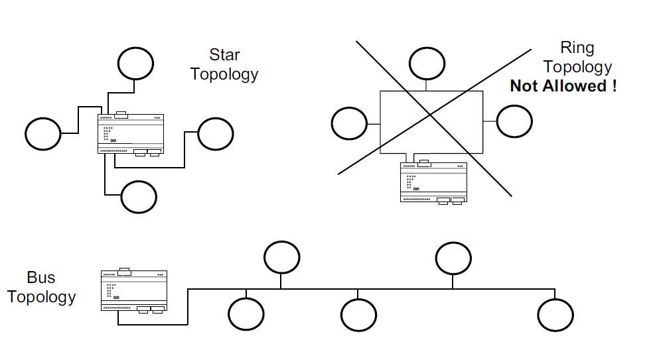
Metering Bus Principles
M-BUS Protocol (EN13757-2)
Master <-> <250 slaves
Bus & star (or mixed) topology
http://www.m-bus.com/
M-Bus power
Bus voltage = 21V – 42V
Slave draws fixed N x 1.5mA where N = 1 – 6 (max 9mA)
Current is dumped in Storage Capacitor
From the storage capacitor (STC) the application is powered through LDO

Slide 4
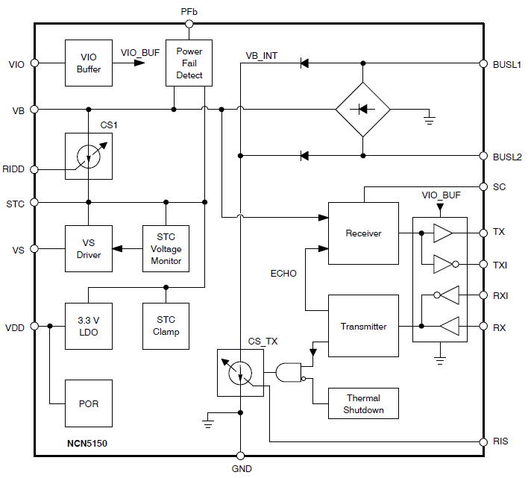
NCN5150
2wire M-BUS transceiver for slave devices and repeaters
TSS721A pin-to-pin compatible
No transistor on STC pin required
Larger C_{VDD}, C_{STC}
Integrated 3.3 V VDD LDO regulator (15 mA peak current)
Supports powering slave device from the bus and from External Power Supply
UART communication speeds up to 38,400 baud (half-duplex)
Adjustable I/O levels
Adjustable constant current sink
up to 2 Unit Loads in SOIC16 package
Up to 6 Unit Loads in QFN20 package
Low bus voltage operation
Extended current budget for external circuits (0.88 mA minimum)
Polarity independent, Power-Fail function, Fast startup

Slide 5
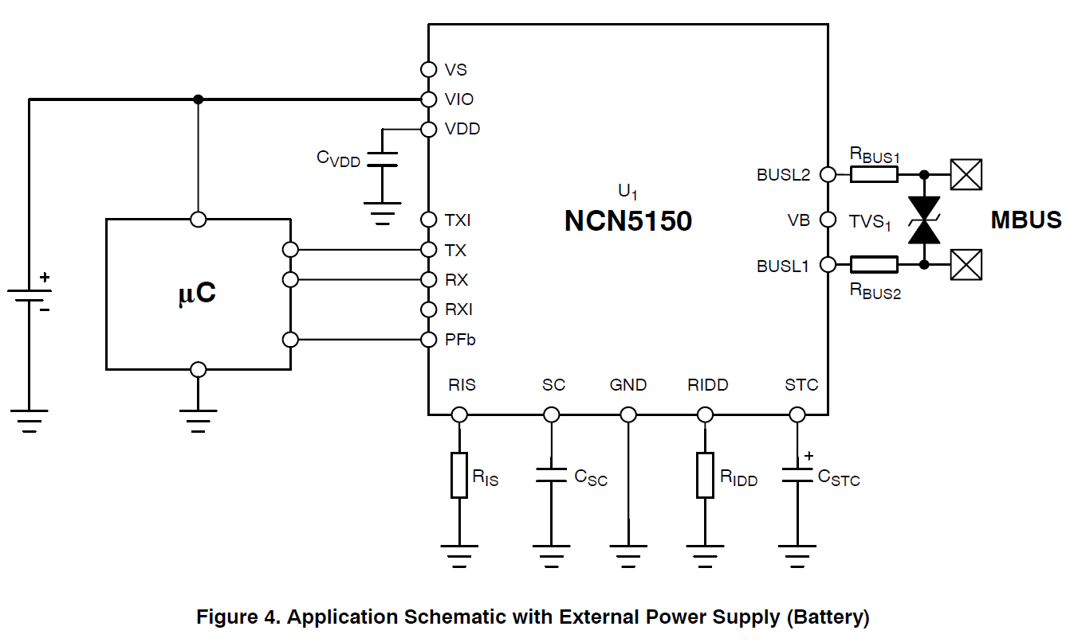
2WLPM (S- CR)
NCN5150 – Battery supply option

Slide 6
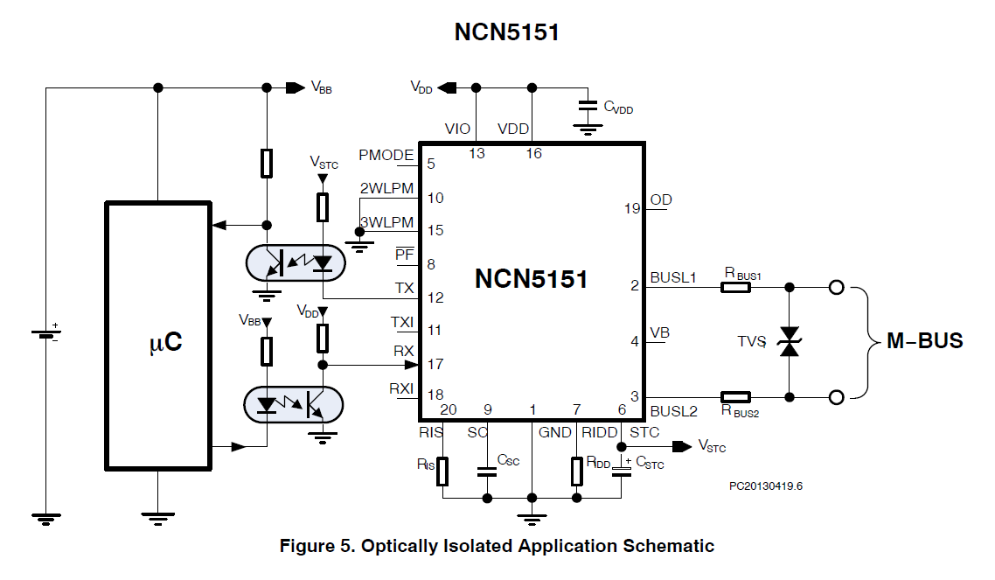
NCN5150 Application Schematic
NCN5151
2- or 3-wire M-BUS transceiver with Low Power Mode Support
Identical to NCN5150 plus:
2-Wire Low Power Mode SCR (System for meter Communication and Readout for powerless meters)
3-Wire Low Power Mode
Notes:
2-Wire Low Power Mode SCR (System for meter Communication and Readout for powerless meters)
3-Wire Low Power Mode

Slide 7
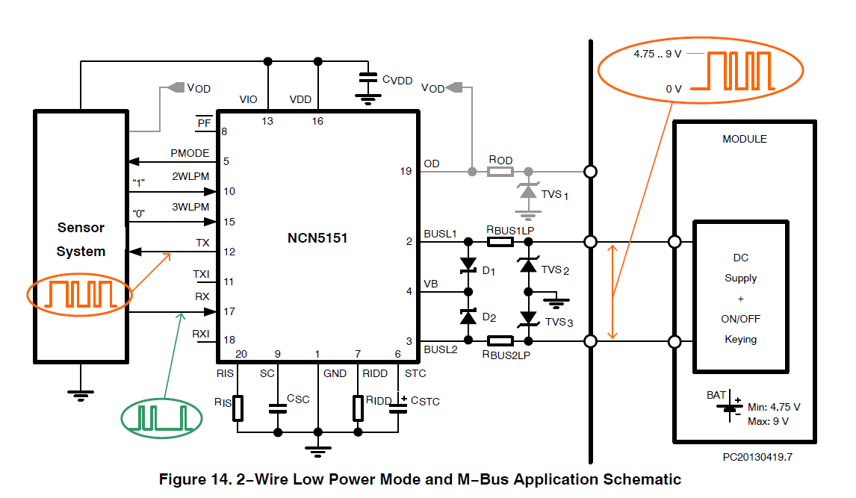
2WLPM (S- CR)
NCN5151 - 2-Wire Low Power Mode

Slide 8
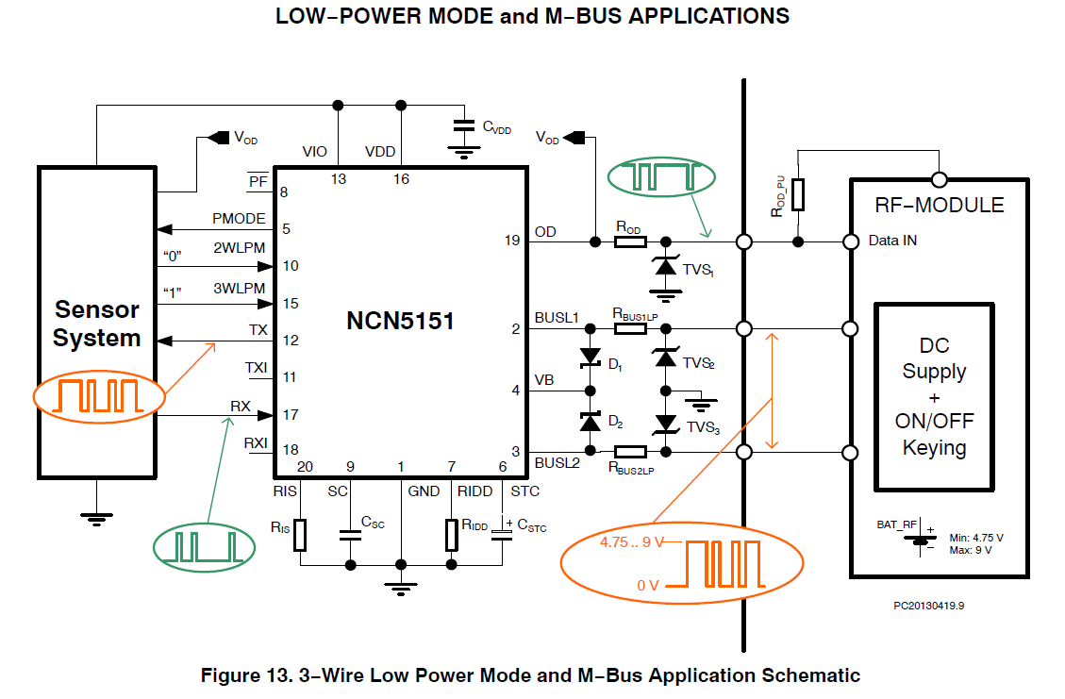
3WLPM
NCN5151 - 3-Wire Low Power Mode

Slide 9
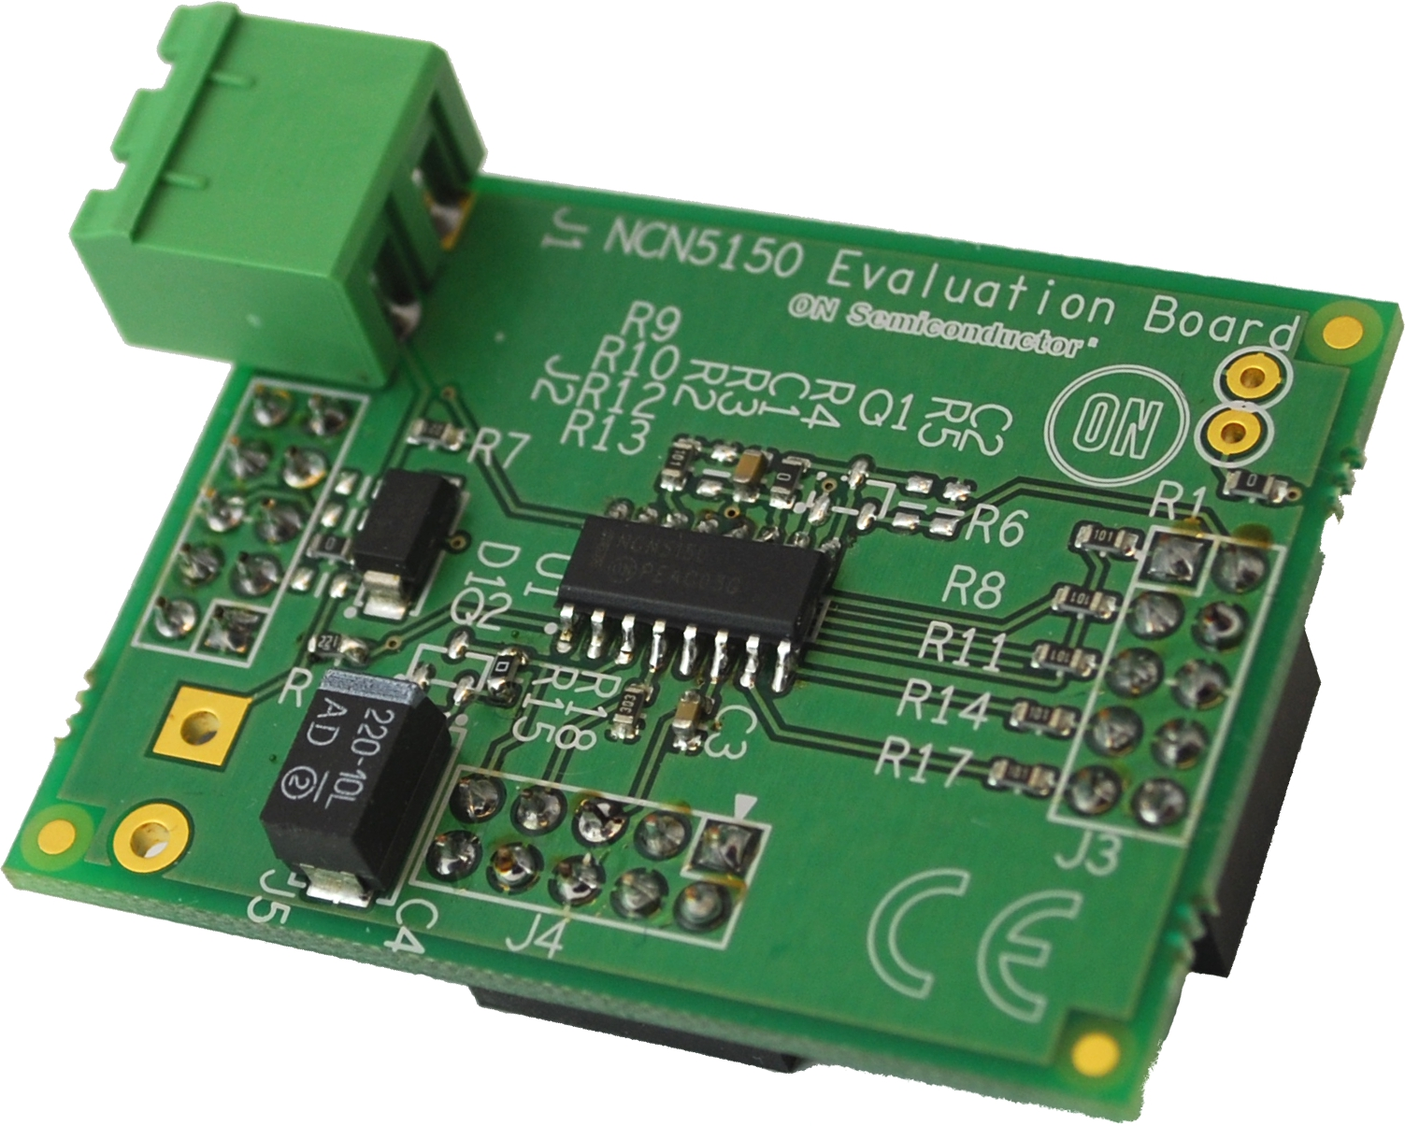
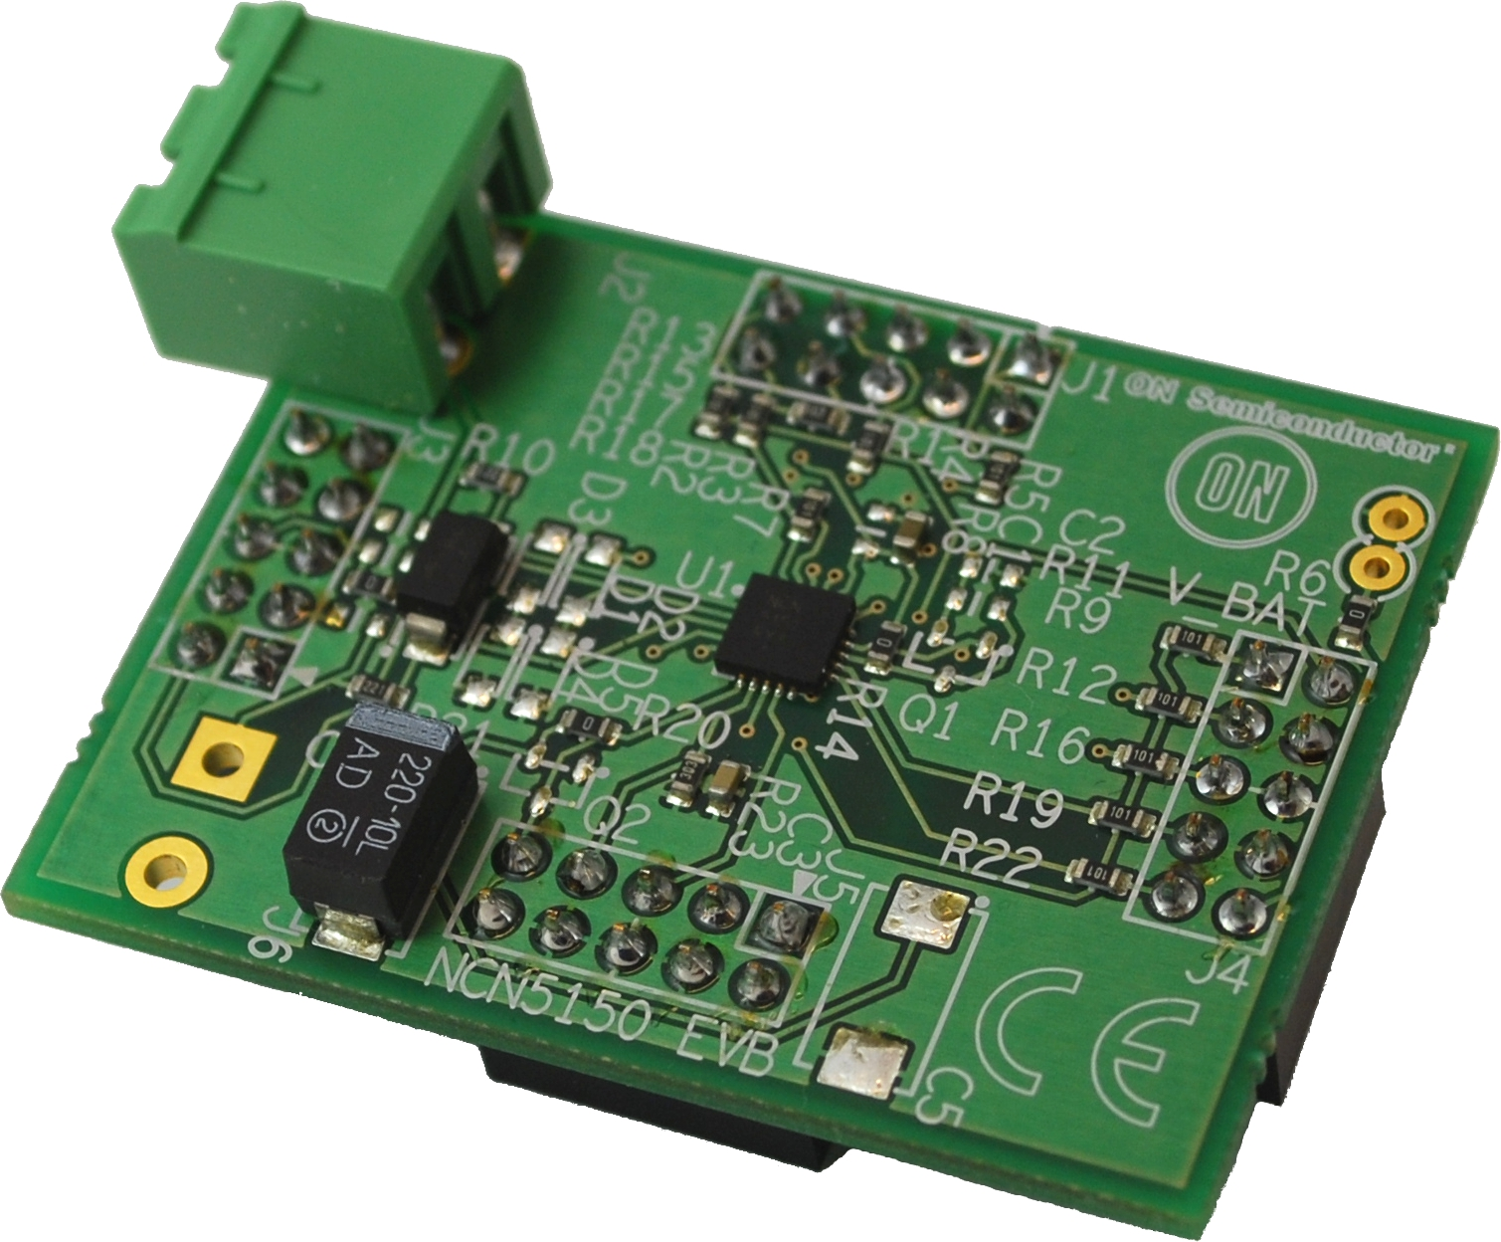
NCN5150 Evaluation Boards
NCN5150SOICGEVB Wired M-BUS Slave Transceiver, 2 unit loads
NCN5150QFNGEVB Wired M-BUS Slave Transceiver, 6 unit loads

