Slide 1
NCL30488B, NCL30486B
Single Stage PSR Flyback, LED Lighting
December 2021
Notes:
*Mandatory Slide*
Above information can be pulled from onsemi.com if needed.

Slide 2
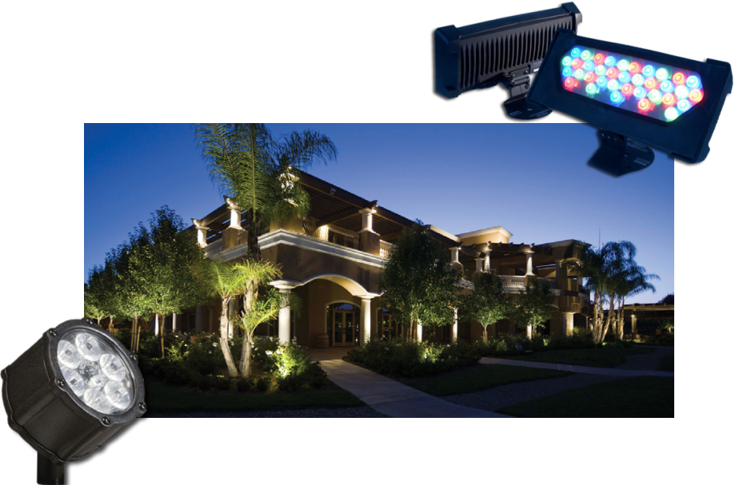

NCL30486B - Dimming
Product Family Overview
Applications
The NCL30486B is a high PF Single stage Constant Current and Constant Voltage PSR PWM controller for Flyback/ Buck-Boost/ Sepic/ Boost. This controller operates in a QR mode to provide high efficiency. Thanks to a novel control method, the device is able to tightly regulate a constant LED current from the primary side. This device is providing very deep analog dimming output current with two dedicated dimming control input pin – ADIM and PDIM.
LED Lighting Driver
Analog/PWM Dimmable LED Driver
Ceiling light
Flood light
Features
Integrated 700 V HV Startup
Precise current regulation accuracy (<±2% typical)
Precise voltage regulation accuracy (<±1% typical)
PF(>0.95)/THD(<10%) @ Universal input
Quasi-resonant control
Standby Mode
Optional PSR/SSR mode
Excellent Dimming features
System or Application Block Diagram
Value Proposition
Fast startup, low standby power
Constant brightness
Aux. power supply for MCU & cold start up
Exceeds global standards PF/THD
Higher efficiency
P_{IN}: < 150 mW
Design flexibility
Wide and Precise dimming operation

Slide 3
NCL30488B – Non-dimming
Product Family Overview
Applications
The NCL30488B is a high PF Single stage Constant Current and Constant Voltage PSR PWM controller for Flyback/ Buck-Boost/ Sepic/ Boost. This controller operates in a QR mode to provide high efficiency. Thanks to a novel control method, the device is able to tightly regulate a constant LED current from the primary side. The device is highly integrated with a minimum number of external components. A robust suite of safety protection is built in to simplify the design.
LED Lighting Driver
Non-dimming LED Driver
Ceiling light
Flood light
Features
Integrated 700 V HV Startup
Precise current regulation accuracy (<±2% typical)
Precise voltage regulation accuracy (<±1% typical)
PF(>0.95)/THD(<10%) @ Universal input
Quasi-resonant control
Standby Mode
Optional PSR/SSR mode
System or Application Block Diagram
Value Proposition
Fast startup, low standby power
Constant brightness
Aux. power supply for MCU & cold start up
Exceeds global standards PF/THD
Higher efficiency
P_{IN}: < 150 mW
Design flexibility

Slide 4
Existing Product Portfolio
Overall Features | NCL30186 (10 SOIC) NCL30188 (8 SOIC) | NCL30386 (9 SOIC) NCL30388 (7 SOIC) | NCL30486 (9 SOIC) NCL30488 (7 SOIC)
Regulation | CC PSR | CC/CV PSR | CC/CV PSR / SSR by fuse option
Topology | Buck-boost/Flyback | Buck-boost/Flyback | Buck-boost/Flyback + Boost
CC Tolerance (T_{J} = 25 ~ 85 °C) | ±3% | ±2% | ±2%
HV Startup | No | Yes | Yes
Line range | 85 ~ 320 Vac (sensed by VS pin) | 85 ~ 267 Vac (sensed by HV pin) | 85 ~ 320 Vac (sensed by HV pin)
Line OVP | No | No | Yes
Standby Mode | No | No | Yes (in B version)
Output Current Limit at Line Transient | No | No | Yes
Dimming Features | NCL30186 (10 SOIC) | NCL30386 (9 SOIC) | NCL30486 (9 SOIC)
Dim. Input Pin | ADIM | ADIM and PDIM | ADIM and PDIM
Dim. Curve | Linear | Option : Linear / Log | Option : Linear / Log
Dim. CC Tolerance | ±33% @ 7% V_{REF} | ±20% @ 10% V_{REF} | ±10% @ 10% V_{REF} ±17% @ 5% V_{REF}
Dim. minimum level | 0% | Option : 0.5% / 0% | Option : 8% / 5% / 1% / 0%

Slide 5
Comparison : NCL3048xA and NCL3048xB
Features | NCL3048xA | NCL3048xB
Max. On Time | Fixed | Variable (Variable max. on time reduces EMI filter oscillation at Vin zero cross in light load.)
Standby | 500 mW | 150 mW (by extended dead time control)
dimCV mode | No | Yes (When dimming input is close to zero, CV level is lowered to turn off LED.)
Flicker-free dimming | Good | Very good (Higher dimming resolution and reinforced dimming signal filter)
CCM prevention | No | Yes (off time is 50 us for 8 ms to prevent CCM at startup.)

Slide 6
Pricing
  NCL30486B1DR2G, NCL30486B2DR2G: $0.40
    2500
    SOIC-9 NB
  NCL30488B1DR2G, NCL30488B2DR2G, NCL30488B4DR2G: $0.36
    2500
    SOIC-7
Collateral
Data Sheets
NCL30486B
NCL30488B
Application Note
NCL30486/8
Design Tool
Excel Calculator
Compensation
Evaluation Boards
NCL30486LED2EVB

