Slide 1
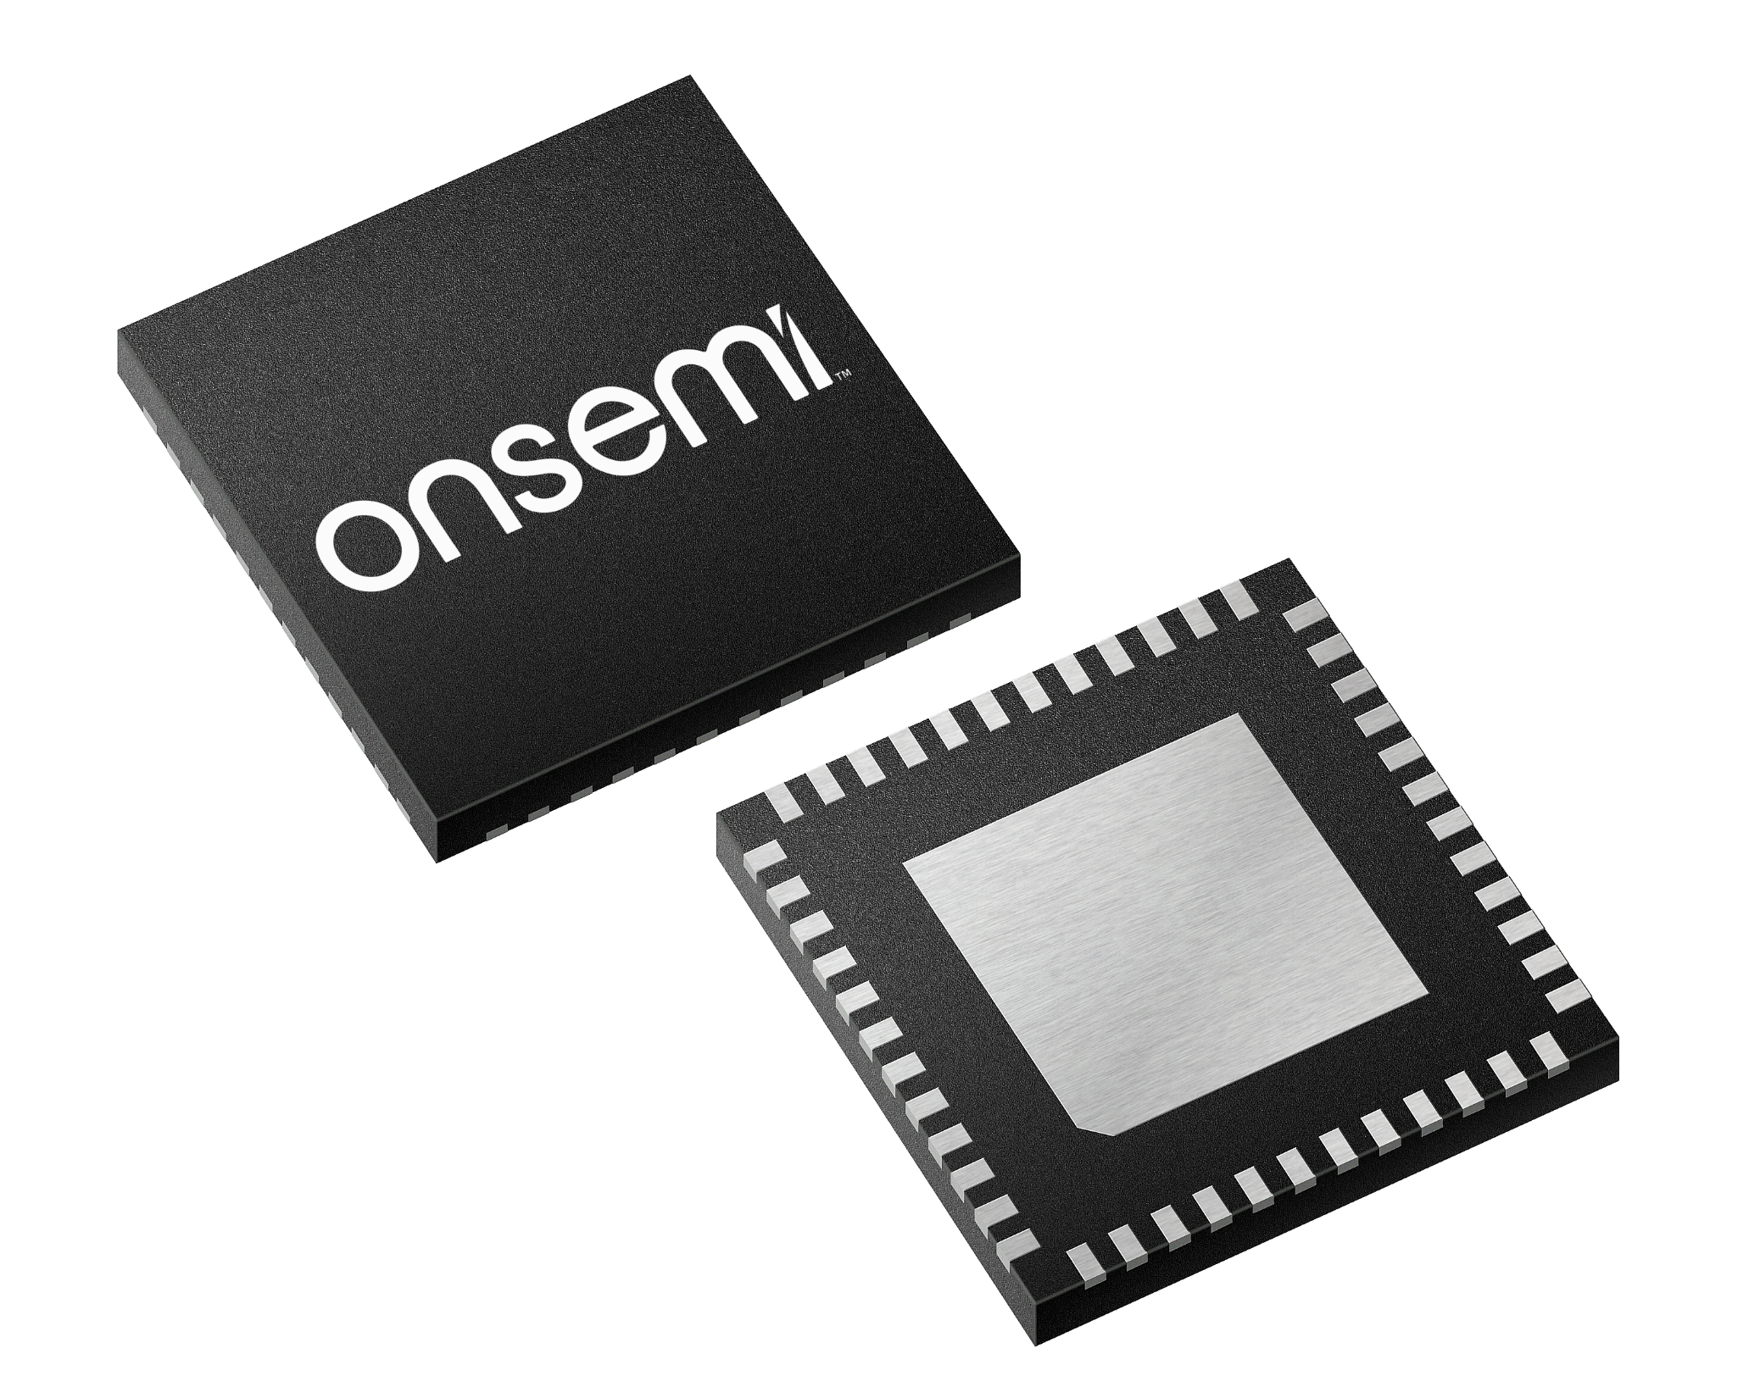
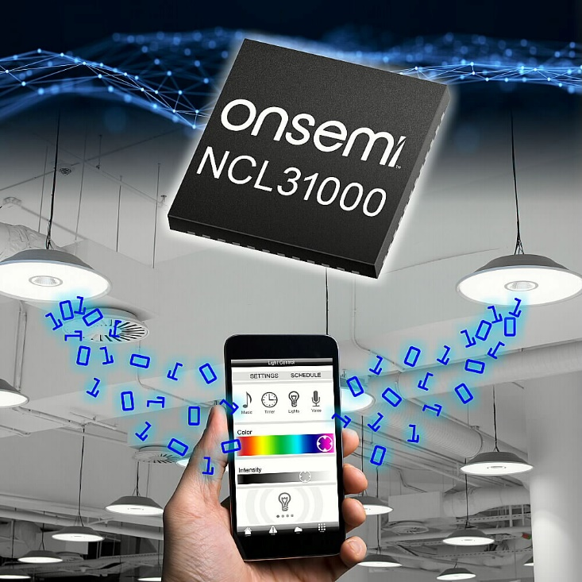
NCL31000/1
Intelligent LED Driver
June 2021
Notes:
*Mandatory Slide*
Above information can be pulled from onsemi.com if needed.

Slide 2
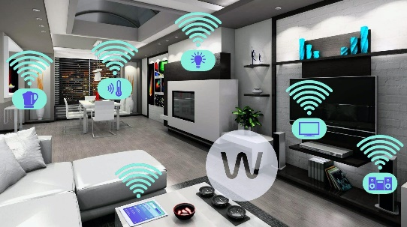
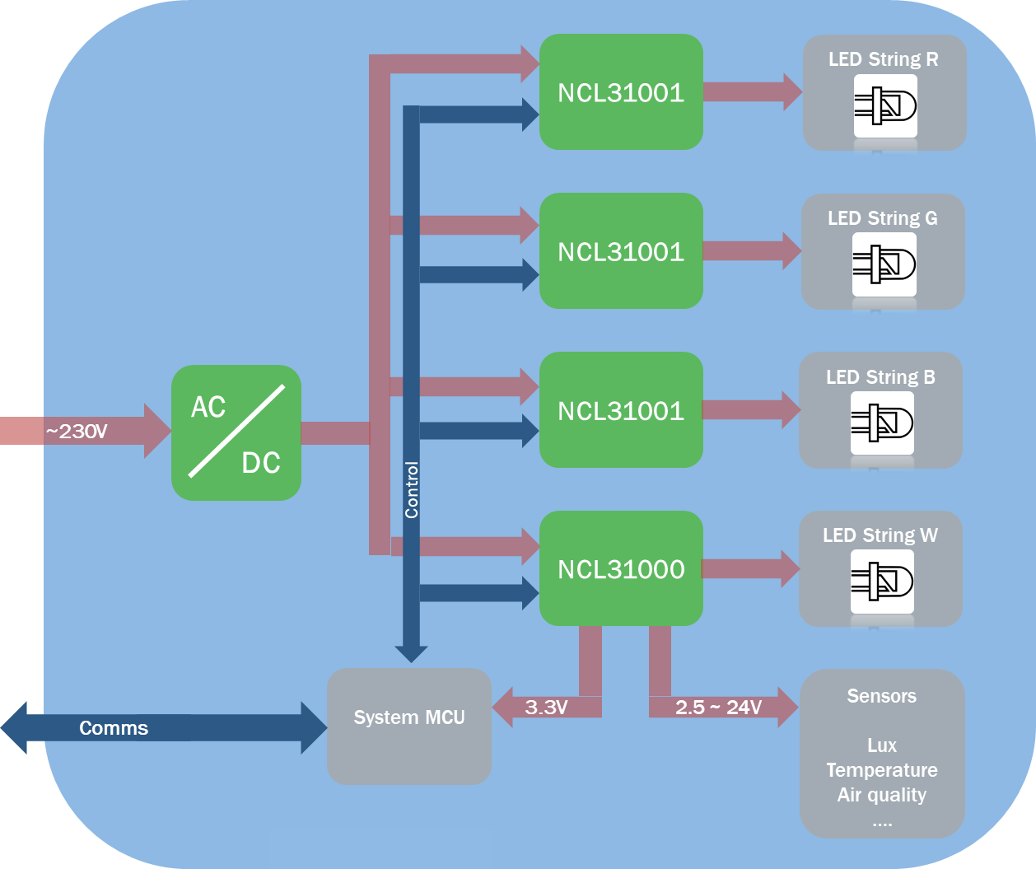
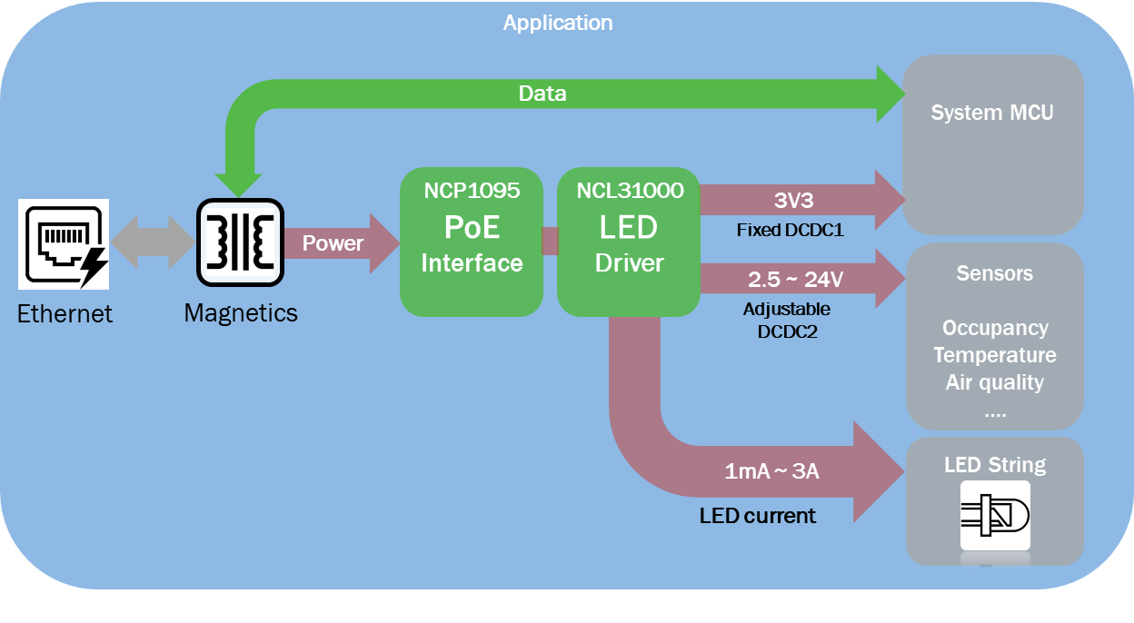
NCL31000/1 - Intelligent LED Driver
Product Family Overview
Applications
Input Voltage from 35V to 57V
97% efficient Buck Controller LED driver
Integrated 3V3 Buck Converter (150mA) for companion MCU.
Integrated Adjustable Buck Converter 2.5-24V
SPI or I2C interface for RF connectivity
Active Fault protection and diagnosis for LED shorts/opens,..
Over/Under Voltage, Over Current, LED Temperature
Visual Light Communication capable, Yellow-Dot ready, up to 10kb/s
Linear, high bandwidth dimming to zero (full range linearity 0.05% INL)
Deep dimming down to 1mA or 0.033% @3A full scale current
Digital Dimming over I2C/SPI (Warm Boot)
High accuracy diagnostic functions to measure voltages/currents
Junction temperature range of -40°C to +125°C
Available in 48-pin QFN 7x7
NCL31001 enables multi-channel operation
Smart LED Lighting
Energy saving lighting Systems
Human Centric Lighting
Communication Lighting
IoT Home appliances
Multi-Channel Example
System Block Diagram

Slide 3
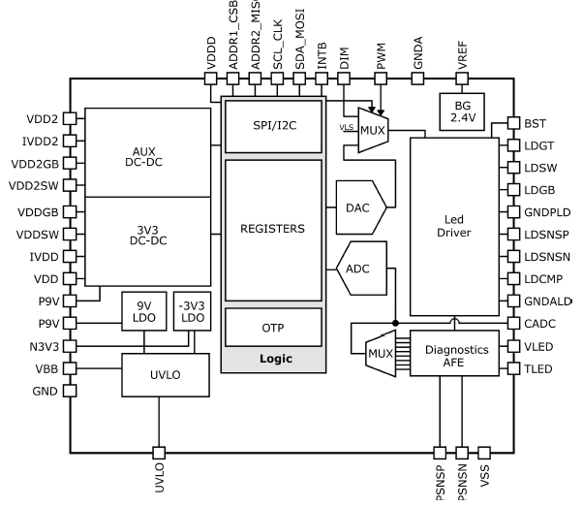
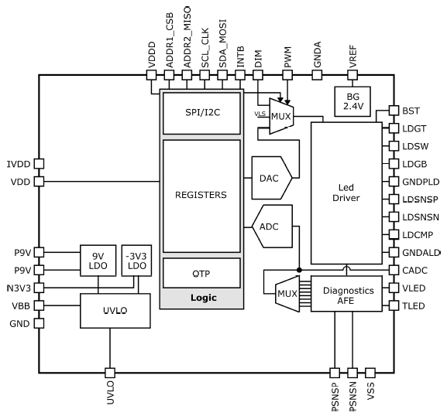
NCL3100x VLC Family Summary
Part Number | Integrated DCDC1 DCDC2 | I²C | SPI | Adjustable UVLO
NCL31000MNIYWG | ✓ | ✓ |  | >100W LED Driver
NCL310000MNSTWG | ✓ |  | ✓ | >100W LED Driver
NCL31001MNITWG |  | ✓ |  | Multi Channel Enabler
NCL31001MNSTWG |  |  | ✓ | Multi Channel Enabler
Production/ON Target
Production/ON Target
NCL31000 Family Key Features
Power Supply
High Input Voltage (24 ~ 57V)
Integrated 3.3V Buck (NCL31000 only)
Adjustable 2.5-24V Buck (NCL31000 only)
Accurate Voltage (2.4V+/-0.3%)
Buck LED Driver
Linearity (full range) 0.05% INL
Deep Dimming to 1mA = 0.066% of 1.5A or 0.033% of 3A
Efficiency (97%)
Spread Spectrum PWM
Connectivity
Serial Interface SPI or I2C
Protections/Diagnostics - LED Temperature, Over/Under Voltage and Over Current
Power Metrology Accuracy (1%)
NCL31000:
NCL31001:
Integrated DCDC’s
DCDC’s removed for Multi Channel Applications

Slide 4
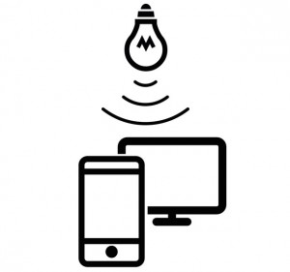
What is YellowDot?
YellowDot is an indoor position location technology
Each LED ballast has a unique identifier that indicates the position within a building
LED ballast signals through visible light communication (VLC) to a camera on a phone or tablet
Phone’s camera detects the code and reveals the position
Accuracy to within 30cm; BLE accuracy is 3 meters
Certification requires a range of tests; passing allows the use of the YellowDot trademark to a luminaire
Has two defined data rates: 1kb/s and 2kb/s

Slide 5
Pricing
NCL31000ASGEVB: $65
MPQ: 1
Evaluation Board
NCL31001MNITWG: $3.42
NCL31001MNSTWG: $3.42
NCL31000MNITWG: $3.64
NCL31000MNSTWG: $3.64
MPQ: 2,500
QFN-48
Collateral
NCL31000
NCL31001
Data Sheets
Click Here
Product Page URL
Click Here
Data Sheets
Click Here
Product Page URL
Click Here
Videos
Click Here
Evaluation Boards
NCL31000ASGEVB
Blog
Click Here
Press Release
Click Here

