Slide 1
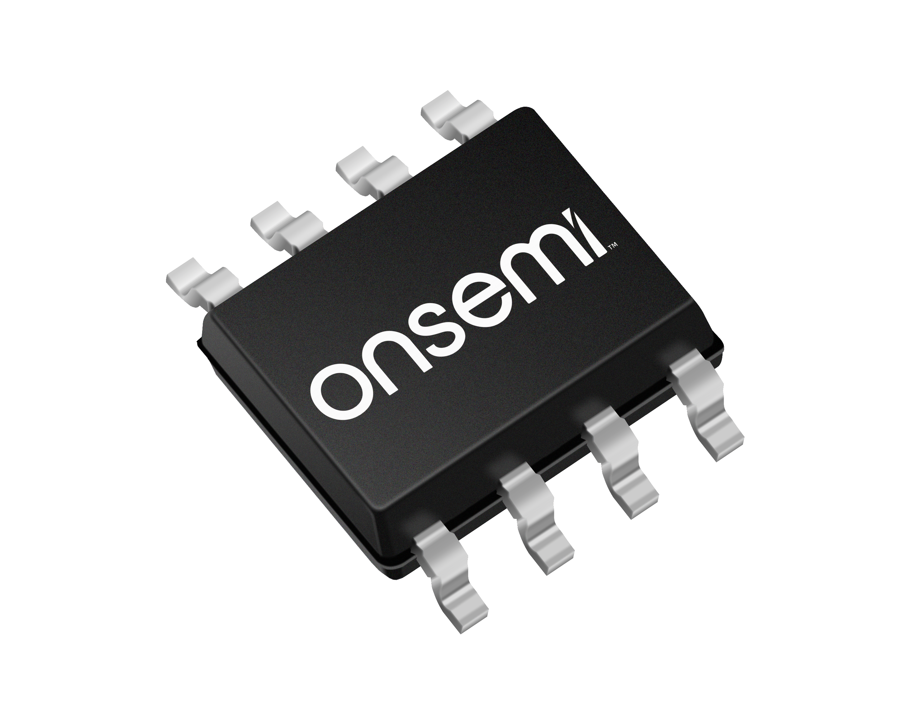
NCL30076, NCL35076
LED Lighting, QR Buck, CCM Buck, Wide Dimming
December 2021
Notes:
*Mandatory Slide*
Above information can be pulled from onsemi.com if needed.

Slide 2
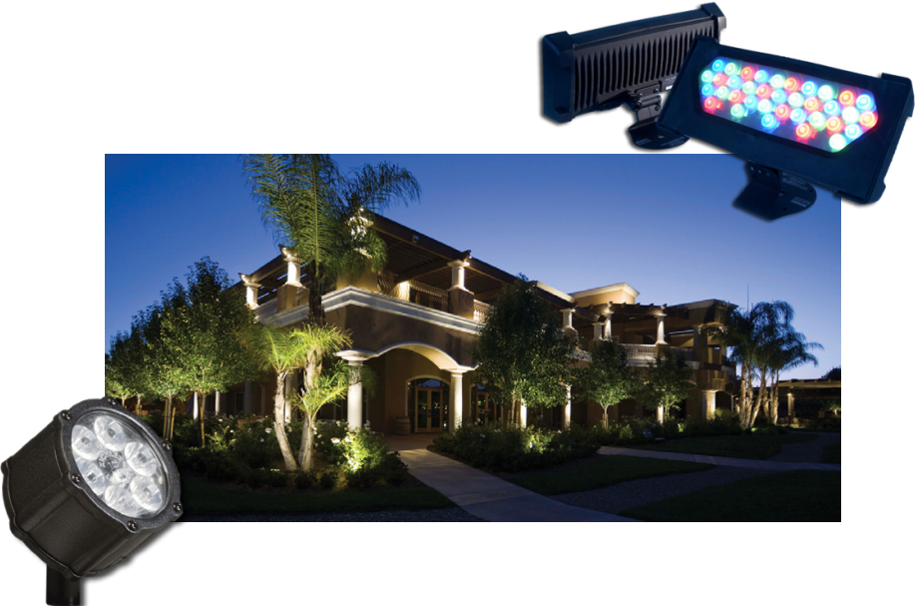
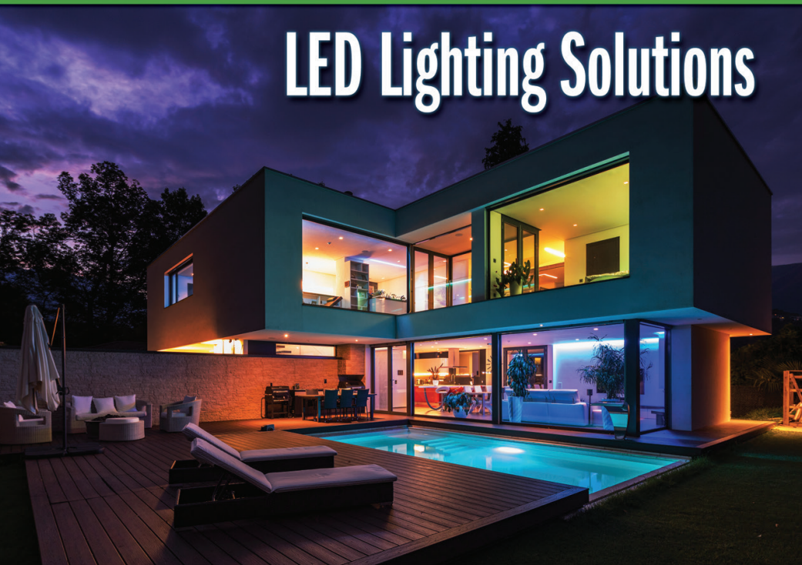
NCL35076 – CCM Buck Controller
Product Family Overview
Applications
The NCL35076 is DC-DC buck controller for wide analog dimming range down to 1%. ON’s proprietary LED current calculation technique and zero input voltage offset of the internal sensing and feedback amplifiers performs precise constant current in the whole analog dimming range. PWM dimming is also provided to keep the constant LED color temperature.
LED Lighting Driver
Analog/PWM Dimmable LED Driver
Smart Lighting
Features
OTA & zero input offset Amplifiers at LED current calculator block
CCM Operation @ full load
Excellent Dimming features
- CCM to DCM transition
- PWM Dimming by PWM signal
Standby mode operation
Various Protections; Auto Restart (AR)
System or Application Block Diagram
Value Proposition
Precise CC regulation
- <±2% @ full load
- <±20% @ 1% load
High efficiency & low profile design
Design flexibility
- Wide Analog Dimming Range; 1~100%
- Keep Constant LED color temperature
Low standby power consumption
High system reliability

Slide 3
NCL30076 – QR Buck Controller
Product Family Overview
Applications
The NCL30076 is DC-DC buck controller for wide analog dimming range down to 1%. ON’s proprietary LED current calculation technique and zero input voltage offset of the internal sensing and feedback amplifiers performs precise constant current in the whole analog dimming range. PWM dimming is also provided to keep the constant LED color temperature.
LED Lighting Driver
Analog/PWM Dimmable LED Driver
Smart Lighting
Features
OTA & zero input offset Amplifiers at LED current calculator block
QR Operation @ full load
Excellent Dimming features
- CCM to DCM transition
- PWM Dimming by PWM signal
Standby mode operation
Various Protections; Auto Restart (AR)
System or Application Block Diagram
Value Proposition
Precise CC regulation
- <±2% @ full load
- <±20% @ 1% load
High efficiency @ high voltage input
Design flexibility
- Wide Analog Dimming Range; 1~100%
- Keep Constant LED color temperature
Low standby power consumption
High system reliability

Slide 4
Existing Product Portfolio & Competitive Comparison
 | CCM DC-DC (<80 V) |  |  |  |  | CrM DC-DC (>200 V)
Company | Richtek | MPS | TI | onsemi |  | Renesas | BPS | onsemi
Part ID | RT8477 | MP24894 | TPS92641 | FL7760 | NCL35076 | R2A20135 | BP2872 | NCL30076
Current Sensing | High Side | High Side | Low Side | High Side | Low Side | High Side | Low Side | Low Side
 | Direct | Direct | Direct | Direct | In-direct (Calculation) | Direct | In-Direct | In-direct (Calculation)
IC Ground | Low Side | Low Side | Low Side | Low Side | Low Side | Floating | Low Side | Low Side
Control Method | CS Peak control | Hysteretic | Sync Buck | Hysteretic | I_{LED} Calculation | Constant ON |  | I_{LED} Calculation
Frequency | 380 KHz | 600 KHz | 1 MHz | 1 MHz | 500 KHz | CrM/100KHz DCM | 2 Ch. CrM | CrM
CC only in Spec. | -10/5% @ Full temp. | ± 3% @ Room temp. | ± 2% @ Room temp. | ± 4% @ Room temp. | ± 2% @ Full temp. | ± 5% @ Room temp. | ± 3% @ Room temp. | ± 2% @ Full temp.
Dimming | A/P DIM | P DIM | A/P DIM | A/P DIM | A/P DIM | A/P DIM | PDIM Only | A/P DIM
ADIM Range | ? | - | 1% | 5% | 1% | 21% |  | 1%
CC @ Min ADIM. | > ± 50% @ Room tem. | - | <± 20% @ Full tem. | >± 40% @ Full tem. | <± 20% @ Full tem. | > ± 30% @ Room tem. | - | <± 20% @ Full tem.
I_{Standby} | 3 mA | 0.5 mA | 2 mA | 0.5 mA | 0.3 mA | 2.2 mA | 0.3 mA @25℃ | 0.3 mA
Protection | UVLO OTP | Open LED Short LED OTP | UVLO Open LED Short LED OTP | UVLO Short LED OTP | UVLO Open LED Short LED OTP | UVLO | UVLO | UVLO Open LED Short LED OTP
PKG | SO 8 | TSOT 6 | HTSSOP 14 | 6 TSOP | SO 8 | SO 8 | SO 16 | SO 8

Slide 5
Pricing
  NCL30076AADR2G: $0.23
    3000
    SOIC-8
  NCL35076AADR2G: $0.23
    3000
    SOIC-8
Collateral
Data Sheets
NCL30076
NCL35076
Simulation Model
NCL30076
NCL35076
Design Tool
QR Buck Design
CCM Buck Design
Evaluation Boards
NCL30076LED1GEVB
NCL35076LED1GEVB

