Slide 1
Industrial Ethernet
NCN26010XMNTXG 10BASE-T1S MACPHY Ethernet Controller
Product Overview
February 17, 2023
Product Marketing Lead
Aaron D’Orlando
aaron.dorlando@onsemi.com
Applications Engineer
Arndt Schuebel
arndt.schuebel@onsemi.com

Slide 2
10BASE-T1S

Slide 3
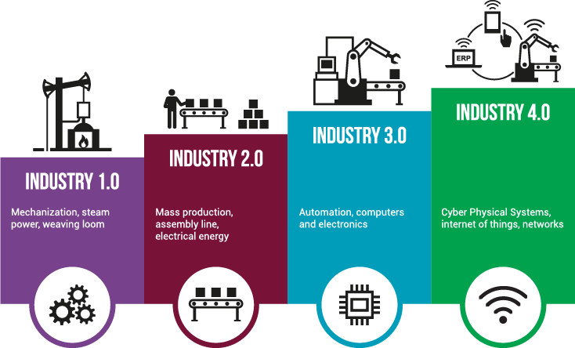

Industry 4.0 Revolution and Market Trend
Significant growth of semiconductor demand in industrial market to support higher connectivity, sensing, and computation to the edge

Slide 4

10BASE-T1S Top-to-Bottom Single-Pair Ethernet (SPE)
New Industrial Ethernet Standards Enabling I4.0 Factory Transformation
Uplink to
global cloud
Virtual
Machine Learning
PLC
AI
Local services
On
-
premises automation cloud
Enterprise Resource
Factory Backbone
Planning (ERP)
Business Intelligence (BI)
Higher rate of interaction
Manufacturing Execution System (MES)
Centralized Supervision
Supervisory Control and Data Acquisition (SCADA)
Distributed Control Systems (DCS)
Control Function move to Virtual PLC
Programmable Logic Controllers (PCL)
Distributed Control
Field Devices / IO
Increased number of devices
Actuators
Sensors
IEEE released 802.3cg SPE which addresses Field I/O (T1S & T1L)
IEEE working on new SPE standards
  802.3da: Multi-drop Enhancements (10BASE-T1M)
  802.3dg: 100Mb, 500m Point-to-Point SPE
Field
/
IO
Connection to
Cyber Physical Production System
cloud
Distributed Control Unit merges
PLC
&
IO Modules

Slide 5
IEEE 802.3cg Multidrop Highlights
Standard approved Q4 2019
Targeting Industrial, Automotive, Building and Intra-System 10Mb/s Networking
10BASE-T1S: Short Reach (25 meters multi-drop)
Optional full duplex point-to-point, half duplex multi-drop
Evolved Media-Access Protocol
PHY-Level Collision Avoidance (PLCA) for enhanced multi-drop performance
Improves performance (over traditional CSMA-CD of “plain” Ethernet) in high loading situations
If network set up properly, collisions are avoided due to “round robin” approach
Preserves the IEEE 802.3/Ethernet frame format at MAC interface
Layers above MAC sublayer are unchanged
Developers can still use existing software/IP in higher layers
From a semiconductor point-of-view only the PHY is different

Slide 6
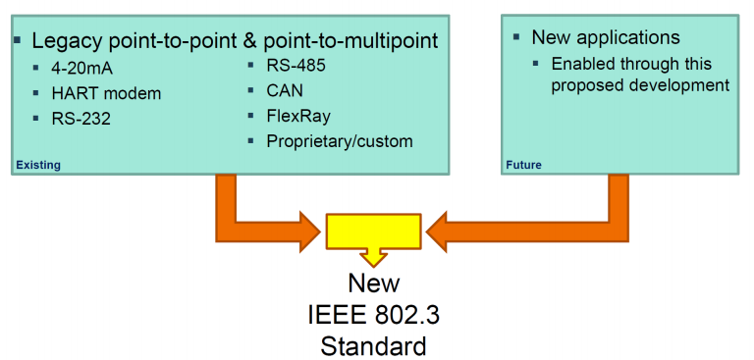
Why 802.3cg? Unify Communications
Installing and maintaining multiple edge protocols is difficult and expensive
Existing networks at the edge use a mix of protocols
Gateways are costly to maintain
Software maintenance requires high effort and cost
802.3cg consolidates and simplifies communication
Consolidates many point-to-point communication standards into one
Reuses of Ethernet ecosystem including:
  Software
  Testing equipment
  Applications
  Knowledge base

Slide 7
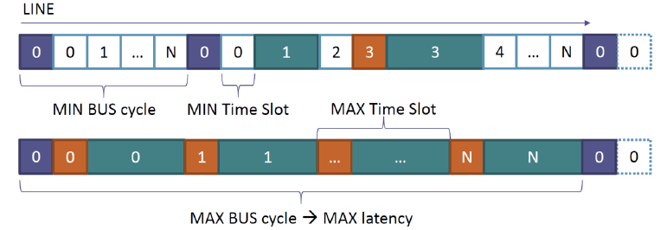
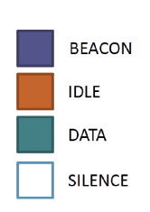
Why 802.3cg? Improve Throughput and Decrease Latency
802.3cg PLCA uses “round robin” arbitration for nodes to transmit
  Each PHY is assigned a unique ID
Increases throughput, especially at high utilization (no collisions)
No wasted bandwidth compared to TDMA systems
  Time slots grow dynamically with the size of the packets
Bounded latency
  Worst case transmission time is predictable as a function of the MTU and the number of nodes

Slide 8
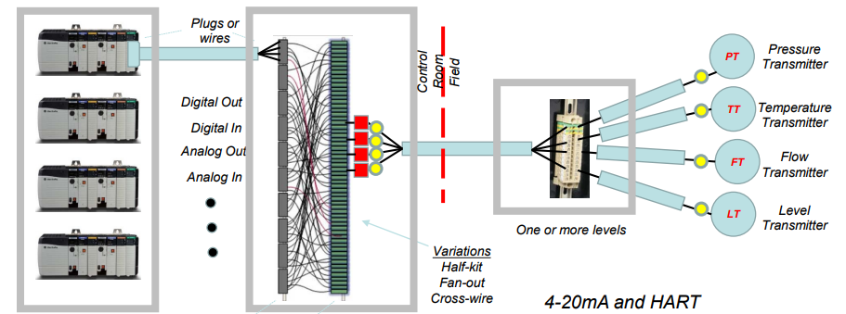
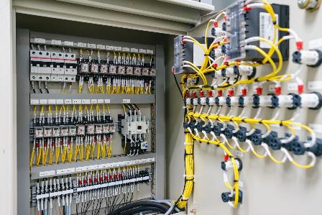
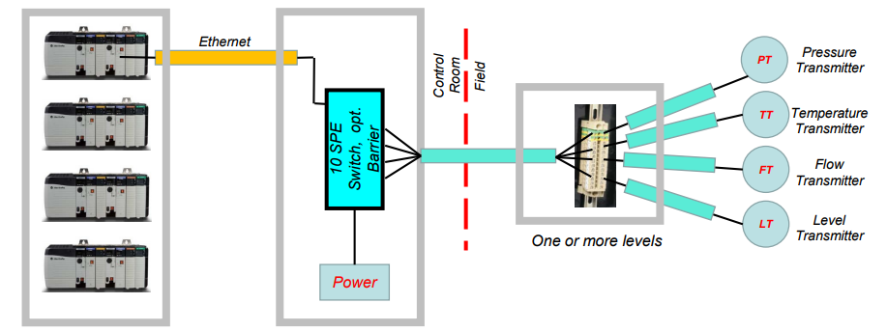
Why 10BASE-T1S? Multi-Drop and Wire Reduction
In a new installation, one single-pair cable can replace all yellow control cables required prior to 10BASE-T1S
40 nodes on 25-meter Single Pair Ethernet (SPE) network demonstrated with onsemi’s 10BASE-T1S MACPHY.
Multi-drop requires far fewer wires:
Up to 70% fewer cables
Up to 80% lower installation costs
Source: www.ieee802.org/3/10SPE/public/Nov2016/diminico_01b_1116.pdf

Slide 9
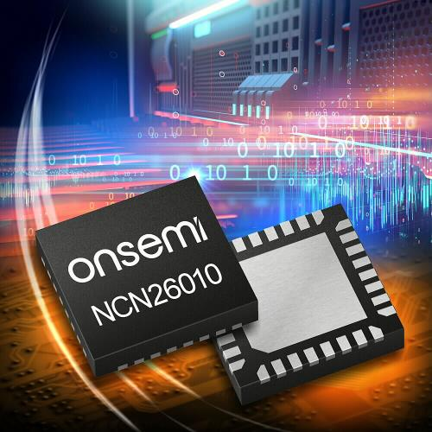
NCN26010XMNTXG
10BASE-T1S MACPHY Ethernet Controller

Slide 10
NCN26010 Value Proposition
Takes Ethernet all the way to the edge enabling a wider set of industrial applications to use Ethernet
Enables Ethernet to be used in industrial applications where it was not possible or practical in the past
Can be used in noisy industrial applications that require deterministic and real-time performance
Compatible with existing infrastructure of twisted-pair or single-pair cables
Multi-drop architecture can significantly reduce the number of cables needed for new installations
Can replace legacy multi-drop communications with lower complexity and lower cost Ethernet installations
Simplify network maintenance by reducing the number of standards that must be supported
Eliminates the need for large switches, gateways, protocol translators, and the additional wiring and power they require
Expand Ethernet connectivity to the very edges of industrial networks while simplifying architectures and lowering network installation and maintenance costs
Notes:
By going all the way to the edge, industrial Ethernet can be used for “last mile” end nodes, sensors, etc. thus enabling Ethernet to be used for a wider set of industrial applications
As an example, some industrial applications may not have been able to use Ethernet due to the cost being too high in the past. 10BASE-T1S uses unshielded single-pair cables which can substantially lower the cost for new installations
Many industrial applications require deterministic and real-time performance, which NCN26010 supports thanks the PLCA architecture of 10BASE-T1S
Existing installations can be upgraded to 10BASE-T1S without having to run new cables. This can substantially lower the cost when converting existing installations to 10BASE-T1S
Companies can lower the complexity and cost of network maintenance by reducing the number of standards that must be supported
Companies can also reduce the complexity and cost of installing and maintaining networks because 10BASE-T1S does not require large switches, gateways, protocol translators, and the additional wiring and power they require

Slide 11
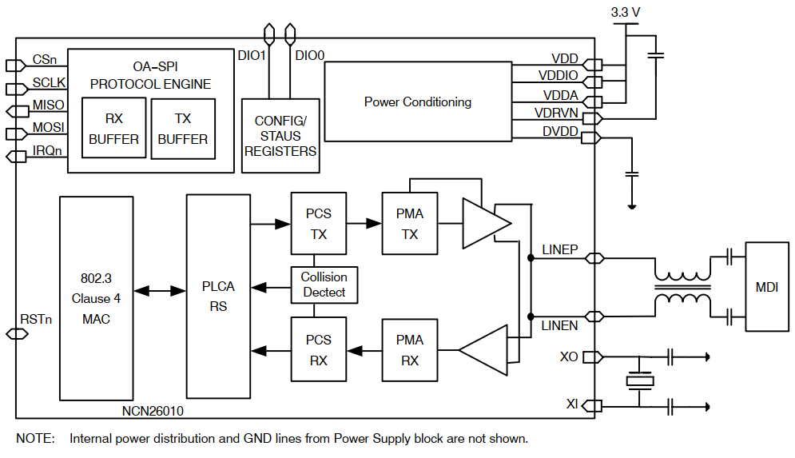




NCN26010: 10BASE-T1S Industrial Ethernet
Value Proposition
Expand Ethernet connectivity to the very edges of industrial networks while simplifying architectures and lowering network installation and maintenance costs
Unique Features & Benefits
Application Diagram
  IEEE 802.3cg 10BASE-T1S Compliant
  OPEN Alliance MACPHY Compliant (TC14 specs)
  Data rate of 10Mbit/s Half Duplex
  MACPHY Controller with SPI
  Physical Layer Collision Avoidance (PLCA)
  Enhanced Noise Immunity
  Replace various wired protocols: HART, FieldBus, CAN, RS485, RS232, FlexRay, etc.
  32-pin QFN, 4mm x 4mm (available)
  32-pin TQFP, 5mm x 5mm body size (samples available)
Markets & Applications
  Process and Factory Automation
  Industrial wired connectivity
  Contactors/Overload Protectors
  Valves/Actuators
  Data Center Management

Slide 12
NCN26010 Key Specifications
Key Specifications
Ambient Temp | -40° to 125° C
Package type | NCN26010XMNTXG: QFN-32, 4 mm x 4 mm (available) NCN26010XFBR2G: TQFP-32, 5 mm x 5 mm (not yet available)
Data rate | 10 Mbps
IEEE standard | 802.3cg-2019 | 10BASE-T1S
Cable reach | Up to 50 meters on an unshielded single-pair cable with 8 nodes
Nodes | Up to 40 nodes on single 25-meter segment

Slide 13








NCN26010 Key Benefits
Uses lower cost unshielded single-pair cables
Up to 40 nodes on single 25-meter segment, 5x the IEEE 802.3cg requirement
Up to 70% fewer cables and up to 80% lower installation costs
Reaches up to 50 meters with 8 nodes, 2x the IEEE 802.3cg requirement
Lower software maintenance costs
Ethernet that can go all the way to edge node devices
PHY compliant with engineered Power over Data Lines (PoDL)
Lower network maintenance by removing gateways and protocol translators

Slide 14
Lower Cost Unshielded Single Pair Cables
Benefits of Unshielded Single Pair Cables
  Simplifies installation and lowers installation cost
  Does not require shielding
  Saves space and weight
  Maximizes flexibility
  Increases data rate using installed base of single-pair or twisted-pair cables

Slide 15
Lowest Line Pin Capacitance
Lowest line pin capacitance enables more nodes per segment which lowers cabling, connector, and installation costs
Enables many industrial applications with support for up to 40 nodes on a single 25m segment, 5x the requirement of the IEEE 802.3cg standard
Reduces installation complexity and cost
  Up to 70% fewer cables
  Up to 80% lower installation costs

Slide 16
Enhanced Noise Immunity Mode
Exceeds noise immunity levels specified in IEEE 802.3cg
Best-in-class bit error rate performance
Meets IEC6100-4-6 conducted-immunity test at 10 Vrms (highest class)
Enabling up to 50 meters reach with 8 nodes, 2x the requirement of the IEEE 802.3cg standard

Slide 17
Lower Software Maintenance Costs
Software support is greatly reduced by following the layered approach of the Ethernet ecosystem
Unlike other networking solutions, changing Ethernet PHYs does not require modifications to upper software layers
Changing Ethernet PHYs does not require new software (only new hardware)

Slide 18




NCN26010 Standard Features
Uses Single Pair Ethernet (SPE) Cables
  Uses lower cost unshielded single twisted pair cables
Multi-drop
  Connects multiple devices on a single-pair cable using one MACPHY per port
MACPHY
  Connect to controllers, sensors, and other devices using mid/low-end MCUs with no integrated MAC
Physical Layer Collision Avoidance
  Allows higher throughput in multi-drop topologies
MAC Address Filtering
  Ethernet frames not intended for a certain node are not processed by host, thus reducing the load

Slide 19






NCN26010 Proprietary Features
Enhanced Noise Immunity Mode
  Exceeds noise immunity levels specified in IEEE 802.3cg, enabling longer cable reach
Lowest MDI capacitance
  Enables more nodes per segment which lowers cabling, connector, and installation costs
Collision Detection Masking
  Further increases noise immunity in pure PLCA networks
PLCA Precedence Mode
  Lower PLCA ID gets precedence over higher ones (similar to CAN arbitration)
PLCA Leader Mode
  Stations with ID other than 0 may start the PLCA cycle
Unique Programmed MAC Address
  Comes with a unique MAC address at no additional cost

Slide 20

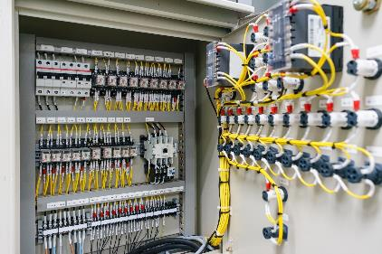






Example Applications
NCN26010 can lower cost and increase data rate for applications including
Elevators
Industrial Cabinets
Robotics
Lighting
Intra-System Communications
Building and Industrial Automation
Train / Tram / Bus
HVAC

Slide 21
Physical Layer Collision Avoidance
When PLCA is enabled, only the PHY device that owns the transmit opportunity is allowed to send data
The transmit opportunities are allocated in a round-robin manner
Each PHY can send a data frame during its transmit opportunity
A new cycle is started when the master node sends a beacon
Guaranteed maximum latency along with improved throughput and access fairness
Enables the deterministic real-time performance many industrial applications require
Transmission Cycle
0
0
1
N
0
0
t
. . .
Beacon
Data PHY 0
Silence
Data PHY 1
Silence
Data PHY N
Beacon

Slide 22
PLCA vs. CSMA/CD: 8 nodes, 64 Bytes payload
PLCA
CSMA/CD
CSMA/CD
PLCA

Slide 23
PLCA Precedence Mode
When PLCA precedence mode is enabled, the PLCA cycle ends each time a packet is transmitted. Nodes with lower ID get priority
  Provides arbitration similar to CAN
    PLCA cycle terminates after ANY packet is sent by any node
    PLCA “master” sends a new BEACON to start a new cycle after at least one IPG (interpacket gap)
  As long as a node with lower ID (higher priority) has something to send, other nodes with higher IDs will wait
    After a node has transmitted a packet, higher priority nodes would get a chance to transmit again because the cycle starts over

Slide 24
Collision Detection Masking
Masking detected collisions in PLCA mode allows even better performance in noisy conditions
Prevents false collision detection in high-noise environments
When used in conjunction with ENI, the NCN26010 has unparalleled noise tolerance

Slide 25
Unique Programmed MAC Address
NCN26010 comes with a unique MAC address at no additional cost
  Customers can read the MAC address from the part and program the source MAC address (or they can provide their own MAC address if they prefer)
  Keeps customers from having to purchase globally unique MAC addresses

Slide 26
MAC Address Filtering
NCN26010 comes with four MAC address filters
Ethernet frames can be filtered by destination address
Enables you to restrict specified nodes from communicating with other nodes, thus reducing unnecessary traffic and reducing the load
Provides an efficient way to support L2 multi-cast addressing

Slide 27
Other Features
PLCA Leader Mode
  Stations with ID other than 0 may start the PLCA cycle
Two Configurable Digital Outputs that can Drive Low Current LEDs (< 20mA)
  Supports systems where up to two LEDs can provide status indicators
Open Alliance Compatible SPI Interface:
  Conforms to Open Alliance TC6 specs for Configuration and Data Frames to Host MCUs
Supports IEEE802.3 CSMA/CD Collision Detection for backward compatibility
  PLCA mode will revert to CSMA/CD operation in case of failures, as per IEEE 802.3cg requirements

Slide 28
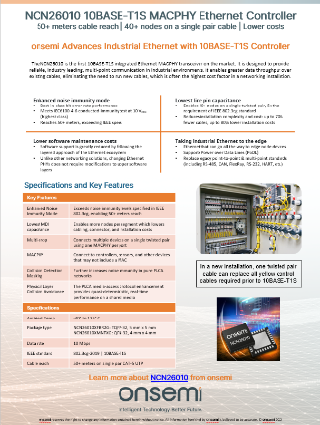
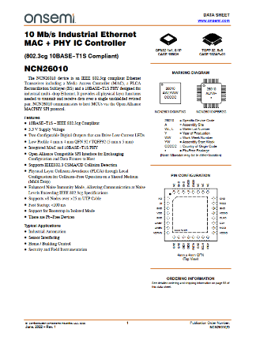
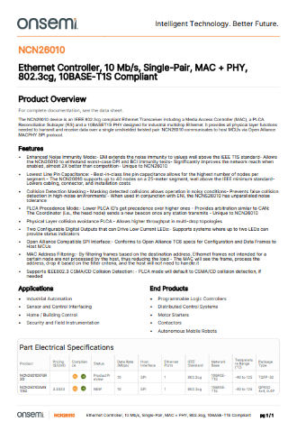
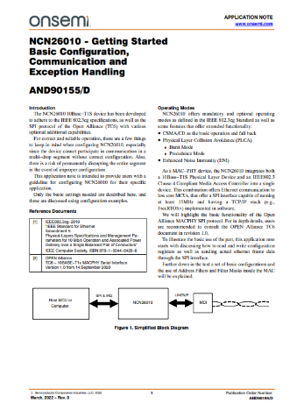
Collateral
Datasheet
Product Overview
Brochure
Application Notes
NCN26010 Presentation
Evaluation Boards

Slide 29
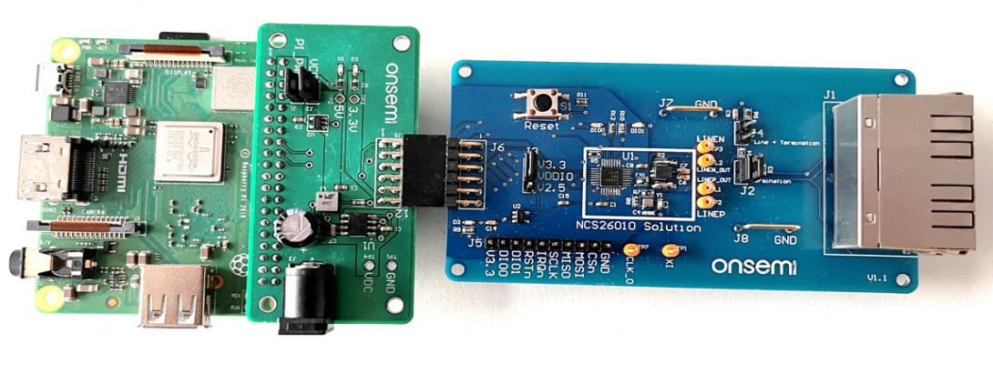
NCN26010 Evaluation Kit
NCN26010XMNEVB Eval Board
  Standard PMOD connector (to host MCU)
  Dual RJ45 connector
    Allows use of readily available Cat 3/5e cables but only uses one twisted pair
NCN26010BMNEVB Bridge Board
    Connects to a Raspberry Pi (not provided), which acts as host
    Provides power for both NCN26010 and the Raspberry Pi
      DC-DC buck regulator (NCV891330 -5V)
      3.3V LDO (NCP115)
Raspberry Pi
SPI
Bridge Board
NCN26010 Eval Board
NCN26010BMNEVB Bridge Board
Dual RJ45 connector
NCN26010
NCP115
Raspberry Pi
(not provided)
NCN26010XMNEVB
NCV891330

Slide 30

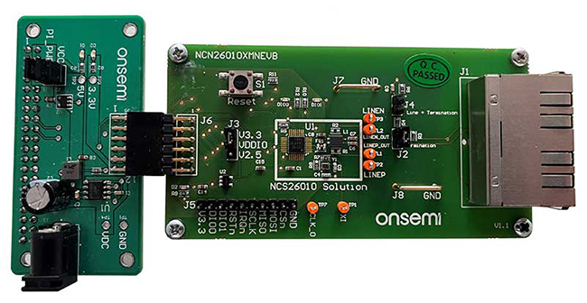
NCN26010 Eval Board / Kits
NCN26010XMNTXG
10BASE-T1S MACPHY Ethernet Controller Product
NCN26010XMNEVB
Eval board for NCN26010XMNTXG
NCN26010BMNEVB
Adapter and power supply board that you would need if you wanted to use a Raspberry PI as a host system for NCN26010XMNEVB
NCN26010XMNEVK
Kit containing NCN26010XMNEVB and NCN26010BMNEVB. Customers who intend to use Raspberry PI would want to order this one

