Slide 1
NCP1343
Quasi-Resonant Flyback Controller with Power Excursion Mode
July 2021
Notes:
*Mandatory Slide*
Above information can be pulled from onsemi.com if needed.

Slide 2
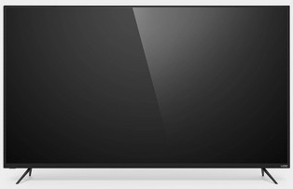
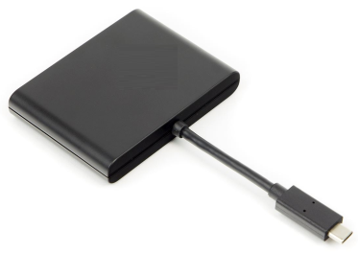

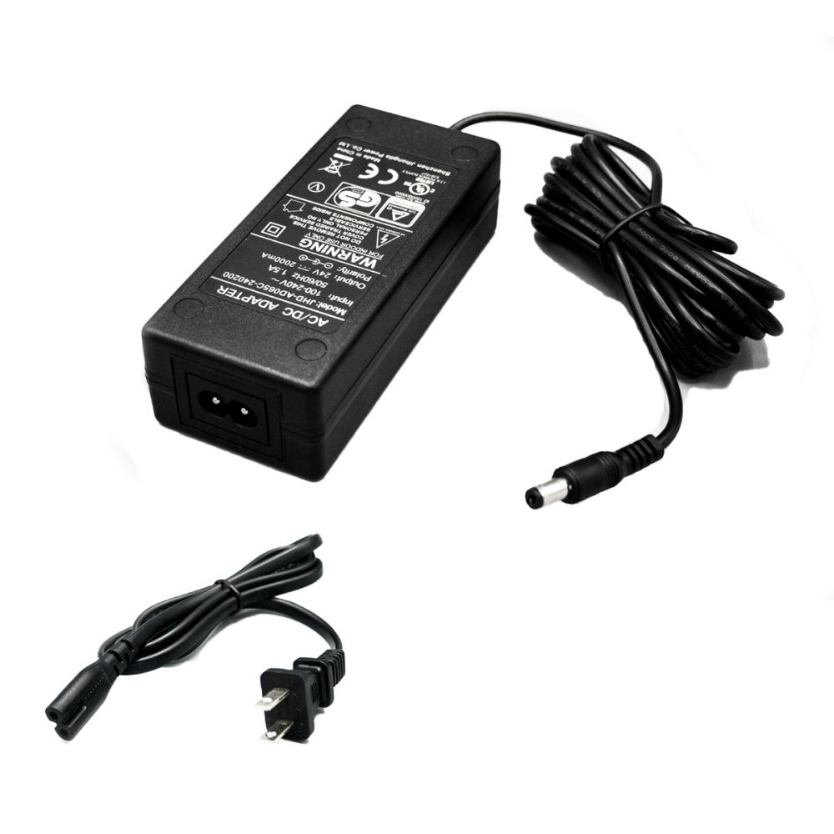
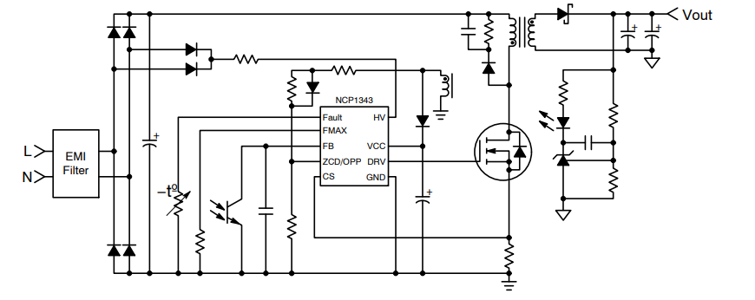
NCP1343 Quasi-Resonant Flyback Controller
Product Family Overview
Applications
The NCP1342/3 is a highly integrated quasi-resonant flyback controller capable of controlling rugged and high-performance off-line power supplies as required by adapter applications. Additionally, the NCP1343 integrates power excursion mode (PEM) to minimize transformer size in designs requiring high transient load capability
Audio Power
Notebook Adapters
Medium or High Power AC-DC Adapters
Ultra High Density AC-DC Adapters
Flat TV SMPS
Computer Power Supplies
Phone and Tablet Adapters
Features
Valley Switching Operation with Valley Lockout
New Quiet-Skip Technology
Min Peak Current Modulation for Rapid Frequency Foldback (RFF)
Power Excursion Mode (PEM) (NCP1343)
High voltage startup circuit with Integrated Brownout
Valley Switching Operation with Valley Lockout
Frequency Foldback with 25 kHz Minimum Frequency
VCC Overvoltage Detection
NTC Compatible Fault Pin
Soft-Start for Smooth Start-up Operation
High Drive Capability: -500 mA / +800 mA
Benefits
Maximizes the efficiency over the entire power range
Ensures Operation Outside Audible Range
Fast reduction of switching frequency for improved light load efficiency
Minimize transformer size for peak power applications
Typical Application Schematic

Slide 3
Existing Family Portfolio & Internal Positioning
Feature | NCP1340 & NCP1341 | NCP1342 & NCP1343 | Comments
Power Excursion Mode (PEM) | NCP1341 | NCP1343
HV Start-Up | Yes | Yes
X2 Discharge | Yes | NCP1342
Integrated BO in HV Pin, VCC OVP | Yes | Yes
NTC Compatible Fault Pin | Yes | Yes
6 Valley Operation, Frequency Foldback | Yes | Yes
Improved Linear Dead-Time | Yes | Yes | Reduces power consumption at light loads
Rapid Frequency Foldback | No | Yes | Fast reduction of fsw at light loads for improved performance
Minimum Dead-Time Added | 0 µs | 0 µs | Allows higher fsw
25 kHz Min Freq | Yes | Yes
Quiet-Skip | Yes | Yes | Avoids the audible frequency range
Adjustable OPP | Yes | Yes
FMAX Clamp | Fixed/Adjustable/None | Adjustable/None
Jitter | Yes | Yes | Jitter on at both LL & HL
Jitter Method | Improved , does not trigger OCP | Improved , does not trigger OCP
Max Frequency | 360 kHz | 500 kHz | Higher due to shorter ZCD blanking time
Programmable Trim | Limited | Yes | Optimize controller behavior
Package Availability | 8/9 Pin | 8/9 Pin SOIC
The NCP1343 upgrades the NCP1341 with the additional of Minimum Peak Current Modulation for Rapid Frequency Fold-back (RFF) and additional configuration options, allowing designs to be better optimized. They are pin-to-pin compatible.
Notes:
How does this device fit into the existing portfolio?
Is it directly replacing old technology? If so, what are the improvements?
Is it an extension of an existing product family?

Slide 4
Pricing
Collateral
Datasheet
Click Here
Product Page
Click Here
Product Presentation
Click Here
NCP134x Design Tool
Click Here

