Slide 1
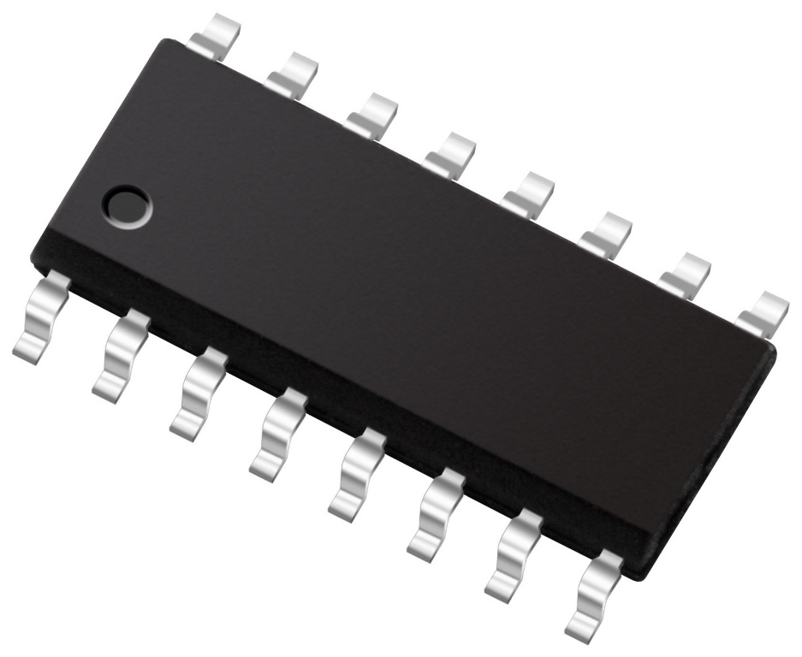
NCP1680
Totem Pole CrM PFC Controller
July 2021
Notes:
*Mandatory Slide*
Above information can be pulled from onsemi.com if needed.

Slide 2
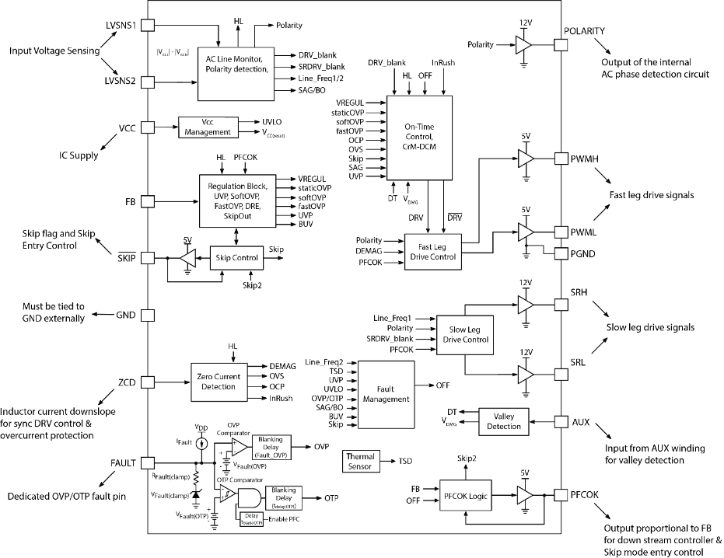
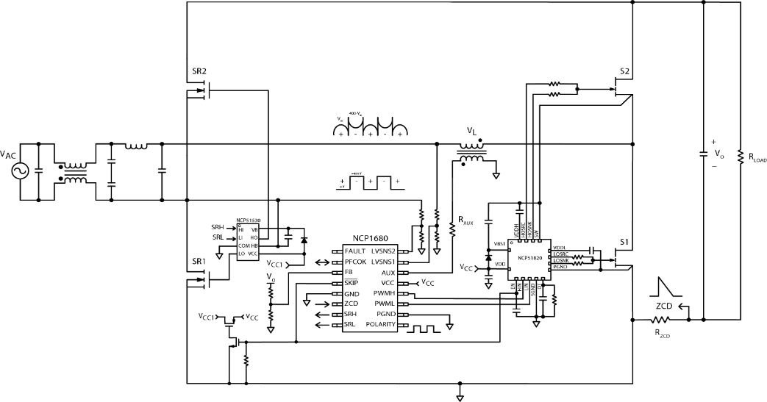
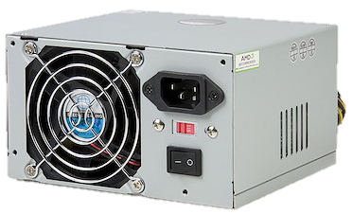
NCP1680 Totem Pole CrM PFC Controller
Product Family Overview
Block Diagram
The NCP1680 is a CrM Totem Pole PFC Controller capable constant on time CrM and valley synchronized frequency foldback for optimized efficiency across the entire load range. With proprietary current sensing architectures and proven control algorithms the NCP1680 allows for a cost-effective solution without jeopardizing performance.
Features
Constant on-time CrM architecture w/ valley switching during foldback
Novel Current Sense scheme
Line polarity detection
Novel valley sense scheme
Control loop Internally compensated
Two low voltage pins for sensing and recreating half-wave sinusoid.
DCM with valley synchronized turn-on for improved light load efficiency
Zero Current Detection for CrM Operation
Integrated Digital voltage loop control
Value Proposition
Typical Application Schematic NCP1680
Optimized performance across power levels
Cycle-by-cycle current limit w/o hall effect sensor
Removes external components
Applications
Telecom 5G / Networking Power Supplies
Industrial Power Supplies
Computing Power Supplies
Gaming Console Power Supplies
UHD TV Power Supplies

Slide 3
Totem Pole PFC Mixed Signal vs. Digital Controller
Digital Controller (DSP/MCU) | Mixed Signal Controller (NCP1680 & 1)
Cloud/High end server | NCP1680 (CrM) -> Telecom 5G/industrial/computing up to 350 W NCP1681 (MM) -> Workstation/gaming console power up to 1 kW NCP1681 (CCM only) -> Network/cloud-server/industrial >2.5 kW
Supports multi-topologies: Boost PFC, Totem Pole PFC, voltage mode LLC etc. | Optimized for Totem Pole PFC: CrM and CCM
Flexibility - Customer can implement custom IP to distinguish from competition | Designed to pass standards for computing & gaming power supplies
Poor standby power. Icc of DSP/MCU is high | Excellent light load efficiency and standby power
THD <2% possible, look-up tables and custom IP | NCP1680 (CrM) -> THD better than standards set for computing NCP1681 (CCM only) -> THD <5%
Telemetry: Input voltage and current. Accuracy 5 %. PM Bus possible | No telemetry

Slide 4
Pricing
NCP1680AAD1R2G: $1.43
MPQ: 2500
SOIC-16
NCP1680ABD1R2G: $1.43
MPQ: 2500
SOIC-16
Collateral
Product Page
Click Here
Product Presentation
Click Here
Video - Power Factor Improvement Methods with Their Advantages & Disadvantages
Click Here

