Slide 1
NCP1681 High Power Totem Pole PFC Controller
Product Introduction

Slide 2
2

Slide 3
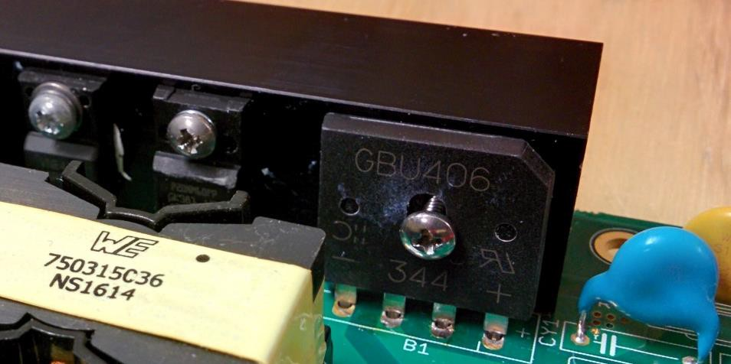
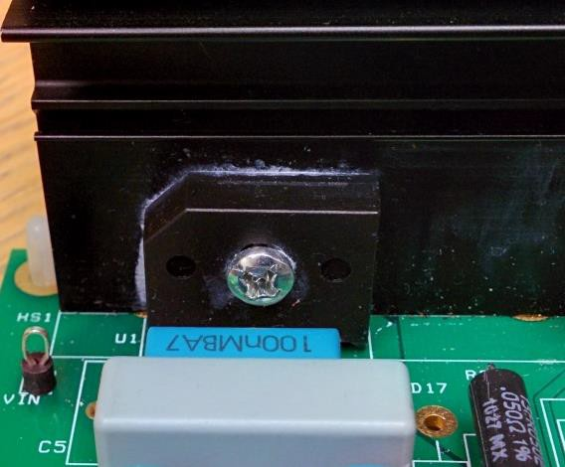
Bridge diode losses account for ~ 4 W @ low line & is 18% of the total losses in a 240 W PS.
NCP4306
NCP1616, NCP1654
NCP1399x
AC
NCP4306
LOAD
PFC Efficiency @ 240 W is ~ 97% (excluding bridge diodes)
LLC efficiency @ 240 W is ~ 97% (Assuming SR FETs)
3

Slide 4
16.0
14.0
12.0
10.0
POWER LOSS (W)
8.0
Vac
6.0
90 Vac
115
4.0
2.0
0.0
100
200
300
400
500 600
OUTPUT POWER (W)
700
800
900
1000
4

Slide 5
Replace all the diodes with FETs
L O A D
AC
•
•
•
5

Slide 6
L O A D
AC
•
6

Slide 7
Analog Mixed Signal Totem Pole PFC COntroller

Slide 8
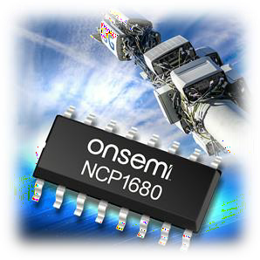
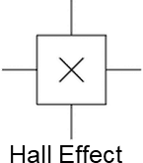
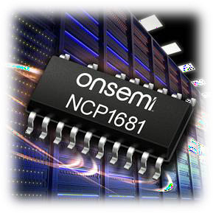
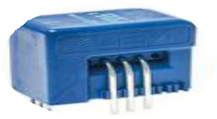

Slide 9
Digital Controller | Mixed Signal Controller (NCP1680 & 1)
Cloud/High end server | NCP1680 (CrM) -> Telecom 5G/industrial/computing up to 350 W NCP1681 (MM) -> Workstation/gaming console power 350 W to 1 kW NCP1681 (CCM only) -> Network/cloud-server/industrial up to 3 kW
Supports multi-topologies: Boost PFC, Totem Pole PFC, voltage mode LLC etc. | Optimized for Totem Pole PFC: CrM and CCM
Flexibility - Customer can implement custom IP to distinguish from competition | Designed to pass standards for computing & gaming power supplies
Poor standby power. Icc of DSP/MCU is high | Excellent light load efficiency and standby power
THD <2% possible, look-up tables and custom IP | NCP1680 (CrM) -> THD better than standards set for computing NCP1681 (CCM only) -> THD <5%
Telemetry: Input voltage and current. Accuracy 5 %. PM Bus possible | No telemetry

Slide 10
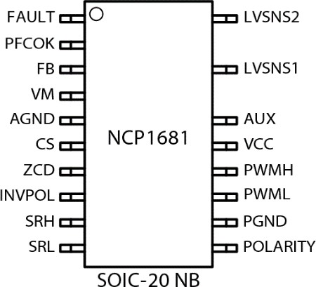
Value Proposition
The NCP1681 is a multi-mode Totem Pole PFC Controller capable of operating in fixed frequency CCM, constant on-time CrM, and valley synchronized frequency foldback for optimized efficiency across the entire load range. With novel current sensing architectures, proven control algorithms for all operating modes, and a suite of protection features, the NCP1681 allows for a cost-effective solution without jeopardizing performance.
Unique Features
Benefits
Device Pin-Out
Fixed frequency CCM w/ Constant on- time CrM and valley switching frequency fold back
Novel current sense scheme providing inductor current upslope and downslope sensing
Line polarity detection
Digital loop compensation
Optimized performance across all power levels
Cycle-by-cycle current limit w/o hall effect sensor
Reduces external components
Other Features
Two low voltage pins for sensing and recreating half-wave sinusoid.
Fixed frequency pseudo-average current mode control for high performance continuous conduction mode operation
Constant on-time CrM and valley synchronized frequency foldback at medium and light load
Skip/Standby mode for optimized light load performance
PFC OK Indicator
Ordering & Package information
Market & Applications
SOIC-20 NB
Multiple Patents Issued/Pending
Server/Computing PFC
OBC
Gaming/TV Power Supplies
5G/Telecom Power

Slide 11
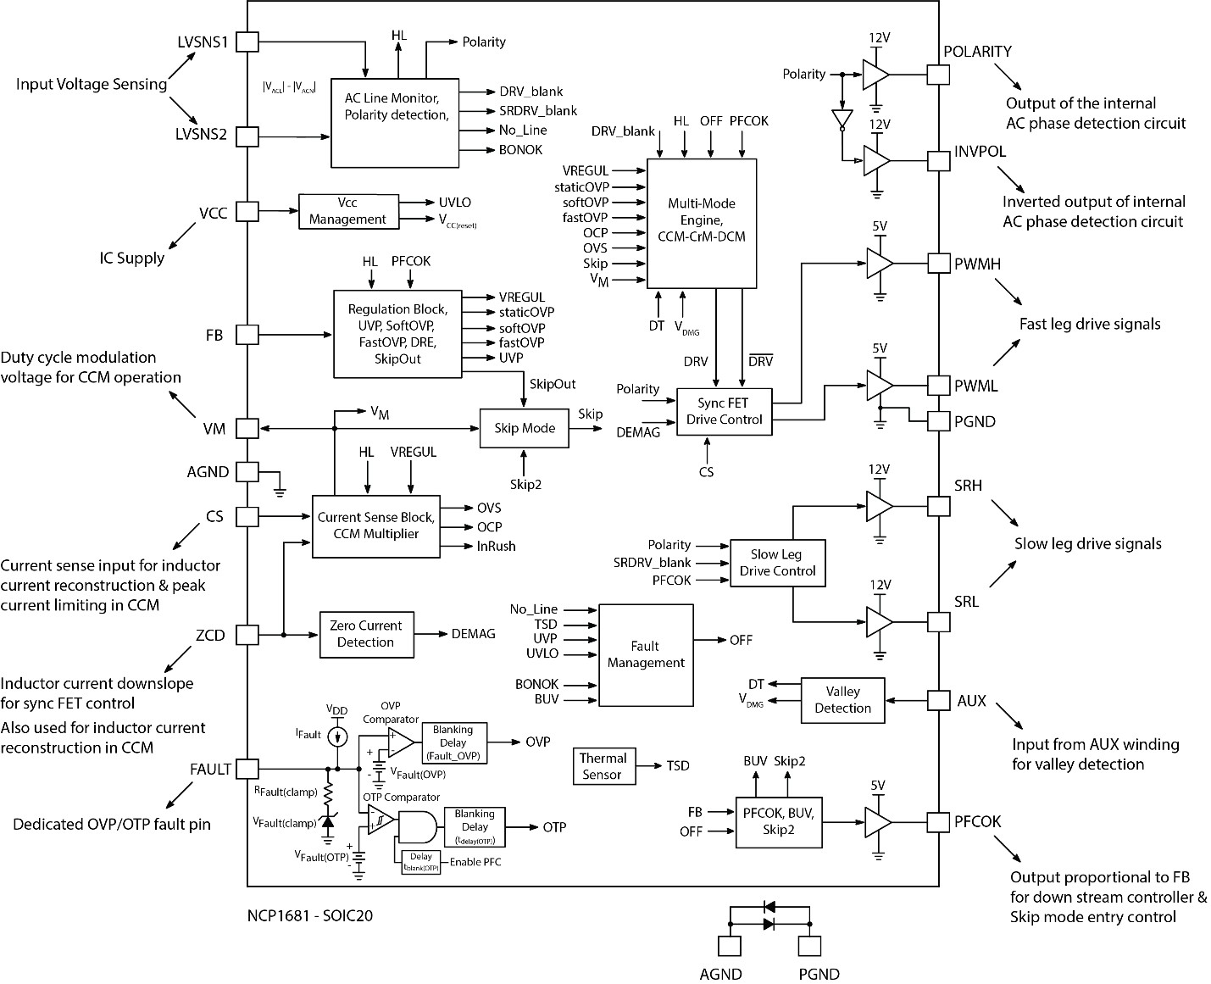

Slide 12
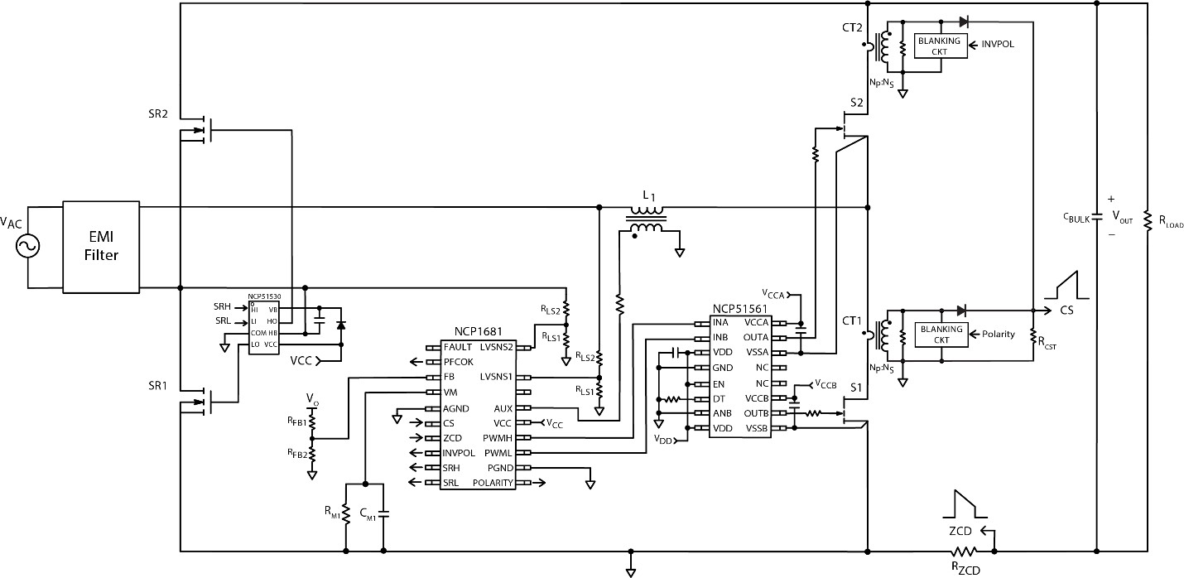
Remove AUX winding from PFC inductor for CCM only design

Slide 13
Description | Value | Units
Input Voltage Range | 90 - 265 | VAC
Line Frequency Range | 47 - 63 | Hz
Output Voltage | 395 | V
Switching Frequency¹ | 25 – 130 | kHz
Output Power² | 500 | W
Output Voltage Ripple | < 5 | %
Power Factor @ Full Load | > 0.95
THD @ Full Load | < 10 | %
Boost Inductor | 175 | µH
Inductor Core Size/Geometry | PQ3230
Bulk Capacitors | 2x 220 | µF
Fast Leg Switch | NCP58921
Fast Leg Level Shifter | NCP51561
Slow Leg Switch | FCPF067N65
ZCD Resistor | 100 | mΩ
F_{SW} range from 25 – 130 kHz. At full load F_{SW} = 65 kHz
Recommended minimum 500 LFM external airflow while operating EVB

Slide 14
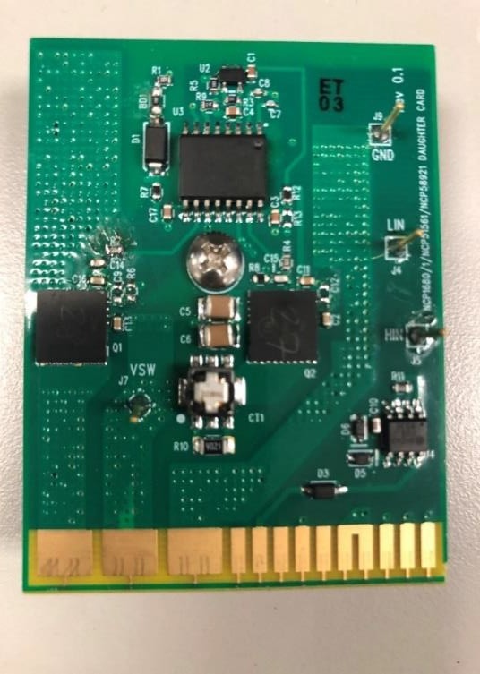
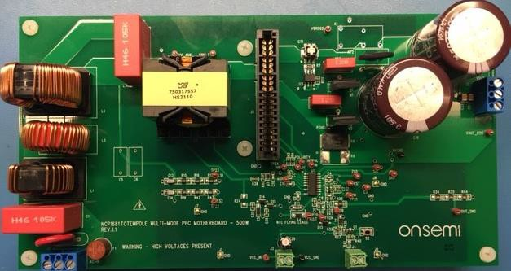
NCP51561: GI Gate Driver
NCP58921:
Integrated Driver-GaN
GaN daughter card
Totem Pole PFC main power board
– MM Board

Slide 15
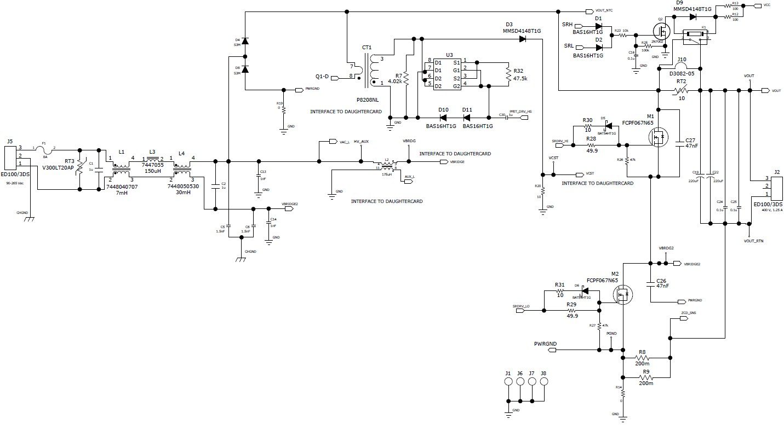

Slide 16
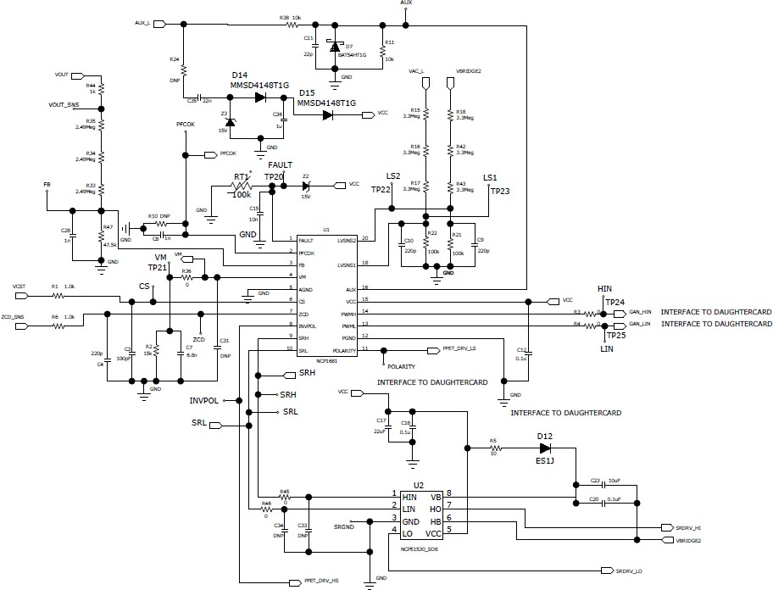

Slide 17
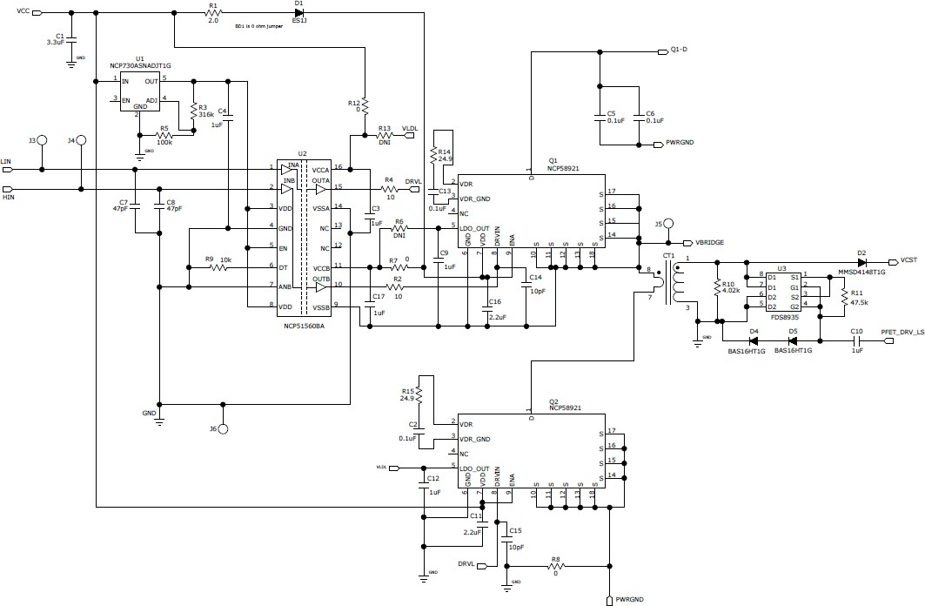
Top Side NCP58921
Small de-coupling caps at logic inputs
Current sense XMFR on drain- side location w/ blanking circuit
Bottom Side NCP58921

Slide 18
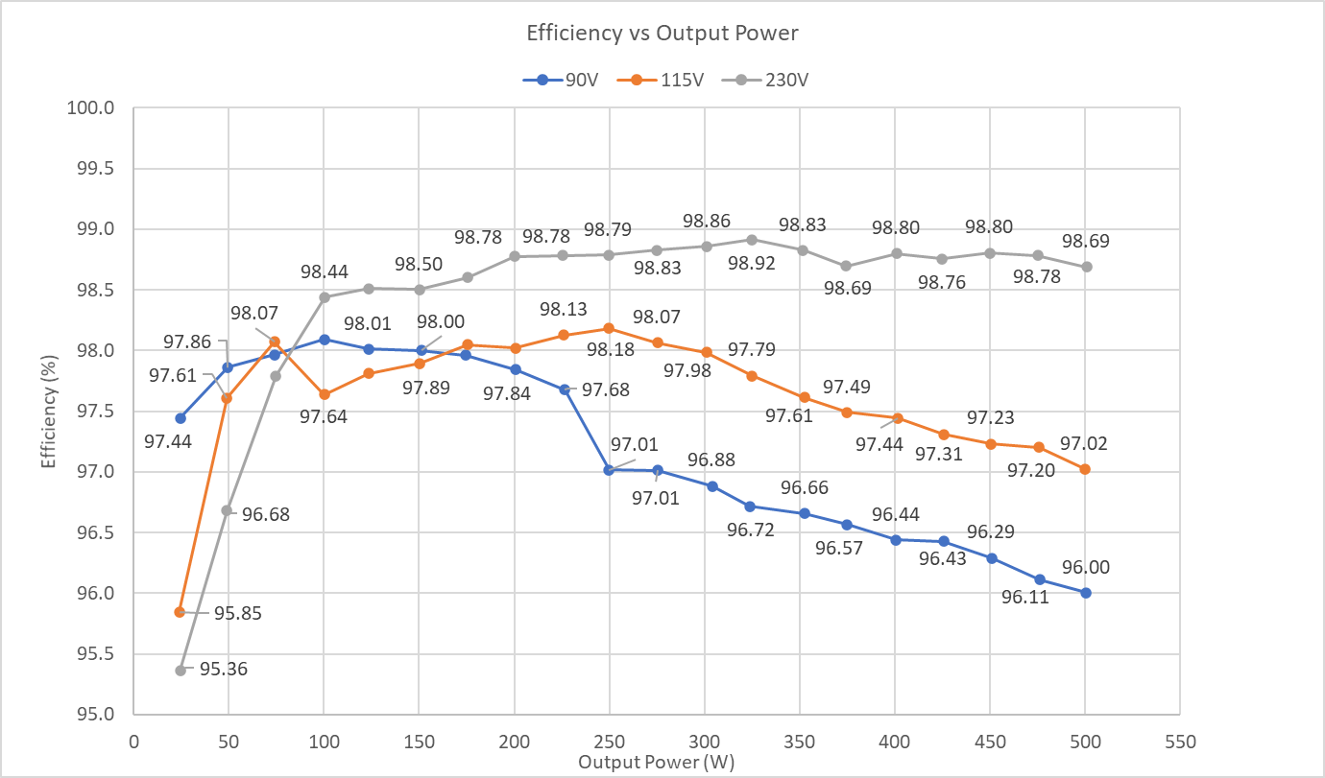

Slide 19
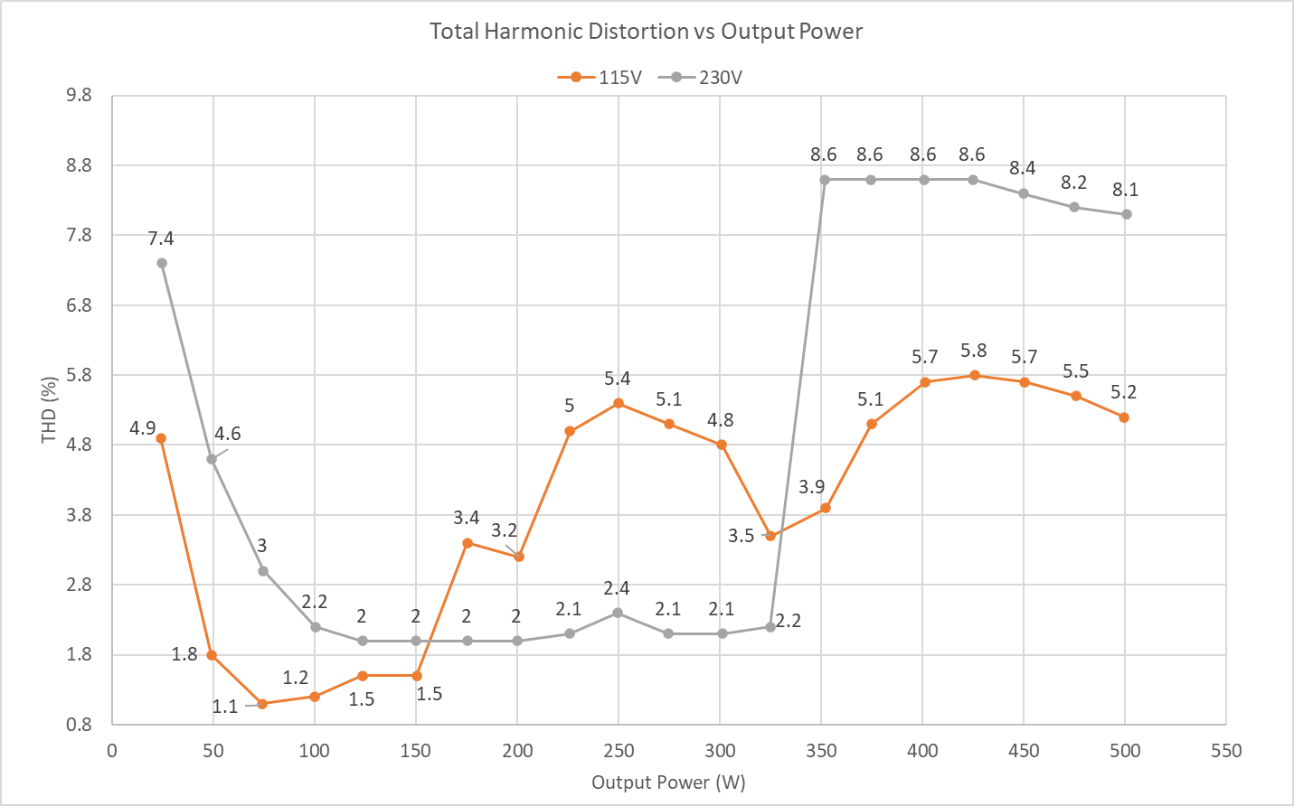
THD performance at 115 & 230 Vac < 10% across all loads

Slide 20
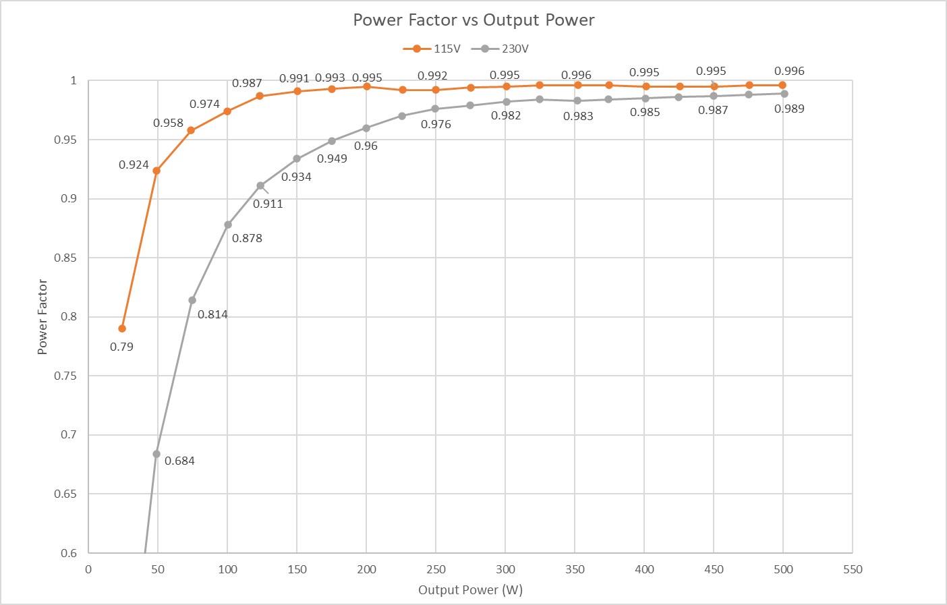
PF is > 0.9 for loads greater than 25%

Slide 21
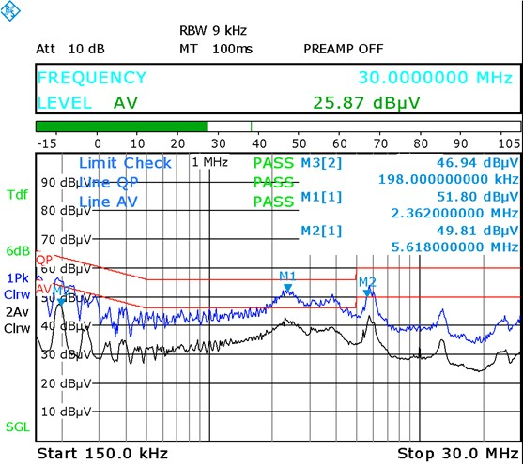
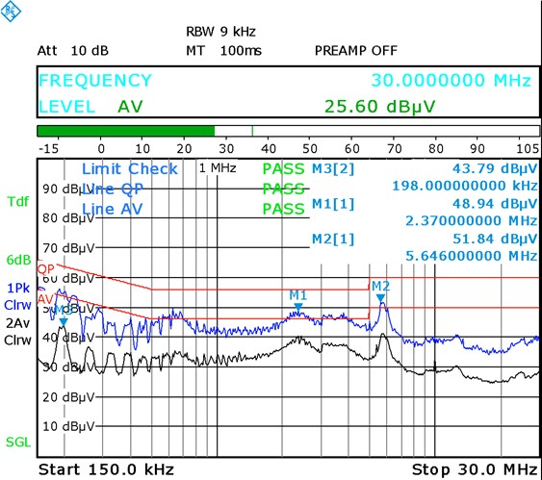
Greater than 5 dBµV of margin
115 V, 500 W
230 V, 500 W

Slide 22
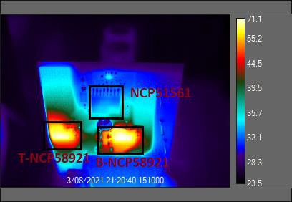
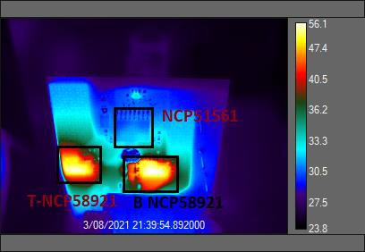
Vout = 395 V
Iload = 1.25 A
70
16706
115 Vac – Max Temp – 71.1° C
230 Vac – Max Temp – 56.1 ° C
To operate at loads > 300 W an external fan is necessary
Recommended minimum 500 LFM at full load

Slide 23
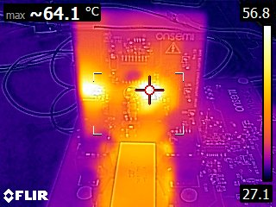
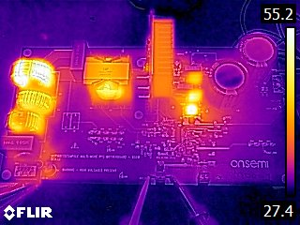
MM Thermal (500 W, 90 Vac, 25°C ambient )
64.7 ºC
54.1 ºC
73.7 ºC
Fast Leg Device Max Temp ~ 64° C
Key Component Temperatures
* To operate at loads > 300 W an external fan is necessary
* Recommended minimum 500 LFM at full load

Slide 24
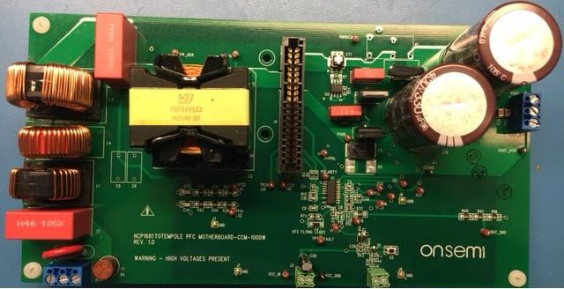
Description | Value | Units
Input Voltage Range | 90 - 265 | VAC
Line Frequency Range | 47 - 63 | Hz
Output Voltage | 395 | V
Switching Frequency | 65 | kHz
Output Power^{1,2} | 500 (LL) / 1000 (HL) | W
Output Voltage Ripple | < 5 | %
Power Factor @ Full Load | > 0.98
THD @ Full Load | < 5 | %
Boost Inductor | 500 | µH
Inductor Core Size/Geometry | PQ4040
Bulk Capacitors | 2x 330 | µF
Fast Leg Switch | NCP58921
Fast Leg Level Shifter | NCP51561
Slow Leg Switch | FCPF067N65
ZCD Resistor | 100 | mΩ
Rated output power is 500 W for 90 – 140 V_{AC}, and 1 kW for 180 – 265 V_{AC}
Recommended minimum 500 LFM external airflow while operating EVB

Slide 25
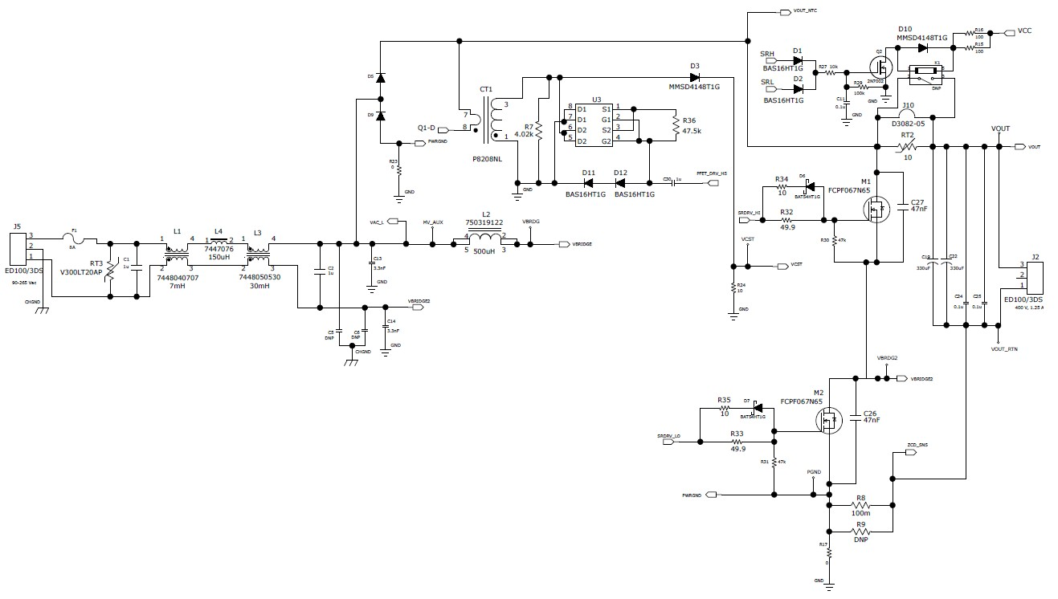
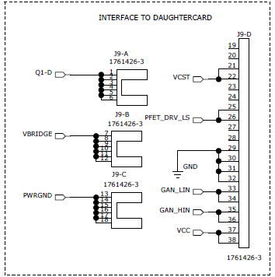
Optional ICL bypass circuit
CS XFMR
Inrush Bypass
Diodes
Optional ICL
CT Blanking
Slow leg SJ FETs w/ EMI caps
HV Nodes for differential line sensing
Daughter card
interface
ZCD Current Sense Resistors
Public Information © onsemi 2021

Slide 26
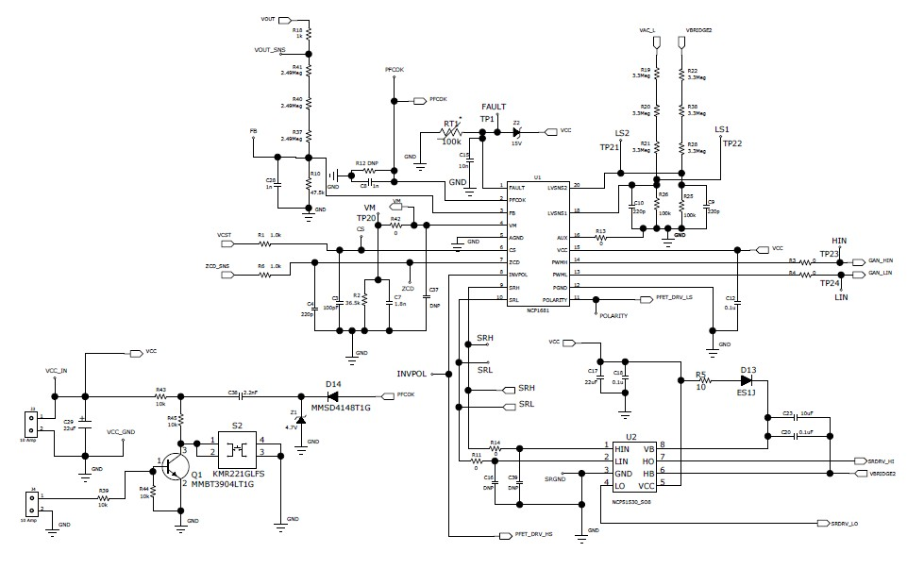
PFCOK & FAULT
Bulk voltage sensing
Differential Line
Voltage Sensing
Fast leg control
signals
CS & ZCD
inputs
V bias and
Polarity Indicator
CC
skip control
Slow leg control signals
Public Information © onsemi 2021

Slide 27
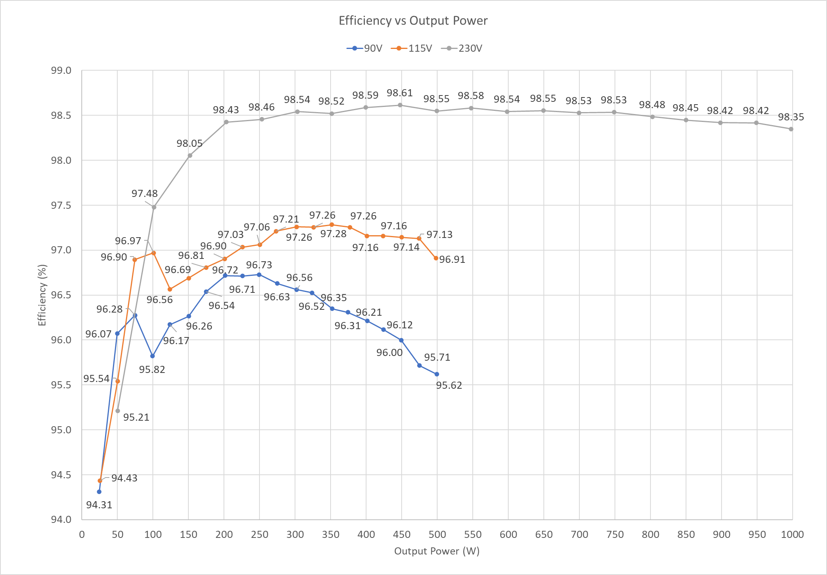

Slide 28
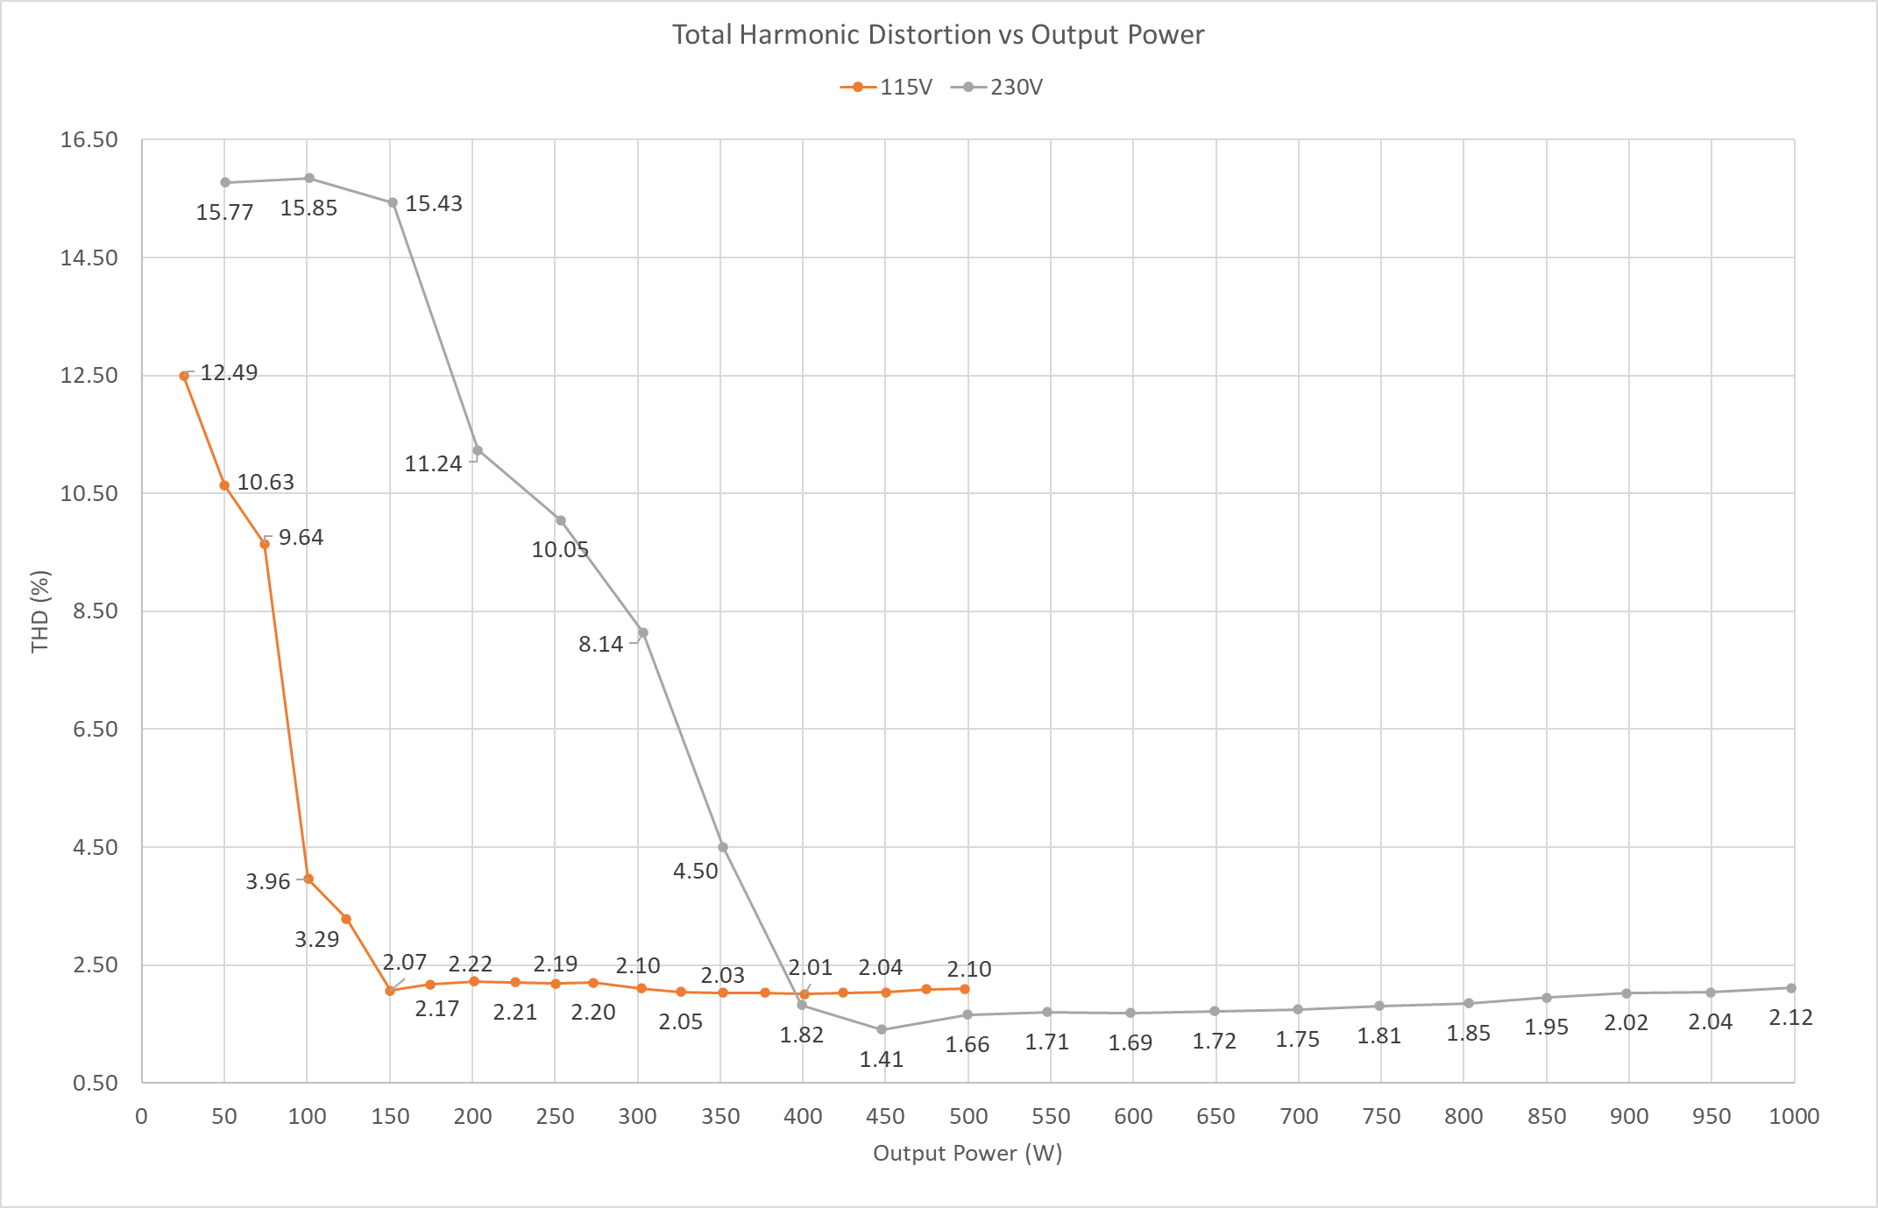
THD performance at 115 & 230 Vac < 5% down to 50% load and < 16% at all loads

Slide 29
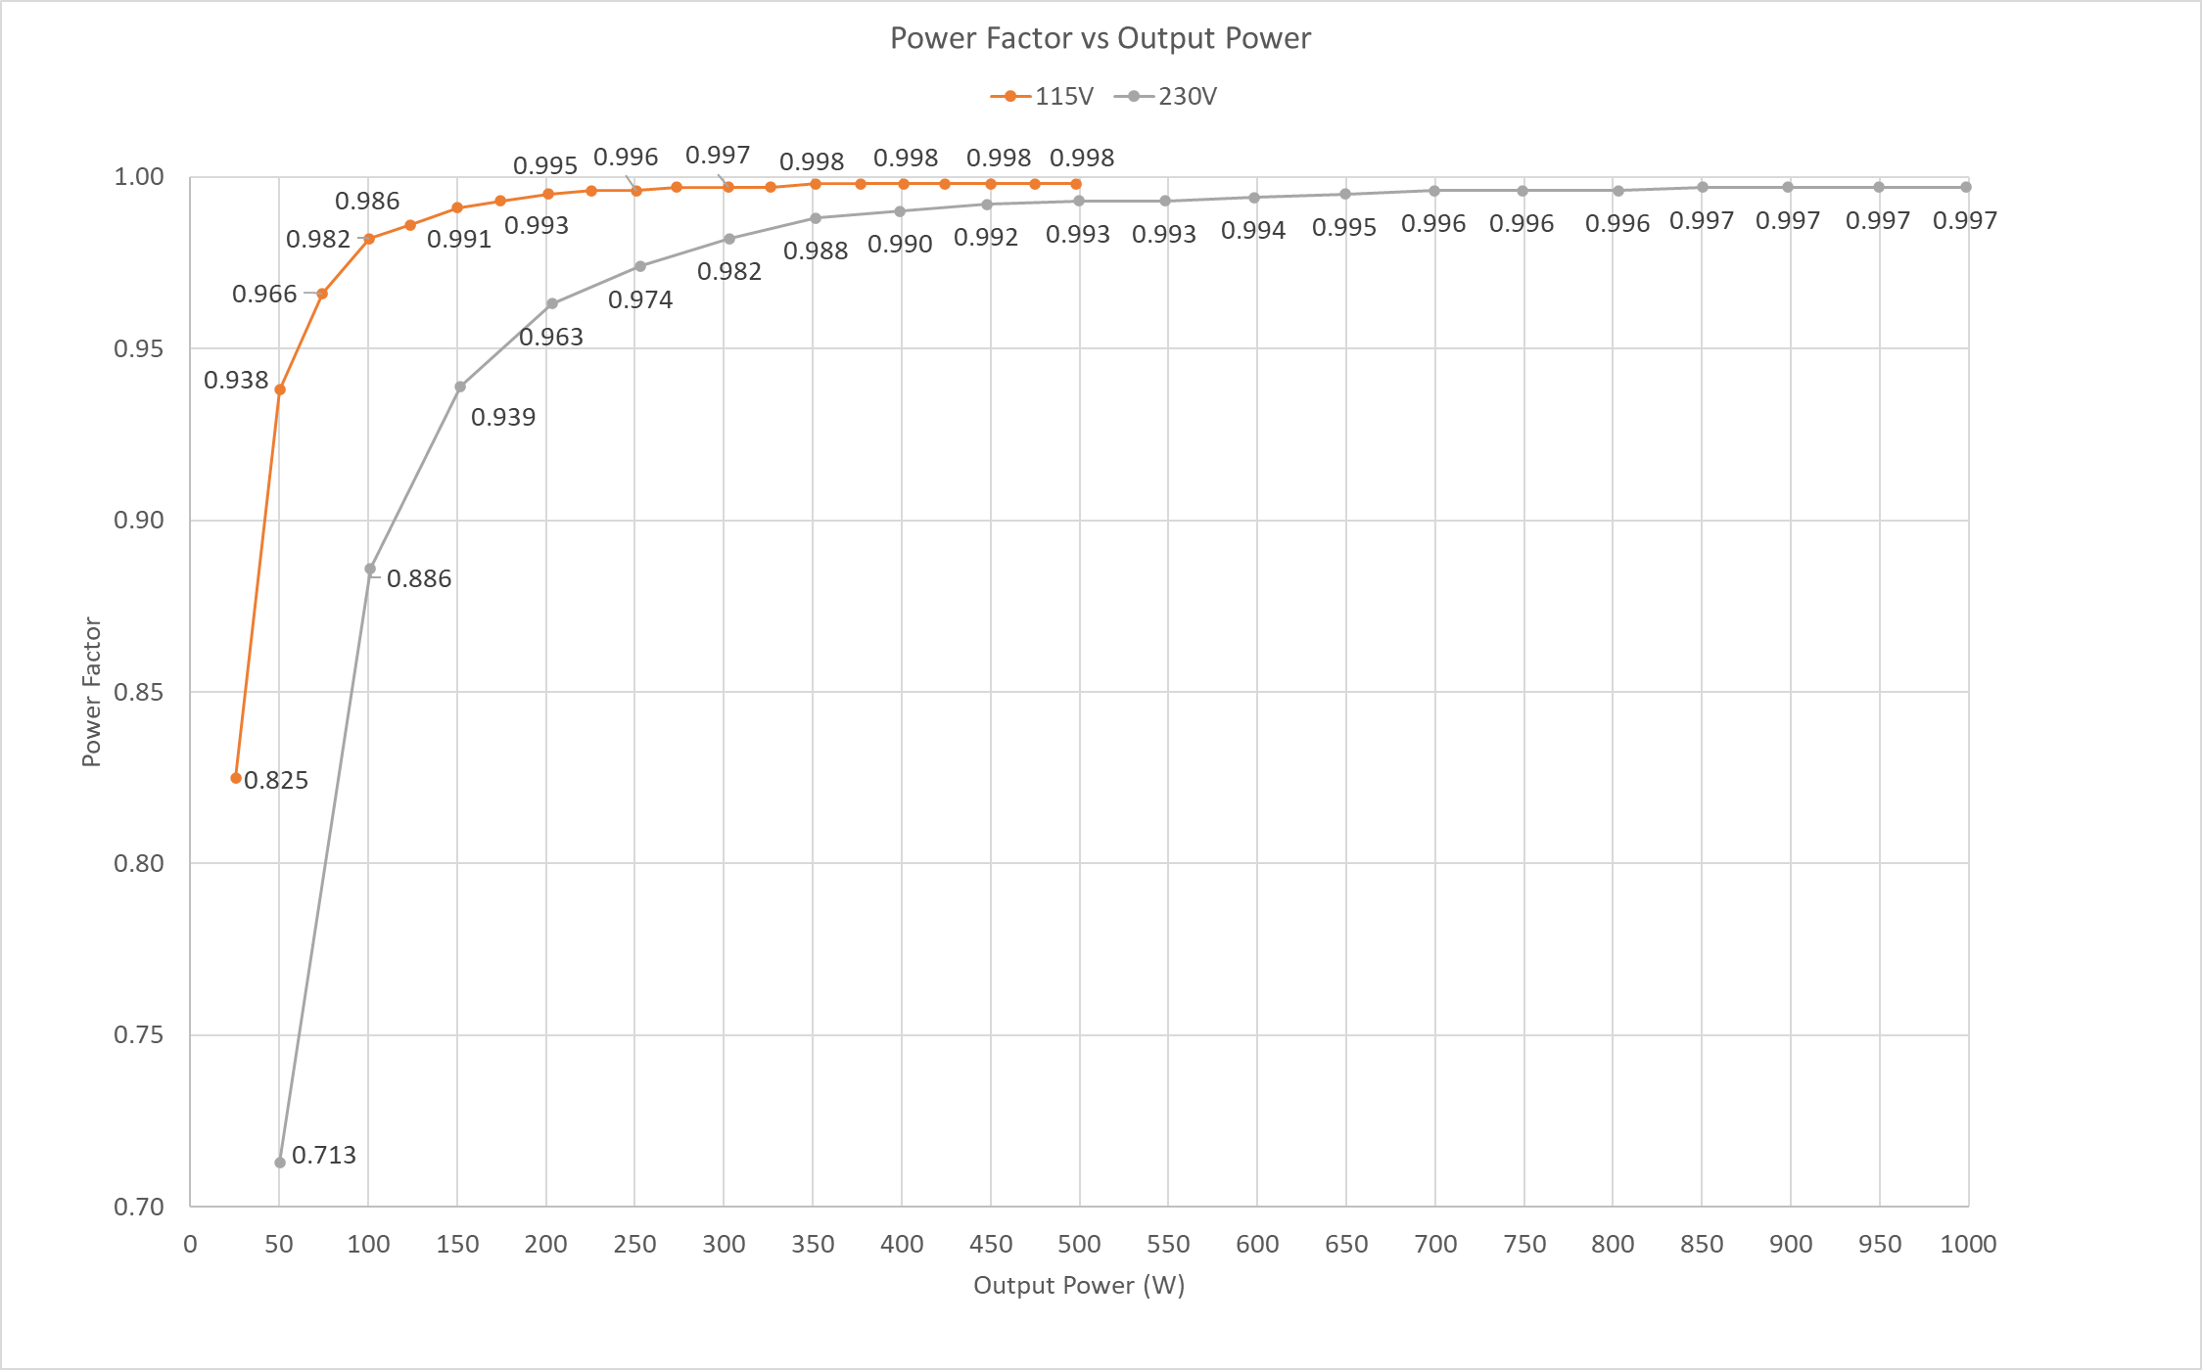
PF is > 0.93 for loads greater than 15%

Slide 30
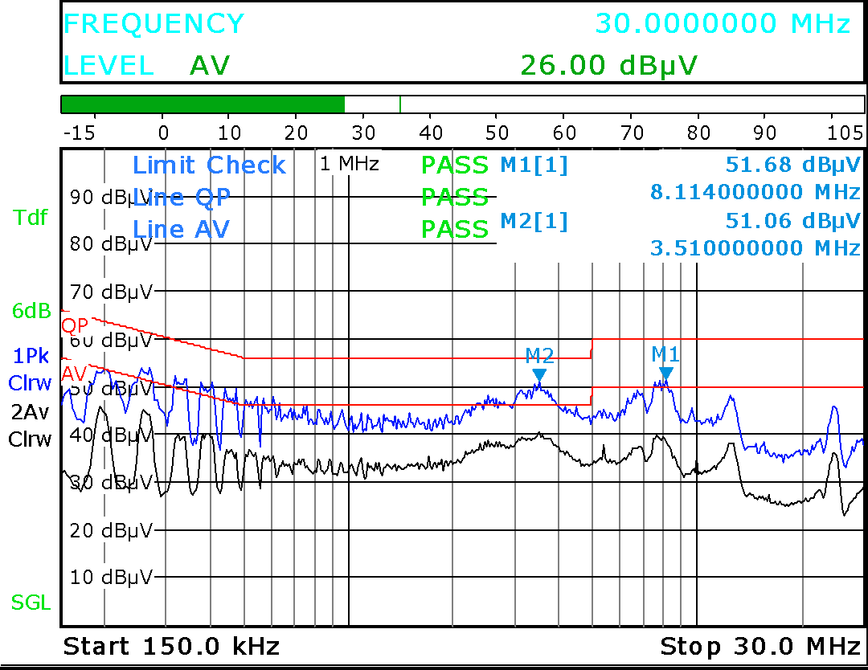
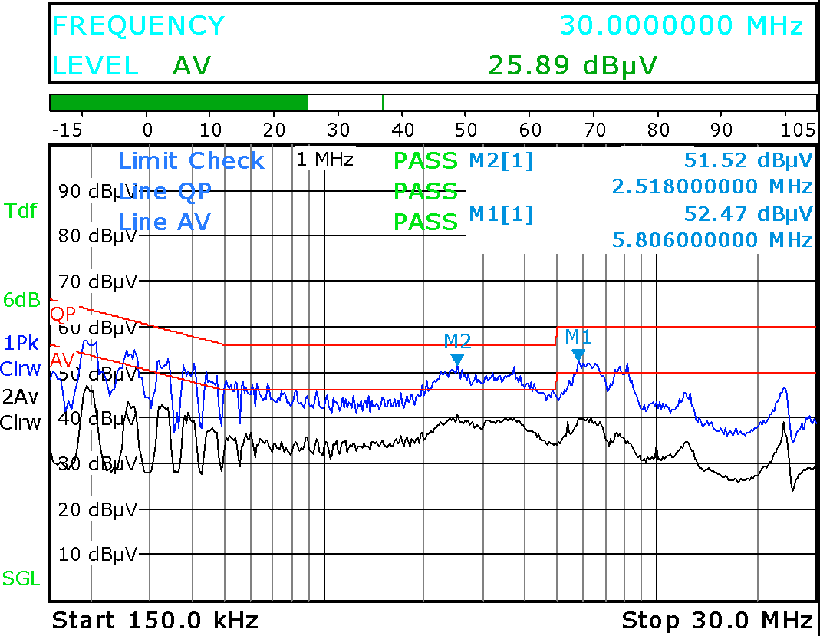
Greater than 5 dBµV of margin
115 V, 500 W
230 V, 1 kW

Slide 31
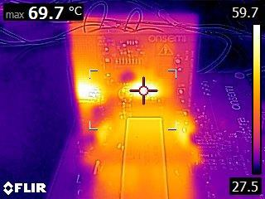
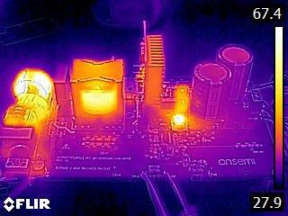
74.0 ºC
64.1 ºC
97.8 ºC
Fast Leg Device Max Temp ~ 70° C
Key Component Temperatures
* Recommended minimum 500 LFM at full load

Slide 32
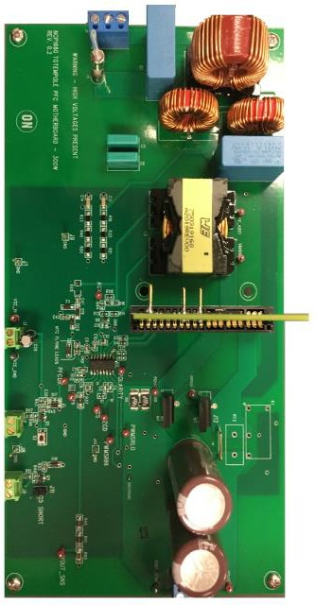
Q2 ‘22
Q2 ‘22
500 W multi-mode
1 kW CCM only

Slide 33
Discovery Questions | Relevance | Response
Are you looking to achieve the best possible PFC stage efficiency? | Design will benefit from bridgeless totem pole PFC | NCP1681 is designed to support bridgeless totem pole PFC, eliminate the loss of input diode bridge and achieve efficiency close to 99 %
Do you use digital MCU to implement totem pole PFC? | Digital MCU solution is more complex and expensive | NCP1681 is an analog mixed signal controller dedicated to totem pole PFC topology, simplifies design and reduces BOM count and cost
What are your efficiency requirements | High light-and no-load efficiency targets benefit from NCP1681 | NCP1681 features CCM operation at high power and optional CrM operation at medium power as well as frequency fold back with valley turn on at light load ensuring high efficiency across power levels

Slide 34
onsemi ultra high-density power solution

Slide 35
onsemi’s ultra high-density power solution
AC
HV
HV
Sync Rec |  | LV Iso DC-DC
Low Power AUX
PFC
Driver or GaN
Iso DC-DC
Driver or GaN
LV
Driver GaN

Slide 36
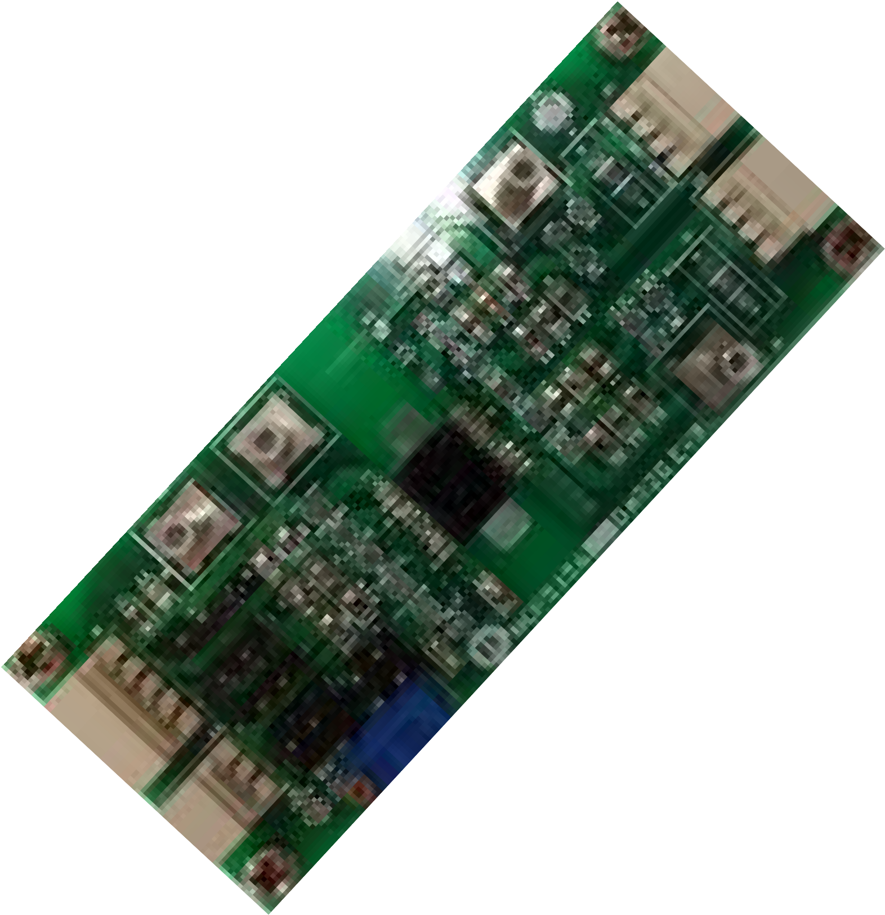
Value Proposition
The NCP5156x are isolated dual-channel gate driver with up to 4.5-A/9-A source and sink peak current. It is designed for fast switching to drive power MOSFETs power switches. The NCP5156x offers short and matched propagation delays. Internal functional isolation between the two secondary-side drivers allows a working voltage of up to ~1,200 VDC. The NCP5156x offers other important protection functions such as independent under-voltage lockout for each drivers and disable function.
Unique Features
Benefits
Device Pin-Out
Input side isolated from output drivers by 5-kVRMS isolation barrier
36 ns Prop Delay & 8 ns Delay Match
>= 150 V/ns dV/dt Immunity
4.5-A/9-A Typical Source/Sink Current Capability
Give reliable operation and safety
Efficient switching
High Robustness
Driver to accommodate diff MOS load
VDD
VCCA
VDD UVLO
UVLO
[5V, 8V, 13V, 17V]
INA (PWM)
INA
INA
Tx
Rx
INB
LOGIC
OUTA
INB (NC)
LOGIC
Input to Output Isolation
VSSA
ANB
Functional Isolation
NC
Other Features
VDD
NC
Matched Propagation Delays : Max. 8 ns
User Programmable Input Logic
Single or Dual-input modes via ANB
DISABLE or ENABLE mode
User Programmable Dead-Time Control
Different UVLO options: 8-V & 17-V (5 & 13 V On demand)
ENA/DIS
UVLO
[5V, 8V, 13V 17V]
VCCB
DT
DEAD TIME CONTROL
INB _{Tx}
Rx
LOGIC
OUTB
GND
VSSB
Market & Applications
Ordering & Package information
Isolated Converters in Offline AC-to-DC Power Supplies
Motor Drive and DC-to-AC Solar Inverters
HEV and EV On-Board chargers
SOIC-WB16
OPN : NCP51561xyDWR2G
x: UVLO level
y: Enable/Disable

Slide 37
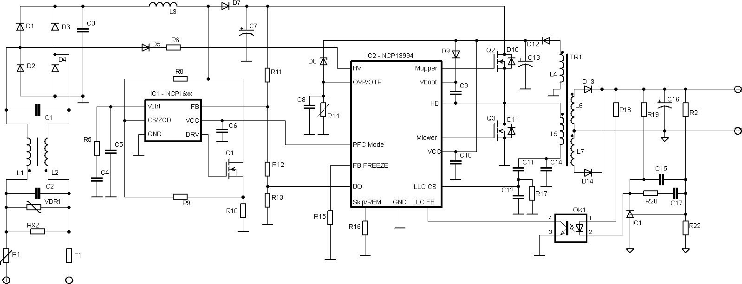
Value Proposition
The NCP13994 is an enhanced, high-performance current mode controller for half bridge resonant LLC that focuses on improved light load efficiency, no-load consumption, PFC vs. LLC communication, reduced acoustic noise in skip, enhanced protection features and higher frequency applications
Unique Features
Benefits
Typical Application Schematic
▪ Reduced ICC
▪
Reduced no-load power
Line sensing with X2 cap discharge
Dedicated light load control
PFC / LLC communication
Current mode control
Ded. Start up sequence
Improved light load efficiency
Optimized operation with latest PFCs
Fast transient response
Reduced soft-start current
Other Features
HV Startup Current Source
Operating frequency from 20 kHz up to 1 MHz Automatic Dead-time with Maximum Dead-time Clamp Off-mode for Extremely Low No-load Consumption Inherent out of Resonance Switching Protection Overload and short circuit protections
Peak power timer / OLP threshold
Pin to Adjacent Pin / Open Pin Fail Safe
Ordering & Package information
Market & Applications
Standard SOIC-16 (less 2 pins) package
Pin to pin compatible to NCP1399 and NCP13992
Design flexibility via IPT options of key parameters
High Power Density Offline Power Supplies
High Performance Computing (USB PD 3.1, AIO)
Industrial Power Supplies (Telecom, Lighting, Battery Charging)

Slide 38
Follow Us @onsemi
www.onsemi

