Slide 1
NCS21802
Precision Operational Amplifier
Notes:
*Mandatory Slide*
Above information can be pulled from onsemi.com if needed.

Slide 2
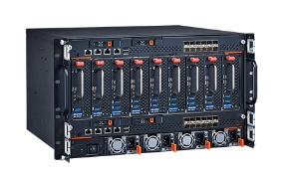
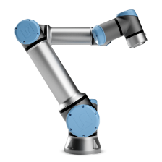

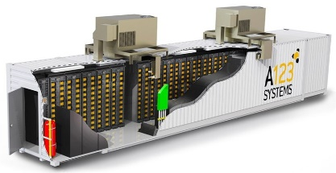
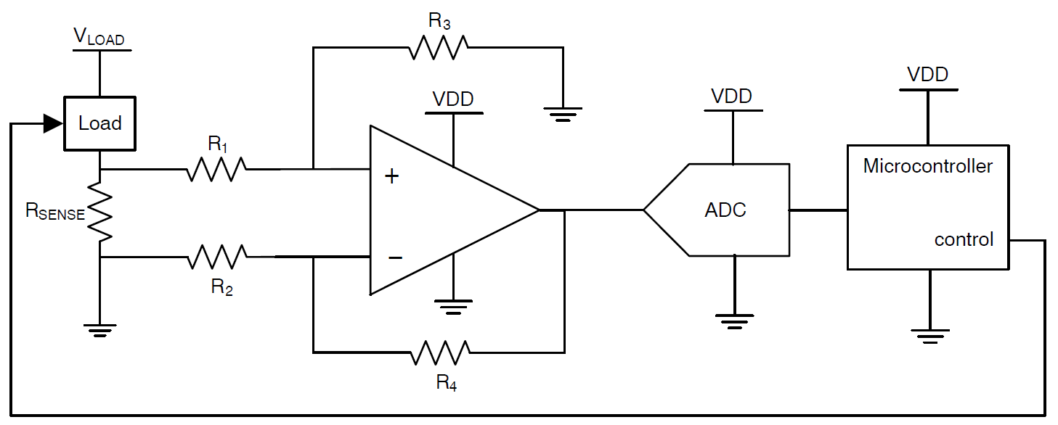
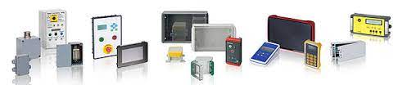

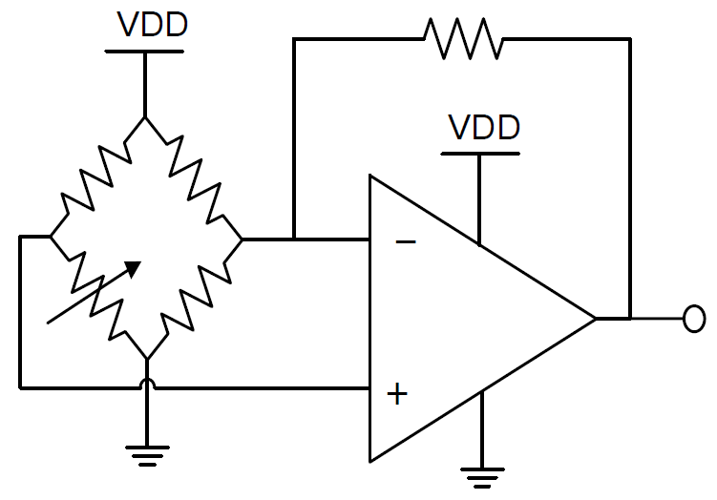
NCS21802 Zero-Drift Precision Op Amp
The NCS21802 zero-drift precision op amps feature low input offset voltage that does not drift over temperature and time. This feature makes them ideal for applications where accuracy is needed, such as current sensing and sensor interface.
Description of product family
Current Sense
Product Overview
Key Parameter are offset voltage, offset voltage drift, settling time and slew rate.
Features
• Input Offset Voltage: 10 µV max @ 25 °C
• Zero-Drift Offset Voltage: 0.075 µV/°C max
• Voltage Noise Density: 42 nV/√Hz
• Gain Bandwidth: 1.5 MHz
• Supply Voltage: 1.6 V to 5.5 V
• Quiescent Current: 75 µA
Motor Control
Power Supply Monitoring
Battery Management
ADC Buffer
onsemi Advantage
Zero-Drift Architecture
Low Current Consumption
Increasing System Accuracy
Precise Performance at Low Voltage and Low Current Operation
A Variety of Package Configurations
Bridge Circuit Amplification
Key Parameter are offset voltage, offset voltage drift, and noise.
Expanding Product Family!
Samples Available now for NCS21801/2/3/4
Transducer Interface
Sensor Interface
Medical Instrumentation
Automotive Qualified under “NCV” Prefix

Slide 3
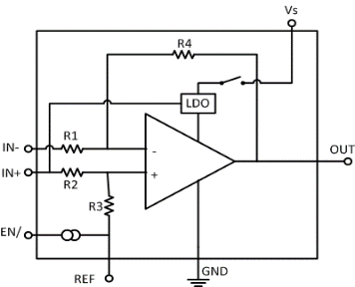
Amplifier Product Portfolio
High-Side
&
Low-Side
Current Sensing for Battery Management,
Motor Control/Drive,
EV/HEV
Current Sense Amplifiers
NCS703x/4x
80V, CMV below Gnd
Ext. Filtering Option
NCS199AxR
26V CMV, 1% Gain Error,
NCS21673/4/5,
40V, CMV below Gnd.
NCS21xR
26V CMV, 0.3% Gain Error,
NCS21671
40V, CMV below Gnd.
Sensors Interface,
Signal Conditioning,
Low-Side
Current Sensing
Low Power &
Precision Op Amps
NCS2007x (Single/Dual/Quad)
36V, 3 MHz, 480 µA, RRO
NCS20166
5V 10MHz Op Amps.
NCS21911/2/4
36V 2 MHz
ZD Op Amps.
Released
NCS2006x (Single/Dual/Quad)
5.5V, 3 MHz, 130 µA, RRIO
NCS20094
5V Low Power Op Amps.
Engr. Sam.
NCS21802
5V 1MHz ZD Op Amp
www.onsemi.com/NCS21802
NCS2008x (Single/Dual/Quad)
5.5V, 1.2 MHz, 50 µA, RRIO
NCS20064
5V Low Power Op Amps.
NCS21801/2/3/4
5V 1MHz ZD Op Amp
NCS2009x (Single/Dual/Quad)
5.5V, 350 KHz, 20 µA, RRIO
NCS20084
5V Low Power Op Amps.
Expanding Product Family!
Samples Available now for NCS21801/2/3/4
NCS(V)x333 Zero-Drift
5.5V, 10 uV Vos, 350 kHz
NCS21871/2/4
5V 350 kHz ZD Op Amp
NCS2250/52
74ns Comparator
TLV272/4
36V Op Amps.
<2019
2020
2021
2022

Slide 4
Competitive
Comparison
 | NCS21802 | AD8571/2/4 | MAX40100
Corporation | ON Semiconductor | Analog Devices | Maximum Integrated
Power Supply
Supply Voltage | 1.6 to 5.5 V (T = 0 to 85 C) | 2.7 V to 5 V | 1.6 V to 5.5 V
IDD | 75 µA typ | 850 µA typ | 66 µA typ
Input
VOS | 10 µV max (T = 25 C) | 5 µV max (T = 25 C) | 10 µV max (T = 25 C)
VOS Drift | 5 nV/C typ, 50 nV/C max | 5 nV/C typ, 40 nV/C max | 5 nV/C typ
Dynamic Performance
Slew Rate | 0.7 V/µs | 0.4 V/µs | 0.2 V/µs
Voltage Noise Density | 42 nV/√Hz | 51 nV/√Hz | 42 nV/√Hz
Voltage Noise | 0.4 µVpp | 1.3 µVpp | 0.42 µVpp
Gain Bandwidth | 1.5 MHz | 1.5 MHz | 1.5 MHz
Package Type | Micro8 | 8L MSOP | WLP
 | UDFN8 | 8L SOIC
 |  | 8L TSSOP
Expanding Package Configurations!
Samples Available Now for NCS21801/2/3/4

Slide 5
Pricing
  NCS21802DMR2G: $0.4046
    4,000
    Micro8
  NCS21802MUTBG: $0.4046
    3,000
    UDFN8
Collateral
Data Sheet
NCS21801/2/3/4
Click Here
Product Overview
NCS21802
Click Here
Blog
Application Requirements for precise Industrial Control
Click Here
Evaluation Board
Battery Management
Click Here

