Slide 1
NCV4390 - LLC Resonant Controller with Synchronous Rectification
Technical Presentation – Dec 2021

Slide 2
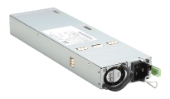

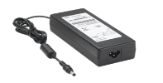
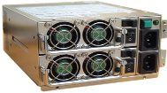
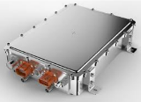
NCP/NCV4390 Applications
High Efficiency 100W to 2000W Power Supplies with PFC pre-regulators
    Large LCD, PDP and RPTV Displays
  Computing Power
    Servers
    High power Adapter
    Telecom Front-End Power
  Industrial Power Systems
  xEV OBC & HV to LV DC/DC Converters

Slide 3
NCP/NCV4390 LLC Resonant Converter Controller with Synchronous Rectification
The NCV4390 is upgrade of FAN7688 in new SOIC-16 NB package, option PWM mode disabled and no thermal shutdown function. It is an advanced secondary side PFM controller for LLC resonant converters with Synchronous Rectification (SR). It employs a current mode control technique based on charge control to simplify the feedback loop design and allow true input power limit capability. A dual edge tracking adaptive dead time control minimizes body diode conduction thus maximizing efficiency.
  Analog Control
  Charge Current Control
  Adaptive SR with Dual edge Tracking
  Green Functions i.e. Symmetric PWM Control and SR Disabling at Light Load Condition
  Closed Loop Soft Start
  No Need for Expensive, Complex Digital MCU
  Excellent Transient response and Easy feedback Loop Design
  Best In Class Efficiency
  Improved Light Load Efficiency
  Monotonic Rising Output Voltage
  Over Current Protection (OCP)
  Output Short protection (OSP)
  Non ZVS Prevention
  Power Limit by Compensation Cutback
  Overload Protection with Programmable Shutdown Delay
  Wide Operating Temperature Range –40°C To 125°C
  AC-DC Power Supply
  Isolated DC-DC Converters
  Industrial Power
  SOIC-16 Narrow Body Package

Slide 4
NCV4390 Key Features
Secondary-Side PFM Controller for LLC Resonant Converter with Synchronous-Rectifier Control
Charge-Current Control for Better Transient Response and Easy Feedback-loop Design
Synchronous-Rectification Control with Dual-Edge Tracking
Closed-Loop Soft-Start for Monotonic Build-up of the Output Voltage
Wide Operating-Frequency Range (39kHz ~ 690kHz)
Green Functions to improve Light-Load Efficiency
  Symmetric PWM control at Light Load to Limit the Switching Frequency while Reducing Switching Losses
  Programmable PWM-Mode Entry Point
  SR Gate-Signal Shrinking at Light-Load Condition to Prevent Negative Resonant Current
  Disabling SR at Extremely Light-Load Condition
Protection Functions with Auto-Restart
  Non-ZVS Prevention by Frequency Shift
  Power Limit by Frequency Shift
  Over-Current Protection (OCP)
  Output-Short Protection (OSP)
  Over-Load Protection (OLP) with Programmable Shutdown Delay Time
Programmable Dead Time for Primary Side Switches and SR Switches
Wide Operating Temperature Range –40°C To 125°C

Slide 5
NCV4390 Pin Description
Pin# | Name | Pin Description
1 | 5VB | 5V REF
2 | PWMS | PWM mode entry level setting
3 | FMIN | Minimum frequency setting pin
4 | FB | Output voltage sensing for feedback control
5 | COMP | Output of error amplifier
6 | SS | Soft-start time programming pin.
7 | ICS | Current information Integration pin for current mode control
8 | CS | Current sensing
9 | RDT | Dead time programming pin for the primary side switches and SR switches
10 | SR1DS | SR1 Darin-to-source voltage detection
11 | SROUT2 | Gate drive output for SR MOSFET 2
12 | SROUT1 | Gate drive output for SR MOSFET 1
13 | PROUT2 | Gate drive output 2 for the primary side switch
14 | PROUT1 | Gate drive output 1 for the primary side switch
15 | VDD | IC Supply voltage
16 | GND | Ground

Slide 6
Typical Application Circuit
NCV4390 is located in the secondary side of an LLC converter
Current transformer for sensing primary-side current
Pulse transformer for driving primary-side MOSFET

Slide 7
Typical Application Circuit – Full-Bridge Scenario
By duplicating the gate-drive signals with reversed polarity, NCV4390 can cover full-bridge application.

Slide 8
NCV4390 Internal Block Diagram
Charge-current PFM
V_{OUT} Error amp.
SR Gate Control
PWM Mode

Slide 9
Outline
Charge Current Control
Dual-edge Tracking SR Control
Operation across Load Variation and PWM
Peripheral Functions
Protections
Comparison
Boards

Slide 10
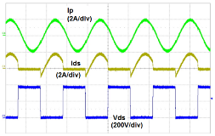
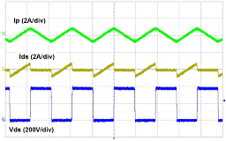
Charge Current Control – Switch Current Signal
Current Sensing Issue in LLC Resonant Converter
PWM converters: Peak switch current is proportional to average input power. Instantaneous switch current signal can be used as ramp signal of peak-current-mode control variable and pulse-by-pulse current limit.
Resonant converters: Switch current is not monotonically increasing. It cannot be used as peak-current-mode ramp signal.
PWM Converter
LLC Resonant Converter

Slide 11
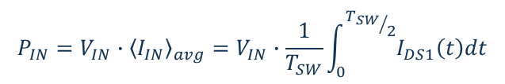
Charge Current Control – Integral of Switch Current
The instantaneous switch current of LLC resonant converter does not reflect the input power properly
However, a half-period integral of the switch current does !
  It can be used for peak-current-mode control
  It can be used for output-current limit (power limit)
  It can be used for green mode (disable SR at light load)
$$P_{IN}={V_{IN}∙{\left\langle I_{IN}\right\rangle }_{avg}=V}_{IN}∙\frac{1}{T_{SW}}\int_{0}^{{T_{SW}}/2}{I_{DS1}\left(t\right)dt}$$

Slide 12
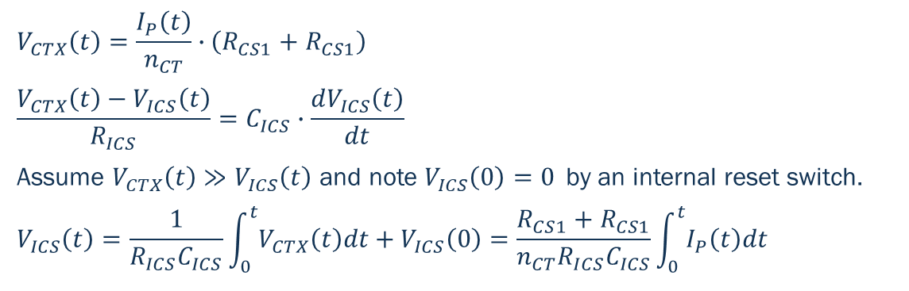
Charge Current Control – Implementation of the Integral
$$V_{CTX}\left(t\right)=\frac{I_{P}\left(t\right)}{n_{CT}}∙\left(R_{CS1}+R_{CS1}\right)$$
$$\frac{V_{CTX}\left(t\right)−V_{ICS}\left(t\right)}{R_{ICS}}=C_{ICS}∙\frac{dV_{ICS}\left(t\right)}{dt}$$
Assume $V_{CTX}\left(t\right)≫V_{ICS}\left(t\right)$ and note $V_{ICS}\left(0\right)=0$ by an internal reset switch.
$$V_{ICS}\left(t\right)=\frac{1}{R_{ICS}C_{ICS}}\int_{0}^{t}{V_{CTX}\left(t\right)dt}+V_{ICS}\left(0\right)=\frac{R_{CS1}+R_{CS1}}{n_{CT}R_{ICS}C_{ICS}}\int_{0}^{t}{I_{P}\left(t\right)dt}$$
10% load
50% load
100% load

Slide 13
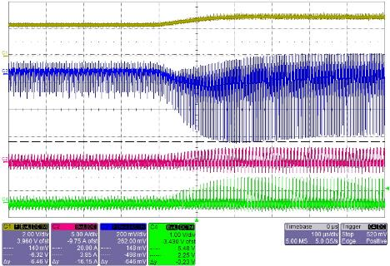
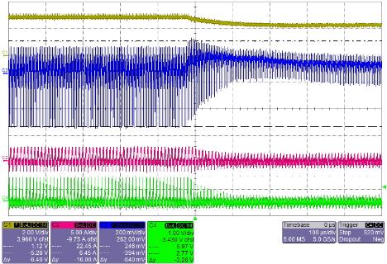
Charge Current Control in Action – Load Change
Dynamic Response
Step load change (25%→100%)
Step load change (100%→25%)
COMP
Vo
Is
ICS

Slide 14
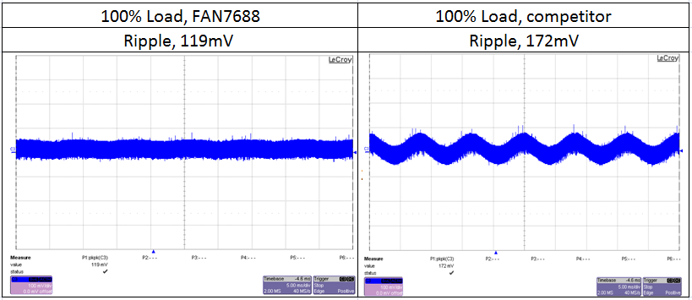
Charge Current Control in Action – Rejection of Input Ripple
Output Ripple Comparison
The inherent line feed-forward characteristics of charge current control reduces the 120Hz ripple of output voltage
NCP4390

Slide 15
Outline
Charge Current Control
Dual-edge Tracking SR Control
Operation across Load Variation and PWM
Peripheral Functions
Protections
Comparison
Boards

Slide 16
Ideal SR Driving Signal
Below resonance
  SR should turn on when I_{SR} starts growing, which is the same moment as PROUT on.
  SR should turn off when I_{SR} reduce to zero, which is before PROUT off.
Above resonance
  SR should turn on when I_{SR} starts growing, which is after PROUT on.
  SR should turn off when I_{SR} reduce to zero, which is after PROUT off.
Below resonance
Above resonance

Slide 17
SR1DS Turning-Point Sensing Circuit
With information of PROUT1, PROUT2, and SR1DS,
SR turning-on moment.
  ANDing of PROUT and SR1DS turning point.
SR turning-off moment
  SR1DS turning point
SR conduction time (SRCOND)
  Time duration between SR turning-on and turning-off moments

Slide 18
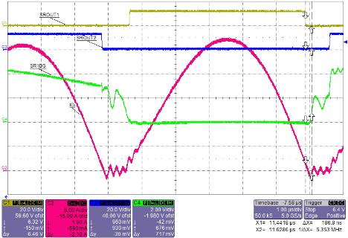
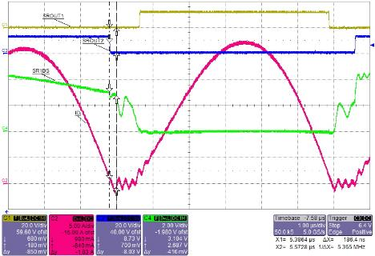
Dual-Edge-Tracking SR Control in Action – Below Resonance
SR operation waveforms for below resonance and full load condition
  Minimum Turn-on dead time
  Controlled Turn-off dead time
SROUT1
SROUT2
SR1DS
ID

Slide 19
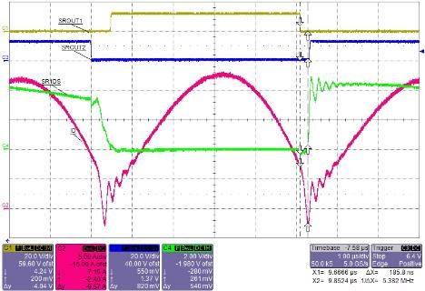

Dual-Edge-Tracking SR Control in Action – Above Resonance
SR operation waveforms for above resonance and full load condition
  Minimum Turn-on dead time
  Controlled Turn-off dead time
SROUT1
SROUT2
SR1DS
ID

Slide 20
Outline
Charge Current Control
Dual-edge Tracking SR Control
Operation across Load Variation and PWM
Peripheral Functions
Protections
Comparison
Boards

Slide 21
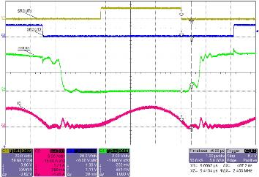
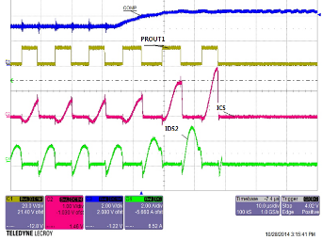
ICS Threshold Voltages – Power limiting and SR Mode Changing
V_{ICS}^{PK} > V_{OCP1} (1.9 V), trigger protection immediately.
V_{ICS}^{PK} > V_{OCL} (1.2 V), increase switching frequency gradually to limit output power.
V_{ICS}^{PK} < V_{TH1} (0.2 V), delay SR turning-on moment (SR shrink).
V_{ICS}^{PK} < V_{TH2} (0.075 V), disable SR gate signal.
1.9V
OCL: Cycle by cycle limit, 1.2V(Above Resonant), 1.45V(Below Resonant)
OCP: Stop working directly, 1.9V

Slide 22
Hybrid Control (PFM+PWM) – Why do we want PWM?
Problem of conventional PFM in above-resonance operation
It is typical to set the operating point of LLC resonant converter for the normal input voltage at the resonant frequency (f_{o}) such that the frequency variation with load change can be minimized
Running in above resonance mode at nominal input voltage allows wider input voltage variation. However, it results in too wide frequency variation. Frequency goes high in light-load conditions.
Clamping highest switching frequency by pulse-width modulation (PWM)
Note: PWM mode can be fully disabled in NCP4390.

Slide 23
Hybrid Control (PFM+PWM) – How do we get PWM?
PWM is initiated when V_{COMP} < V_{COMP.PWM}
  Medium to heavy load → PFM
  Light load → PWM
Delay PROUT1 rising and make PROUT2 turn off earlier. Modulate the on-time by V_{COMP}.
Flawless transition between PFM and PWM.
SR is disabled in PWM mode.

Slide 24
Setting V_{COMP.PWM} by PWMS Pin
V_{COMP} threshold for PWM mode is programmable via the PWMS-pin resistor.
In NCP4390, the threshold can be programmed lower than the skip-mode threshold (1.25 V), identical to disabling PWM mode.
VCOMP.SKIP
NCV4390
FAN7688

Slide 25
Outline
Charge Current Control
Dual-edge Tracking SR Control
Operation across Load Variation and PWM
Peripheral Functions
  Dead-time Programming
  Closed-loop Soft Start
Protections
Comparison
Boards

Slide 26
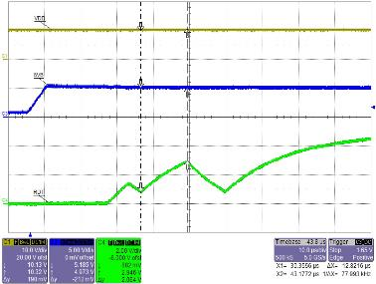
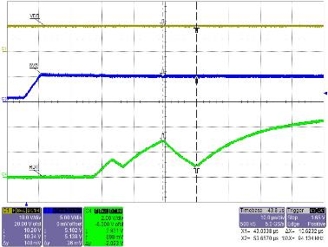
Dead-time Programming
Dead time of PROUTs and SROUTs are set by RDT pin.
Remote on/off can be implemented by pulling RDT pin down to GND.
VDD
5VB
SROUT dead time
PROUT dead time
RDT

Slide 27
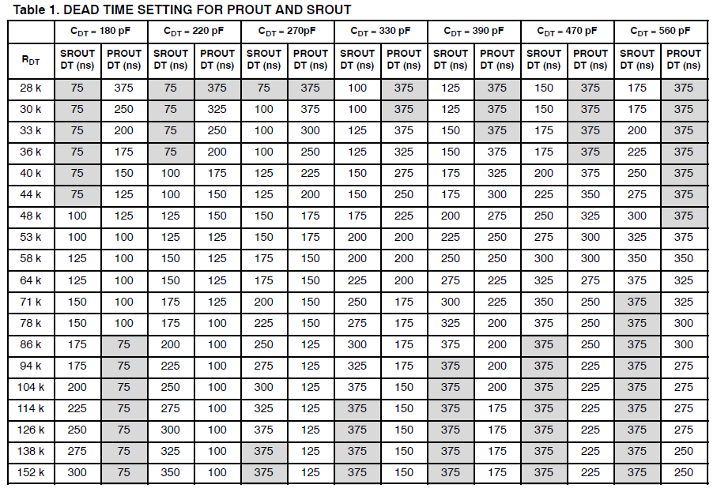
Dead-time Programming
VDD

Slide 28
Closed Loop Soft-Start – How?
The feedback loop is always closed and responds to the load change any time
Monotonic rising of the output voltage
Output rise time is adjusted by SS-pin capacitor.

Slide 29
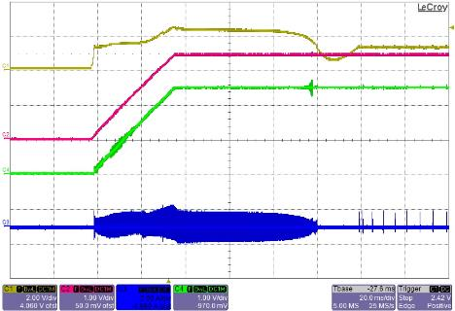
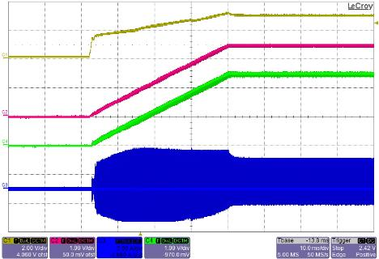
Closed-loop Soft-start Waveforms
Soft-start at no load
Soft-start at full load (21A)
COMP
Vss
Vo
Is

Slide 30
Outline
Charge Current Control
Dual-edge Tracking SR Control
Operation across Load Variation and PWM
Peripheral Functions
Protections
Comparison
Boards

Slide 31
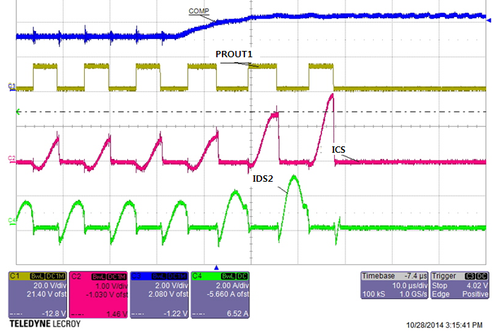
Over Current Protection1 (OCP, ICS part)
OCP is triggered when V_{ICS} > 1.9V
  Drastic change that V_{OCL} fails to protect.
COMP
PROUT1
ICS
IDS2

Slide 32
Over Current Protection2 (OCP, CS part)
CS pin detects instantaneous current in the resonant tank.
CS-pin OCP protects primary-side power switch from over-current stress.

Slide 33
Over-Load Protection (OLP) with Programmable Delay Time
OLP is triggered when V_{COMP} is saturated high, which happens when output power is limited.
The SS-pin capacitor adjusts the shutdown delay of overload protection (OLP).
  During normal operation, the SS-pin voltage is clamped at 2.4V. When V_{COMP} is saturated high, a current source I_{SS} charges the SS-pin capacitor.
  When the SS-pin capacitor voltage reaches 3.6V, OLP is triggered. The time for charging the SS-pin capacitor from 2.4V to 3.6V determines the OLP delay time
  Reference voltage for error amplifier is decoupled from SS pin by a blocking diode during OLP delay time.

Slide 34
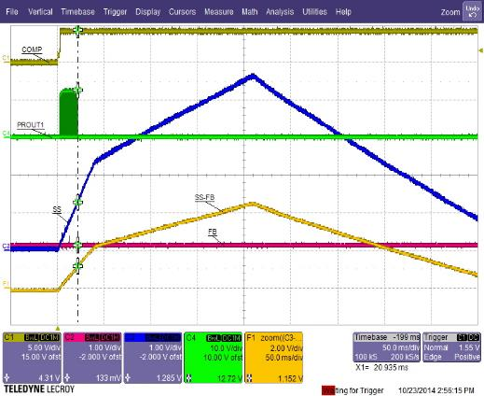
Output Short Protection (OSP)
OSP is triggered when (V_{SS}-V_{FB}) > 1.2V,
  V_{OUT} drops by 50% during normal operation. (2.4V - V_{FB} >1.2V)
  V_{OUT} has hard time to build up during soft start.
COMP
PROUT1
SS
FB

Slide 35
Non-ZVS Protection by Switching-Frequency Shift
Shift criterion: V_{COMP}>3V (heavy load) and V_{CS}<0.3V at PROUT1 falling edge.
With a fixed minimum frequency,
LLC converter can go into capacitive region during over load condition or holdup time.
With frequency shift,
the capacitive-region operation during over load condition or holdup time can be avoided
PROUT1
PROUT1
PROUT1
PROUT1

Slide 36
Outline
Charge Current Control
Dual-edge Tracking SR Control
Operation across Load Variation and PWM
Peripheral Functions
Protections
Comparison
Boards

Slide 37
Comparison
Devices |  | NCV4390 | CM6901
General Description |  | Secondary side PFM controller w/ SR | Secondary side PFM controller with SR
Duty cycle symmetry |  | 50% (counter based) | Not shown in Datasheet
Frequency | Fmin accuracy | +/- 4 % | +/- 10% accuracy
 | Fmax | 690kHz (39kHz min) | Not shown in Datasheet
Protections | Brown out | N/A | N/A
 | Non ZVS prevention | √
 | Fast shutdown OCP | √ | √
 | Delayed Shutdown OLP with constant power limit, output Short protection, AR Timeout latch mode | √
Control method |  | Hybrid control Current mode PFM Advanced PWM with ZVS | Conventional Hybrid Control VCO PFM Conventional PWM (NO ZVS)
Holdup boost function with dual current limit threshold |  | (Vin=400V→240V can be covered)
Soft start |  | Closed loop S/S | Closed loop S/S
SR control method |  | Dual-edge tracking with voltage sensing | Open loop control without sensing SR voltage
SR Dead time |  | Adjust for best efficiency | Adjustable but requires too much margin
UVLO |  | 8.5/10.5V | 10 /11 V
Drive current (Source/Sink) |  | 100mA / 100mA | 60 mA / 120mA

Slide 38
Outline
Charge Current Control
Dual-edge Tracking SR Control
Operation across Load Variation and PWM
Peripheral Functions
Protections
Comparison
Boards

Slide 39
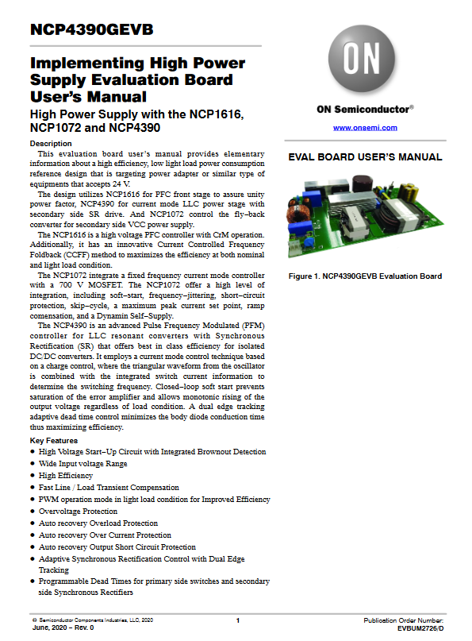
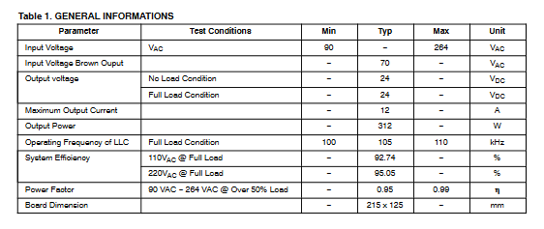
NCP4390 Evaluation board

Slide 40
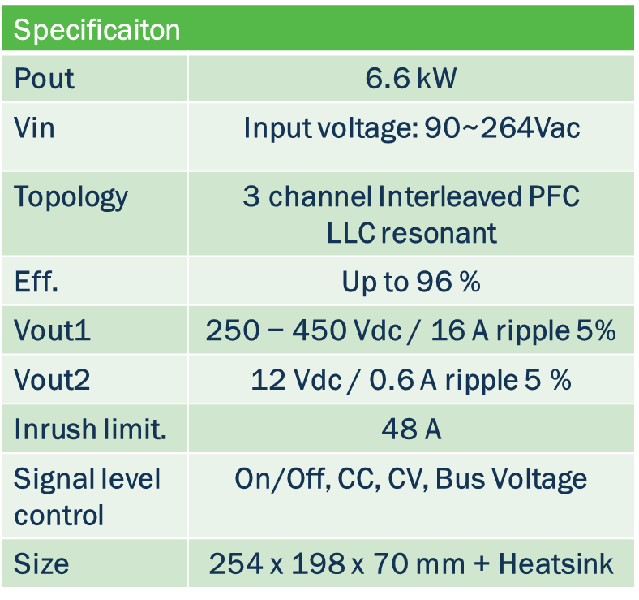
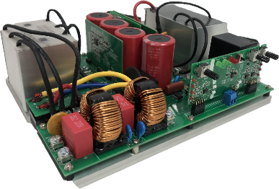
SEC-6D6KW-OBC-SIC-GEVB - 6.6kW SiC Model
Project folder | Webpage | Video | Blog
Loanable & Orderable
Notes:
HW fully built and tested at this time

Slide 41
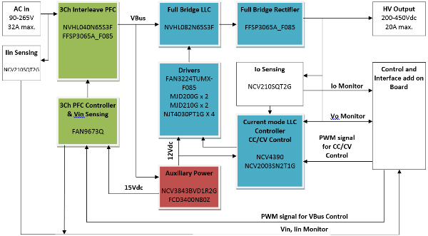
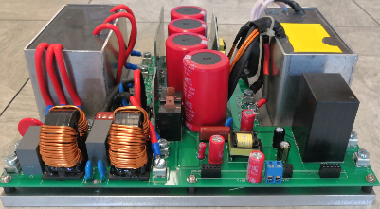
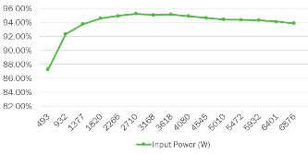
6.6kW OBC Si Model
Features
Wide output voltage range coverage, 200~450V
High efficiency system, >95% at 400V output
Hardware PFC and LLC control approach for ease of design and reliability
Three channel interleaved PFC for high efficiency and power density
Single full bridge LLC for trade-off the efficiency and cost
Up to 95.2% total efficiency at 220Vac
>0.999 Power Factor
Loanable & Orderable
Notes:
HW fully built and tested at this time with discrete driver implementation.

Slide 42
Thank You!

