Slide 1
NCV51513 Automotive 130V 2/3 A H/L Side Gate Driver
Technical Presentation

Slide 2
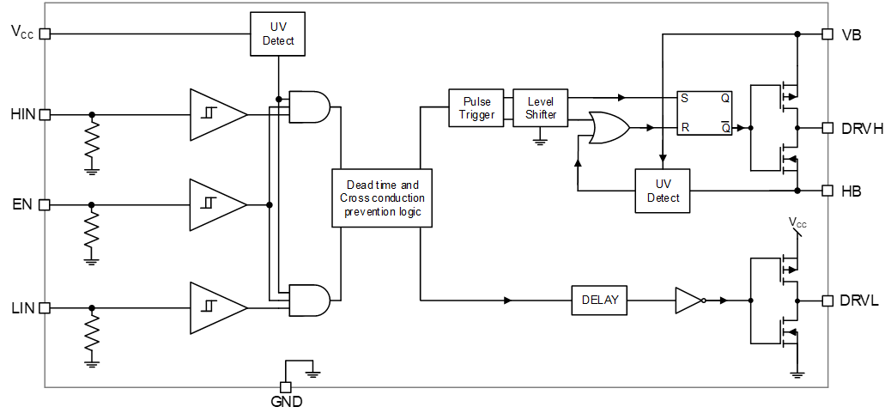
NCV51513 Overview
1.1 Key Features
Automotive Qualified to AEC Q100
Voltage Range: up to 130 V
dV/dt Immunity ±50 V/ns
Gate Drive Supply Range from 6.4 V to 20 V
Output Source / Sink Current Capability 3 A / 2 A
3.3 V and 5 V Input Logic Compatible
Extended Allowable Negative Bridge Pin Voltage Swing to –10V
  Matched Propagation Delays between Both Channels
  Propagation Delay 50 ns typically
  Under VCC LockOut (UVLO) for Both Channels
Pin to Pin Compatible with Industry Standards

Slide 3
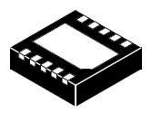
NCV51513 Overview
1.2 Package and Pin Configuration
Pin out | Name | Function
1 | VCC | Power Ground
2 | NC | Not connected
3 | VB | High Side Supply
4 | DRVH | High Side Output
5 | HB | High Side Supply Return, Half Bridge Pin
6 | EN | Enable input
7 | HIN | High side input
8 | LIN | Low side input
9 | GND | Low side and logic supply
10 | DRVL | Low side output
EP | EP | Connect the EP flag to GND
DFNW10, 3x3, 0.5P
Case 507AG

Slide 4
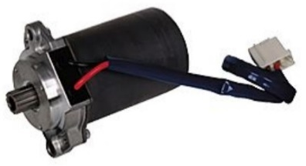
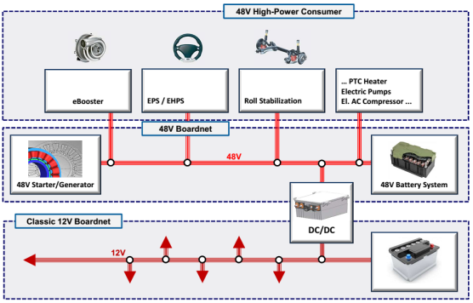
NCV51513 Overview
1.3 Typical Automotive Applications
48 V Automotive DC/DC Converters
On-Board Chargers
Electric Power Steering
48 V BSB and ISG

Slide 5
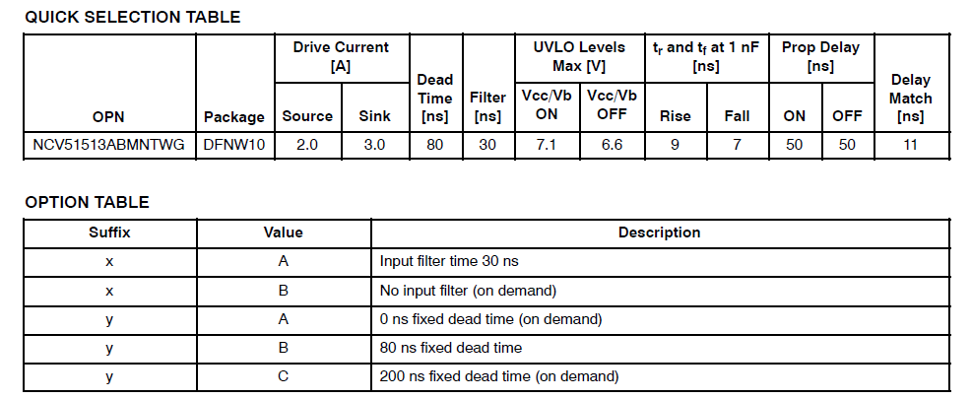
NCV51513 Overview
1.4 Device options

Slide 6
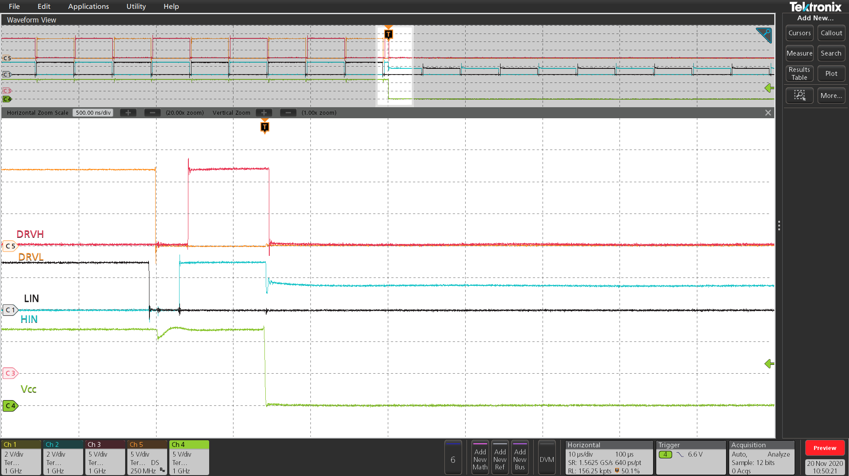
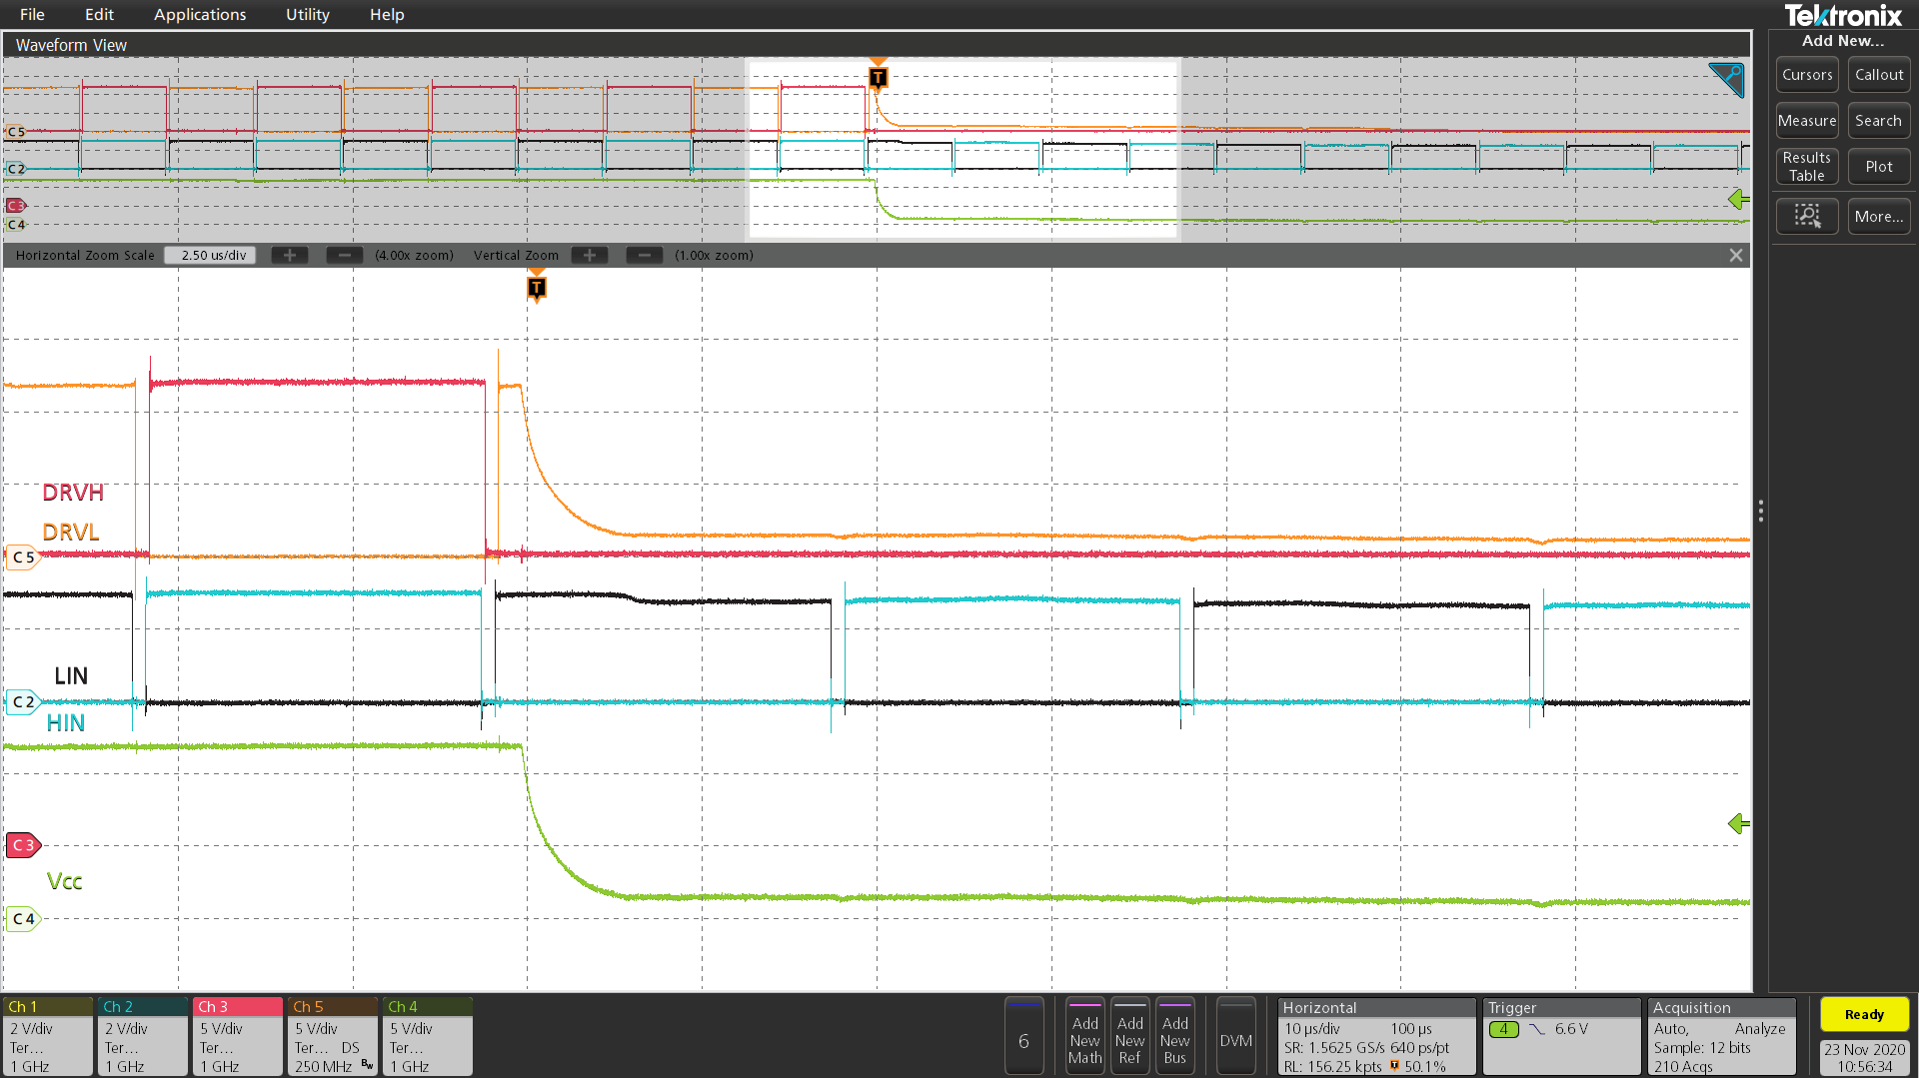
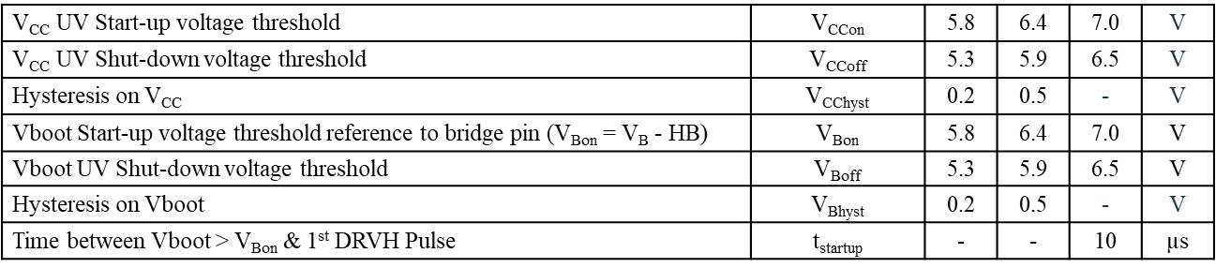
Detailed Description
2.1 Under Voltage Lock Out
Both high side and low side driver has UVLO protection independently which monitors the V_{CC} supply voltage and VB bootstrap voltage. The V_{CC} UVLO disables both high side and low side driver when V_{CC} is below the specified threshold.
The UVLO is properly activated even in case the V_{CC} (V_{B}) disappear quickly. All drivers are turned off as expected.
DRVL
DRVL
DRVH
DRVH
LIN
LIN
HIN
HIN
VCC
VCC
Specification

Slide 7
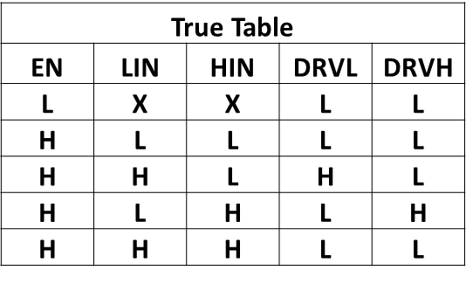
Detailed Description
2.2 Output Stage
The NCV51513 output stage is able to sink/source current of 3.0 A /2.0 A typical and interface for drive the switching power MOSFETs. High speed switching, low resistance and high current capability of both high side and low side driver allow for efficient switching operation. The low side driver is referenced from V_{CC} to GND and the high side is referenced from VB to HB. The device logic status as below
Input to Output Definition

Slide 8
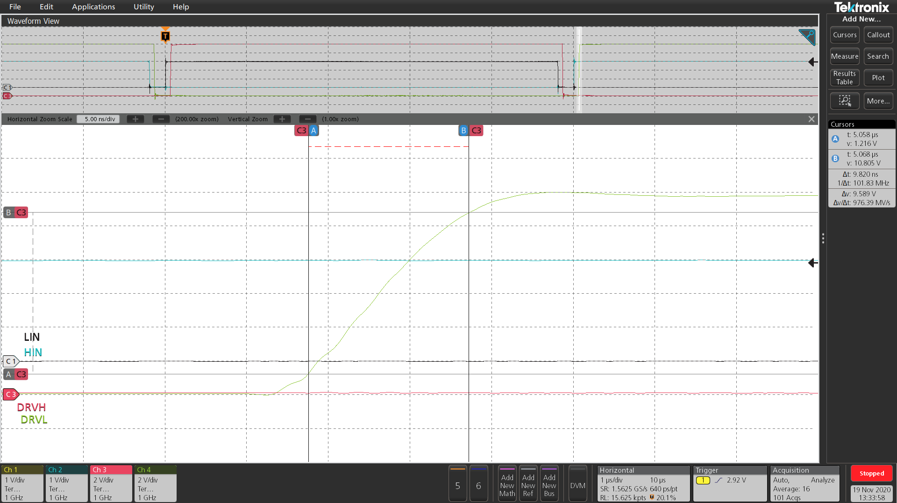
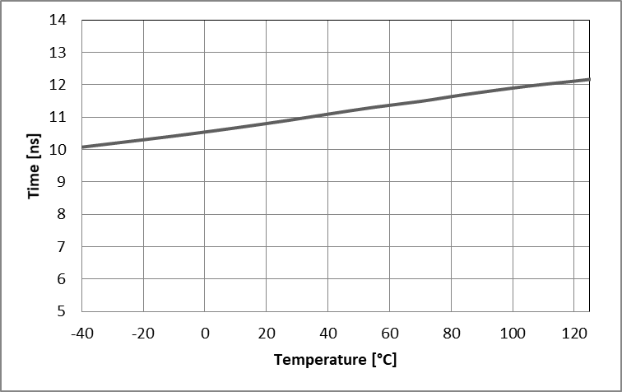
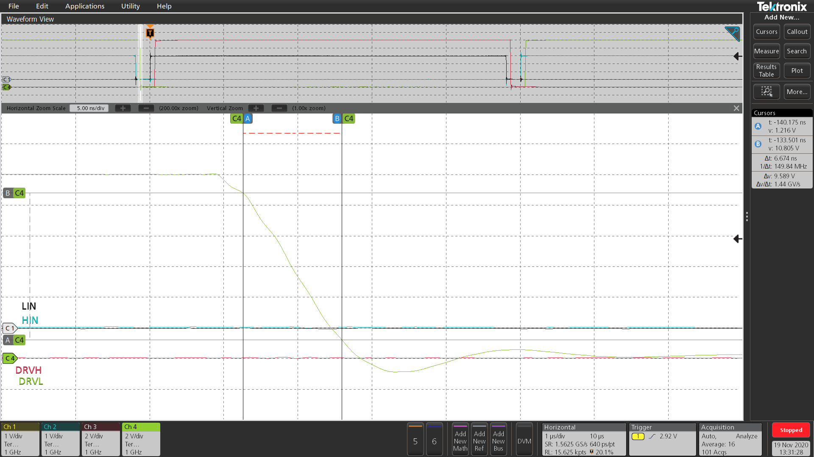
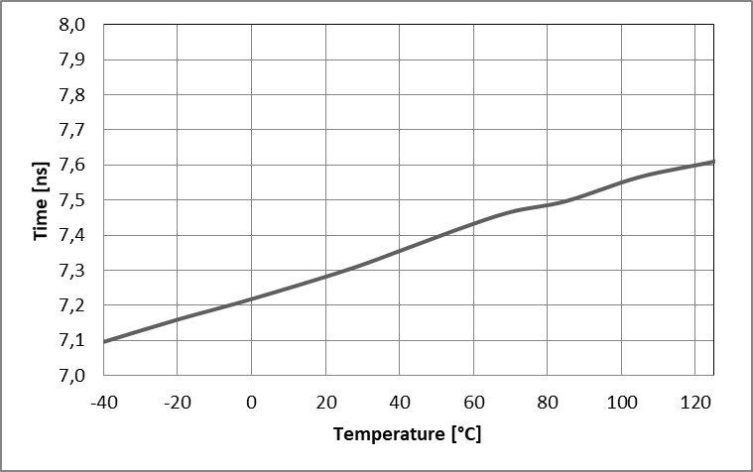
Detailed Description
2.3 Output Stage (DRVx Rise and Fall time)
Rise Time variation over the temperature [-40℃ ~ 125℃]
Rise Time waveform
VCC = 12 V
Cload = 1 nF
9.8 ns
Fall Time variation over the temperature [-40℃ ~ 125℃]
6.8 ns
Fall Time waveform
VCC = 12 V
Cload = 1 nF

Slide 9
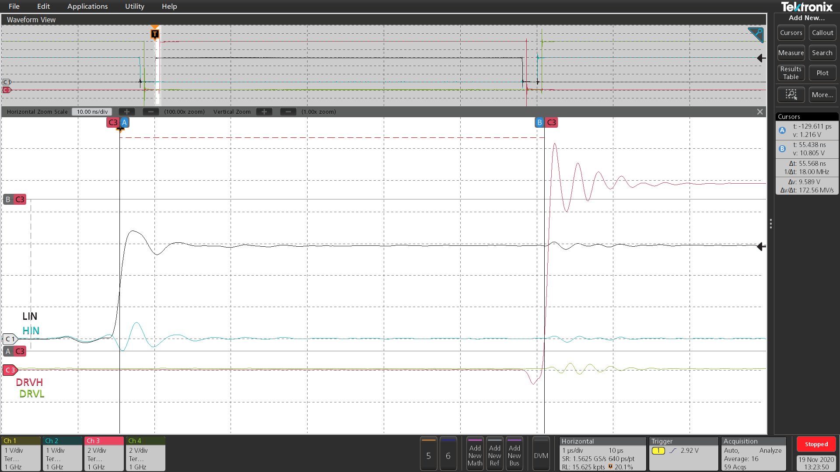
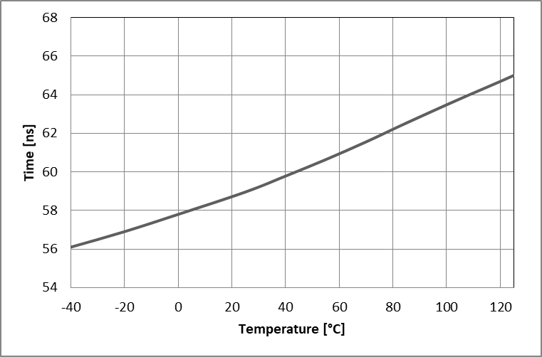

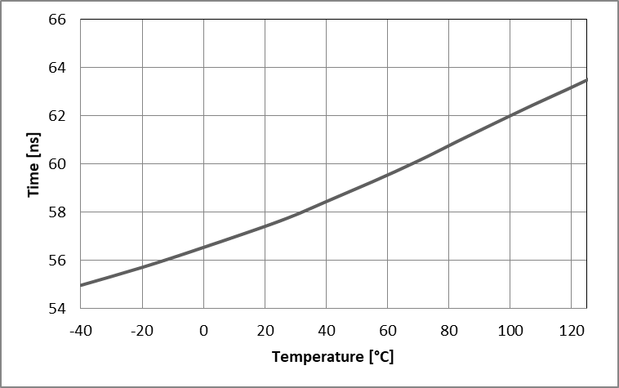
Detailed Description
2.4 Input to Output Propagation Delay
t_{ON} delay variation over the temperature [-40℃ ~ 125℃]
Propagation delay
t_{ON}
56 ns
t_{OFF} delay variation over the temperature [-40℃ ~ 125℃]
Propagation delay
t_{OFF}
53 ns

Slide 10
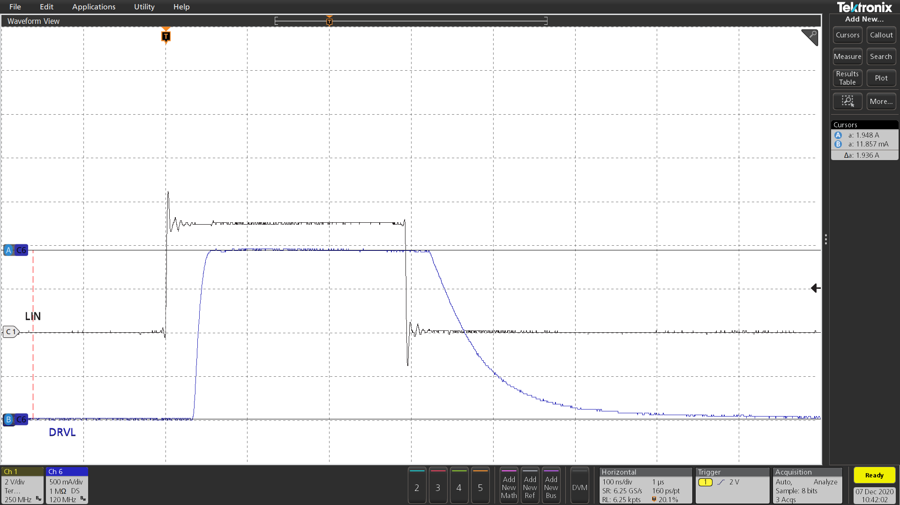
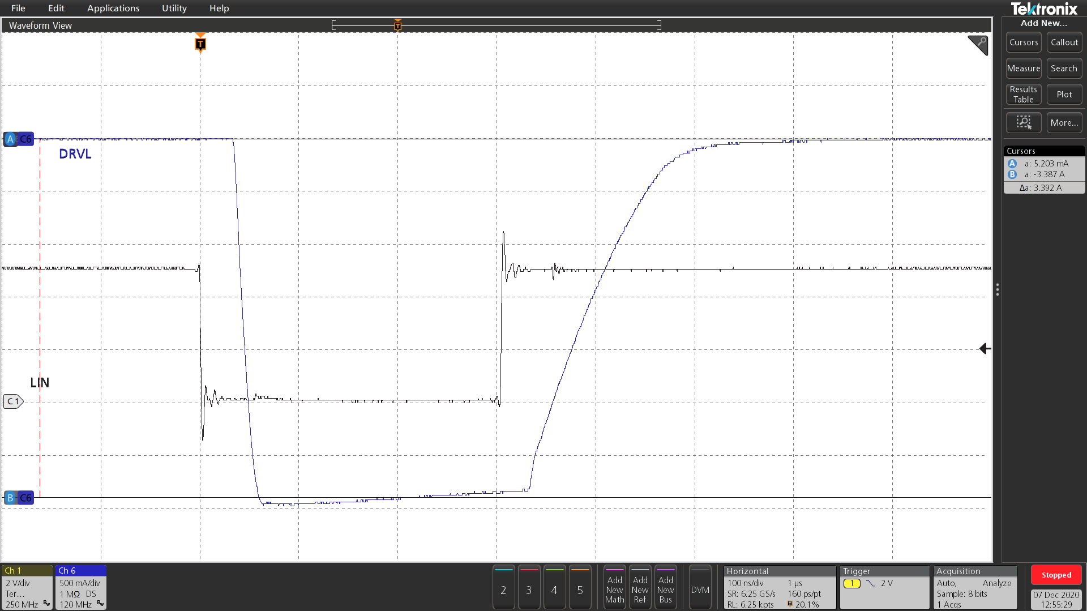
Detailed Description
2.5 Output Stage (Drive Current Capability)
Source current at Vcc = 12 V
Sink current at Vcc = 12 V
1.9 A
3.3 A

Slide 11
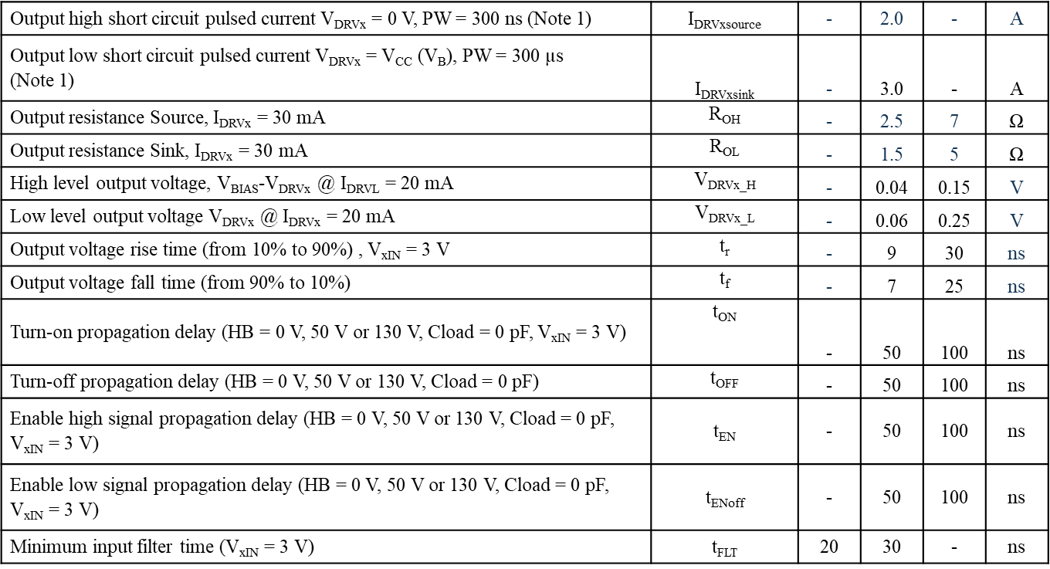
Detailed Description
2.5 Output Stage (Drive Current Capability)

Slide 12
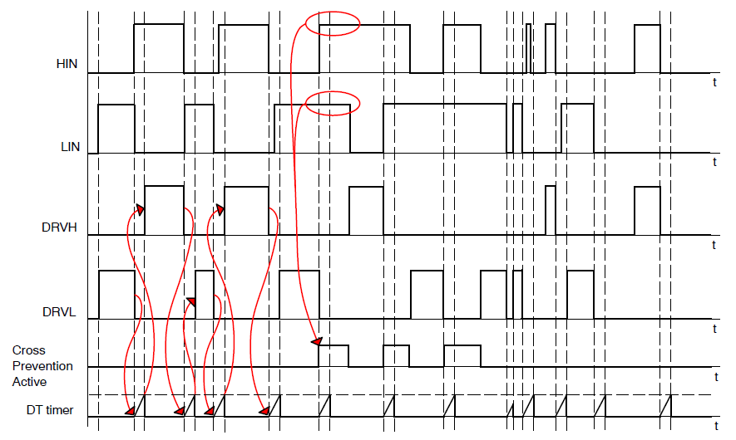
Detailed Description
2.6 Dead Time and Interlock Protection
NCV51513xB features inbuild 80 ns dead control logic. The logic inserts the 80 ns delay after any driver turn off to postpone turn on of the opposite one. The delay helps to minimize cross conduction current through the MOSFETs
The dead time section also includes cross conduction prevention logic (interlock), which does not let to set both drivers to High simultaneously.
Dead time value can be changed (0/80/200 ns) and interlock can be inhibited by metal option

Slide 13
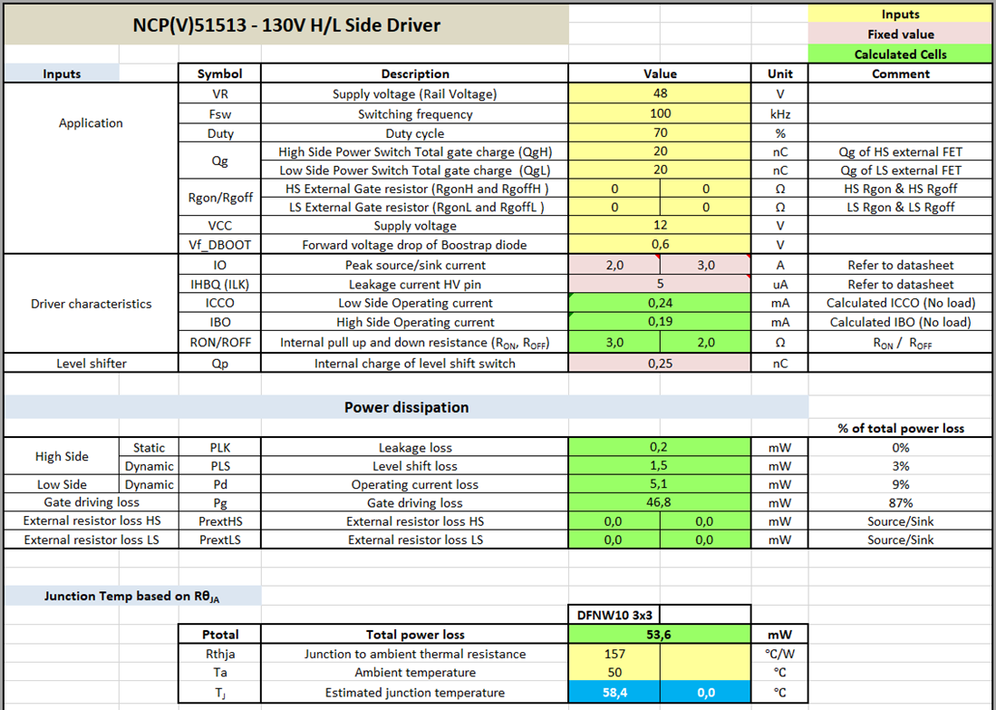
Detailed Description
2.7 Thermal capability
A Power loss calculator is available. It counts with external resistors (if used) to show how much energy will be lost in the device and how much energy will be lost on external resistors.
For detail description of the calculation go to:
https://www.onsemi.com/pub/collateral/AND90004-d.pdf

Slide 14
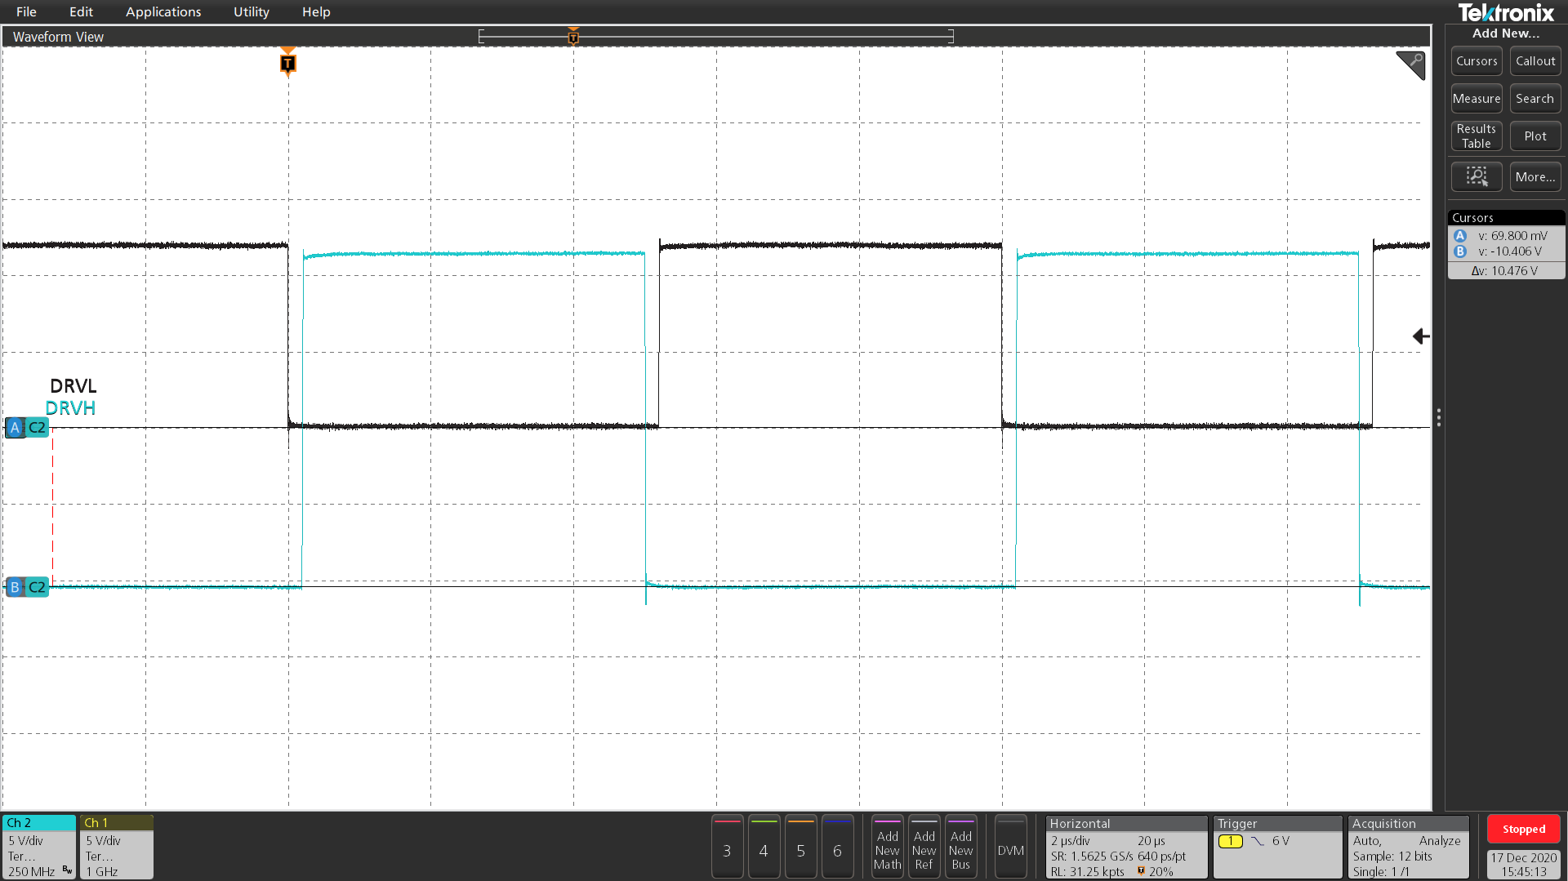
HS Negative Characteristics
3.1 Negative DC Characteristics
If Vcc = 12 V, the HB pin can be kept DC negative 10 V. The IC is switching properly, but maximum ratings value (VB-VHB) is exceeded.

Slide 15
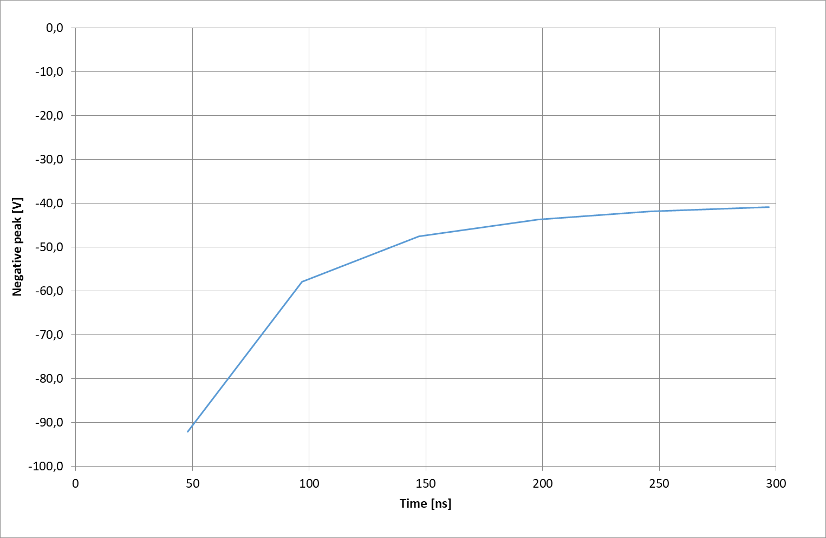
HS Negative Characteristics
3.2 Negative Transient Information
Regardless of the info shown, it is highly recommended that the application circuit design is such that it removes or at least always limit the negative transient voltage on VB pin as much as possible via careful PCB layout and proper component selection.
Indicative Negative Transient Immunity

Slide 16
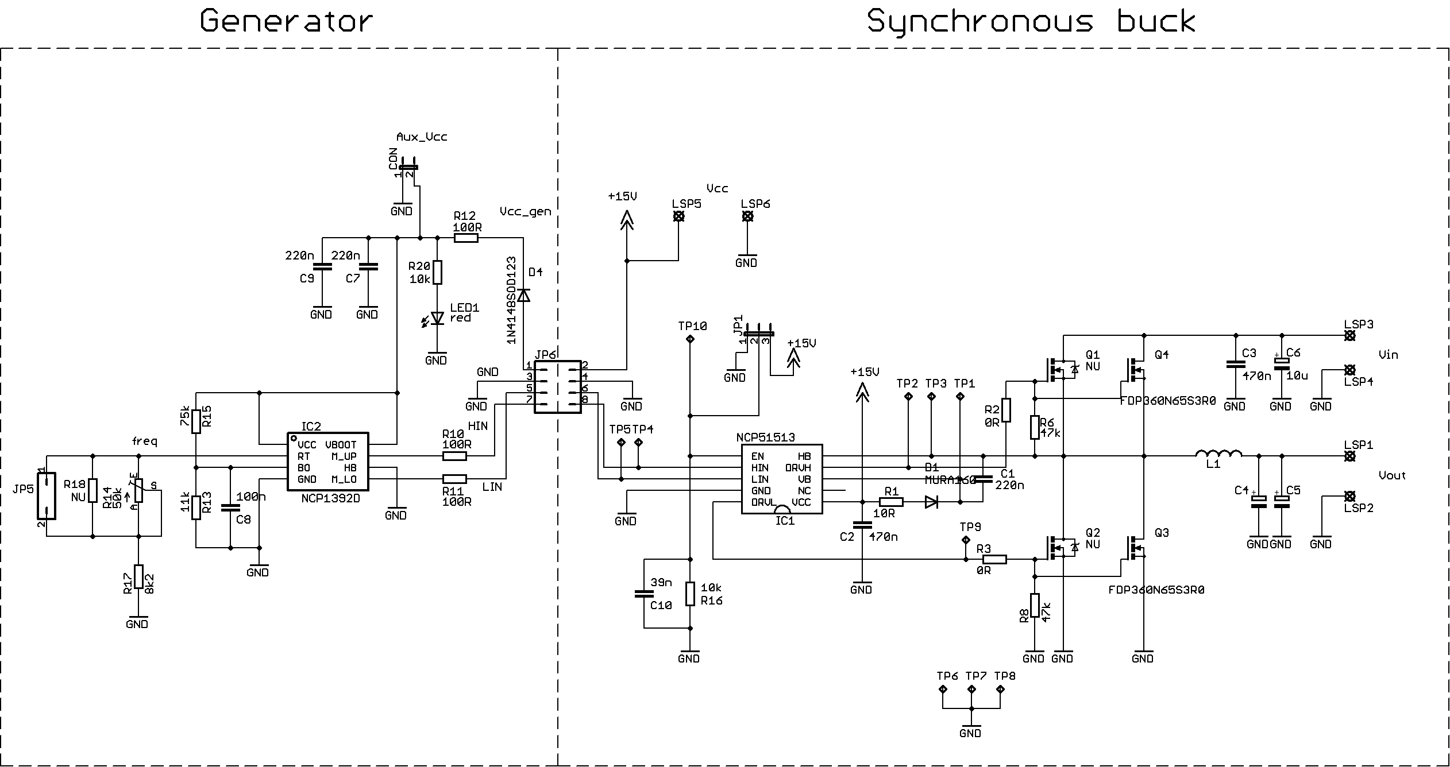
NCV51513 in Buck application
Measurement of Open Loop Synchronous Buck Convertor
Buck converter Schematic

Slide 17
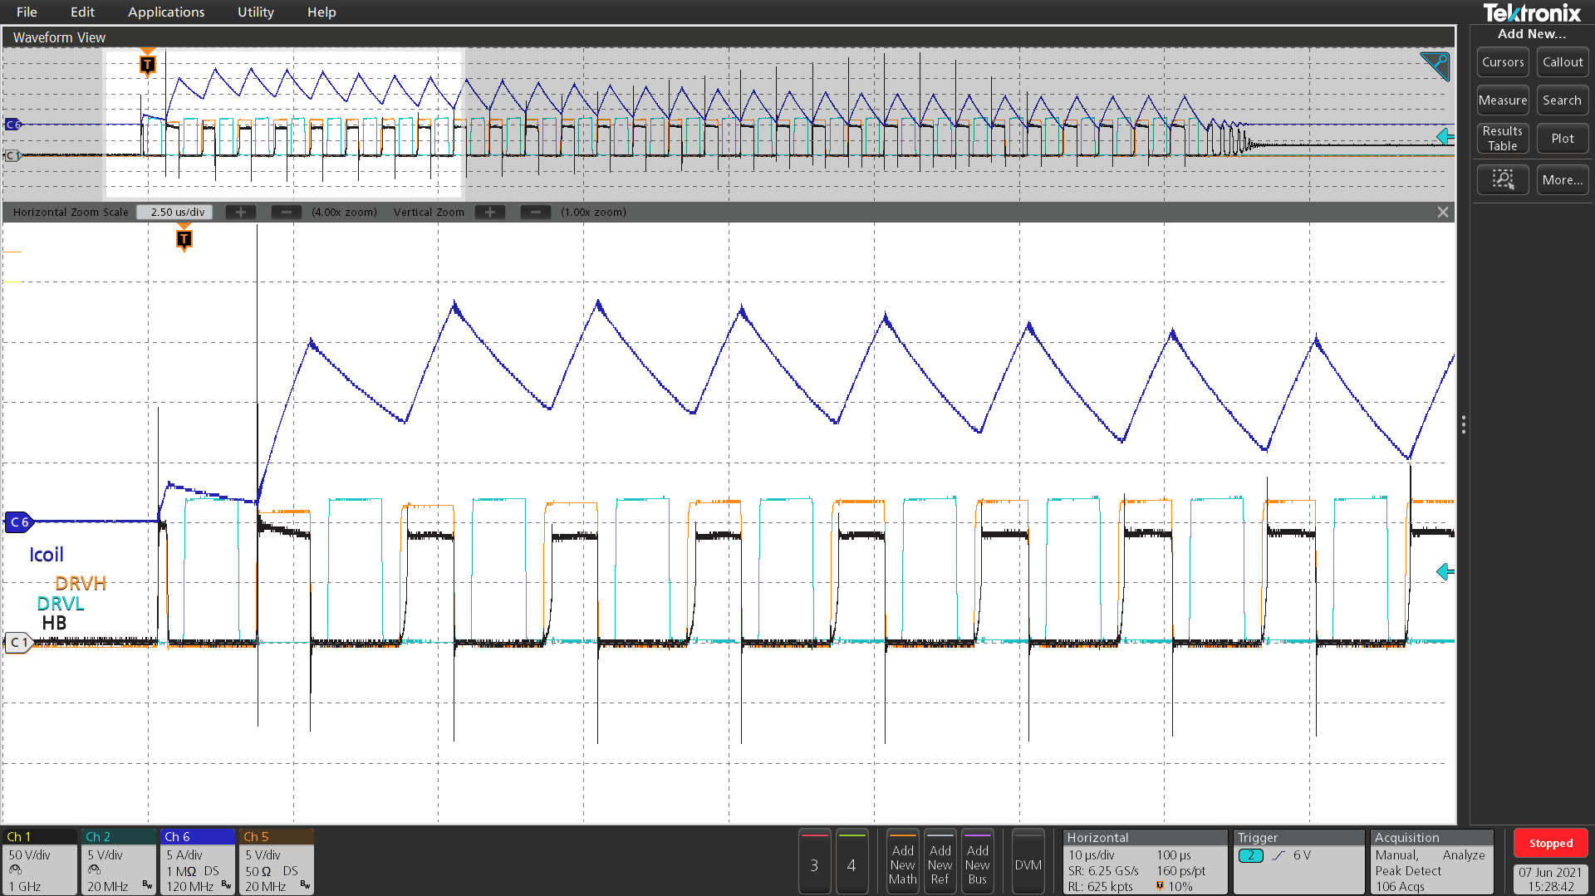
NCV51513 in Buck application
Measurement of Open Loop Synchronous Buck Convertor
C1 – Half Bridge pin
C2 – Low Side Driver
C5 – High Side Driver
C6 – Coil current
Input voltage: 100 V
Coil current: 18 A peak
Test for DRVH hard switch

Slide 18
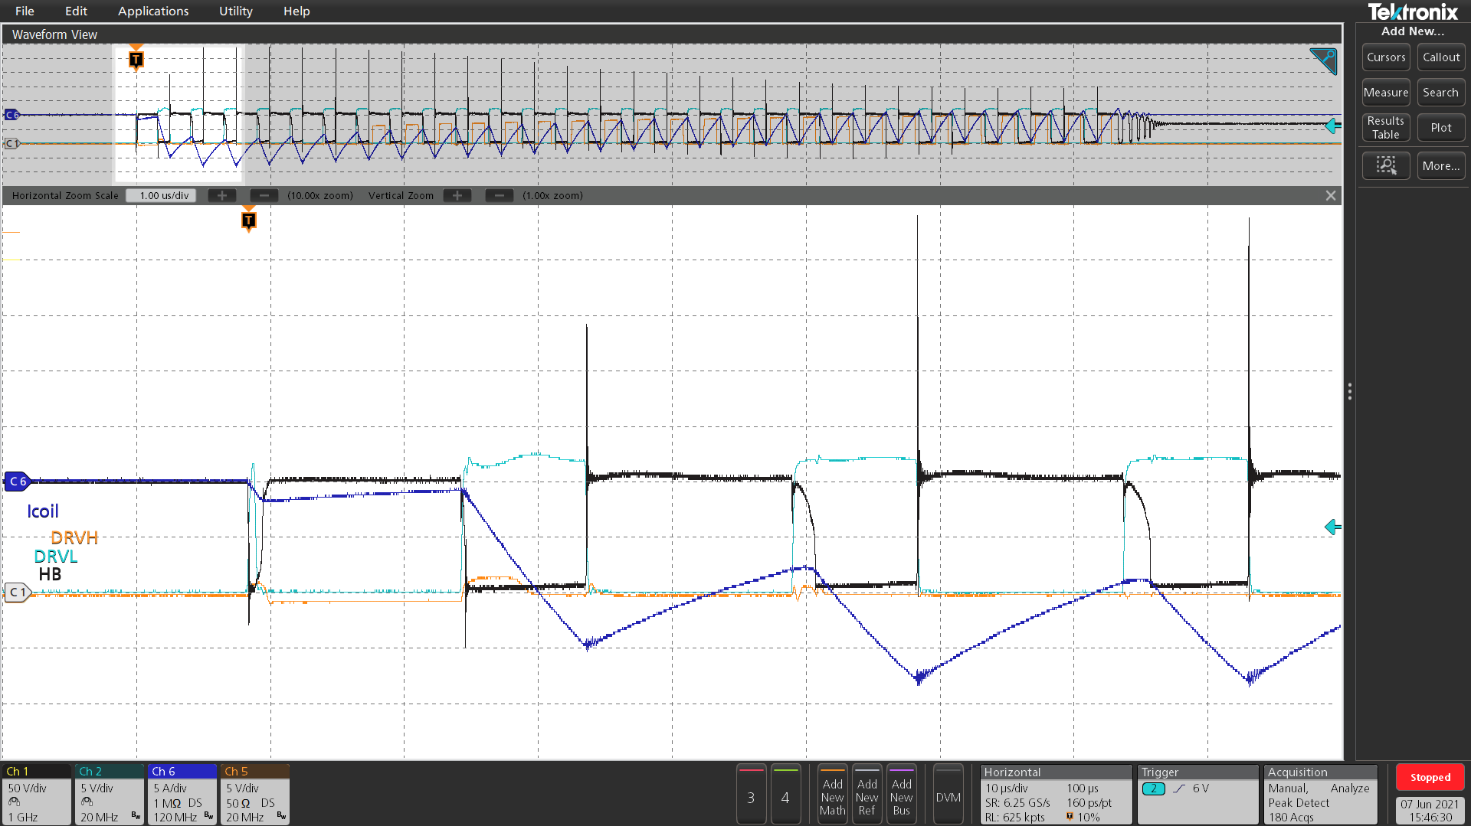
NCV51513 in Buck application
Measurement of Open Loop Synchronous Buck Convertor
C1 – Half Bridge pin
C2 – Low Side Driver
C5 – High Side Driver
C6 – Coil current
Input voltage: 100 V
Coil current: 18 A peak
Test for DRVL Hard switch
Note: The DRVH is not switching at the beginning, because Cboot is not charged.
DRVH starts to switch here

Slide 19
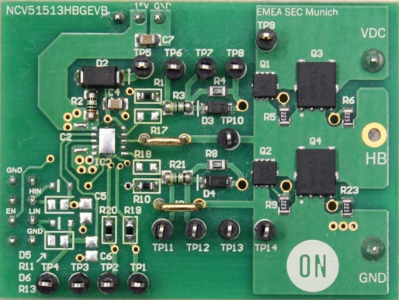
NCV51513 Daughter Card
Features
NCV51513 High/Low Side Gate Driver
2 Different MOSFET Packages
Adjustable Gate Resistance
Internal Dead Time Control
Adjustable Bootstrap
Gate Current and Gate Voltage Measurement
Interface to Baseboard (Plug and Play)
This daughter card is designed to be tested in
https://www.onsemi.com/pub/collateral/seco-gdbb-gevb_schematic.pdf
Some key parameters can be set/tested, like rise time, fall time, propagation delay etc.

Slide 20
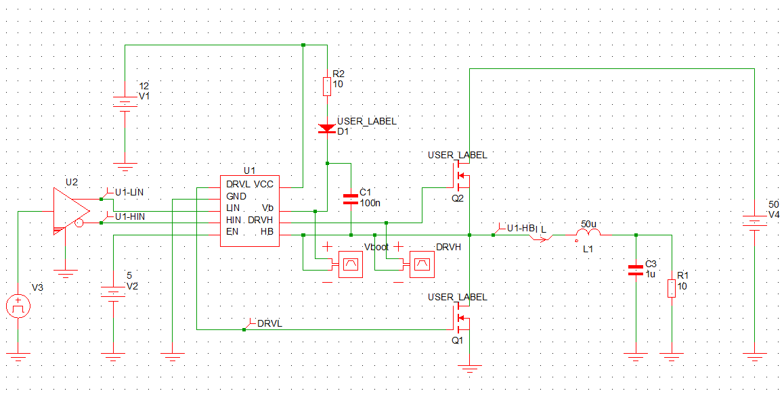
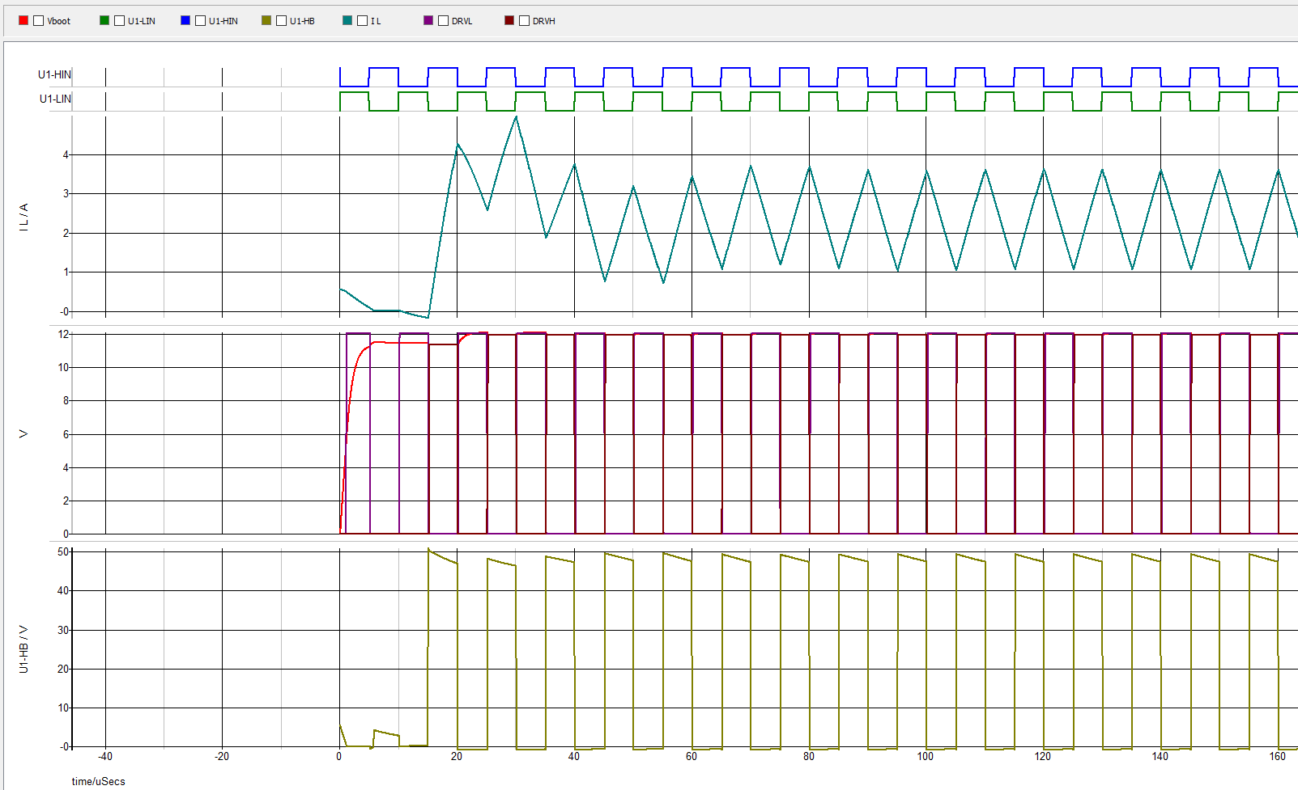
NCV51513 SIMPLIS model Buck
Customers can simply update the schematic and/or values to their needs to see device behavior.
The SIMPLIS model is available at:
https://www.onsemi.com/pub/collateral/ncp51513%20simplis%20buck%20circuit%20model.zip

Slide 21
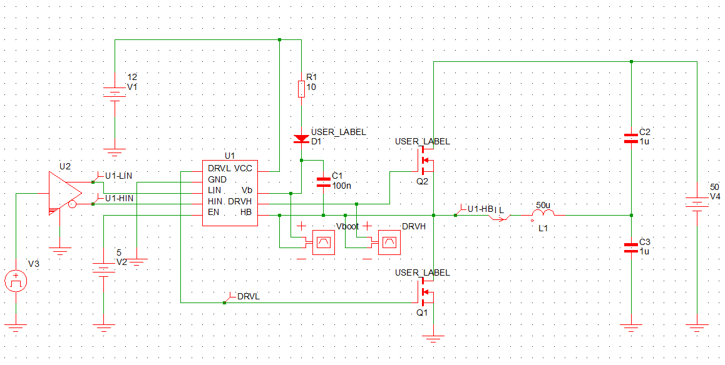
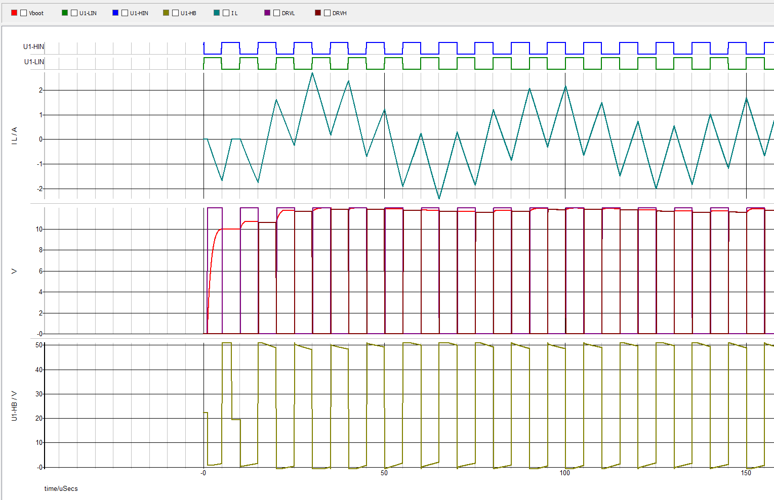
NCV51513 SIMPLIS model Half Bridge
Customers can simply update the schematic and/or values to their needs to see device behavior.
The SIMPLIS model is available at:
https://www.onsemi.com/pub/collateral/ncp51513%20simplis%20half%20bridge%20circuit%20model.zip

