Slide 1
PoE Powered Devices Product Selector
May 2022 Mike Sandyck

Slide 2
Practical PoE Power Considerations
For Powered Devices up to Class 8 (>100W)
Power Range |  |  |  |  | Recommended parts
IEEE Standard | PD Class | Theoretical Power | Max Power @ PD | Max Power @ Application | Integrated DCDC | Vaux | Integrated FET
802.3af (2pair PoE) | 0 | 15W | 13W | 11,7W | NCP1081 NCP1083 | NCP1083 NCP1092 | NCP1090 NCP1091 NCP1092
 | 1 | 4W | 3,84W | 3,46W
 | 2 | 7W | 6,49W | 5,84W
 | 3 | 15W | 13W | 11,7W
802.3at (PoE+) | 4 | 30W | 25,5W | 23W | NCP1081 NCP1083 | NCP1083 NCP1094 | NCP1081 NCP1083 NCP1093 NCP1094
802.3bt (4pair PoE, 4PPoE, PoE++) | 5 | 45W | 40W | 36W |  | NCP1095 NCP1096 | NCP1096
 | 6 | 60W | 51W | 45,9W
802.3bt (higher power PoE) | 7 | 75W | 62W | 55,8W | NCL31010* | NCP1095 NCP1096 | NCP1096
 | 8 | 90W | 71,3W | 64,2W
NCL31010: PoE I/f LED driver
@90% DCDC efficiency
After connection + line losses

Slide 3
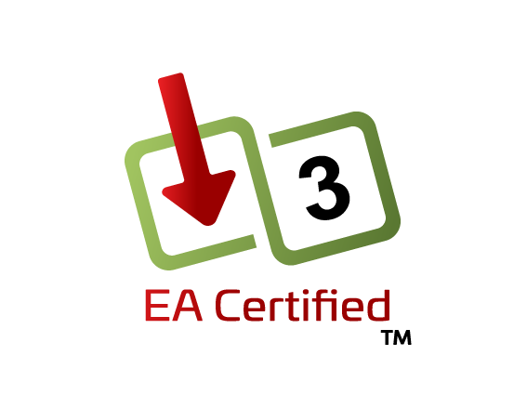
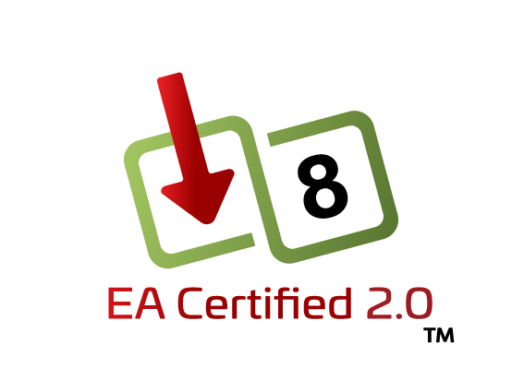
ON Semi PoE Product Portfolio
For Powered Devices up to 100W
Part Number | Integrated DC-DC | Rear Aux Priority pin | Front/Rear Low VAux pin | Adjustable UVLO | Integrated FET | Short MPS Indicator | Autoclass | Power Range | Power Capability
NCP1090 |  |  |  |  | ü |  |  | 15W | 25W
NCP1091 |  |  |  | ü | ü |  |  | 15W | 25W
NCP1092 |  | ü |  |  | ü |  |  | 15W | 25W
NCP1093 |  |  |  | ü | ü |  |  | 30W | 40W
NCP1094 |  | ü |  |  | ü |  |  | 30W | 40W
NCP1081 | ü |  |  | ü | ü |  |  | 30W | 40W
NCP1083 | ü |  | ü | ü | ü |  |  | 30W | 40W
NCP1095 |  | ü |  |  |  | ü | ü | 90W | 100W
NCP1096 |  | ü |  |  | ü | ü | ü | 90W | 100W
NCL31010 | 2 |  |  | ü |  | ü | ü | 90W | 115W
In Certification
New
Note: All devices are backward compatible

Slide 4
Evaluation Boards
Part | Board part | Category | Certification | Description | OPN | Status | Link
NCP1081 | NCP1081 | EVB |  | High Power PoE-PD Splitter Evaluation Board | NCP1081SPCGEVB | Active | https://www.onsemi.com/support/evaluation-board/ncp1081spcgevb
NCP1083 | NCP1083 | ASEVB |  | Power over Ethernet (PoE) Shield Evaluation Board | POE-GEVB | Active | https://www.onsemi.com/support/evaluation-board/poe-gevb
NCP1083 | NCP1083 |  |  | Redesign for EA certification |  | Design
NCP1090 | NCP1090 | EVB | Class 3 PD | PoE-PD Interface Controller Evaluation Board | NCP1090GEVB | Active | https://www.onsemi.com/support/evaluation-board/ncp1090gevb
NCP1091 |  |  |  | Use NCP1090GEVB |  | Active | NCP1090GEVB can be used as well to evaluate NCP1091, only the adjustable UVLO cannot be tested
NCP1092 |  |  |  | Use NCP1090GEVB |  | Active | NCP1090GEVB can be used as well to evaluate NCP1092, only the AUX cannot be tested
NCP1093 |  |  |  | Use NCP1094GEVB |  | Active | NCP1094GEVB can be used as well to evaluate NCP1093, only the adjustable UVLO cannot be tested
NCP1094 | NCP1094 | EVB | Class 4 PD | PoE-PD Interface Controller Evaluation Board | NCP1094GEVB | Active | https://www.onsemi.com/support/evaluation-board/ncp1094gevb
NCP1095 | NCP1095 | EVB | Class 8 PD | PoE-PD Interface Controller Evaluation Board, IEEE 802.3bt | NCP1095GEVB | Active | https://www.onsemi.com/support/evaluation-board/ncp1095gevb
NCP1096 | NCP1096 | Demo |  | Power Over Ethernet (PoE) Power Module (90 Watts) | LIGHTING-POWER-POE-GEVB | Active | https://www.onsemi.com/support/evaluation-board/lighting-power-poe-gevb
NCP1096 | NCP1096 | EVB | Class 8 PD | PoE-PD Interface Controller Evaluation Board, IEEE 802.3bt | NCP1096GEVB | Active | https://www.onsemi.com/support/evaluation-board/ncp1096gevb
NCL31010 | NCL31010 | EVB-1" | Class 8 PD | PoE I/f Intelligent LED Driver Evaluation Kit | NCL31010GEVK | Active | https://www.onsemi.com/design/tools-software/evaluation-board/ncl31010gevk
NCL31010 | NCL31010 | EVB-1" | Class 8 PD | PoE I/f Intelligent LED Driver Reference Design | NCL31010REFGEVB | Active | Part of the EVK, not for sale separately
NCL31010 |  |  |  | PoE LED Driver Arduino Adapter Shield | NCL31010AASGEVB | Active | Part of the EVK, not for sale separately
Note: All EVB’s and ref designs are optimized for power efficiency, conducted and radiated EMI

