Slide 1
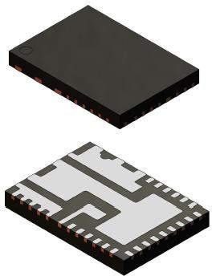
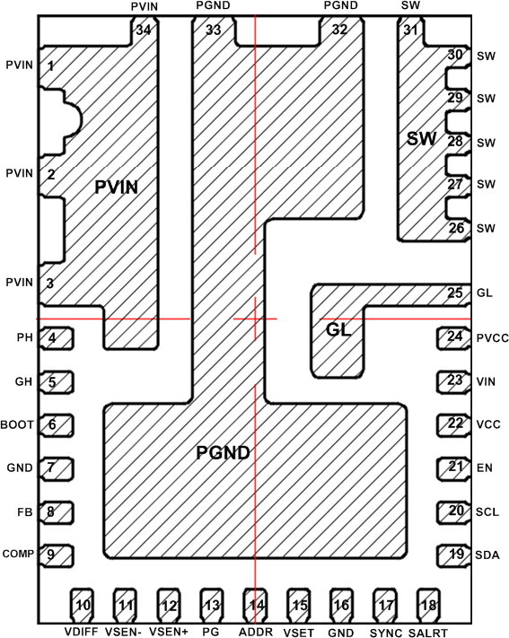
FAN251015/30/40
Fixed Frequency 15A–40A Buck with PMBUS
August 2021
Notes:
*Mandatory Slide*
Above information can be pulled from onsemi.com if needed.

Slide 2
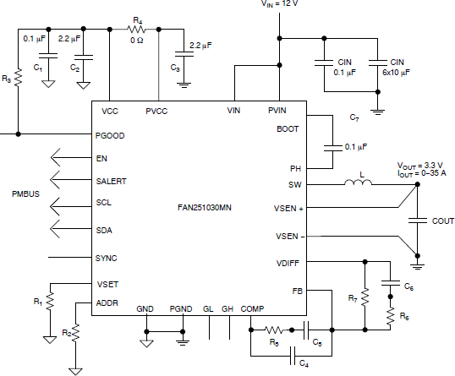
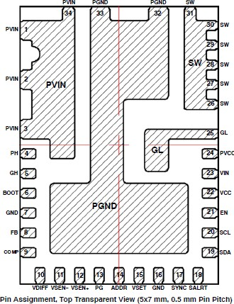
FAN251015/30/40
Product Family Overview
The FAN251015/30/40 is a highly efficient synchronous buck regulator with digital interface, capable of operating with an input range from 4.5 V to 18 V and supporting 15-40A load currents. The FAN2510xx utilizes a fixed−frequency voltage−mode control architecture to provide a synchronized constant switching frequency while ensuring fast transient response. Switching frequency and over−current protection can be programmed to provide a flexible solution for various applications. Output over−voltage, under−voltage, over−current, and thermal shutdown protections help prevent damage to the device during fault conditions.
Applications
Server
Computing
Telecom
Networking
Desktop Computers, Notebooks, Gaming
High Density Power Solutions
Features
VIN = 4.5V ~ 18V
VOUT = 0.5V ~ 5.5V (differential sensing)
IOUT = 15A/ 35A/ 40A (FAN251015/ 30/ 40)
Fixed Frequency Voltage-Mode controller
Selectable FSW from 200kHz up to 2.2/1.8/1.4MHz
Frequency synchronization – master or slave
Telemetry, Adjust, Margin & Faults with PMBUS
Adjustable output current limit
Benefits
High efficiency over 96% peak with PT11 FET technology
Telemetry and Adjustment with PMBUS
Memory for fault event recode/read and customer configurations
Typical Application Block Diagram
Value Proposition
FAN251000 family enables to achieve high efficiency over 96% peak with PT11 FET technology and to have telemetry features with PMBUS capability

Slide 3
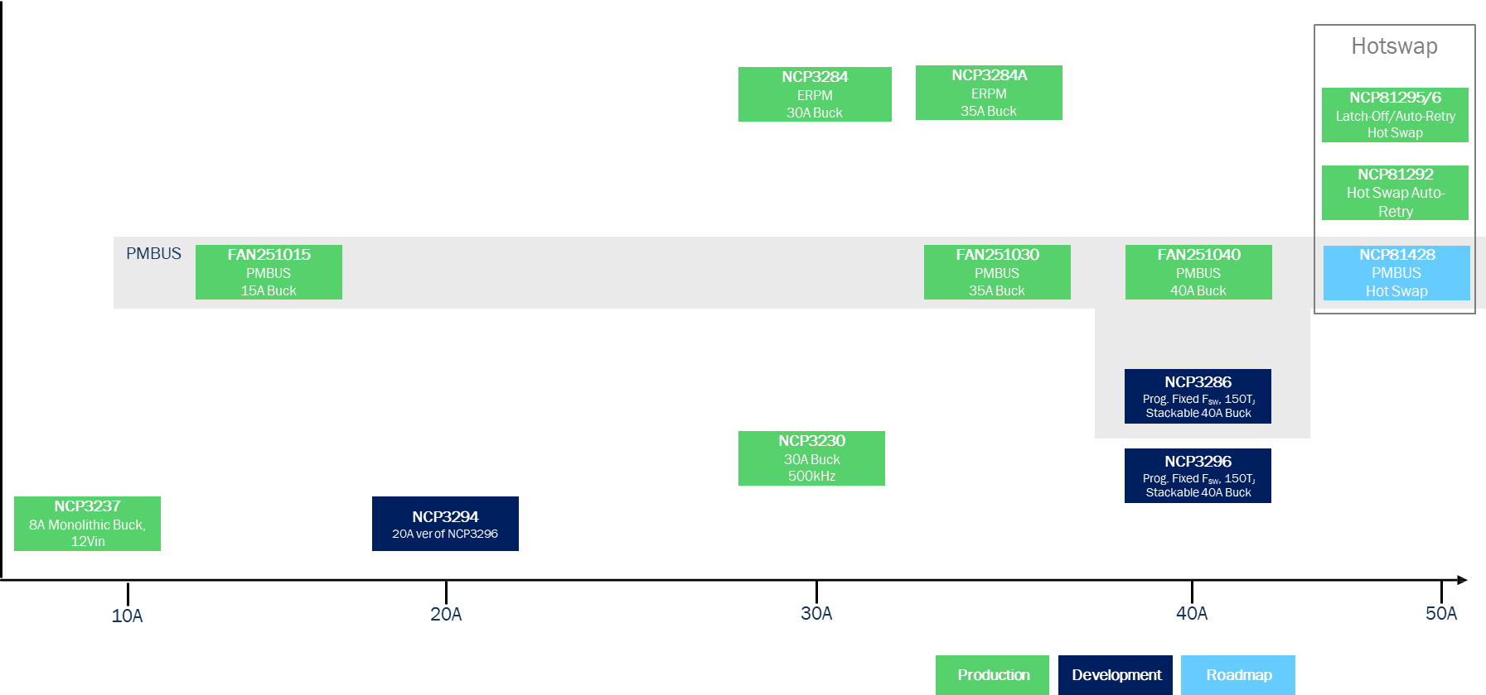
Existing Product Portfolio
P/N | IOUT | VIN Range | VOUT Range | Fsw | Operating/ Control Mode | I_{Q} (I_{SD}) | Protection | Package | Features/Comments
FAN251015 | 15A | 4.5V to 18V | 0.5V to 5.5V | 200kHz to 2.2MHz | CCM | 2.8mA | Hiccup/ Latch-off | QFN34, 5x7, 0.5P | PMBUS 1.3.1 compatible NVM Integrated
FAN251030 | 35A | 4.5V to 18V | 0.5V to 5.5V | 200kHz to 1.8MHz | CCM | 2.8mA | Hiccup/ Latch-off | QFN34, 5x7, 0.5P | PMBUS 1.3.1 compatible NVM Integrated
FAN251040 | 40A | 4.5V to 18V | 0.5V to 5.5V | 200kHz to 1.4MHz | CCM | 2.8mA | Hiccup/ Latch-off | QFN34, 5x7, 0.5P | PMBUS 1.3.1 compatible NVM Integrated
NCP3230 | 30 A | 4.5 V to 18 V | 0.6 V to 16 V | 500 kHz | PWM/Voltage | 4.9 mA (58 uA) | OCP(Hiccup/Latch-off) OVP(Hiccup) UVLO, Thermal(Latch-off) | QFN40, 6x6, 0.5P | External Programmable Soft−start Power Good Output Adaptive dead time control
NCP3237 | 8A | 4.7 V to 16 V | 0.6V to 0.8*VIN and up to 12V | 300kHz to 1.2MHz | FCCM/Voltage | 6.1mA | Hiccup (OCP/UVP) Hiccup/Latch-off (OVP, Fuse) | QFN18 3.5x3.5, 0.5P
NCP3284/A | 30A/35A | 4.5 V to 18 V | 0.8 V to 5.5 V | 500 kHz/600 kHz/ 800 kHz/1MHz | PWM, PFM FCCM/Current | 3.5 mA (42 uA) | OCP & OVP & UVP (selectable Latch-off or Hiccup) & programmable UVLO Thermal (hiccup) | PQFN37 5x6, 0.5P | Programmable Soft-Start time Output Discharge in Shutdown Power Good Indication Enable control

Slide 4
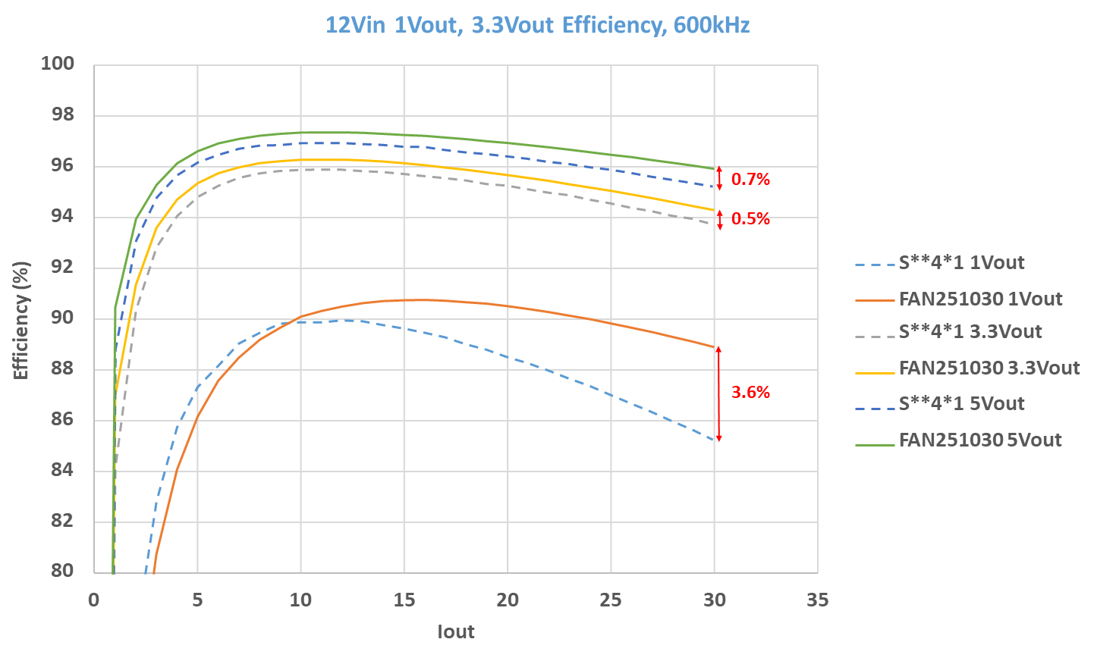
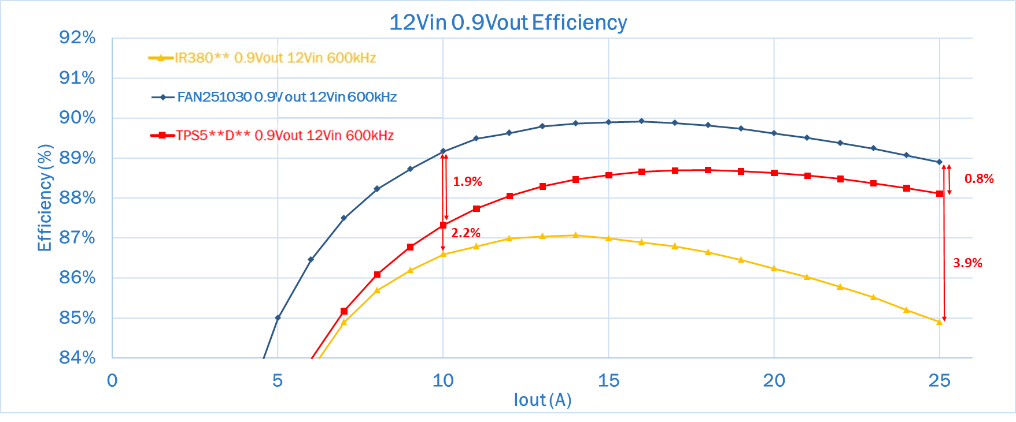
Competitor Comparison

Slide 5
Pricing
FAN251015MNTXG: $1.5
MPQ: 5000 REEL
WQFN34
FAN251030MNTXG: $1.7
MPQ: 5000 REEL
WQFN34
FAN251040MNTXG: $1.9
MPQ: 5000 REEL
WQFN34
Collateral
FAN251015 Product Page
Click Here
FAN251030 Product Page
Click Here
FAN251040 Product Page
Click Here

