Slide 1
NCP3237
8A Integrated Synchronous Buck Regulator
August 2021
Notes:
*Mandatory Slide*
Above information can be pulled from onsemi.com if needed.

Slide 2
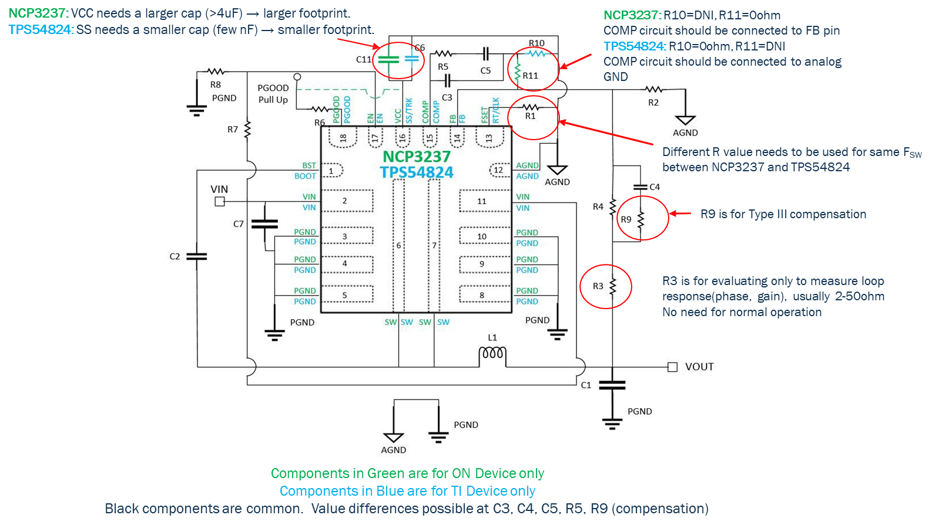
NCP3237 - 8A Integrated Synchronous Buck Regulator
Product Family Overview
Applications
The NCP3237 is a single−phase synchronous buck converter that integrates power MOSFETs to provide a high−efficiency and compact−footprint power management solution. This device is able to deliver up to 8 A output current over a wide output voltage range from 0.6 V to 12 V (up to 80% of VIN). The NCP3237 offers a fixed frequency regulator ideally suited for noise sensitive systems.
Base Station Radio Units
Server and Storage System
Telecom and Networking
Point of Load
Active Antenna System
Remote Radio Units
Features
Forced CCM
VIN = 4.7 V ~ 16 V
VOUT = 0.6 V ~ 0.80*VIN and up to 12 V
Integrated Power MOSFETs
Up to 8A Output Current
Integrated 5 V LDO
Programmable Switching Frequency from 300 kHz to 1.2 MHz
Both High−side and Low−side OCP Operation
Hiccup Over−Current Protection
Hiccup Over−Voltage and Under−Voltage Protection
Recoverable Thermal Shutdown Protection
3.5 mm x 3.5 mm, FCQFN18 Package
Safe Startup into Pre−biased Output Voltage
Application Schematic
Value Proposition
NCP3237 shows better or comparable performance to TPS54824 under identical test conditions
Higher efficiency
Better load transient performance
Low output ripple
Better thermal performance

Slide 3
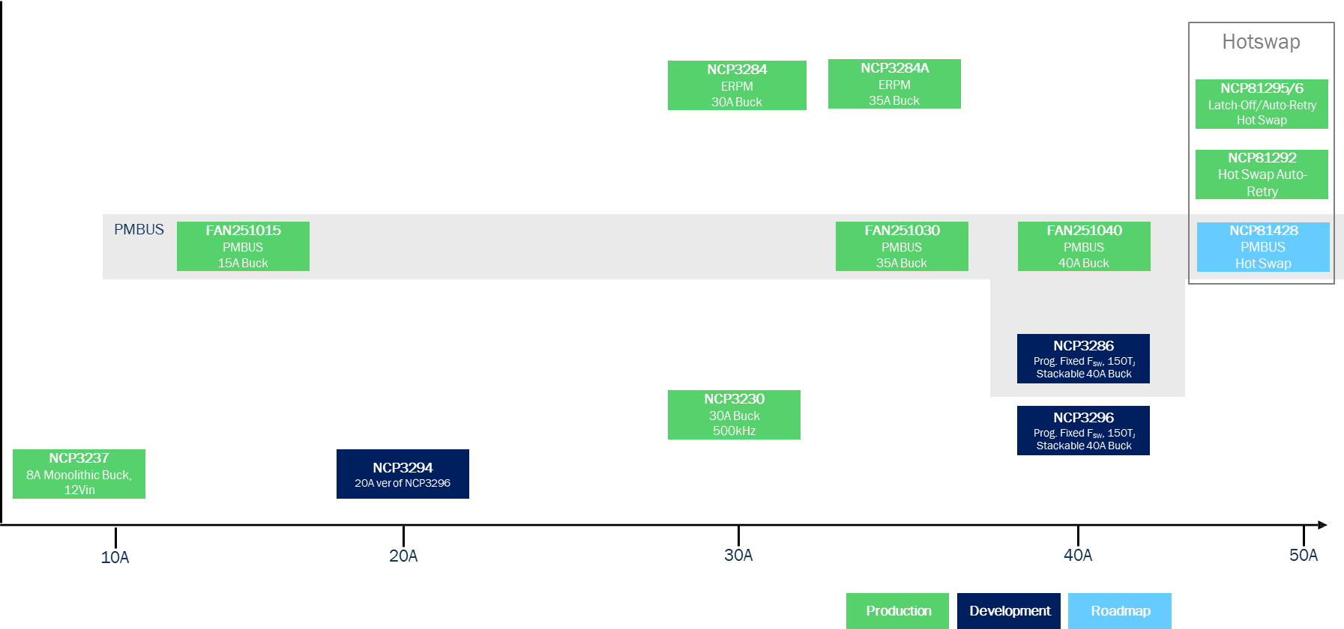
Existing Product Portfolio
P/N | IOUT | VIN Range | VOUT Range | Fsw | Operating/ Control Mode | I_{Q} (I_{SD}) | Protection | Package | Features/Comments
FAN251015 | 15A | 4.5V to 18V | 0.5V to 5.5V | 200kHz to 2.2MHz | CCM | 2.8mA | Hiccup/ Latch-off | QFN34, 5x7, 0.5P | PMBUS 1.3.1 compatible NVM Integrated
FAN251030 | 35A | 4.5V to 18V | 0.5V to 5.5V | 200kHz to 1.8MHz | CCM | 2.8mA | Hiccup/ Latch-off | QFN34, 5x7, 0.5P | PMBUS 1.3.1 compatible NVM Integrated
FAN251040 | 40A | 4.5V to 18V | 0.5V to 5.5V | 200kHz to 1.4MHz | CCM | 2.8mA | Hiccup/ Latch-off | QFN34, 5x7, 0.5P | PMBUS 1.3.1 compatible NVM Integrated
NCP3230 | 30 A | 4.5 V to 18 V | 0.6 V to 16 V | 500 kHz | PWM/Voltage | 4.9 mA (58 uA) | OCP(Hiccup/Latch-off) OVP(Hiccup) UVLO, Thermal(Latch-off) | QFN40, 6x6, 0.5P | External Programmable Soft−start Power Good Output Adaptive dead time control
NCP3237 | 8A | 4.7 V to 16 V | 0.6V to 0.8*VIN and up to 12V | 300kHz to 1.2MHz | FCCM/Voltage | 6.1mA | Hiccup (OCP/UVP) Hiccup/Latch-off (OVP, Fuse) | QFN18 3.5x3.5, 0.5P
NCP3284/A | 30A/35A | 4.5 V to 18 V | 0.8 V to 5.5 V | 500 kHz/600 kHz/ 800 kHz/1MHz | PWM, PFM FCCM/Current | 3.5 mA (42 uA) | OCP & OVP & UVP (selectable Latch-off or Hiccup) & programmable UVLO Thermal (hiccup) | PQFN37 5x6, 0.5P | Programmable Soft-Start time Output Discharge in Shutdown Power Good Indication Enable control

Slide 4
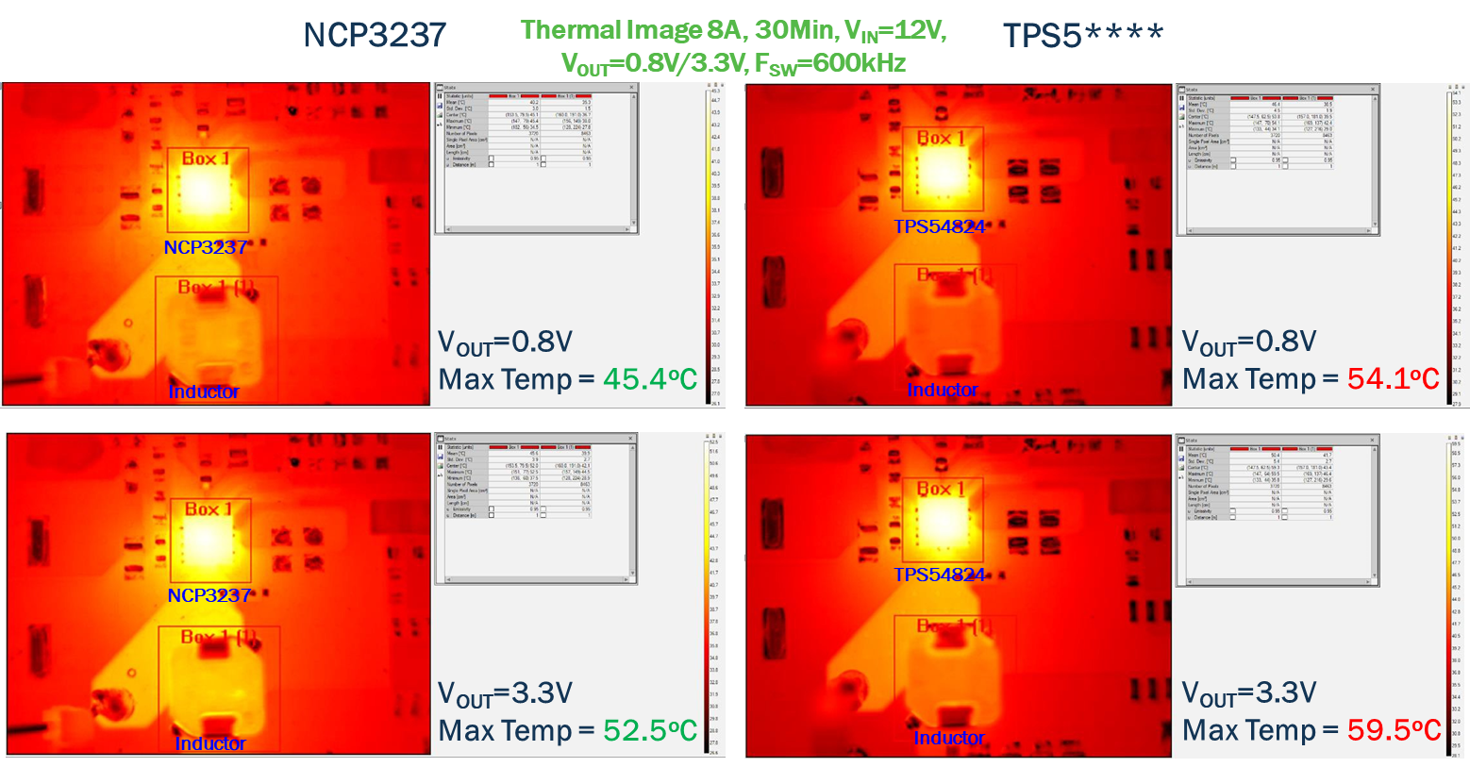
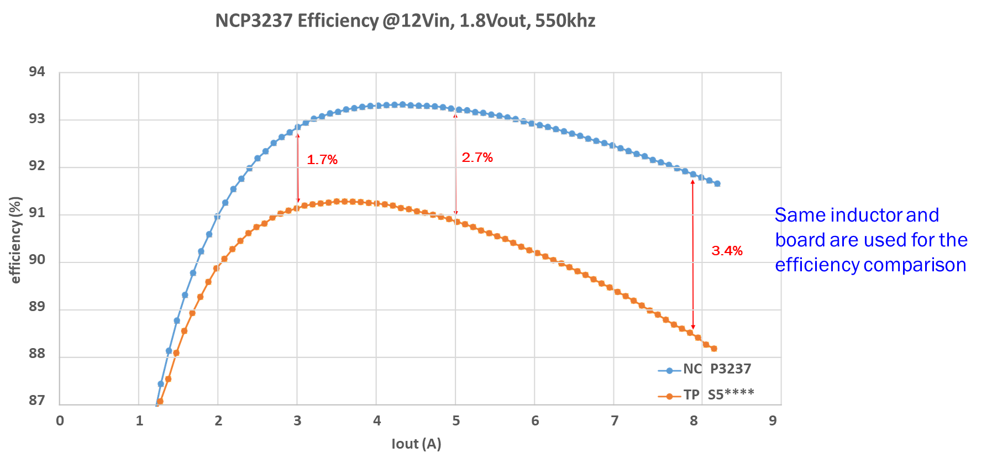
NCP3237 – Competitive Comparison
 | NCP3237 | TPS54824 | Overall Performance
Efficiency | 91.90% | 88.50% | NCP3237
Load Transient | 201mVP2P | 224mVP2P
VOUT Ripple | 14mVP2P | 17.5mVP2P
Thermal | 45.4C | 54.1C

Slide 5
Pricing
NCP3237MNTXG: $1.2
MPQ: 3000
QFN-18
Collateral
Datasheet
Click Here
Product Page
Click Here
Design Aid
Click Here
Sales Presentation
Click Here

