Slide 1
NCS20084
QUAD RRIO AMPLIFIER
Notes:
*Mandatory Slide*
Above information can be pulled from onsemi.com if needed.

Slide 2
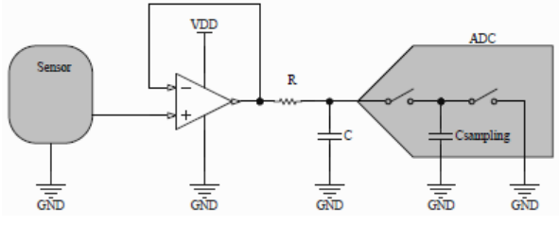
QUAD RRIO AMPLIFIER
Features
Good cost to performance Ratio with a migration path to higher speeds or lower current
Low Quiescent current & low Operating voltage
Rail to Rail In/Out
Single, Dual and Quad in Smaller Packages
Application Block Diagram
Applications
Automotive
Current Sensing
Sensor Signal Conditioning
Consumer
Battery Powered/Portable
Unity Gain Buffer Stage for Sampling with ADC
Interfacing a high impedance sensor’s output to a relatively low−impedance ADC input usually requires an intermediate stage to avoid unwanted interference of the two devices, and this stage needs to have a high input impedance, a low output impedance and high output current. The unity gain buffer is recommended here (Figure 29).The ADC’s internal sampling capacitor requires a buffer front−end to recharge it faster than the sampling time, and this problem is even worse if more channels are sampled by the same ADC using an internal multiplexer. In order to achieve a settling time shorter than the multiplexed sampling rate, an RC stage is recommended between the buffer and the ADC input. The R resistor’s value should be low enough to charge the capacitor quickly, but at the same time large enough to isolate the capacitive load from the opamp’s output to preserve phase margin. When transients are generated by the sensor’s output, first the two opamp’s inputs see a high differential voltage between them, then the output settles and brings the inverting input back to the correct voltage. To successfully accommodate for example a 0.1 V to 4 V sensor signal, the opamp’s differential input range of the NCS(V) 20081/2/4 series is close to the supply range VDD−VSS, and the output will match the input. The differential input voltage is limited only by the ESD protection structure and not by back−to−back diodes between inputs.
Value Proposition
Low offset voltage, without sacrificing the performance or paying the premium of the precision op amps. These families allow engineers migrate up or down the GBWP range based on the application need
Low power consumption
Input/output voltage swings closer to the supply rails, without any degradation in the output
Multiple configurations allow to implement filters, gain stages etc. in a small form factors

Slide 3
Existing Product Portfolio
NCS2005
8 MHz, 2.2V-32V,
Rail to Rail Output
NCS2007x (Single/Dual/Quad)
36V Low Power CMOS family
3 MHz, 480 µA, RRO
NCS2003x (Single/Dual/Quad)
5.5V Low Power , High Slew Rate 7 MHz, 230 µA, RRO
Supply Current
NCS2006x (Single/Dual/Quad)
5.5V Low Power CMOS family
3 MHz, 130 µA, RRIO
NCS2008x (Single/Dual/Quad)
5.5V Low Power CMOS family
1.2 MHz, 50 µA, RRIO
NCS2009x (Single/Dual/Quad)
5.5V Low Power CMOS family
350 KHz, 20 µA, RRIO
Gain Bandwidth Product
Competitive Comparison

Slide 4
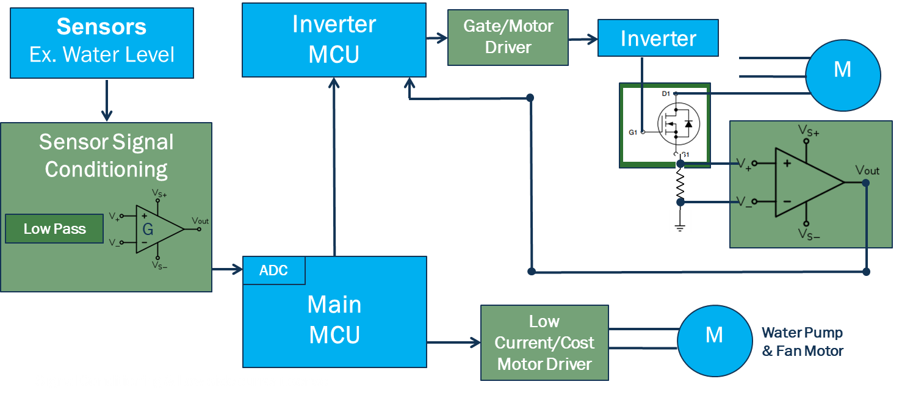
Pricing
Collateral
Pricing (1 Ku):
NCS20084DR2G : $0.26
MPQ: 2500
Package: SOIC-14
Data Sheet
Click Here
Solution Sell
Device | Ch. | Min.V_{S} (V) | Max.V_{S} (V) | I_{Q} /Ch. (uA) | GBW (MHz) | Max. V_{OS} (mV) | V_{OS} Drift (µV/ºC) | I_{B} (pA)
NCS2008x | 1,2,4 | 1.8 | 5.5 | 50 | 1.2 | 4 | 1 | 0.001

Slide 5
Companion Products
Parameter | NCS2009x | NCS2008x | NCS2006X
Operating Temperature Range (°C) | -40 to +125 | -40 to +125 | -40 to +125
Supply Current (µA) | 29 | 50 | 140
GBWP ( MHz) | 0.35 | 1.2 | 3
Offset Voltage (max.) | 4mV | 3mV | 3mV
Slew rate (V/µs) | 0.15 | 0.5 | 1.5
Rail-to-Rail Swing | Input /Output | Input /Output | Input /Output
Operating Voltage Range (V) | 1.8 -5.5 | 1.8 -5.5 | 1.8 -5.5
Input Bias Current (pA) | 1 | 1 | 1
Packages | Single – SC70, TSOP-5, UDFN6 Dual – Micro8, TSSOP-8, SOIC-8 Quad* – SOIC-14, SOP-14, TSSOP-14 (Contact Sales)
 | NCV Prefix for Automotive and Other Applications Requiring Unique Site and Control Change Requirements; AEC−Q100 Qualified and PPAP Capable
Ideal Applications | Filter Circuits, Buffering, Sensor Signal Conditioning, Amplification, Combine with a Precision Amplifier like the NCSx333 to make a two gain stage precision amplification circuit

