Slide 1
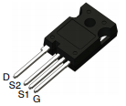
NTBG015N065SC1 / NTH4L015N065SC1
SiC 650V MOSFETs
Notes:
*Mandatory Slide*
Above information can be pulled from onsemi.com if needed.

Slide 2
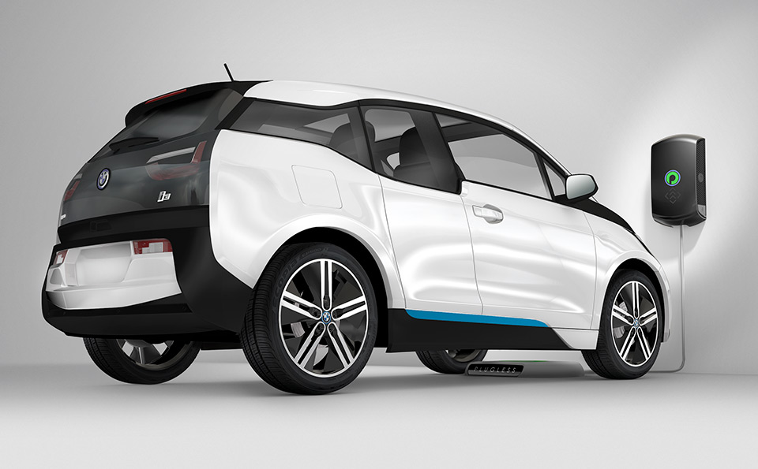
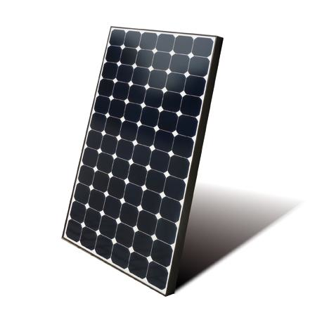
650V Silicon Carbide (SiC) MOSFETs
Product Family Overview
Applications
ON Semiconductor offers Silicon Carbide (SiC) MOSFET uses a completely new technology that provide superior switching performance and higher reliability compared to Silicon. In addition, the low ON resistance and compact chip size ensure low capacitance and gate charge. Consequently, system benefits include highest efficiency, faster operation frequency, increased power density, reduced EMI, and reduced system size.
Solar Photo-Voltaic Inverters (PV)
Power Factor Correctors (PFC)
Electric / Hybrid Vehicle Chargers
Uninterruptible Power Supplies (UPS)
Telecom Power Supplies
Server Power Supplies
Features
High Power Density
Ultra Low Gate Charge
Low Effective Output Capacitance
Low VF (lower conduction losses)
Leakage stability over temperature range
100% UIL Tested
Higher operating temperature (TJMAX=175ºC)
Value Proposition
High Quality
High Efficiency and Frequency Operation
Multiple performance / pricing solutions
Broad array of packaging solutions
Wide WBG portfolio
Automotive Qualification AEC-Q101

Slide 3
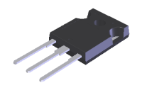
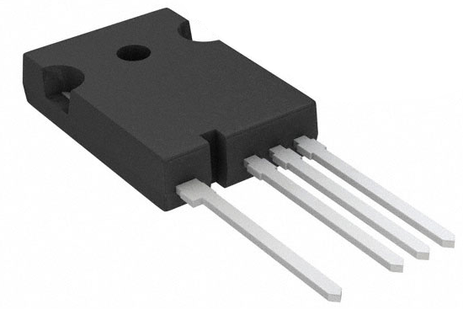
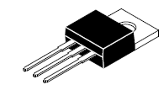
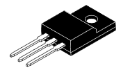
Existing Product Portfolio
R_{DS(ON)} TYP (mΩ) |  | TO-247-3 | TO-247-4 | D2PAK-7 | TO220-3 | TO220FP-3 | TOLL | PQFN88
15 |  | NVHL015N065SC1 NTHL015N065SC1 | NVH4L015N065SC1 NTH4L015N065SC1 | NVBG015N065SC1 NTBG015N065SC1 | NTP015N065SC1 | NTPF015N065SC1 | NTBL015N065SC1 | NTMT015N065SC1
25 |  | NVHL025N065SC1 NTHL025N065SC1 | NVH4L025N065SC1 NTH4L025N065SC1 | NVBG025N065SC1 NTBG025N065SC1 | NTP025N065SC1 | NTPF025N065SC1 | NTBL025N065SC1 | NTMT025N065SC1
45 |  | NVHL045N065SC1 NTHL045N065SC1 | NVH4L045N065SC1 NTH4L045N065SC1 | NVBG045N065SC1 NTBG045N065SC1 | NTP045N065SC1 | NTPF045N065SC1 | NTBL045N065SC1 | NTMT045N065SC1
60 |  | NVHL060N065SC1 NTHL060N065SC1 | NVH4L060N065SC1 NTH4L060N065SC1 | NVBG060N065SC1 NTBG060N065SC1 | NTP060N065SC1 | NTPF060N065SC1 | NTBL060N065SC1 | NTMT060N065SC1
75 |  | NVHL075N065SC1 NTHL075N065SC1 | NVH4L075N065SC1 NTH4L075N065SC1 | NVBG075N065SC1 NTBG075N065SC1
95 |  | NTHL095N065SC1 | NTH4L095N065SC1 | NVBG095N065SC1 NTBG095N065SC1
Apr’21 / Sep’21
Jun’21 / Dec’21
Jun’21 / Dec’21
Jun’21 / Dec’21
Apr’21 / Sep’21
Now / Jan’21
Now / Jan’21
Apr’21 / Sep’21
Jun’21 / Nov’21
Jun’21 / Nov’21
Jun’21 / Nov’21
Jun’21 / Nov’21
Jun’21 / Nov’21
Jun’21 / Nov’21
Jul’21 / Feb’22
Jul’21 / Feb’22
Jul’21 / Feb’22
Released – Green
Developing – Black (ES/RTM)
Future – Red (Evaluation and early engagement. Samples underlined)

Slide 4
Solution Sell
Pricing
NTBG015N065SC1 : $10.5
MPQ: 800
Package: D2PAK-6/7
NTH4L015N065SC1 : $10.5
MPQ: 450
Package: TO-247
Collateral
Data Sheets
NTBG015N065SC1
NTH4L015N065SC1
White Papers
Click Here
Videos
Click Here
Evaluation Boards
Click Here

