Slide 1
NCV7544 / NCV7547
Multi-channel MOSFET Pre-drivers for
Passenger Vehicle Power Actuator Solutions
Notes:
*Mandatory Slide*
Above information can be pulled from onsemi.com if needed.

Slide 2
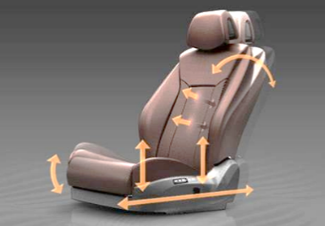


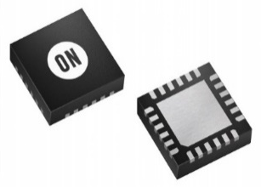
Pre-driver + MOSFET Power Actuator Solutions
Product Family Overview
Applications
Application Diagram
Multi-channel FLEXMOS™ pre-drivers provide a scalable solution to deliver smart control of power actuators in passenger vehicle applications
Features
Half-bridge configured pre-drivers for logic level N-MOSFETs
4 / 6 / 7 channel variants available in QFN packages
Regulated charge pump
5 V CMOS compatible I/O
    16-bit SPI for control and diagnosis
    Reset and Failsafe inputs
    PWM control inputs
Programmable overload protection thresholds
Programmable slew rate
Low quiescent current
  Power Seat Control
  Position Actuators
  Heaters
  Sunroof Actuator
  Wiper Motors
Value Proposition
Scalable to Load by Choice of External MOSFET
Software-compatible Variants
Supports Functional Safety Compliance
AEC−Q100 Qualified and PPAP Capable
Wettable Flanks Pb−free QFN Packaging
  Lift Gate / Rear Door / Trunk Lid
  Cargo Door / Sliding Door
  Door Locks / Fuel Door Release

Slide 3
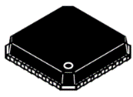
Product Portfolio
Family Feature Details
Targeted to Seat Motor Control Applications
Independent Channels (4/6/7)
  External logic-level MOSFETs
  Slew rate control via gate current drive
  Assignable PWM control inputs
  Low quiescent current sleep mode
Regulated charge pump
  High-side gate driver supply
  Switched output (CPSW) for reverse-battery
  protection MOSFET and security MOSFET
Protection & Diagnosis
  Independent MOSFET overload protection
  via VDS sensing
  Global VS Supply Under/Over Voltage
  Global Charge Pump Under/Over Voltage
System & Driver Status Reporting
  Global Power Supply Fail (VS, Vcc, CPump)
  MOSFET overload status
  Output Status: HS On, LS On, High-Z
  Off-state load/HBx node status
16-bit SPI interface
  Error detection
  Daisy chain capable with protocol-compatible
  8-bit & 16-bit devices
Supports Functional Safety Compliant Designs
  Fail safe mode via SPI/external input
QFN Package
NCV7544
4x Outputs
2 PWM Inputs
QFN-32 5 x 5 mm
NCV7546
6x Outputs
4 PWM Inputs
QFN-40 6 x 6 mm
NCV7547
7x Outputs
4 PWM Inputs
QFN-48 7 x 7 mm

Slide 4
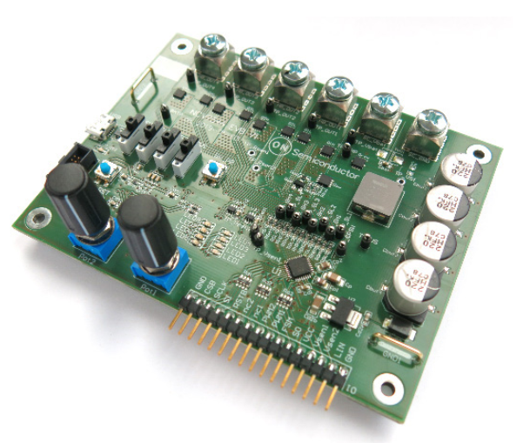
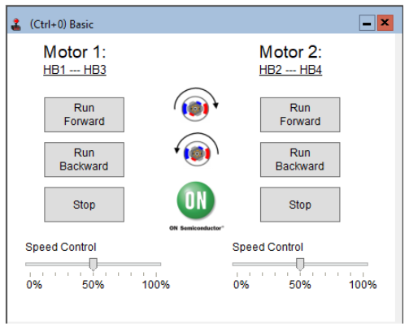

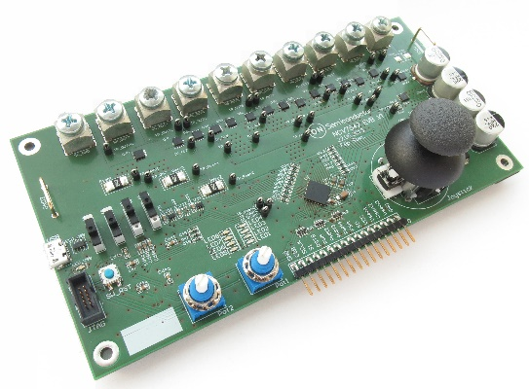
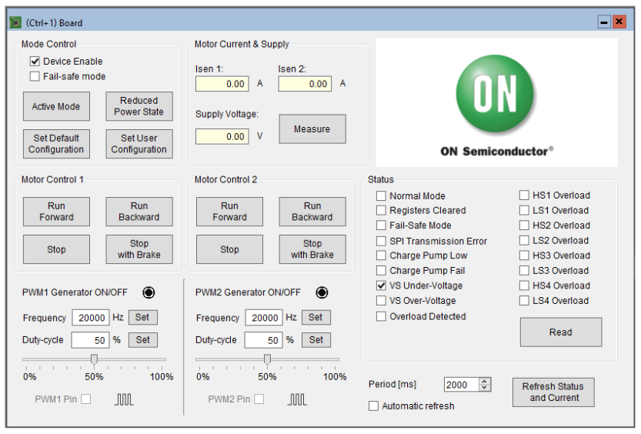
Pricing
Collateral
NCV7544MWTXG: $1.1682
  MPQ: 5000 / Tape & Reel
  Package: QFN-32 5 x 5 mm
NCV7547MWTXG: $1.9510
  MPQ: 2500 / Tape & Reel
  Package: QFN-48 7 x 7 mm
Product Page
(NCV7544MWTXG)
Click Here
Eval Board
(NCV7544)
Click Here
Product Page
(NCV7547MWTXG)
Click Here
EVB Control GUI

