Slide 1
NCP51561xxDWR2G
High Performance Isolated Drivers in SOIC16-WB
Notes:
*Mandatory Slide*
Above information can be pulled from onsemi.com if needed.

Slide 2





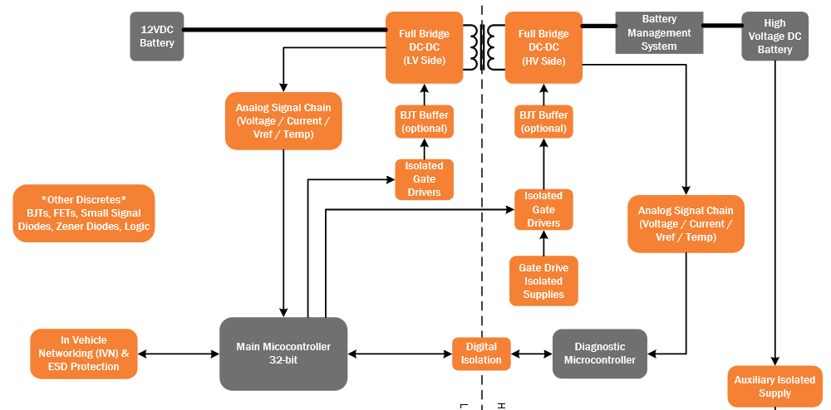
2-Ch Isolated Gate Drivers
Product Family Overview
Applications
NCP51561xy are 4.5−A/9−A isolated dual−channel gate drivers designed for fast switching to drive power MOSFETs and SiC MOSFETs
Features
5 kV RMS Galvanic Isolation from input to each output and 1500 V peak differential voltage between output channels
Output Supply Voltage from 6.5 V to 30 V with 5-V, 8-V, 13-V, 17- V UVLO
Propagation Delay Typical 36 ns with
  5 ns Max Delay Matching per Channel
  5 ns Max Pulse−Width Distortion
200V/ns dV/dt Immunity
User Programmable Overlap or Dead-Time Control
NCV51561 AEC Qualified
  Industrial Power
  Server & Cloud
  Telecom
  Solar / UPS
  xEV OBC & DC/DC
System or Application Block Diagram
Value Proposition
5 kVRMS isolation level
Strong drive capability
Various UVLO capabilities for MOS & SiC
Fast dynamic performances
High CMTI
User Programmable Overlap or Dead-Time Control
User Programmable Input Logic

Slide 3
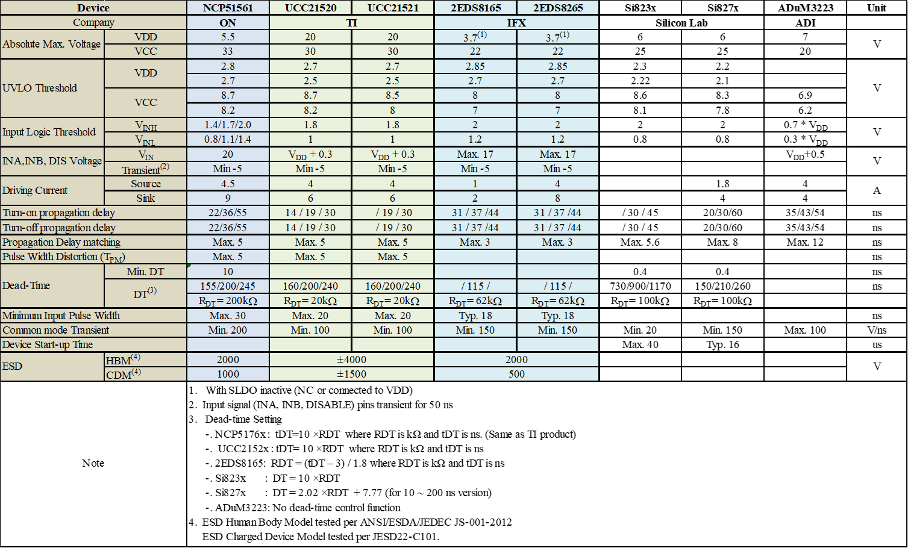
Existing Product Portfolio
Competitive Landscape

Slide 4
Pricing
Pricing:
  NCP51561xyDWR2G: 1.45$
    MPQ: 1000
    Package: SOIC-16WB
  NCV51561xyDWR2G: 1.80$
    MPQ: 1000
    Package: SOIC-16WB
  x: UVLO level
  y: ENA/DIS
Collaterals
Data Sheet
Click Here
Customer Presentation
Click Here
Simulation Model
Click Here
Video
Click Here
More at: NCP51561 Web Page

