Slide 1
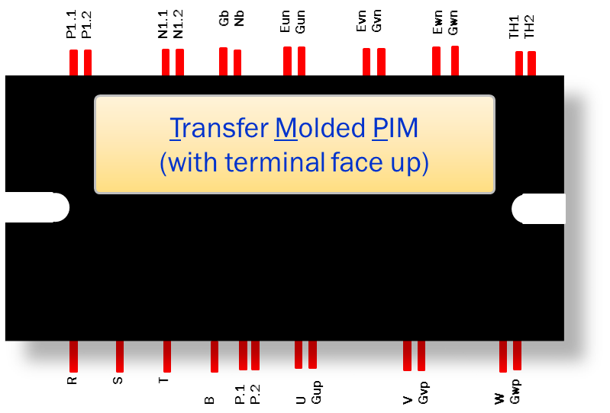
1200V and 650V Transfer Molded PIM
TMPIM
October 2021
Notes:
*Mandatory Slide*
Above information can be pulled from onsemi.com if needed.

Slide 2
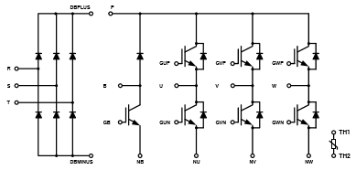
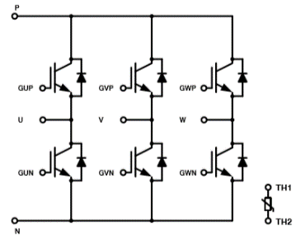
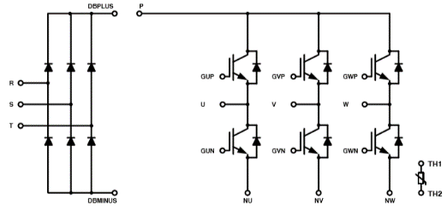
TMPIMs for Industrial Drives: DIP Series
Features and Benefits
Block Diagram
Transfer Molded Process
High performance IGBT/FRD with low switching loss & good softness
Integrated module for single phase & three phase applications
Extended product life time
High efficiency
High power density
Corrosion resistance
Complete portfolio
1200V Line-up
CIB
Product | Voltage | Current | Substrate | Configuration | Status
NXH50M65L4C2SG | 650V | 50A | DBC(Al2O3) | CI+ Inter PFC | Released
NXH50M65L4C2ESG | 650V | 50A | HPS | CI+ Inter PFC | Released
NXH25C120L2C2SG | 1200V | 25A | DBC(Al2O3) | CIB | Released
NXH35C120L2C2SG | 1200V | 35A | DBC(Al2O3) | CIB | Released
NXH35C120L2C2S1G | 1200V | 35A | DBC(Al2O3) | CI | Released
NXH35C120L2C2ESG | 1200V | 35A | DBC (HPS) | CIB | Released
NXH50C120L2C2ESG | 1200V | 50A | DBC(HPS) | CIB | Released
NXH50C120L2C2ES1G | 1200V | 50A | DBC(HPS) | CI | Released
Six Pack
CI
Target Applications
HVAC
Industrial pumps /fans
Motor Drive
Servo

Slide 3
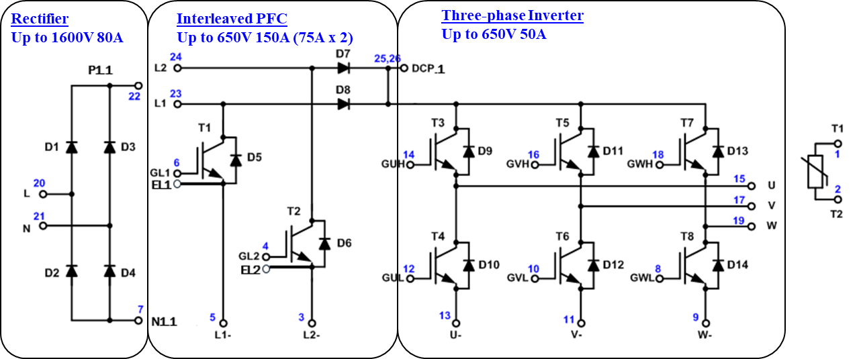
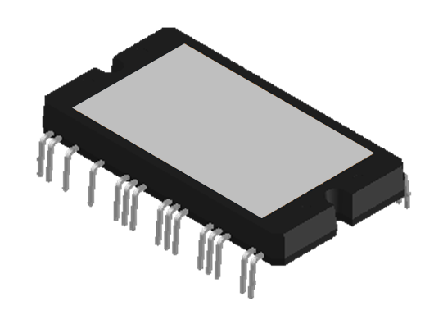
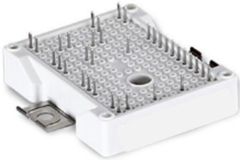
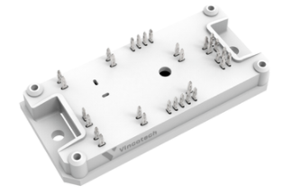
VS. gel filled module solution
ON TMPIM CIP Solution:
TMPIM CIP Advantage:
High output power with wide portfolio selection
Standardized pinout for scalable output power
Low parasitic
Long lifetime
System level cost saving
X 1
VS.
Compared to key competitors, customer in favor of TMPIM wide output power (2kW ~ 8kW+), easy cooling design (low Rth), cost saving with small inductor (high fsw).
Competitors’ Gel filled Solution:
OR
Gel filled Module :
Output power limited by high thermal resistance
non-standardized product
Low PFC switching frequency

Slide 4
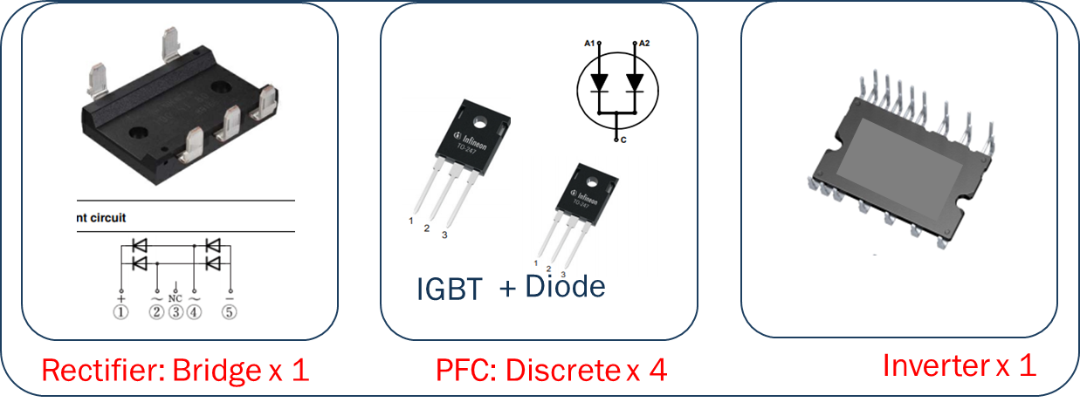
VS. discrete solution
ON TMPIM CIP Solution:
TMPIM CIP Advantage:
Easy installation
Safety distance: clearance distance = 6mm, CTI 600.
High output power with wide portfolio selection
Standardized pinout
Easy PCB Layout with low parasitic
System level cost saving
X 1
VS.
Discrete Solution:
Discrete:
Multiple components for installation
Limited safety distance
Layout challenge for high PFC switching frequency
Aux component in thermal pad, heatsink, assembly kits

Slide 5
Pricing
NXH25C120L2C2SG: $32.4000
6
DIP26
NXH35C120L2C2ESG: $38.7067
6
DIP26
NXH35C120L2C2S1G: $33.3067
6
DIP52
NXH35C120L2C2SG: $35.8267
6
DIP52
NXH50C120L2C2ES1G: $43.2000
6
DIP26
NXH50C120L2C2ESG: $45.3600
6
DIP26
NXH50M65L4C2SG: $42.3000
6
DIP27
NXH50M65L4C2ESG: $48.8400
6
DIP27
Collateral
Data Sheets
NXH25C120L2C2SG
NXH35C120L2C2SG/S1G
NXH35C120L2C2ESG
NXH50C120L2C2ESG/ES1G
NXH50M65L4C2ESG
NXH50M65L4C2SG
TMPIM CIB for Motor Drive Webinar
Click Here
Motor Development Kit
Click Here

