Slide 1
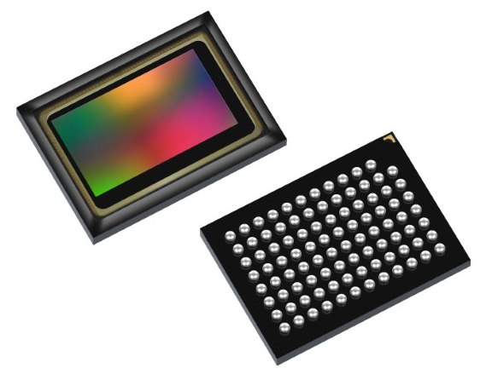
AR0821CS
October 2021
Notes:
*Mandatory Slide*
Above information can be pulled from onsemi.com if needed.

Slide 2
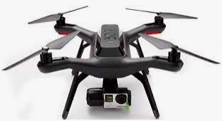
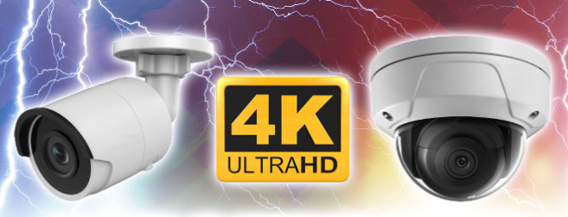
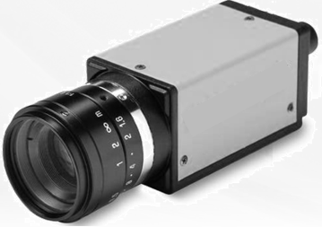
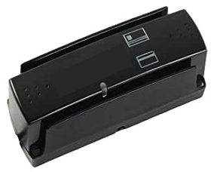
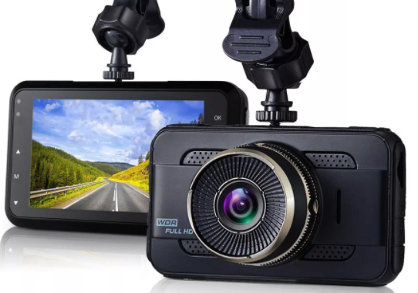
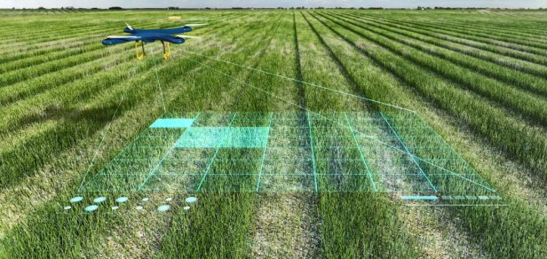
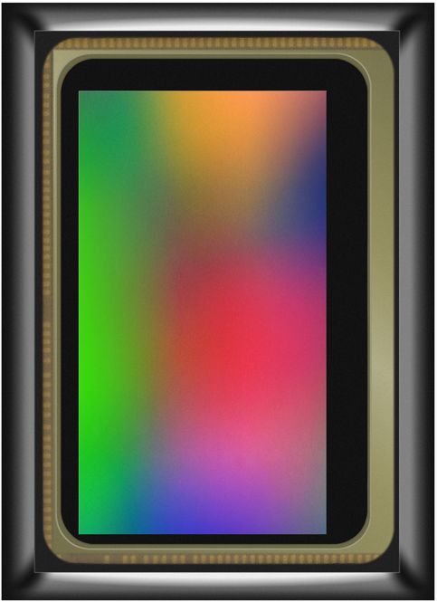
AR0821CS
Product Family Overview
Applications
8MP, 4K High-performance CMOS Digital Image Sensor Delivers High-Quality Images in Bright & Lowlight Conditions
High-End Drones
Surveillance
Features
3840 x 2160 [16:9], 2.1μ BSI Pixel, 1/1.7” Format
eHDR 4-exp >140dB
Scalable Power Design
Multiple Trigger Modes, Subsampling Modes
Double-Side ARC BBAR Glass
MV Cameras
ID/Doc Readers
System or Application Block Diagram
Dashcams
Smart Agriculture
ACDC Power Supply
I2C I/F
AP1302
Value Proposition
USB3.1
MIPI
MIPI
SoC
eHDR with >140dB Delivers Excellent Image Quality in Challenging Conditions, Highest Performance @ Lowest Power
Large Pixel Provides Superior Lowlight Performance
Subsampling Modes Optimizes Bandwidth & Power
Mono-Summing Mode for Very Poor Lighting Conditions
High-Speed MIPI I/F for High Frame Rate & Detail
BBAR Glass with ARC Ensures High-Fidelity Optical Path
HDMI
MIPI
PCIe
I2C I/F

Slide 3
onsemi High Performance Rolling Shutter Sensors
Parameter | AR0221 | AR0430/AR0431 | AR0521/AR0522 | AR0821
Optical Format | 1/1.7” | 1/3.1” | 1/2.5” | 1/1.7”
Output Resolution | 1920 x 1080 | 2316 x 1746 | 1280 x 800 | 3840 x 2160
Frame Rate | 60fps | 120fps | 60fps | 60fps
Pixel | 4.2μm | 2.0μm | 2.2μm | 2.1μm
Chroma | RGB | RGB | Mono/RGB | RGB
Relative QE (wrt AR0221) | 1.0/1.0/1.0 | 0.9/0.9/0.8 || 0.9/1.6/1.8 | 1.1/1.0/1.0 || 1.1/1.6/1.8 | 1.2/1.0/1.0
SNRmax | 41dB | 39dB/42dB | 40dB | 41dB
Dynamic Range | Linear 66dB LI-HDR 100dB | Linear 78dB | Linear 74dB LI-HDR 100dB | Linear 78dB LI-HDR 100dB 3exp eHDR 120dB 4exp eHDR >140dB
Power @ max fps | 284mW, 4.73mW/fps | 290mW; 2.42mW/fps | 320mW; 5.33mW/fps | 520mW; 8.67mW/fps
Output Interface | MIPI 4-Lane | MIPI DPHY 4-Lane, 1.5G/Lane MIPI CPHY 2-Lane, 1.3G/Lane | MIPI 4-Lane, 1.2G/Lane | MIPI 4-Lane, 1.68G/Lane
Package | iBGA-87; 12x9mm | mPLCC-52; 12x12mm | mPLCC-53; 12x12mm | iBGA-95; 11x8mm
Notes:
Full Well Capacity: This represents the amount of charge a pixel can hold before saturating. It directly impacts the dynamic range of the sensor.
Dark Current: Is a representation of electrons being created independent of photon capture. Generally seen to be higher at higher temperature. A reduction in dark current reduces the total noise floor resulting in SNR improvement
Global Shutter Efficiency:
****************************************************************************************************************
Dynamic Range: This represents a cameras capabilities to display/reproduce the brightest & darkest portions of the image . Within one image there may be a portion that is in complete black & a portion that is complete saturated. The largest possible signal is directly proportional to the full well capacity of the pixel.
Full Well Capacity: This represents the maximum number of electrons per pixel.
Higher guarantee can have
Machine vision calculate thresholds
DR = ratio of Margin of error to the total sample size
How many distinct
Pixel gives
Dark Current: In VR, close to human skin, extremely high temp will make dark current degrades on image quality which in turn will impact machine vision algorithms in finding objects
Designer of a VR headset to keep the headset cool
Global Shutter Efficiency: Additive component that increases the margin of error

Slide 4
Competition – Comparative Analysis
Parameter | onsemi | Sony | Sony | Omnivision | Smartsens
Comp P/N | AR0821 | IMX415/515/715 | IMX334 | OS08A10/20 | SC8238
Resolution | 3840 x 2160 | 3840 x 2160 | 3840 x 2160 | 3840 x 2160 | 3840 x 2160
Pixel Size | 2.1μ | 1.45μ | 2.0μ | 2.0μ | 1.50μ
Optical Format | 1/1.7” | 1/2.8” | 1/1.8” | 1/1.8” | 1/2.7”
Chroma | RGB | RGB | Mono / RGB | RGB | RGB
Frame Rate @ 12b | 60fps | 60fps/52fps/60fps | 60fps | 60fps | 30fps
HDR @ 30fps | eHDR >140dB | LI-HDR (DOL) | LI-HDR (DOL) | LI-HDR 85dB | LI-HDR 100dB
Interface | MIPI 4-Lane 1.68G/Lane | MIPI 4-Lane 1.56G/Lane | MIPI 4-Lane 1.56G/Lane | MIPI 4-Lane 1.5G/Lane | MIPI 4-Lane 746M/Lane
SNR1 (Lux) | 0.60 | 0.79/0.76/0.73 | 0.59 | NA | NA
Power | 520mW @ 60fps | 582mW/??/?? | 523mW | 792mW @ 60fps | NA
Package | iBGA-95 | LGA-114/BGA-65/ LGA-114 | LGA-128 | CSP-92 | CSP-41 PLCC-48

Slide 5
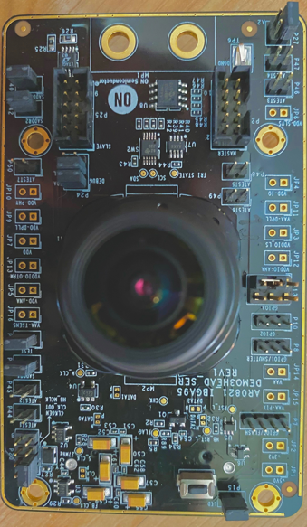
AR0821CS – Collateral & Support
AR0821CS FAE Training
AR0821CS Product Presentation
AR0821CS Selling Guide
AR0821CS Evaluation Board
Pricing – Contact onsemi Sales
AR0821 External DevWare Software & Technical Documentation– AR0821 Image Sensor Portal

