Slide 1
NCP59763
Low Voltage Linear Voltage Regulator (LDO)
October 2021
Notes:
*Mandatory Slide*
Above information can be pulled from onsemi.com if needed.

Slide 2
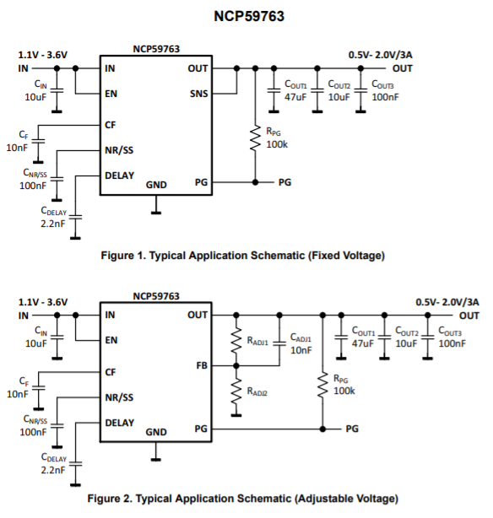
NCP59763 / Linear Voltage Regulator
Product Family Overview
Applications
The NCP59763 is a 3 A capable, low noise (4.3 μV_{RMS}), ultra low dropout (70 mV max. at 3 A), fast load transient response linear
regulator (LDO) equipped with an NMOS pass transistor without the need of external bias voltage. The device output voltage is adjustable from 0.5 V to 2.0 V through the use of an external resistor divider and also available in fixed output versions.
High Speed Analog VCO, ADC, DAC
FPGAs, DSPs, SerDes
Imaging Sensors and ASICs
Communications, Test, Measurement
Features
Operating Input Voltage Range: 1.1V – 3.6V
Output Voltage: 0.5 V – 2.0V
High Output Current 3 A
High Accuracy ±1% Including Line/Load Regulation and Temperature Variation
Very Low Output Voltage Noise: 4.3 µV_{RMS} typ. (10 Hz – 100 kHz)
Very Low Dropout Voltage 70 mV typ. at 3 A
Application Descriptions
This set of features makes NCP59763 LDO an ideal solution for powering analog, digital and mixed signal high current demanding circuits like analog−to−digital converters (ADCs), digital−to−analog converters (DACs), high performance serializers and deserializers (SerDes), application specific integrated circuits (ASICs), field programmable gate arrays (FPGAs), digital signal processors (DSPs).

Slide 3
D
D
High
Performance
LDOs
G
Charge
Pump
Vbias
S
G
S
PMOS
PMOS
PMOS
NMOS
(Vbias)
NMOS
(Charge-Pump)
High PSRR/
Low Noise
Low Voltage
Low Iq
High Efficiency
High Efficiency
Current | 300mA –> 1.2A | 200mA -> 300mA | 3mA – 150mA | 300mA – 3A | 2A-4A -> 5A
Vin (Min) | 1.8V ->1.6V | 1.1V | 1.7V | 0.8V | 1.1V -> 0.9V
Vout (Min) | 1.2V | 0.6V | 0.6V | 0.4V | 0.5V
Noise | 6.5 ->4.5 -> 2 uV_{RMS} | 10uV_{RMS} | 125uV_{RMS} | 18uVrms -> 6uV_{RMS} | 4.5uV_{RMS}
PSRR | 92dB | 95dB | 60dB | 70dB | 60dB
Iq | 12uA – 60uA | 20uA | 500nA -> 50nA | 35uA – 1.3mA | 1.3mA
Fast Transient |  |  |  | Yes +/-30mV | Yes +/-17mV
Smallest Size | WLCSP4 0.65x0.65mm | WLCSP4 0.65x0.65mm | 5-Pin, xDFN 1.2x1.2mm | WLCSP6 0.8x1.2mm | DFN10 3x3mm
Products | NCP164, NCP187, NCP185 | NCP110, NCP111 | NCP170, NCP171 (SLIQ) | NCP136, NCP138, NCP59745 | NCP5976X

Slide 4
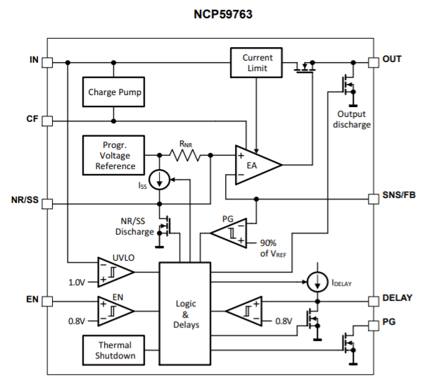
Pricing
NCP59763AMN050TBG: $0.48
3,000
DFN-10
NCP59763AMN080TBG: $0.48
3,000
DFN-10
NCP59763AMN100TBG: $0.48
3,000
DFN-10
NCP59763AMN120TBG: $0.48
3,000
DFN-10
Collateral
Data Sheet
Click Here

