Slide 1
NCID9210
High Speed Dual-Channel, Bi-Directional Ceramic Digital Isolator
SOIC16 W
September 2021
Notes:
*Mandatory Slide*
Above information can be pulled from onsemi.com if needed.

Slide 2
NCID9210 Bi-Directional Ceramic Digital Isolator
Product Overview
Applications
The NCID9210 devices are galvanically isolated full duplex, bi−directional, high−speed dual−channel digital isolators. These devices support isolated communications thereby allowing digital signals to communicate between systems without conducting ground loops or hazardous voltages.
onsemi’s digital isolation technology results in superior electrical performance with safety reliability of >0.5 mm insulator barrier.
Isolated PWM Control
Industrial Fieldbus Communications
Microprocessor System Interface (SPI, I2C, etc.)
Programmable Logic Control
Isolated Data Acquisition System
Voltage Level Translator
Found in Power Supplies, Motor Control, Network Communications, On Board Charging, Industrial Machines
Features
High Speed:
50 Mbit/s Data Rate (NRZ)
25 ns Maximum Propagation Delay
10 ns Maximum Pulse Width Distortion
Off−Chip Capacitive Isolation to Achieve Reliable High Voltage Insulation
DTI (Distance Through Insulation): ≥ 0.5 mm
Maximum Working Insulation Voltage: 2000 Vpeak
Full Duplex, Bi−directional Communication
100 KV/s Minimum Common Mode Rejection
NCIV Prefix for Automotive and Other Applications Requiring Unique Site and Control Change Requirements; AEC−Q100 Qualified and PPAP Capable (Pending)
Safety and Regulatory Approvals
UL1577, 5000 VRMS for 1 Minute
DIN VDE V 0884−11 (Pending)
Value Proposition
Performance of a digital isolator with safety advantages of an optocoupler
Reliable High Voltage Insulation
Device performance is predictable across a wide rang of voltages and temperatures.
Superior Lifetime
Improves Noise Immunity while meeting EMC/EMI requirements.

Slide 3
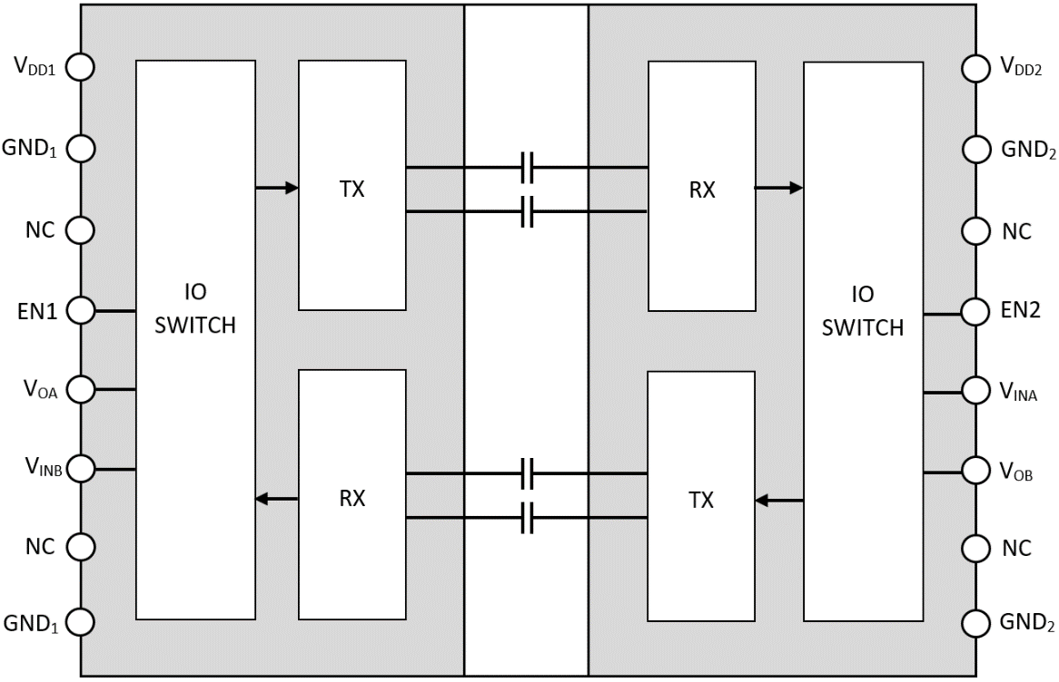
NCID9210 – A Technical Overview
Galvanic isolation is a principle of isolating functional sections of electrical systems to prevent current flow.
Galvanic Isolation Benefits
Safety of End User
Protecting LV circuits from HV Circuits
Filtering of Common-Mode Noise
Eliminating Ground Loop Noise
Level-Shift between Power Domains
Circuit A
Circuit B
Galvanic Isolation
Off-Chip Bi-Directional Basics
Bi-Directional communication between two isolated circuits.
Off−chip ceramic capacitors that serve both as the isolation barrier and as the medium of transmission for signal switching using on−off keying (OOK) technique,
Tx, modulates the VIN input logic state with a high frequency carrier signal.
Rx detects the barrier signal and demodulates it using an envelope detection technique.
GND A
High Impedance
GND B
Off-Chip Capacitor With Ceramic Substrate
Top View

Slide 4
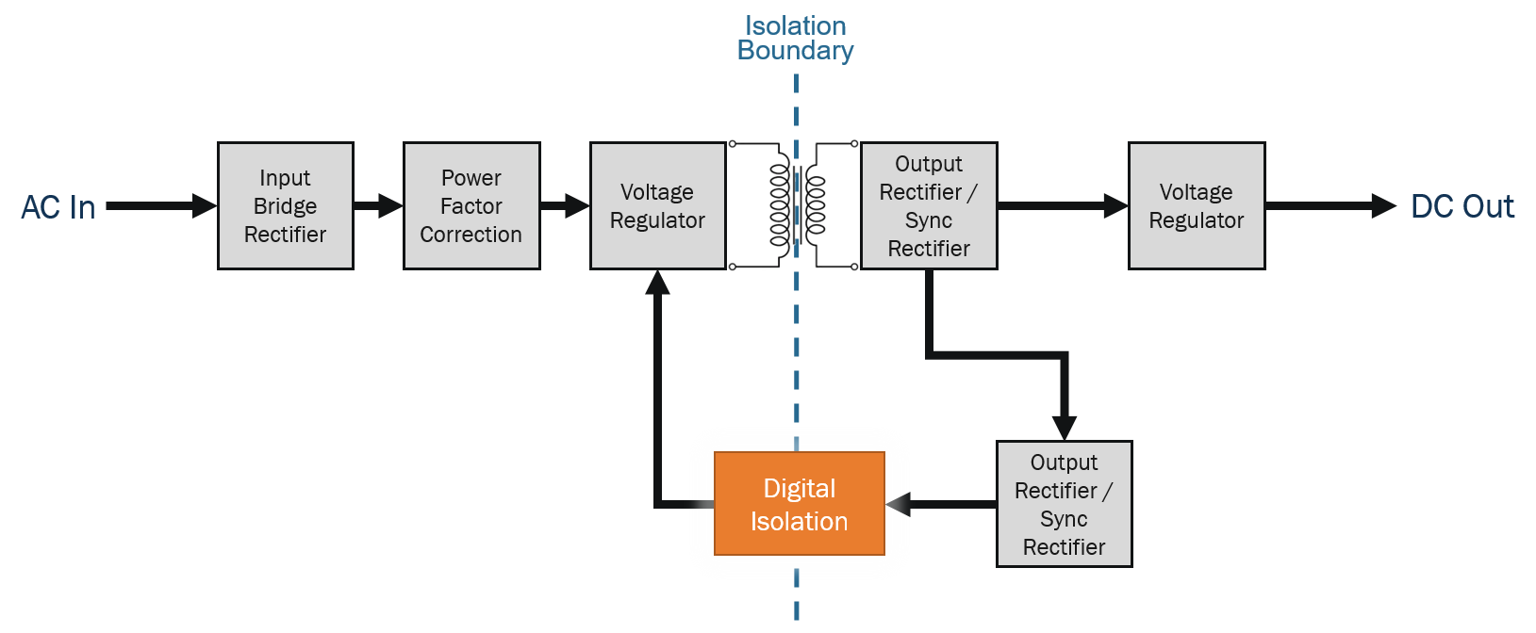
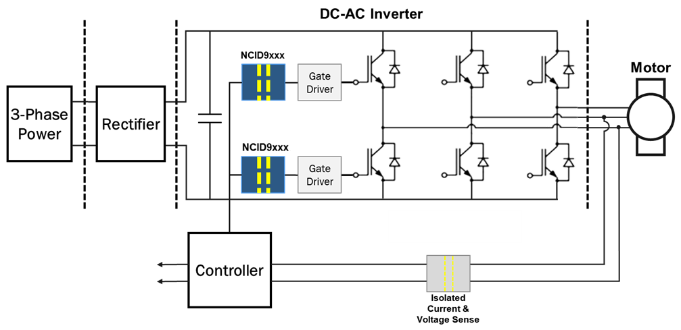
Power Supply Block Diagram
Motor Control (AC-DC Inverter) Block Diagram

Slide 5
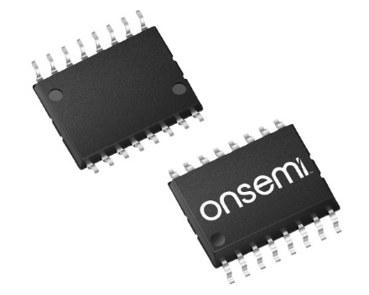
Pricing
NCDI9210: $1.7000
1,000
SOIC16 W
NCID9210R2: $1.7000
750
SOIC16 W
Collateral
Data Sheet
Click Here
Digi-Max Xref
Click Here
Digi-Max Video
Click Here
Evaluation Boards
Click Here
SOIC16 W
Case 751EN
Click Here

