Slide 1
Power and Analog Switch Overview
Apr.2021

Slide 2
Power Switch Products Overview
Apr.2021

Slide 3
Power Switch Product Portfolio
OVP Switch
OCP Switch
Load Switch
Key Product portfolio:
FPF2280/1 & FPF3380:
  29V/4.5A OVP w/ 100V TVS in 12-CSP
FPF2260A:
  28V OVP controller negative VIN protection to -28V
FPF2283C:
  28V/7A OVP w/ 8mΩ Ron and moisture detection in 20-CSP
FPF3042:
  18V/2A DISO OVP in 16-CSP
FPF2286:
  28V/4A OVP in 6-CSP
Key Product portfolio:
FPF2195:
  6V/1.5A ILIM w/ RCB in 6-CSP
FPF2495C:
  6V/2A ILIM w/ TRCB & 28Vabs at VOUT in 9-CSP
FPF2595:
  6V/3.5A ILIM w/ TRCB & 28Vabs at VOUT in 12-CSP
FPF2895C:
  28V/5A ILIM w/ TRCB and OVP in 24-CSP
Key Product portfolio:
FPF1038/9:
  6V/3.5A 20mΩ SW
FPF1048:
  6V/3A 23mΩ SW w/ TRCB
FPF1203/4:
  6V/2.2A 55mΩ SW in 4-CSP
FPF1504:
  4V/1.5A 15mΩ SW in 4-CSP
NCP451/A:
  7V/3A 12mΩ SW in 6-CSP
FPF1320/1:
  6V1/5A DISO SW w/ TRCB in 6-CSP

Slide 4
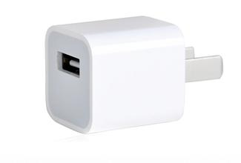



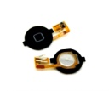
Power Switch in application - I
Travel Adapter
Input
OVP/OCP MUS
Battery charger
PMIC
USB port
Micro B or Type C
OUTPUT
Fingerprint module
Application processor
OTG function
Load switch
Mobile Device / Computing

Slide 5
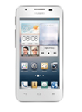
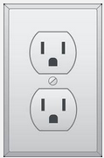
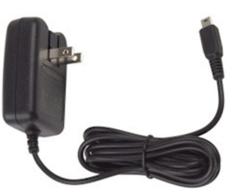
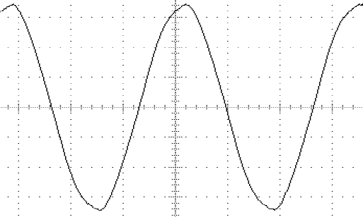
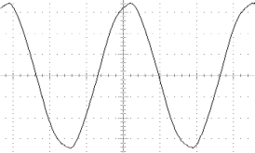
Why Portable Surge Protection?
-- Surge pulse path from AC power
After Market
Wall adaptor
Possible ±2kV surge pulse transient from lightning strike*
Transformer 34 to 1 Turn Ratio
Positive transient can be trickled down to cell phone
Rectifier & Filter
120V_{RMS}
5/√2V_{RMS}
5V_{DC}
±2000V surge
±50V surge
+50V surge
*More information can be obtained from IEC61000-4-5 specification

Slide 6
FPF2280/2281BUCX
-28V/4.5A Adjustable OVP Switch w/ TVS
Production
Benefits
Features
With FPF2280 the entire VBUS line is protected Against Surge & 6V OVP compare to discrete TVS that have 20V clamping voltage
Over 60% PCB space saving compare to discrete solution of Surge + OVP
Fast OVP response time
100V Surge Capability based on IEC61000-4-5
29V / 4.5A of Maximum Ratings
Wide voltage range: 2.5V ~ 23V
RON : Typ 30mΩ @ 5V and 25C
Default OVP trip voltage:
  FPF2280 : 6.8V +/- 3%
  FPF2281 : 14V +/- 3%
Adjustable OVP w/ external R divider
Active LOW operation
Thermal shutdown
WL-CSP 3x4 array with 0.4mm pitch in 1288um x 1828 um
Applications
Mobile Handsets and Tablets
Portable Media Players
MP3 Players
Power Banks

Slide 7
FPF3380UCX
28V OVP with low on-resistance integrated NMOSFET
Production
Benefits
Features
High level surge protection with internal TVS
Super fast OVP responding
Low Ron to reduce voltage drop
±100V Surge Capability based on IEC61000-4-5
Clamping Voltage @+100V surge: 37V
IEC61000-4-2:
  Contact Discharge: 8kV
  Air Discharge: 15kV
Internal NMOS-FET with low Rdson: 17mΩ
Current capability: typical 4.5A
Wide voltage range: 2.5V ~ 28V
Fast OVP response time: <50ns
Default OVP trip voltage: 6.5V ± 3%
Default ON state for power switch
Package:
  WLCSP-12 with Backside Laminate
  1.288mm x 1.828mm, 0.4mm ball pitch
Applications
Mobile device and smart phones
Portable media devices
Advanced Dongle and Docking Station

Slide 8
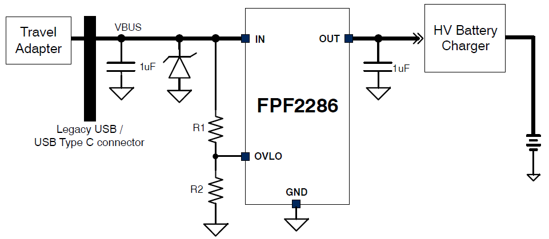
FPF2286UCX
29V OVP with low on-resistance integrated NMOSFET
Production
Benefits
Features
High level surge protection with external TVS
Super fast OVP responding
Low Ron to reduce voltage drop
36V peak voltage tolerance for surge event
Internal NMOS-FET with low Rdson: 25mΩ
Current capability: typical 3A
Wide voltage range: 2.5V ~ 28V
Super fast OVP response time: 50ns
Default OVP trip voltage: 6.8V ± 3%
Adjustable OVP w/ external R divider
Default ON state for power switch
Package:
  WLCSP-6 with Backside Laminate
  0.9mm x 1.3mm, 0.4mm ball pitch
Applications
Mobile device and smart phones
Portable media devices
Advanced Dongle and Docking Station

Slide 9
Comparison Table
Key Parameters | FPF2280/2281 | FPF3380 | FPF2286 | Competitor M | Competitor T1 | Competitor T2
Surge protection | 100V | 100V | N/A | 80V | 100V | 100V
Vabs | 29V | 28V | 28V | 28V | 30V | 30
Max Current | 4.5A | 4.5A | 4A | 4.5A | 3.5A | 3.5A
Operating Current @ 5V | typ 50uA | typ 90uA | typ 50uA | typ 70uA | typ 175uA | typ 337uA
Ron @ 5V, 25 °C | typ 33mΩ | typ 15mΩ | typ 25mΩ | typ 38mΩ | typ 39mΩ | typ 39mΩ
Default OVLO | 6.8V ± 200mV 14V ± 200mV | 6.8V ± 200mV | 6.8V ± 150mV | 15.5V ± 500mV 6.8V ± 200mV 5.825V ± 175mV | 6.2V ± 200mV | 5.95V ± 50mV 9.98V ± 80mV 13.32V ±120mV
OVLO Adjustment | Ext R network | Ext R network | Ext R network | Ext R network | Fixed OVLO only | Fixed OVLO only
EN Behavior | Active LOW | Active LOW | OVLO pin | Active LOW | Active LOW | Active LOW
Enable de-bounce | typ 15ms | typ 15ms | typ 15ms | Typ 30ms | Typ 25ms | Typ 20ms
OVP Response | typ 125ns | typ 40ns | typ 50ns | Typ 2uS | Max 100ns | Max 100ns
Package | 1.288 x 1.828 mm² WLCSP-12 0.4mm pitch | 1.288 x 1.828 mm² WLCSP-12 0.4mm pitch | 0.9 x 1.3 mm² WLCSP-6 0.4mm pitch | 1.3x1.8 mm^2 WL-CSP | 1.4x1.89mm^2 WL-CSP | 1.29x1.99mm^2 WL-CSP
Estimated cost | Middle | Middle-High | Low | Middle-High | Middle | Middle
P2P solution in the market | Yes | Yes | Yes | Yes | Yes | Yes

Slide 10
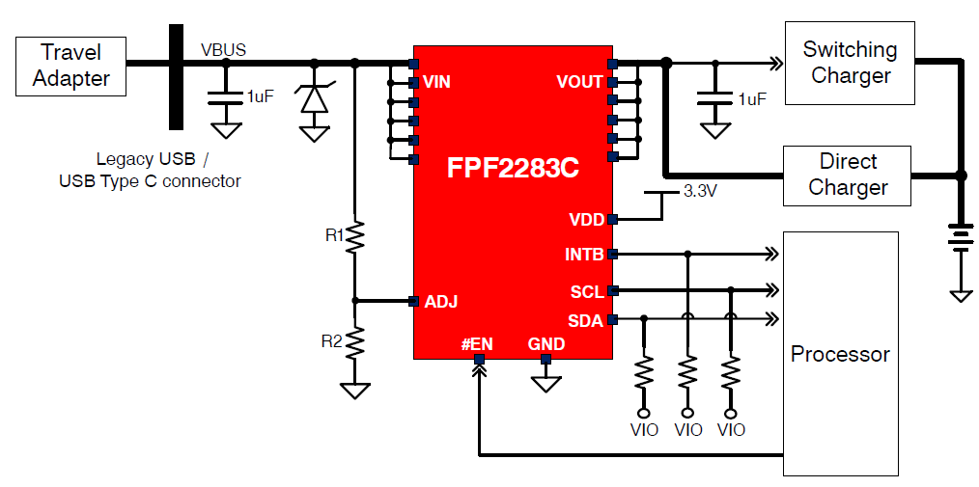
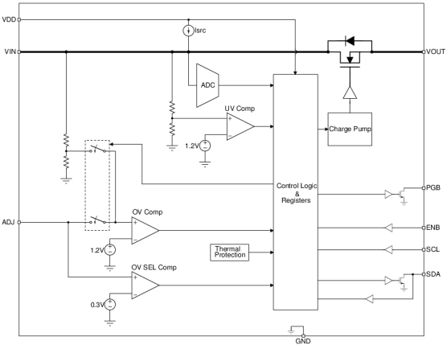
FPF2283C
28V/7A OVP Switch with ultra low on resistance and moisture detection
Production
Benefits
Features
Super fast OVP responding to protect next stage system
Ultra low Ron to reduce voltage drop
Support processor algorithm for moisture detection
28V / 7A of Maximum Rating
36V peak voltage tolerant for surge event
RON : Typ. 7.5mΩ @ 5V and 25C
8-bits ADC on VIN for moisture detection
Super fast OVP response time: maximum 50ns
Default OVP trip voltage: 6.8V ± 3%
Adjustable OVP with external R divider
I2C communication:
  Moisture detection pulse setup
  VIN voltage detection
  OVP level setup
Package:
  WLCSP-20 with Backside Laminate
  2.2mm x 1.8mm, 0.4mm ball pitch
Applications
Mobile device and smart phones
Portable media devices
Advanced Dongle and Docking Station

Slide 11
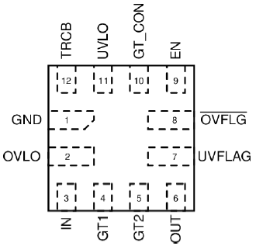
FPF2260A
28V OVP with external MOS gate driver
Production
Benefits
Features
High level surge protection with external TVS
Negative input voltage protection
Fast OVP responding
Integrated discharge path to save PCB area
External NMOS-FET gate driver
Wide voltage range: 2.5V ~ 28V
Super fast OVP response time: 100ns
Dual gate driver for convenient control
Negative VIN protection to -28V
Reverse Current Blocking (RCB)
Selectable True Reverse Current Blocking (TRCB)
Selectable Vgs level for external FET control
Integrated VIN discharge path
Default OVP trip voltage: 6.1V ± 3%
Adjustable OVP w/ external R divider
Open-drain PGOOD to indicate VBUS status
Active High enable control
OV_FLAG to indicate VBUS over voltage
Active Low enable control
Package:
TMLP-12, 1.6mm x 1.6mm, 0.4mm pin pitch
Applications
Mobile device and smart phones
Portable media devices
Advanced Dongle and Docking Station

Slide 12
Negative VIN protection Application
Application: co-working with external bi-directional TVS to achieve negative VIN protection of up to -28V,
which is required by major smart phone manufacturers.
Negative VIN
Up to -28V

Slide 13
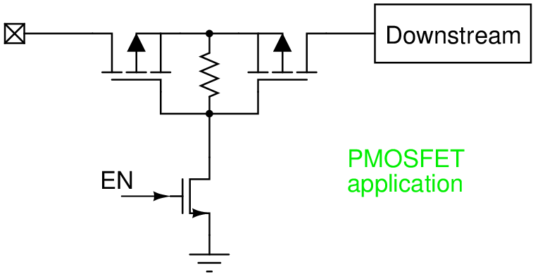
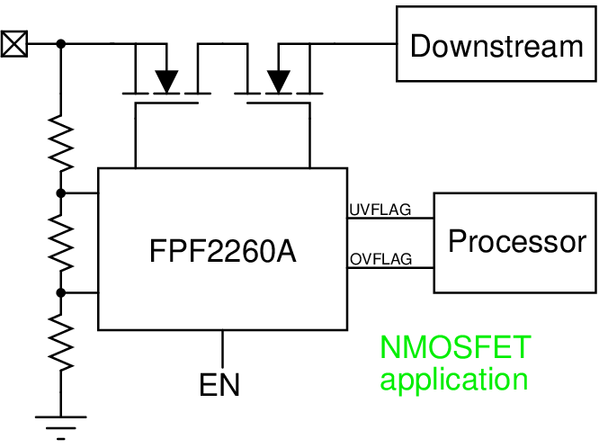
Application NMOS vs PMOS
NMOS (controlled by FPF2260A) advantages over PMOS:
Better price with same Rdson
Smaller package with same Rdson
Stable Rdson with different voltage
Programmable UVLO and OVLO

Slide 14
Power Switch in application - II
Travel Adapter
Input
OVP/OCP MUS
Battery charger
OUTPUT
PMIC
USB port
Micro B or Type C
OTG function
Application processor
Fingerprint module
Load switch
Mobile Device / Computing

Slide 15
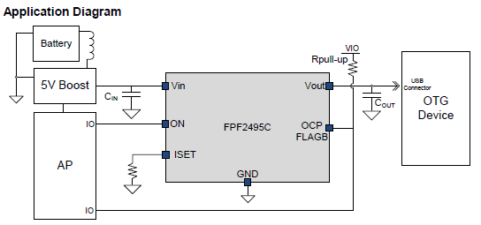
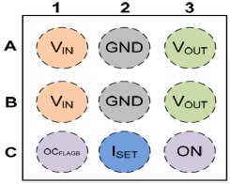
FPF2495CUCX
Adjustable ILIM Switch with OVP
Production
Benefits
Features
True Reverse-Current Blocking function to obstruct unwanted reverse current from VOUT to VIN during ON and OFF state
Wide Operating range
28V ratings at VOUT, 6V ratings at VIN
2.5V to 5.5V Operating Range
Adjustable ILIM : 0.1~2A with +/-10%
Low Ron : typ 70 mΩ at 5V
Output OVP threshold: 5.6Vmin / 5.8Vtyp / 6Vmax
Active HIGH
UVLO & TRCB, Thermal Shutdown
ESD protected:
  2kV HBM & 2.5kV CDM
  IEC61000-4-2 Air Discharge: >15KV
  IEC61000-4-2 Contact Discharge: >8KV
Package:
  9 balls in WL-CSP with 0.4mm pitch
  3 x 3 bump array in 1.21mm x 1.21 mm
Applications
Mobile device and smart phones
Portable media devices
Advanced Dongle and Docking Station

Slide 16
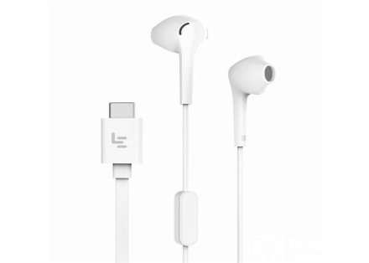
FPF2495C Application Example - I
- USB Type-C for Mobile Phone
Application : Power Switch for USB Type C accessories including Audio headset, U Disk, Dongle etc.
Requirements : A power switch for Type C audio is in request, whose Vbus need to share the internal 5V DC/DC as some PMIC has leakage issue for OTG function in standby mode.
PMIC
USB Type C
Connector
6V only
BOOST
DC/DC
FPF2495C
OCP&OVP
POWER SWITCH
5V
Common Power Switch
VOUT
VBUS
28V
Tolerance

Slide 17
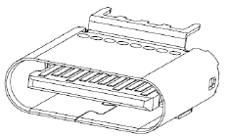
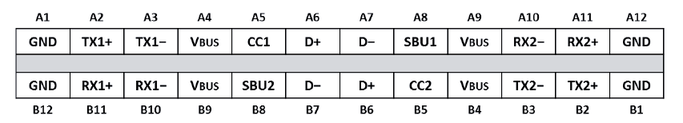
FPF2495C Application Example - II
- USB Type-C for Tablet/Notebook
Application : USB TYPE-C with PD function, I_{LIM} path with RCB & 20V capability at output
Requirements:
  I_{LIM} for OCP
    Min 1.5A / Max 2A with Rset = 634 Ω for USB TYPE-C Vbus output
    Min 300mA with Rset=3.09kΩ for USB TYPE-C Vconn
  OVP and >20Vabs capability at output side is required since 20V DC can be applied to Vout
  TRCB to block reverse current during ON and OFF.
I_{LIM} set = min 1.5A
5V from DC/DC
VIN
FPF2495C
VOUT
V_{BUS}: Output can be 5V or ~20VDC
with hot plug-in
ON
I_{LIM} set = min 300mA
Power / Data line 1
CC1 (V_{CONN})
5V from DC/DC
VIN
FPF2495C
VOUT
ON
I_{LIM} set = min 300mA
Power / Data line 2
CC2 (V_{CONN})
VIN
FPF2495C
VOUT
CC is easy to short to Vbus !
ON
USB TYPE C
Connector

Slide 18
FPF2595UCX
28V output tolerant load switch with adj. current limit
Production
Benefits
Features
Protect system against over voltage from external plug-in
Protect short circuit event from external plug-in
Avoid system damage from reverse current
Keep output current under control in OTG application
Low On-Resistance: typ.35mΩ, max.45mΩ @VIN=5V
Power supply: 2.5V to 5.5V
Adjustable ILIM: 0.1~3.5A with ±10% accuracy
Open-Drain OCP warning on FLAGB
Under Voltage Lockout (UVLO): typ. 2.2V
Output OVP: typ. 5.8V±0.2V
Quiescent / Shutdown current: typ. 65uA / 0.1uA
True Reverse Current Block (TRCB)
ESD protection:
  Human Body Model: 2kV
  Charged Device Model: 2.5kV
  IEC 61000-4-2 Air Discharge:15kV
  IEC 61000-4-2 Contact Discharge: 8kV
Package:
  WLCSP-12 with Backside Laminate
  1.3mm x 1.8mm, 0.4mm ball pitch
Applications
Notebook and Desktop with USB connectors
Smart Phones and Tablet PCs

Slide 19
FPF2595 Application Example - I
- USB Type-C in Smart Phone
Application : Smart phone USB Type C output source OCP plus OVP
Requirements: Output current limitation with ultra low Ron and reverse current limitation when Vout is greater than Vin, minimize PCB layout size
Block Diagram:
Charger &
System
FPF3380
VIN
VOUT
USB Type C
Connector
I_{LIM} set = min 3A
5V
from DC/DC
VIN
FPF2595
VOUT
VBUS
ON
Outside mobile phone
inside mobile phone
OTG device being Charged
or
Travel Adapter with Type C

Slide 20

FPF2595 Application Example - II
- USB Type-C in Tablet/Notebook
Application : Power Switch for USB Type C for Tablet/Notebook.
Requirements : Some end customers would like to use two different current limitations as OCP for diverse scenarios (such as 3A OCP with wall adapter and 1A OCP without wall adapter), single piece FPF2595 can realize this function with external resistor network setting.
Type C Port #1
VIN
VOUT
Buck-Boost Battery Charging Block
w/ power path
System
VBUS
FPF2281
FPF2595
BAT
VIN
BATTERIES
(~3S /~13.2V)
VOUT
5V
Buck Converter

Slide 21
Power Switch in USB Type C Application
OCP Switch for VBUS and VCONN (Host Side)
VOUT
FPF2281
VIN
Charger & System
USB Type C
Connector
I_{LIM} set = min 3A
VIN
FPF2595
VOUT
5V from DC/DC
VBUS
FPF2895C
28V/5A ILIM SW with TRCB & OVP
in 1.68x2.7 CSP
ON
Comm Signal
I_{LIM} set = min 250mA
VIN
FPF2495C
VOUT
5V from DC/DC
CC1
Type C Power Role Quick Swap supporting!
ON
I_{LIM} set = min 250mA
VIN
FPF2495C
VOUT
CC2
ON
Comm Signal
<VBUS/CC1&CC2 for USB Type C w/o PD>
<VBUS/CC1&CC2 for USB Type C w/ PD>

Slide 22
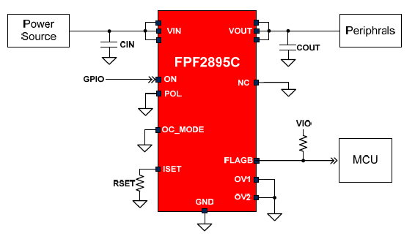
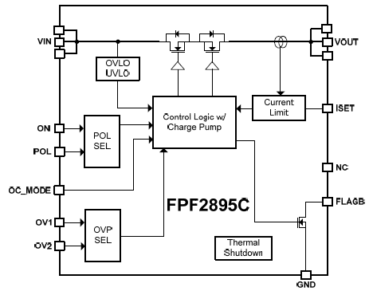
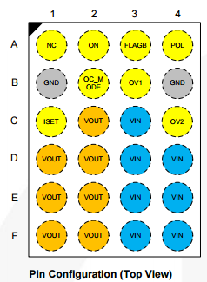
FPF2895C/V
28V/5A ILIM Switch w/ OVP & TRCB for USB PD
Production
Benefits
Features
Tolerant to HV on both side without extra protection
Fully support USB type C with PD
Q-Grade available for automotive application
Low On-Resistance: Typ. 27mΩ @VIN=5V
28V Vabs for VIN and VOUT
Maximum 5A DC current capability
Precise Adjustable ILIM:
  0.5~2.0A with ±10% accuracy
  2.0~5.0A with ±5% accuracy
Selectable ON polarity and OVLO trigger point
Selectable OC behavior
  Auto-restart
  Current source
True Reverse Current Block (TRCB)
Open-Drain OCP warning on FLAGB
Package:
  WLCSP-24 with Backside Laminate
  1.68mm x 2.7mm, 0.4mm ball pitch
Applications
Mobile device and smart phones
Portable media devices
Advanced Notebook, UMPC and MID

Slide 23
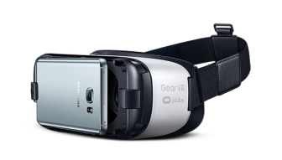
FPF2895C Application case
– Quick Swap in USB-PD
TA powers system and device(s) connected with docking.
TA is plugged out suddenly then 5V source supply device(s) within 150us.

Slide 24
FPF2895C & FPF2595
Application with Multiple Type C Ports in Notebook
Input: 20V@5A
VBUS
VIN
VOUT
Buck-Boost Battery Charging Block
w/ power path
System
FPF2895C
Type C Port #1
BAT
FPF2595
BATTERIES
(~3S /~13.2V)
VOUT
VIN
Output: 5V@3A
5V
Buck Converter
BAT
Provide flexible solution for multiple Type C application with different configurations:
Port #1: 20V, 5A SINK path
  5V, 3A SOURCE path
Port #2: 20V, 5A SINK path
20V, 5A SOURCE path
Input: 20V@5A
VBUS
VIN
FPF2895C
VOUT
Type C Port #2
FPF2895C
5V/12V/20V
Buck-Boost Converter
VOUT
BAT
VIN
Output: 20V@5A

Slide 25
Comparison Table
Key Parameters | FPF2495C | FPF2595 | FPF2895C
VOUT Absolute Rating | 28V | 28V | 28V
VIN Absolute Rating | 5V | 5V | 28V
Max Current | 2A | 3.5A | 5A
Ron @ 5V, 25 °C | typ 70mΩ | Typ 35mΩ | typ 27mΩ
True Reverse-Current Blocking | Yes | Yes | Yes
OVLO Adjustment | Fixed 5.8V | Fixed 5.8V | 5.95V / 10V / 16.8V / 23V Adjustable with two pins
ON Behavior | Fixed, Active HIGH | Fixed, Active HIGH | Selectable
Selectable OC behavior | NO | NO | Yes, Auto-restart / current source
Package | 1.2 x 1.2 mm² WLCSP-9 0.4mm pitch | 1.3 x 1.8 mm² WLCSP-12 0.4mm pitch | 1.68 x 2.7mm² WLCSP-24 0.4mm pitch
Estimated cost | Low | Middle | Middle-High

Slide 26
Power Switch in application - III
Travel Adapter
Input
OVP/OCP MUS
Battery charger
PMIC
OUTPUT
USB port
Micro B or Type C
OTG function
Fingerprint module
Application processor
Load switch
Mobile Device / Computing

Slide 27
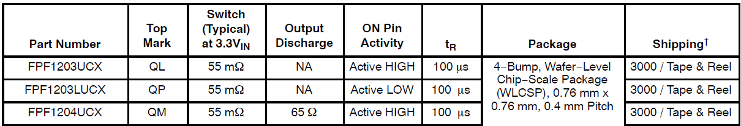
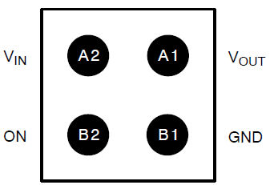
FPF1203/3L/4
Compact 6V/2.2A Switch
Production
Benefits
Features
Lower power consumption
Reducing PCB size
Simplify design efforts
More reliability
6V/2.2A Capability
1.2V to 5.5V Input Voltage Range
The first smallest 5V rated device in industry
Typical RON:
  45mΩ @ VIN = 5.5V
  55mΩ @ VIN = 3.3V
  90mΩ @ VIN = 1.8V
  185mΩ @ VIN = 1.2V
Slew rate control with Tr of 100us and 2us
Output discharge function, FPF1204
Low <1.5µA Quiescent Current
ESD Protected, 8kV HBM, 2kV CDM
0.76x0.76mm WLCSP
Applications
Cell Phones
PDAs
Handheld Devices

Slide 28
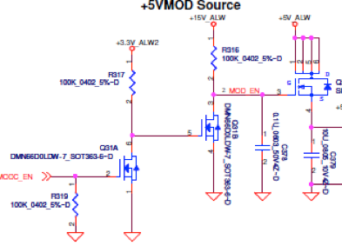
The Integration / Size Advantage
Conventional Solution
ONSEMI FPF1204 Load Switch
R
CSD25302
92%
Board
Space
Saving
FPF1204
3.3mm
0.76mm
R
N-FET
N-FET
0.76mm
C
0.58mm²
Controlled Slew-Rate
Reduced Design time
2.5mm
8.25mm²
92%
Solution Size
Reduction
Need Design time and expertise
Slew-Rate control will need R and C

Slide 29
Integrated Load Switch vs. Discrete
 | Integrated load switch (Non Current Limited) | Discrete load switch (MOSFET) | Advantage
R_{ON} | 6-mOhm~100-mOhm | 5-mOhm~100-mOhm | Even
Control Voltage / V_{GS} | < 1.2V | > 3.0V to 4.5V | Integrated LS
ON/Gate Charge | <1pC | 10nC | Integrated LS
Turn On Current | <1uA | 10mA | Integrated LS
V_{IN}(V_{DS}) Max | ≤ 6V | 12V+ | Application Dependent
I_{D} | ≤ 6A | > 6A | Application Dependent
Solution Size | 1x | 7x~10x | Integrated LS
Number of Components | 1 | 6 | Integrated LS
Design Complexity | Low | High | Integrated LS

Slide 30
Analog Switch Products Overview
Apr.2021

Slide 31
Analog Switch Portfolio
General Analog Switches
Application Specific Switches
SPST
Type C Audio
MIPI
SPDT
Reset timer switch
Video
SP3T
USB/MHL/UART/Audio
Customized
SP8T
Legacy/Hifi Audio
SIM
SP16T
HDMI
USB/Audio

Slide 32








General Purpose Switches
Consumer
Industrial
Communications
Computing
Automotive
Healthcare

Slide 33
FSA4476
USB Type-C analog switch with protection
Production
Benefits
Features
Fully integrated high performance Type-C audio solution
HV tolerance to protect internal silicon from surge, false connection
Vbat range from 2.7V to 5.5V (Primary)
VBUS range from 4.0V to 20V (Active when VBAT is off)
OVP function on Common node pins
Power-Off Protection on Common Ports
Analog Audio device unplug detection
HiFi Audio/USB SW
  Audio SW, THD+N <-110dB; 1 VRMS, 32 Ω Load;
  USB SW, BW:1GHz
MIC/GND SW
500m Ω on GND_M to SBUx
80m Ω on SBUx to GND
SBU Bypass SW – 5 Ω Typical On Resistance
25-Ball WLCSP (2.03mm x 2.03mm)
Applications
USB Type-C interface device, Mobile phone
Tablets and Notebooks
Notes:
Q1 2019
The FSA4476 was the industry leading Type-C audio solution developed with a top5 Chinese OEM. The FSA4476 continues to used by most top mobile OEM’s and provides top performance compared to the competition. It allows Type-C analog audio to share the Type-C connector with other digital signals like USB. Type-C analog audio allows backwards compatibility with existing 3.5mm headphones.

Slide 34
FSA4480
USB Type-C analog switch with protection
Production
Benefits
Features
HV tolerance to protect internal silicon from surge, false connection
Provide feasibility to connect analog/digital audio accessory through USB Type-C interface
VCC range from 2.7V to 5.5V (Primary)
OVP function on Common node pins
Analog Audio device unplug detection
20V tolerance on connector side pins: DP/R,DN/L, CC_IN,GBSUx,SBUx
High performance Audio/USB SW
  Audio SW, THD+N <-105dB; 1 VRMS, 32 Ω Load;
  USB SW, BW:950 MHz
300m Ω on Sense to GSBUx
50m Ω on SBUx to AGND
Software controllable through I2C interface
25-Ball WLCSP25 (2.24mm x 2.28mm)
Applications
USB Type-C interface device
Mobile phone, Tablets and Notebooks
Notes:
Q1 2019
The FSA4480 is the second generation Type-C audio solution that was developed with QCOM for their SDM855 and SM8150 reference designs. It is widely adopted at mobile OEM’s. The FSA4480 adds moisture detection, high performance THD+N and crosstalk and high voltage protection on the connector pins.

Slide 35
FSA4476 vs. FSA4480 Comparison Table
Feature | FSA4476 | FSA4480
USB/Audio switch | Yes | Yes
MIC/GND switch | Yes | Yes
Sense switch | Yes | Yes
AUX switch | Yes | Yes
CC switch | Yes | No
GPIO/I2C | GPIO | I2C
OVP | Yes | Yes
Switch Slow turn-on | No | Yes
OMTP/CITA detection | No | Yes
Resistance detection | No | Yes
OVP function | Yes | Yes

Slide 36
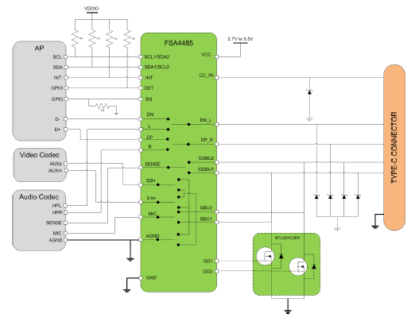
FSA4485
USB Type-C analog switch with protection
Production
Features
Benefits
VCC range from 2.7V to 5.5V
OVP function on Common node pins
Analog Audio device unplug detection
16V tolerance on connector side pins: DP/R,DN/L,GBSUx,SBUx
20V tolerance on CC_IN
High performance Audio/USB SW
  Audio SW, THD+N <-110dB; 1 VRMS, 32 Ω Load;
  USB SW, BW: 1 GHz
250mΩ on Sense to GSBUx, 75mΩ on SBUx to AGND
Programmable Gate Drive for optional external SBUx to AGND
2 I²C addresses and 1.2V capable I²C interface
Optional normally closed configuration for SBU data switch
HV tolerance to protect internal silicon from surge, false connection
Provide feasibility to connect analog/digital audio accessory through USB Type-C interface
Data Switch configured for Factory Mode
Optional external GND switch to boost performance
Applications
USB Type-C interface device
Mobile phone
Tablets and Notebooks

Slide 37
Comparison to Competitor’s Audio Switch
Parameter | FSA4485 | FSA4480 | Competitor 1
DC Tolerance | 16V | 20V | 12V
Surge | +/- 35V | +/- 20V | +/- 25V
USB BW | >1 GHz | 950 MHz | 800 MHz
THD+N | -110dB | -110dB | -100dB
Ron_audio | 1Ω | 1Ω | 2.2Ω
Rsense | 250mΩ | 300mΩ | 1.7Ω (1)
Rgnd | 75mΩ (2) | 50mΩ | 80mΩ
Icc (standby) | 1uA (typ) | 1uA (typ) | 3.9uA (typ)
Icc | 60uA (max) | 65uA (max) | 400uA (max)

Slide 38
THANK YOU
THANK YOU!

