Slide 1
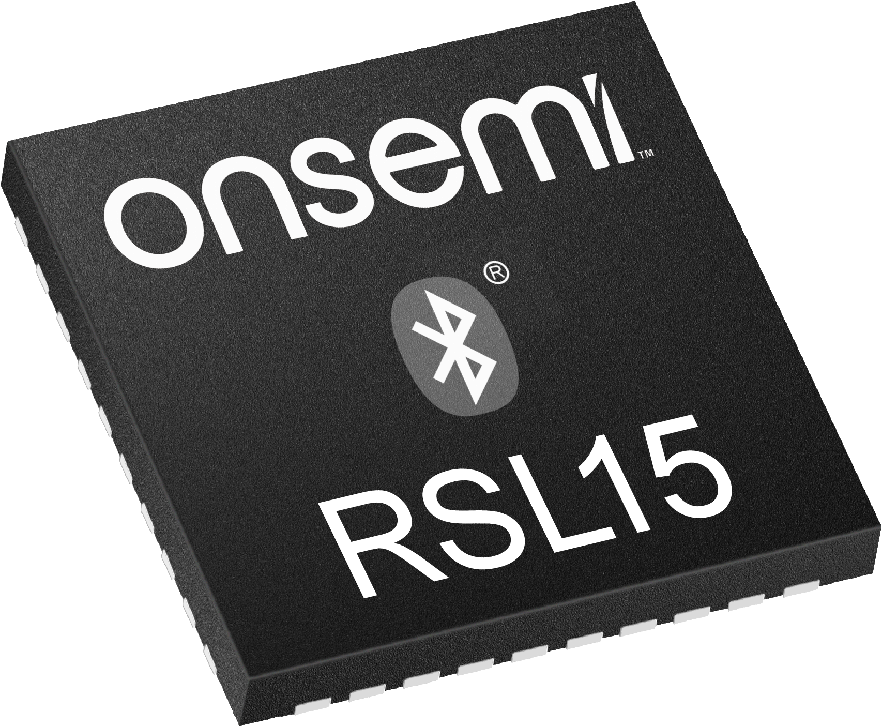
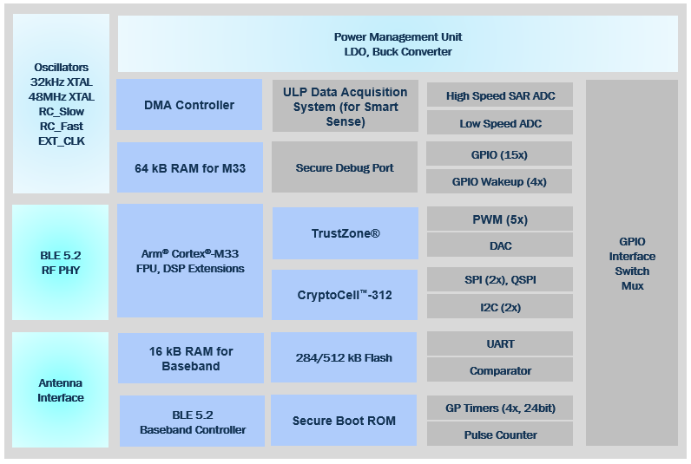
RSL15
Industry’s Lowest Power, Secure, Flash-Based Bluetooth® Low Energy-Enabled Microcontroller Solution
Ultra-Low Power Secure MCU
Includes Flash, RAM, and built-in power management
Several power modes with configurable RAM retention & wakeup source
New Smart Sense mode for reading external sensors with very low system-level power consumption
Cybersecurity Encryption Platform for end-to-end security
Similar power performance to industry-leading RSL10
Bluetooth 5.2 with Long Range, Localization
Certified, industry-leading benchmark scores
Maximum Flexibility
User Friendly
Easy-to-use Software Development Kit:
Profiles & sample code for rapid application development
CMSIS Drivers
Suite of mobile apps
Online forum with knowledge base articles, FAQs and developer resources
Ultra-Low Power
Extensive set of peripherals | 40-pin QFN with 15 GPIO
Flexible clocking scheme | Wide supply range from 1.2 – 3.6V
Security
Flexibility

