Slide 1
IGBT Presentation
May 2022
Notes:
DONE

Slide 2
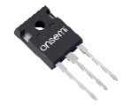
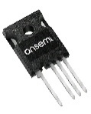
650V FS4 IGBTs
IGBT Rating (A) | Diode Rating (A) | TO-247-3LD |  |  | TO-247-4LD
 |  | Fast | Medium | Low VCE(SAT) | Fast | Medium | Low VCE(SAT)
40 | 20 | FGH40T65SQD-F155 | FGHL40T65MQD
 | 40 |  | FGHL40T65MQDT | FGHL40T65LQDT
50 | 30 | FGH50T65SQD-F155 | FGHL50T65MQD |  | FGH4L50T65SQD
 | 50 | FGHL50T65SQDT | FGHL50T65MQDT | FGHL50T65LQDT |  | FGHL50T65MQDTL4 | FGHL50T65LQDTL4
60 | 30 | FGH60T65SQD-F155
75 | 50 | FGH75T65SQD-F155 | FGHL75T65MQD
 | 50 | FGH75T65SQDT-F155 | FGHL75T65MQDT | FGHL75T65LQDT | FGH75T65SQDTL4 | FGHL75T65MQDTL4 | FGHL75T65LQDTL4
Notes:
All devices are long lead (20mm)
L4 and 4L in part number indicates four lead package

Slide 3
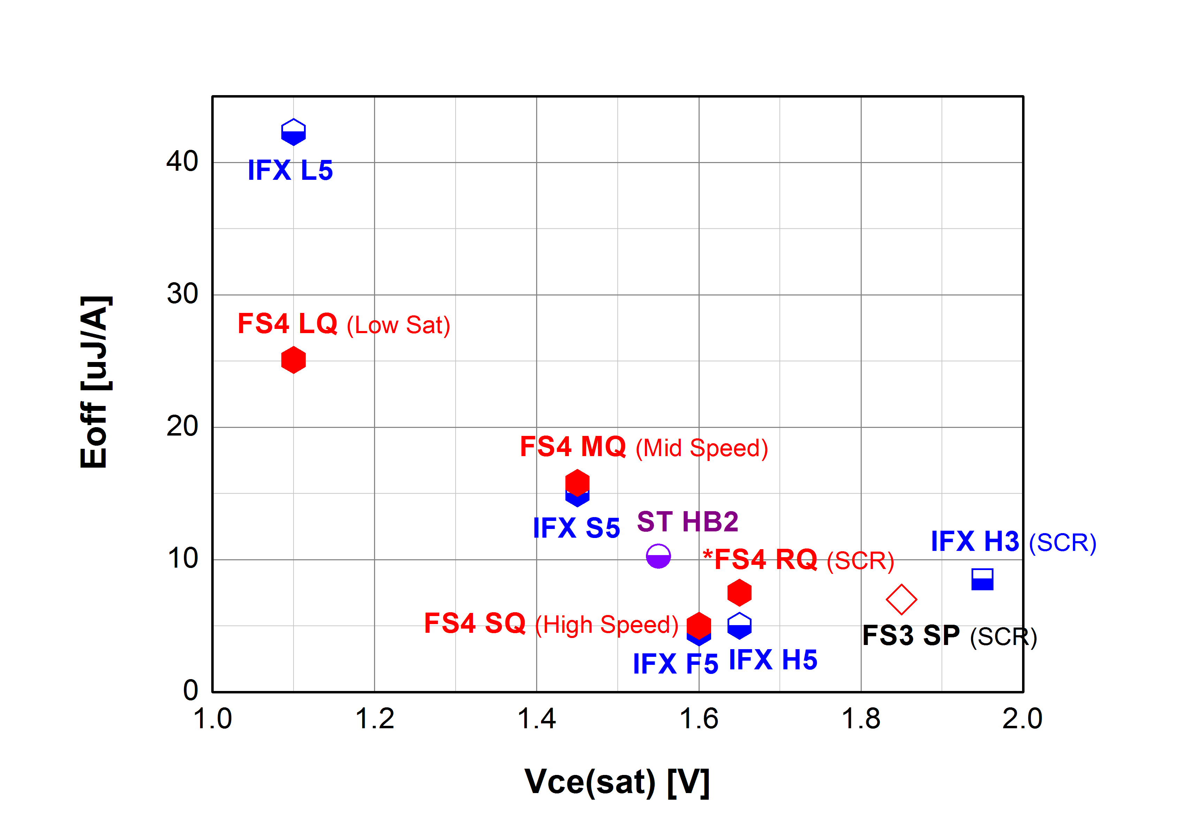
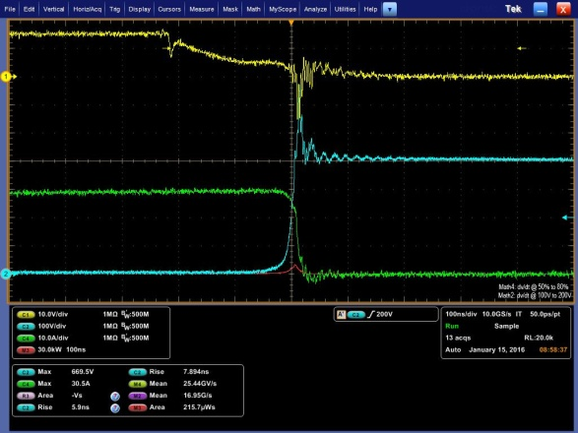
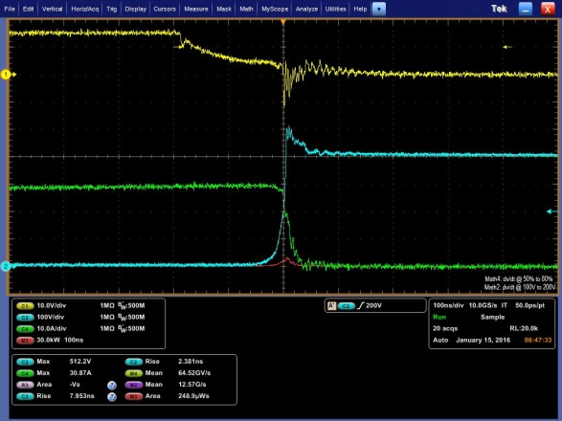
FS4 650V IGBTs - High Speed
0.13% higher in max. efficiency and
0.08% higher in weighted efficiency
against FS3
Faster switching causes
higher voltage spike
Competitor, at 400V, Rg=10Ω
Competitor’s high speed IGBT needs higher Rg due to severe voltage spike
670V @Ic=30A (H5)
Vge, 10V/div
Vce, 100V/div
Po=4kW, Vin=200V to Vo=400V
fs=20kHz, Rg=22Ω, Vge=15V
with 20A SiC diode
Ice, 10A/div
510V @Ic=30A (FS4)
FGH75T65SQD at 400V, Rg=10Ω
Vge, 10V/div
ONsemi high speed IGBT can use lower Rg thank to less voltage spike
Ice, 10A/div
Vce, 100V/div

Slide 4
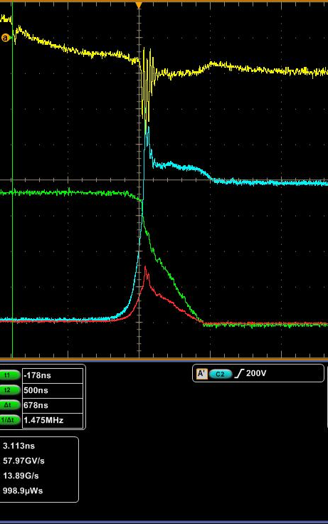
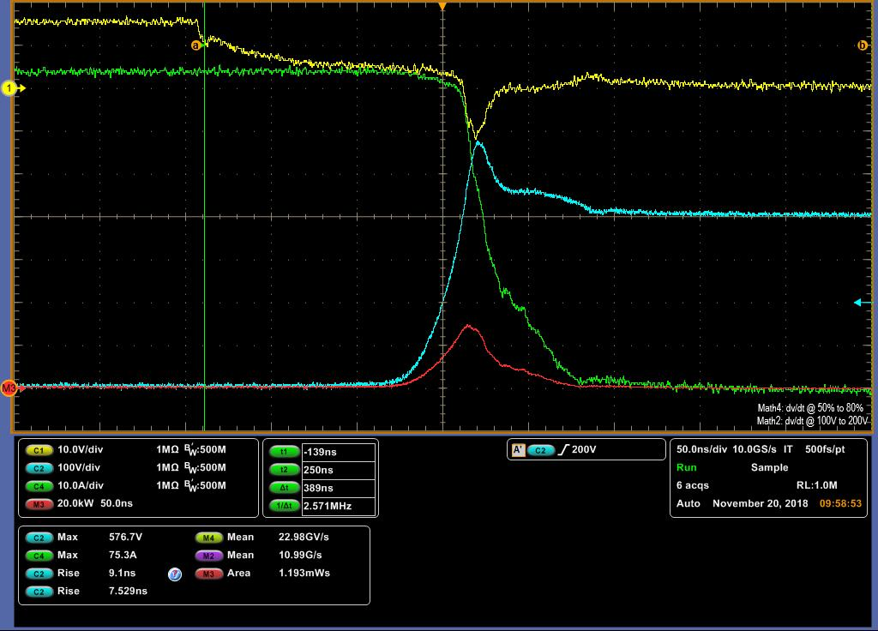
FS4 650V IGBTs - Medium Speed
650V FS4 SQD (1.6V) vs. MQD (1.45V)
Turn-off at 400V, Vge=15V, Rg=10Ω, RT
Vce_peak and Eoff vs. Rg at 400V,75A, Vge=15V, 125℃, Lσ=30nH
Vge
Ic
Vce
565V
605V_{peak}
with Oscillations
6Ω
18.5Ω
Softer current falling,
Lower voltage overshoot,
No gate oscillation
If design Margin 90% of BV_{ces}, 585V
MQD → 6Ω
SQD → 18.5Ω
With the allowable lower Rg
MQD → 1.39mJ
SQD → 1.46mJ

Slide 5
FS4 650V IGBTs - Low Vce(sat) Version
DC performance
AC performance
All measurements based on 75 A device
Very good E_{OFF} than competitor → NPC case, good performance in reactive period Φ
Similar E_{ON}, but getting better at high-current

Slide 6
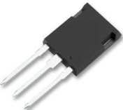
1200V UFS IGBTs
IGBT Rating (A) | Diode Rating (A) | Diode Selection | TO247 |  | TO247-4LD |  | Power TO247
 |  |  | Fast | Low VCE(SAT) | Fast | Low VCE(SAT) | Fast | Low VCE(SAT)
25 | 20 | Fast switching | NGTB25N120FL3
40 | 40 | Low VF | NGTB40N120S3 | NGTB40N120L3
 |  | Fast switching | NGTB40N120FL3 |  | FGH40T120SQDNL4 | FGH4L40T120LQD
60 | 60 | Fast switching |  |  |  |  | FGY60T120SQDN
75 | 75 | Fast switching |  |  |  |  | FGY75T120SQDN
Notes:
All devices are long lead (20mm)

Slide 7
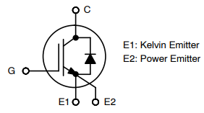
1200V 40A IGBT with low VCE(SAT)+fast switching diode
Features
Benefits
Block Diagram
Low VCE(SAT) optimization
  VCE(SAT) 1.55V/40A
Fast switching co-packed diode
  IRRM 27A/25C/1A/ns
Low EON losses
  1.04mJ/40A/600V/25C
Low EOFF losses
  1.35mJ/40A/600V/25C
Low conduction losses
Optimized for hard-switching applications
Low switch on losses
Low switch off losses
Specifications
Product | Description | Package
FGH4L40T120LQD | IGBT 40A, 1200V Ultra Field Stop | TO247-4LD
Package
End products
Applications
Solar Inverter
UPS
Energy Storage
Industrial Applications
TO247-4LD

Slide 8
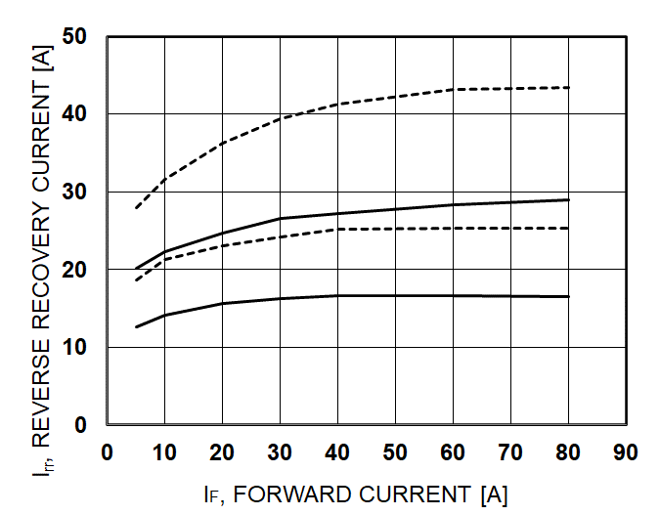
Low reverse recovery current and losses
1A/ns: Dashed line 175C, Solid line 25C
0.5A/ns: Dashed line 175C, Solid line 25C
Parameter | Conditions |  | Value
Reverse Recovery Energy | TJ = 25℃, IF = 40 A, VR = 600V, dl_{F}/dt = 1000 A/us | Erec | 126 | uJ
Reverse Recovery Time |  | trr | 59 | ns
Reverse Recovery Charge |  | Qrr | 804 | nC
Reverse Recovery Energy | TJ = 175℃, IF = 20 A, VR = 600V, dl_{F}/dt = 1000 A/us | Erec | 540 | uJ
Reverse Recovery Time |  | trr | 115 | ns
Reverse Recovery Charge |  | Qrr | 2090 | nC
Reverse Recovery Energy | TJ = 175℃, IF = 40 A, VR = 600V, dl_{F}/dt = 1000 A/us | Erec | 667 | uJ
Reverse Recovery Time |  | trr | 127 | ns
Reverse Recovery Charge |  | Qrr | 2613 | nC

Slide 9
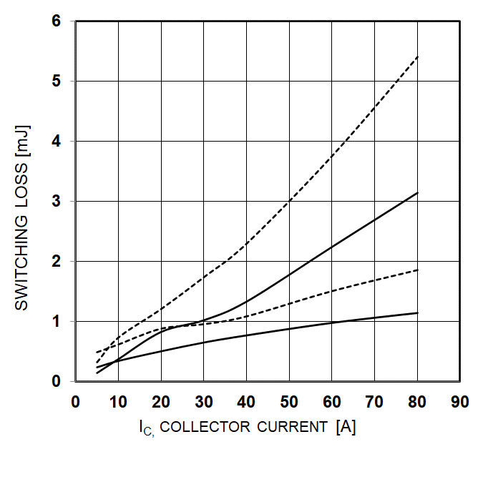
Low switching losses
Vcc = 600V, V_{GE} = 15V
I_{c} = 40A, R_{G} = 5Ω
T_{J} = 25℃
T_{J} = 175℃
EON: Dashed line 175C, Solid line 25C
EOFF: Dashed line 175C, Solid line 25C

Slide 10
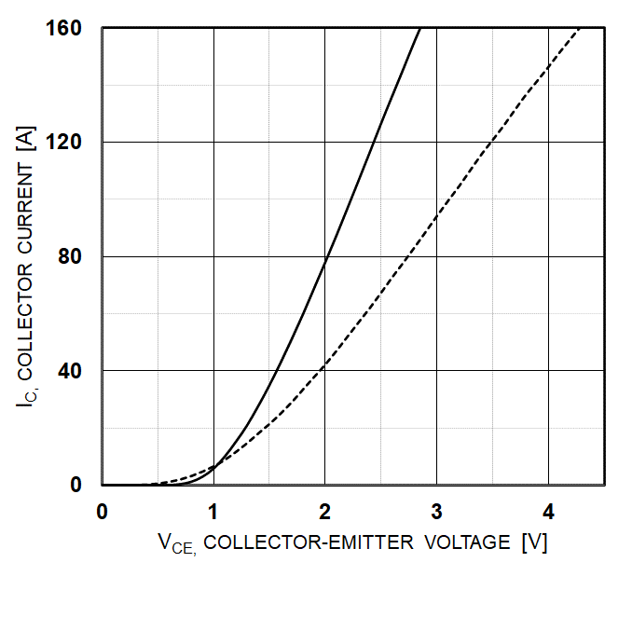
Low conduction losses
V_{GE} = 15V
T_{J} = 25℃
T_{J} = 175℃
EON: Dashed line 175C, Solid line 25C
EOFF: Dashed line 175C, Solid line 25C

Slide 11
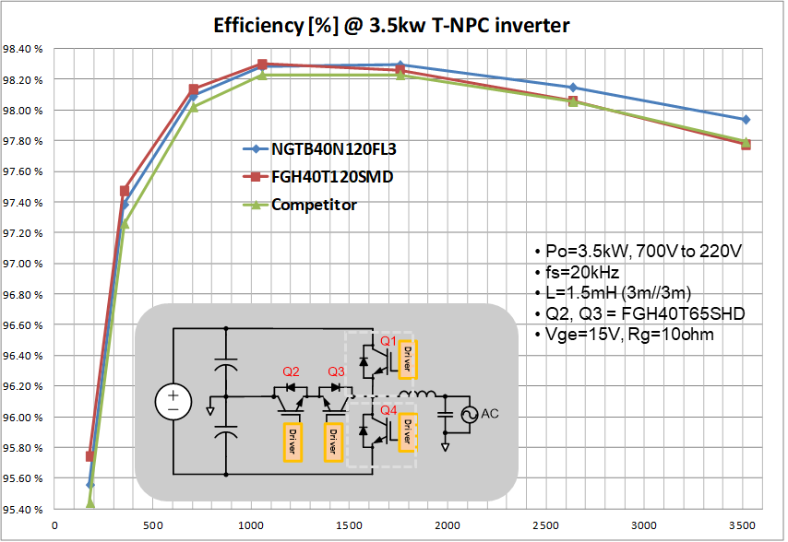
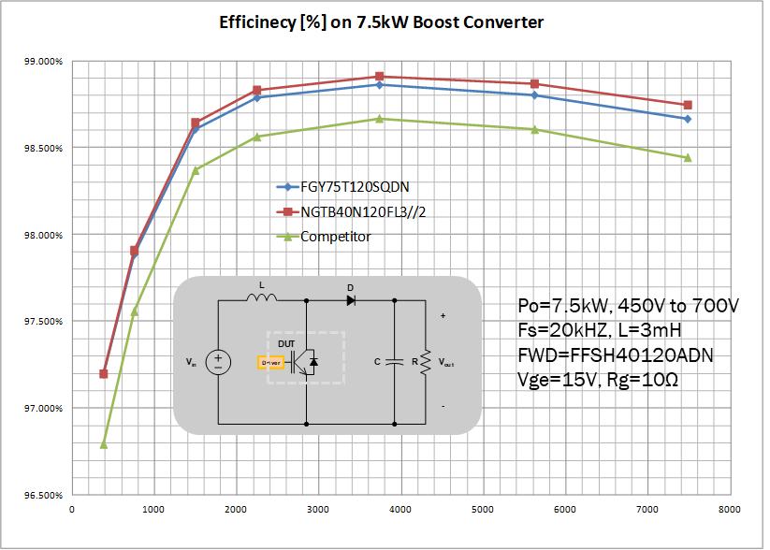
1200V UFS (FSIII, Ultra-Field Stop)
Trade-off between Vce(sat) and Eoff
IFX CS6
UFS Short Circuit

