Slide 1
Meeting Challenging Power Density Requirement with 300 W Totem Pole PFC & LLC Design

Slide 2







Power Density & Efficiency for AC-DC Power Getting Tougher
Totem Pole PFC + Resonant LLC
NCP1680 + NCP13992 + NCP4306
500 kHz, 93+ % eff.
GaN’s efficiency
Silicon’s efficiency
Switching Frequency & Efficiency
CrM PFC + ACF
NCP1623 + NCP1568 + NCP4306
200-400 kHz, 91+ % eff.
CrM PFC + HF QR
NCP1623 + NCP1345 + NCP4306
100-200 kHz, 90+ % eff.
Power Level
100 W
150 W
200 W
kW
Notes:
Continued push for high power density and small profile AC-DC to satisfy power hungry applications, more power delivery in same form factor
Topologies that are more efficient and higher switching frequency are needed, QR and ACF for low power, LLC for medium to high power
WBG semiconductors like GaN has lower Qg and zero reverse recovery allows totem pole PFC to be adopted and LLC to run at 500 kHz or higher
Totem pole PFC + LLC well positioned for UHD design from 200 W to kW applications including gaming laptop, industrial lighting, battery charging and telecom

Slide 3
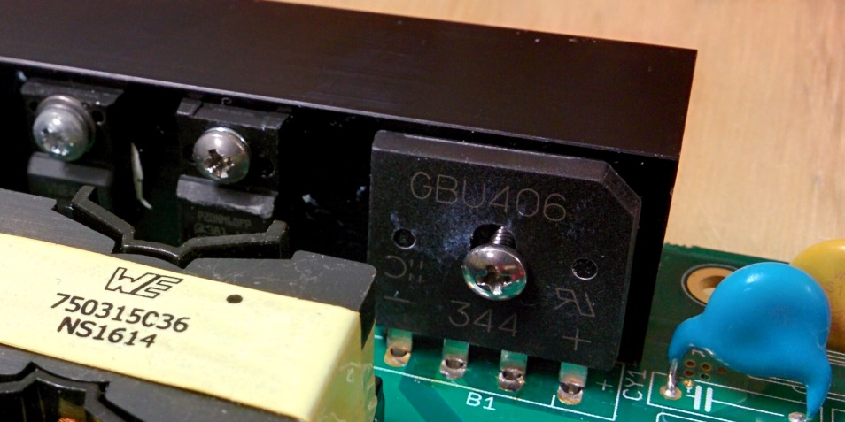
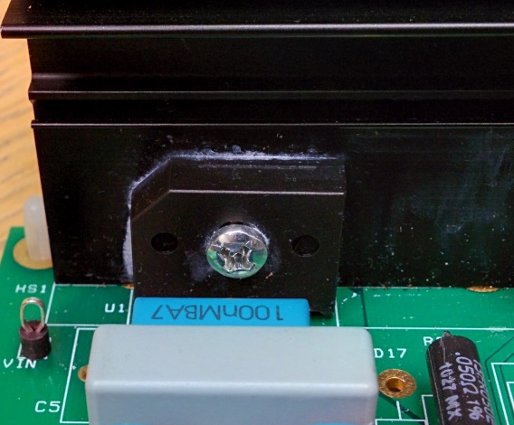
Why Totem Pole PFC?
240 AIO EVB
NCP1631 PFC EVB
Diode bridge with heat sink
Efficiency of the PFC boost stage & LLC stage have plateaued. Bridge diodes are the major source of power loss
Notes:
AC DC above 70 W requires PFC
ZVS soft switching topologies such as LLC with SR achieves optimized efficiency for DC DC stage
Power loss in bridge rectifier in front of PFC of AC DC remaining hurdle for size reduction due to bulky heat sink

Slide 4
How to Make Boost PFC More Efficient?
Active bridge solution is costly and clunky
Body diode of Synchronous FET prevents CCM operation
Replace input bridge diodes with FETs. All diodes have to be replaced with ~ 50 mΩ, 650 V FETs
2 FETs in the ‘bridge’ and 1 FET in the boost stage always conducting
MOSFET marketer’s dream come true!! 6 HV FETs!!!
Notes:
Replacing diode bridge with low resistance with FET yields some efficiency improvements, but high BOM count and cost, inelegant

Slide 5
Bridgeless Totem Pole PFC
Totem Pole is an elegant 4 switch boost solution that reduces number of components in the current path
1 FET in the “diode” section (Low Freq leg) and 1 FET in the boost section conducting
Notes:
Totem Pole PFC can achieve the ultimate PFC efficiency, 99 % high line efficiency when fast leg switches uses GaN which has zero reverse recovery
Silicon FET can be used for fast leg switches if CrM operation, albeit slightly lower efficiency
GaN allows higher switching frequency to be used for Totem Pole PFC stage, enabling further size reduction

Slide 6
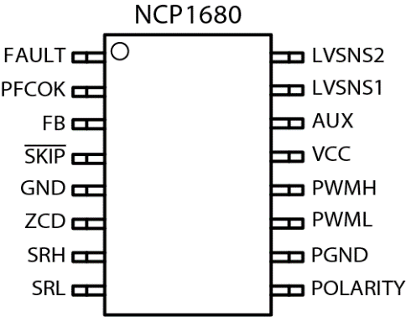
NCP1680 Bridgeless Totem Pole CrM PFC Controller
Value Proposition
The NCP1680 is a CrM Totem Pole PFC Controller capable constant on time CrM and valley synchronized frequency foldback for optimized efficiency across the entire load range. With proprietary current sensing architectures and proven control algorithms the NCP1680 allows for a cost-effective solution without jeopardizing performance.
Unique Features
Benefits
Device Pin-Out
Constant on-time CrM architecture
w. valley switching during foldback
Novel Current Sense scheme
Line polarity detection
Novel valley sense scheme
Control loop Internally compensated
Optimized performance across power levels
Cycle-by-cycle current limit
w/o hall effect sensor
Removes external components;
Other Features
Two low voltage pins for sensing and recreating half-wave sinusoid.
DCM with valley synchronized turn-on for improved light load efficiency
Zero Current Detection for CrM Operation
Integrated Digital voltage loop control
Market & Applications
Ordering & Package information
Telecom 5G / Networking Power Supplies
Industrial Power Supplies
Computing Power Supplies
Gaming Console Power Supplies
UHD TV Power Supplies
SOIC-16
Multiple Patents Issued/Pending
Notes:
CrM totem pole PFC well suited for 200 W to 350 W applications, such as power supplies for high performance computing, gaming and industrial lighting
CrM totem pole PFC best trade off between efficiency, EMI and size
Above 350 W to kW, CCM totem pole PFC operation at heavy loads should be selected
NCP1680 is industry’s first mixed signal control with dedicated features for totem pole PFC, simplifying design, reducing time to market and enabling cost effective solution

Slide 7


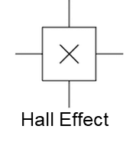
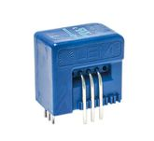
Totem Pole PFC market scenario – onsemi’s advantages
Existing solution on the market
MCU based solution
complex design, high BOM
need software code development
costly current sensing method
NCP1680/1
Industry’s first mixed signal controller for Totem Pole PFC
optimal BOM
faster development
cost effective
Notes:
NCP1680 is industry’s first mixed signal control with dedicated features for totem pole PFC, simplifying design, reducing time to market and enabling cost effective solution
MCU based solution too complex and expensive for <350 W applications

Slide 8
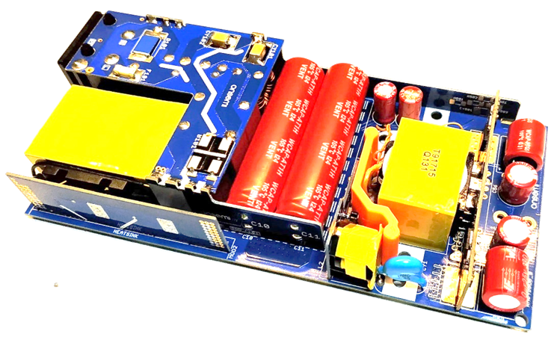
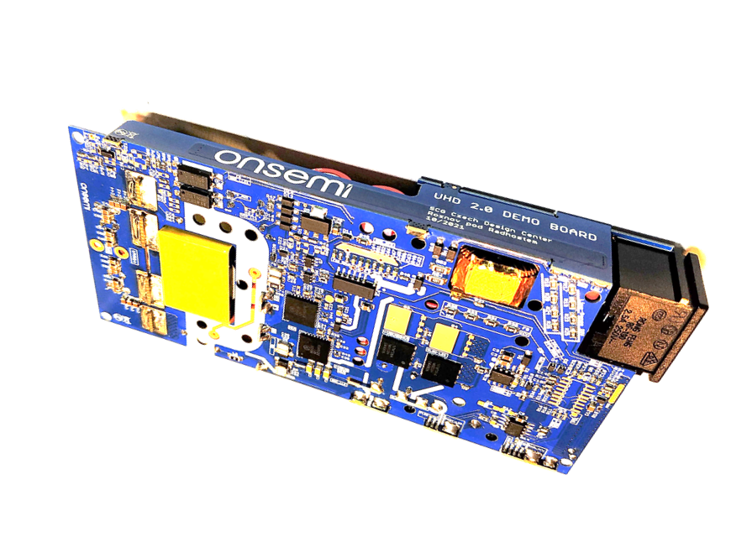

300 W TP PFC & LLC Ultra High Density Design
Value Proposition
This design is based on NCP1680 CrM TP PFC, NCP13994 Resonant LLC operating @ 500 kHz and NCP4306 SR controller. GaN HEMT is employed as the power switches for totem pole PFC’s fast leg and resonant LLC
Specifications and Features
Demoboard Photo
AC input from 90 V to 265 V
Output voltage 20 V
Max output power: 330 W
Bridgeless Totem-pole CrM PFC with NCP1680
TP PFC fast-leg stage with 650 V/ 50 mΩ integrated driver-GaN
LLC HB stage with 650 V/ 150 mΩ integrated driver-GaN
Average efficiency: 92.6 % @ 110 Vac, 93.7 @ 230 Vac
Full load efficiency: >93 % @ 110 Vac
PCB size: 134 mm x 62 mm x 18mm
Volume: 9.12 inch³
Power density: >36W/ inch³ including line socket
Modular design allows flexibility for power scaling or enhancing
Small size with compact design based on simple 2-layers PCBs
Primary side protections: line UVP/ OVP, bulk UVP/OVP, options for OTP
Output OVP
Output OCP and SCP
Vo
Vin
Market & Applications
Gaming Laptop computer
Smart TV’s, Consoles
Notes:
CrM totem Pole PFC and 500 kHz LLC together with GaN allows very high efficiency to be achieved, >93 % at worst case low line in order to meet thermal challenge in an ultra high-density power
Industry leading power density of 36 W/in3 can be achieved

Slide 9
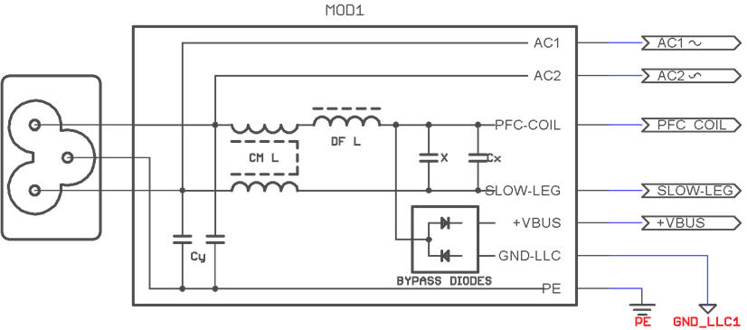
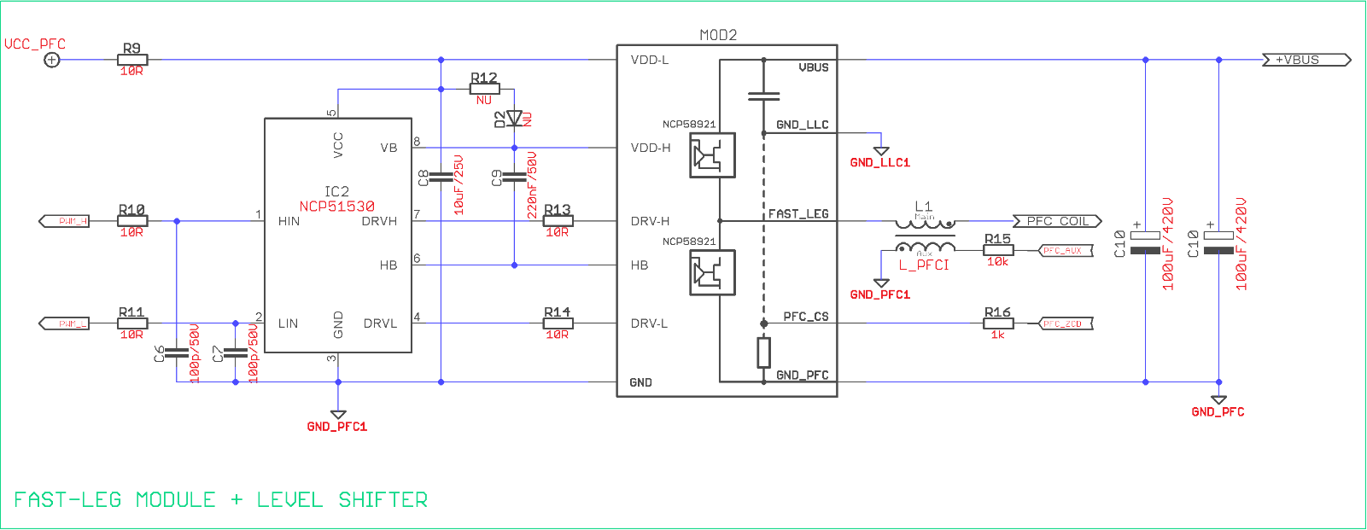
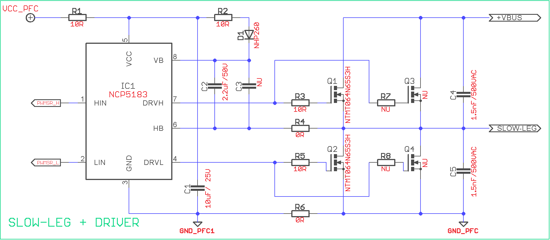
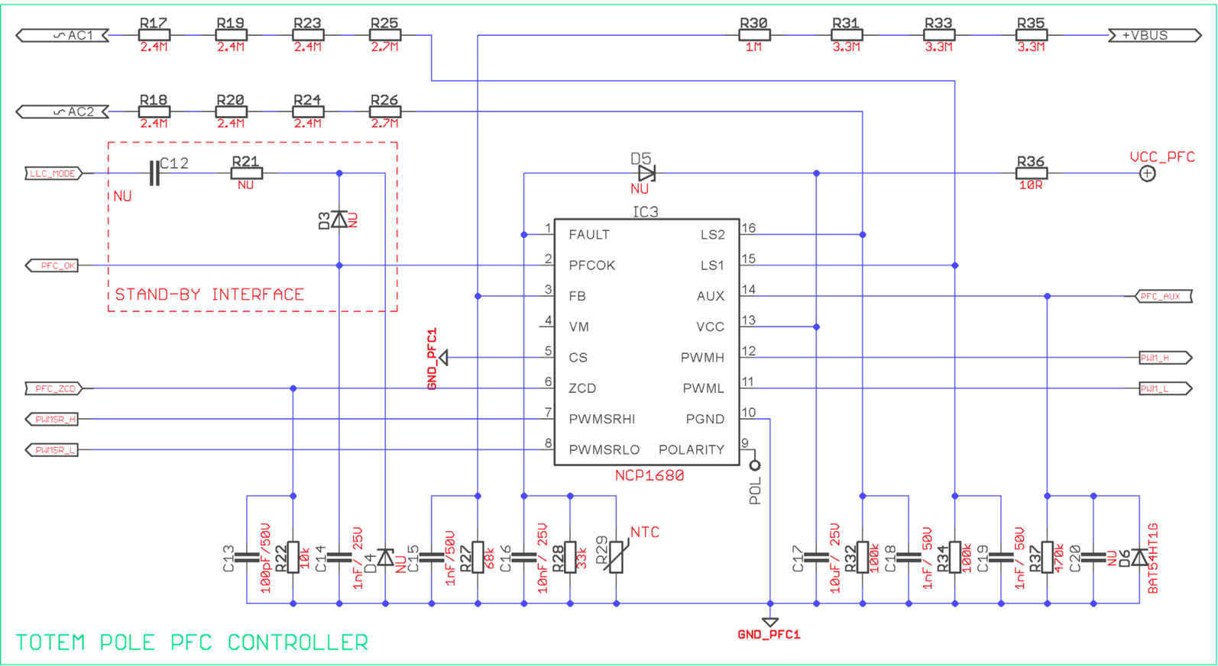
Schematic Diagram of Totem Pole PPFC Stage
Input EMI Filter block
Fast-leg + Level shifter
Integrated
driver
GaN
Integrated
driver
GaN
Slow-leg + Driver

Slide 10
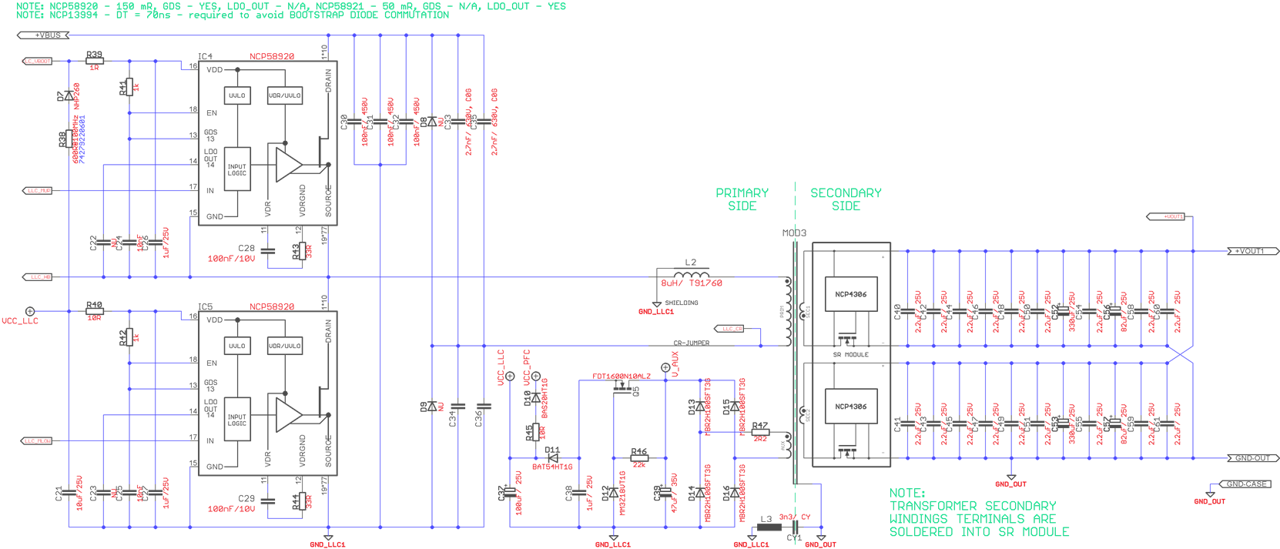
Schematic Diagram of LLC HB Stage
Integrated driver GaN
Integrated driver GaN

Slide 11
300 W Ultra High Density Board Performance
No-load Consumption [mW] @ Line
90 Vrms | 110 Vrms | 230 Vrms | 265 Vrms
131 | 133 | 158 | 164

Slide 12
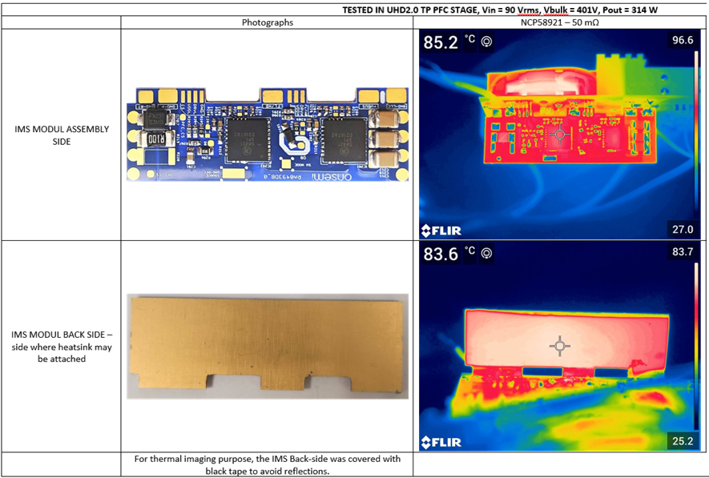
Thermal Images @ 90V AC, Load 314W (after 15 minutes)

