Slide 1
xEV Aux Power Supply
Overview Q3’22

Slide 2
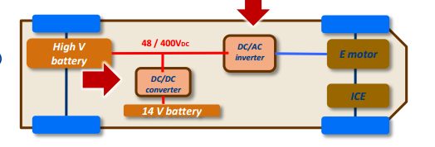
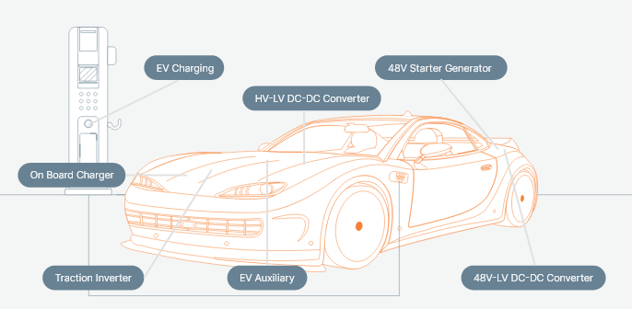
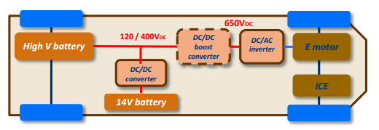
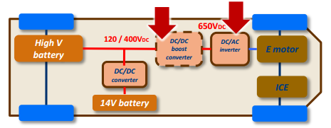
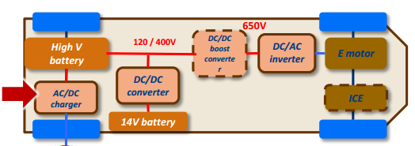
Overall electronics systems in HEV/EV
Mild Hybrid Converters
LH-HV DC/DC Converters
(F Hybrid/PHEV/BEV)
Traction inverters
(F Hybrid/PHEV/BEV)
All systems in xEV needs a low power Aux PSU to deliver regulated dc voltages from either or both 12V and HV Battery packs
OBC (PHEV/BEV)

Slide 3
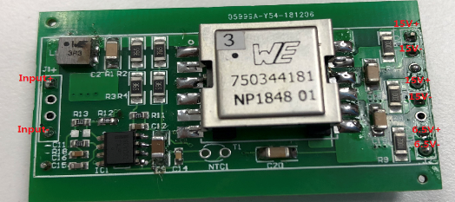
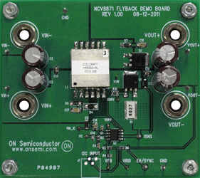
ASG Auxiliary PSU for xEV
Any Low Power SMPS that is connected to the Battery or the Ac mains (OBC) to deliver regulated bias voltages to key components of the system (MCU, Drivers, Controllers, …)
10W 3 outputs PSR Flyback
Using NCV1362
12W PSR Flyback
Using NCV12711
20 W 3 Flyback
Using NCV8871

Slide 4
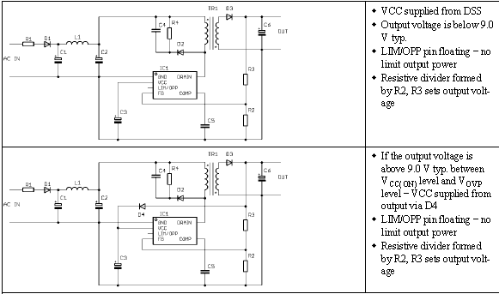
NCV1060/63 – 11 & 34 Ω Switchers for low power Buck
The NCV1060~63 products integrate a 670V MOSFET for cost effective isolated & non isolated switching power supply capable of delivering from few Watts to 12 W.
  34 Ω (NCV1060) & 11 Ω (NCV1063) – Other RdsON on demand
  Frequency foldback and skip
  Mode
  Direct FB connection
  Power scalability
  Improved efficiency at light
  loads
  Easy implementation of buck/buck-boost or flyback
  Short circuit protection Independent of the aux. Winding
  Adjustable Ipeak: 250 mA & 650 mA
  OPP thru Aux winding
  Soft start: 4 ms (TBC)
  Internal switching frequency: 65 & 100 kHz
  Frequency jittering
  Wide Start-up voltage down to 20 Vdc
  Auxiliary Supply for EV – OBC & Traction Inverters
  NCV1060: 34 Ω / 250 mA in SOIC-10
  NCV1063: 11.4 Ω / 650 mA in SOIC-16
  A : with Brown-in – B : w/o Brown-in

Slide 5
NCV1070~77 – 4.7 to 22 Ω 670V Integrated Switchers
The NCV1070~1077 products integrate 670V MOSFET providing for a switching power supply capable of delivering up to 2~20 watts of output power.
  Frequency foldback and skip mode
  Internal HV Startup featuring Dynamic Self Supply (DSS)
Ease of design
Ability to change peak current limit
Improved efficiency at light loads
Loss less startup sequence
Short circuit protection Independent of the aux. winding when the DSS is used
Soft start: 1 ms
Internal switching frequency: 65, 100 and 130 kHz
Frequency jittering
Over Voltage Protection – Vcc pin
RTM’d versions
NCV1075P065G/NCV1075P100G
NCV1076P065G/NCV1076P100G
NCV1077STBT3G
  Auxiliary Supply for EV – OBC & Traction Inverters
NCP107XSTYT3G – SOT-223 / Y A:65 kHz/B/100kHz/C:130 kHz
NCP107XPxxxG – PDIP7 / 65/100/130 kHz

Slide 6
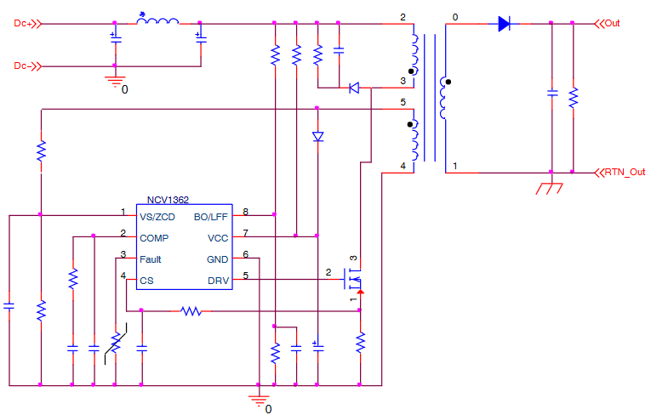
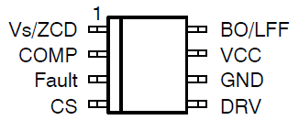
NCV1362 Automotive Wide Vin PSR Controller
The NCV1362 is a Quasi-Resonant primary side PWM controller which provides Constant-Voltage (CV) and Constant-Current (CC) output regulation without the need of an optical coupler. The controller achieves excellent line and load regulation of 5% and features protections such as Brown-Out, UVP/OVP, OTP, SCP, as well as improved light load efficiency and stand-by performance.
Primary Side Regulation
Valley Lockout
Line Feed Forward
Frequency Jitter
Dual Frozen Peak Current
Eliminates optocoupler & feedback circuitry
Eliminates valley jumping
Improved CC regulation
Improved EMI signature
Optimized light load & stand-by
Constant Voltage Primary−Side Regulation < ±5
Constant Current Primary−Side Regulation < ±5
LFF and BO Feature on Dedicated Pin
Max Frequency Clamp Options
No Clamp, 80, 110 and 140 kHz
Wide Operation VCC Range up to 28 V
Multiple protections
Low power AC/DC adapters for chargers
Automotive and Industrial Auxiliary Power
SOIC-8
NCV1362AADR2G, NCV1362ABCDR2G, NCV1362ACDR2G

Slide 7
PSR Product Family Comparison
 | NCP1360 (1st gen) | NCP1361 (1st gen) | NCV/NCP1362 (2nd gen) | FAN105 | TI UCC2870x | Benefit
Current Regulation | CC on primary | CC on primary | CC on primary | CC on primary | CC on primary
Voltage Regulation | CV on primary | CV on secondary (opto) | CV on primary | CV on primary | CV on primary | Auto desire no opto due to reliability
Package | TSOP6 | TSOP6 | SO8 | TSOP6 | TSOP6 | Dedicated BO & Fault pin
HV Startup Current Source | No | No | No | No | No
Valley Lockout | First 4 Valleys | First 4 Valleys | First 4 Valleys | No | No | Eliminates valley jumping
VCO mode - Min frequency | 200 Hz 600 Hz 1.2 kHz | 200 Hz 600 Hz 1.2 kHz | 200 Hz 400 Hz 1 kHz 2 kHz 3 kHz 4 kHz | 1.25 kHz | 1 kHz | Options when controller enters standby
Double frozen peak current | No | No | Yes | No | No | Optimizes for light load & standby
Frozen Peak Current in VCO mode | 15% 20% 25% | 15% 20% 25% | 25% 30% 35% 40% |  | 15%
Frozen Peak Current in STB mode | NA | NA | 5.6% 8.1% 11.3% 13.8% | NA | NA | Optimize Standby
Maximum frequency clamp | No clamp 80 kHz 110 kHz | No clamp 80 kHz 110 kHz | No clamp 80 kHz 110 kHz 140 kHz | 76 kHz | 130 kHz | Higher frequency clamp
Dynamic frequency clamp (Hi/Lo Mains) | No | No | Yes (optional) | No | No | Detects low or high lines and adjusts clamp
Cable compensation (5 V) | 0 150 mV 300 mV 450 mV | 0 150 mV 300 mV 450 mV | 0 150 mV 300 mV 450 mV | Resistor Programmable | Programmable (UCC28700) 0 (UCC28701) 150 mV(UCC28702) 300 mV (UCC28703 | Optional
Cable compensation (12 V) | 0 360 mV | 0 360 mV | 0 200 mV 250 mV 300 mV 410 mV | Resistor Programmable | 0 | Optional
Brown Out | No | No | Yes | Yes | 70V fixed | Dedicated pin
Protections | UVP/OVP, OCP, SCP | UVP/OVP, OCP, SCP | UVP/OVP, OCP, SCP, OTP, BO | OVP, Internal OTP | OVP, OCP, BO | Fault protections
NTC Compatible OTP | No | No | Yes, Fault Pin | No | Yes | High accuracy OTP
LineFeed Forward | No | No | Yes | No | Yes | Improved CC regulation
CV/CC Regulation | ±5%/±10% | ±5%/±10% | <±5%/±5% | ?? | ±5%/±5% | Improved regulation
Jitter | No | No | Yes | No | Yes | Improved EMI signature

Slide 8
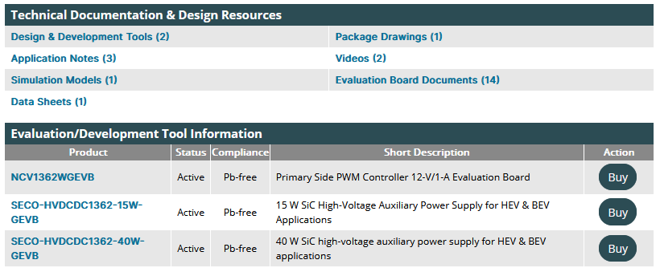
NCV1362 Collaterals
MathCad Design for AC Ac & Dc Input
App Notes and Design guide with PSR
Simplis Model

Slide 9
NCV12711 Low Vin DC-DC Flyback Controller
The NCV12711 is a fixed-frequency peak-current-mode PWM controller containing all of the features necessary for implementing single-ended power converter topologies. The device operates from 4 V to 45 V without auxiliary winding and can accept transient spikes up to 50 V.
Low Voltage Operation
Adjustable Over Power Protection
NTC-Compatible Fault Interface
Frequency Jitter
Error Amplifier Option
AEC-Q100 Qualified
4 – 45 V Input Range
Limits Total Power Capability
Provides Thermal Protection
Improves EMI signature
For non-isolated designs
For automotive applications
Internal 7.5-V Regulator
0% Duty Ratio Operation in No-Load Condition
Single Resistor Programmable Oscillator – 100 kHz to 1 MHz
Adjustable Soft-Start on Peak Current and Frequency
Output OVP Fault Interface
1 A / 2.8 A Source / Sink Gate Driver
AEC-Q100: NCV12711 in MSOP-10
Automotive 12V Auxiliary Power Supply
Primary-side regulated isolated converters
Non-isolated dc-dc converters.

Slide 10
Comparative Performance
 | ON NCV12711 | ON NCV887x | TPS40210(-Q1) | LM5155-Q1 | Benefits
Topology | Iso. Flyback Non-Iso Flyback | Boost Non-Iso Flyback | Boost/SEPIC Non-Iso Flyback | Boost/SEPIC/ Non-Iso Flyback | Optimized for isolated flyback
Input Voltage Range | 4 – 45 V | 3.2 – 40 V | 4.5 – 52 V | 3.5 – 45 V 2.97 – 16 V BIAS=V_{cc} | 4 V required for modules
Transient/Load Dump | 45 V | 45 V | 52 V | 50 V | Automotive requirement
Switching Frequency | 100 kHz to 1 MHz | 50 kHz or 100 kHz | 35 kHz to 1 MHz | 100 kHz to 2.2 MHz
Soft Start | Adjustable | Yes, Fixed | Adjustable | Adjustable
Current Sense Threshold | 250 mV | 400 mV | 150 mV | 100 mV
Programmable Oscillator | Yes | No | Yes | Yes
Max duty ratio | 90% | 92.5% | - | 93%
t_{ON(min)} (typical) | 125 ns | 250 ns | 275 ns @ 12 V | 50 ns
Jitter | Optional | No | No | No | Facilitates EMI
0% duty ratio | Yes | No | No | No | Safe no-load operation in low-power isolated converters.
External Sync | No | Yes | Yes | Yes | Sync to external clock
Faults | OCP, OPP, OTP (NTC), SCP, UVLO | OCP, SCP, TSD | OCP, UVLO | OVP, SCP, Thermal Shutdown, UVLO | Fewer external components, robustness
Auto-recovery | Auto-Recovery/Latch | - | OCP Retry | - | Design flexibility
ESD, HBM | 2 kV | 2 kV | 2 kV | 2 kV
Operating Junction Temp | -40 °C to +125 °C | -40 °C to +150 °C | -40 °C to +125 °C | -40 °C to +125 °C | Characterization up to 150 °C
Packages | MSOP10 | SOIC8 | HVSSOP10, VSON10, PDSO10 | 3x2 WSON12 (wettable flank) | Leadless with wettable flanks for inspection

Slide 11
NCV12711 4-45Vin SSR Isolated 12W Board
This board is designed to deliver 12 V/1 A from a 4- to 45-V input voltage
Its main purpose is to let the designer test the part along its full operating range

Slide 12
NCV12711 4-45Vin PSR Isolated 12W Board
This board is designed to deliver 12 V/1 A from 4 to 45 V
Main application is an automotive converter without optocoupler
The auxiliary winding is used for a simple yet efficient regulation means

Slide 13
NCV10317 Low Vin PSR Flyback Switcher
The NCV10317 is a Primary Side Regulation (PSR) controller with an integrated 70-V MOSFET containing all of the features necessary for implementing single-ended power converter topologies which saves the secondary feedback circuitry (opto & TL431). Thanks to the dynamic self supply and a floating arrangement, the auxiliary winding is also not needed. It operates in QR peak current mode control to offer high efficiency at high load.
Primary Side voltage Regulation
Internal 70-V MOSFET – 0.5 Ohm
Low Voltage Operation
NTC-Compatible Fault Interface
Frequency Jitter
AEC-Q100 Qualified
Eliminate Opto+TL431 and auxiliary winding
4.5 – 45 V Input Range
Provides Thermal Protection
Improves EMI signature
For automotive applications
±5% Voltage regulation
Internal 7.5-V Regulator
Double frozen peak current for light and No-Load performance
1st Samples Q4’22
Automotive 12V Auxiliary Power Supply
Standard Part #: NCV10317xPRD2G
Package: SOIC-8 EP

Slide 14
NCV12711 vs. NCV10317 High level positioning

Slide 15
Competitive landscape

